Slide 1
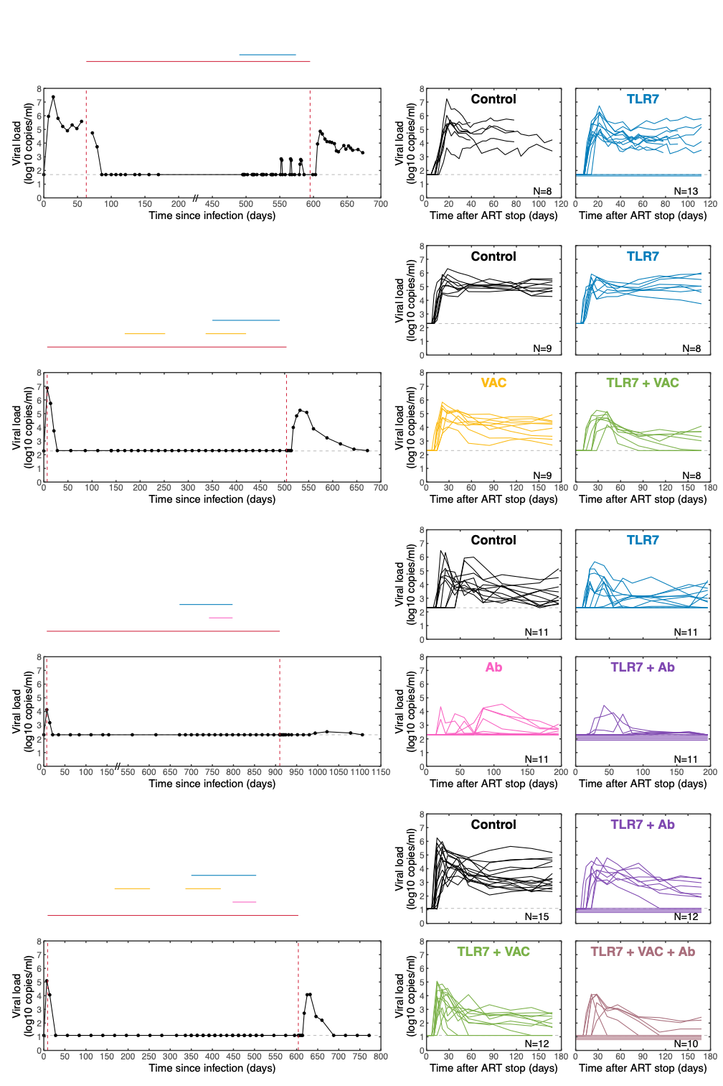
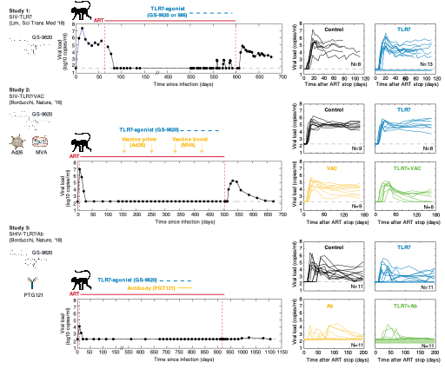
Study 1:
SIV-TLR7
(Lim, Sci Trans Med, ‘18)
TLR7-agonist
(GS-9620 or 986)
ART
Study 2:
SIV-TLR7-VAC
(Borducchi, Nature, ‘16)
TLR7-agonist (GS-986)
Vaccine prime
(Ad26)
Vaccine boost
(MVA)
ART
Study 3:
SHIV-TLR7-AB
(Borducchi, Nature, ‘18)
TLR7-agonist
(GS-9620)
ART
Antibody (PGT121)
PGT121
Study 4:
SHIV-TLR7-VAC-AB
(Walker-Sperling, Nat Com, ‘22)
TLR7-agonist (GS-9620)
Vaccine prime
(Ad26)
Vaccine boost
(MVA)
ART
Antibody (PGT121)
PGT121

Slide 2
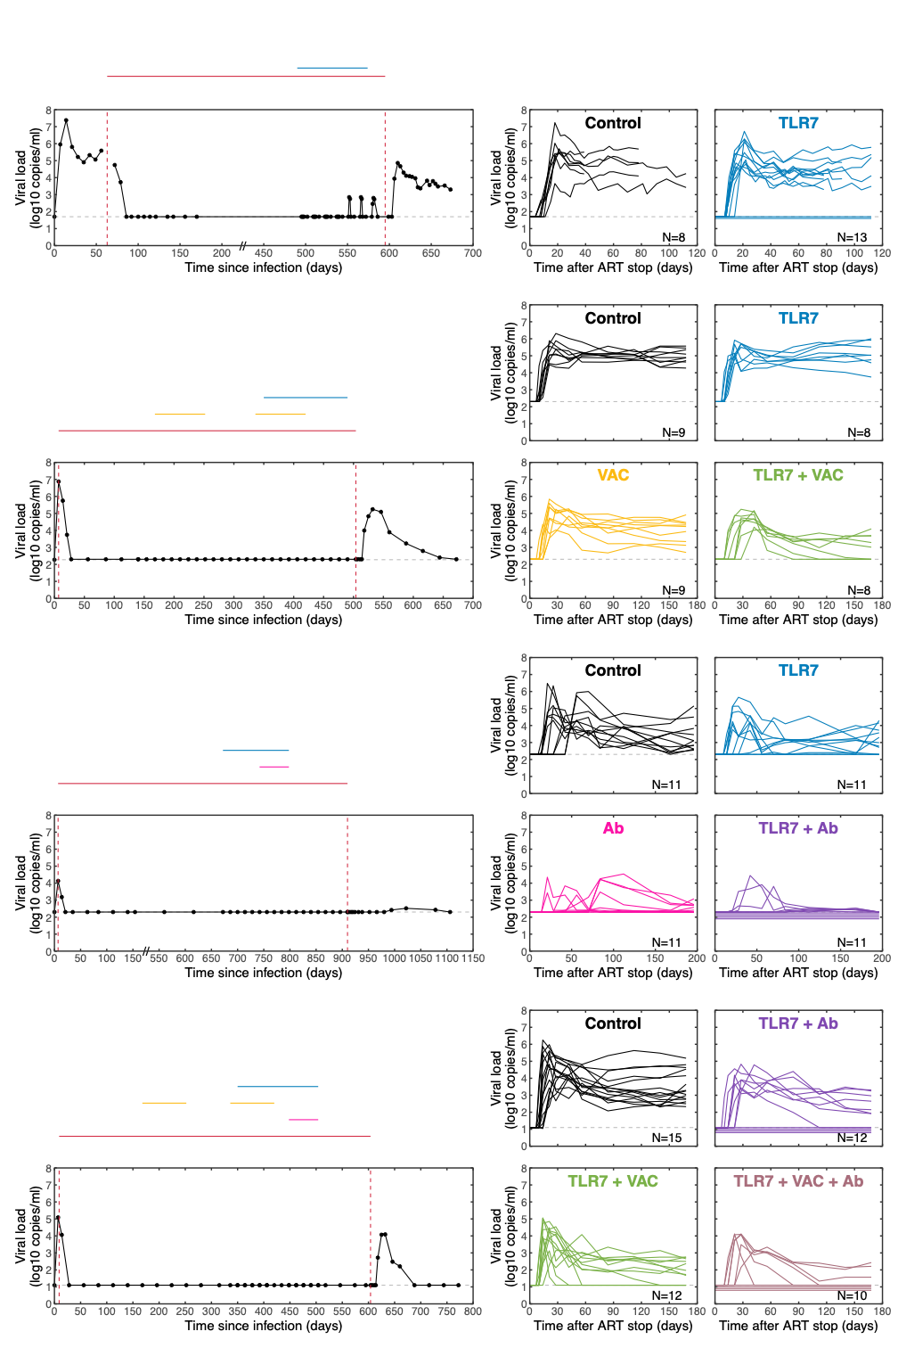
Study 1:
SIV-TLR7
(Lim, Sci Trans Med, ‘18)
TLR7-agonist
(GS-9620 or 986)
ART
Study 2:
SIV-TLR7-VAC
(Borducchi, Nature, ‘16)
TLR7-agonist (GS-986)
Vaccine prime
(Ad26)
Vaccine boost
(MVA)
ART
Study 3:
SHIV-TLR7-AB
(Borducchi, Nature, ‘18)
TLR7-agonist
(GS-9620)
ART
Antibody (PGT121)
PGT121
Study 4:
SHIV-TLR7-VAC-AB
(Walker-Sperling, Nat Com, ‘22)
TLR7-agonist (GS-9620)
Vaccine prime
(Ad26)
Vaccine boost
(MVA)
ART
Antibody (PGT121)
PGT121

Slide 3
Study 1:
SIV-TLR7
(Lim, Sci Trans Med ‘18)

