Slide 1
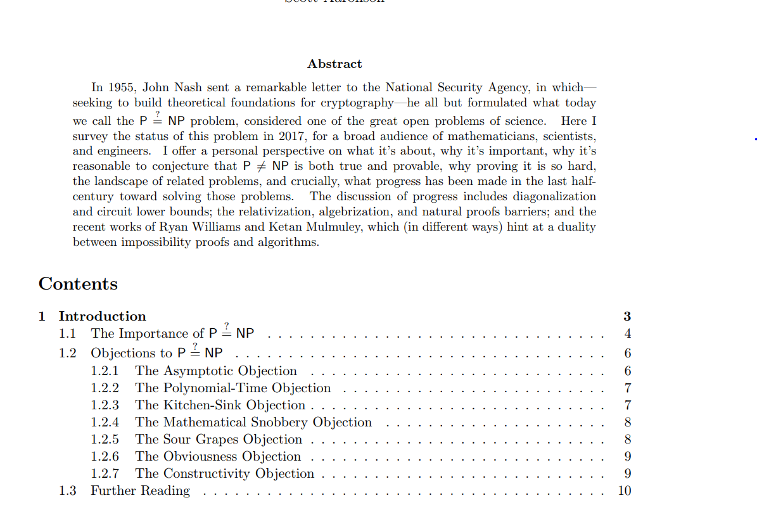
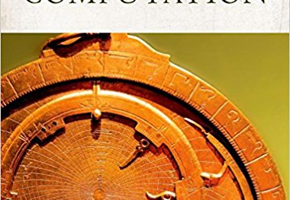


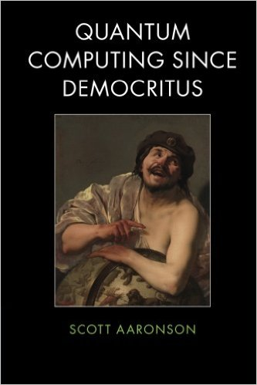

Lecture 17: The P vs NP question

Slide 2
Midterm 11/15
Topics:
Uncomputability
Restricted computational models
Modelling running time: TIME(T(n)), P, EXP
Relations between NAND++/NAND<</Turing machines and NAND/Circuits.
NP and NP completeness
Randomized computation
Logistics:
I will be away week of 12th-16th. Brian in charge
Recap & review lecture on Friday 11/9 5pm Science Center D
No lecture Tuesday 11/13.

Slide 3
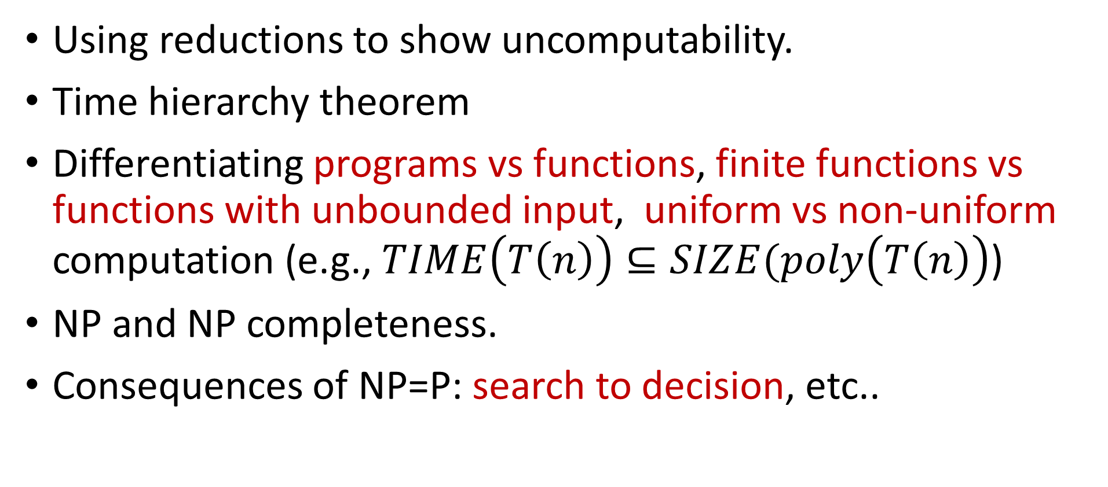
Highlights
Using reductions to show uncomputability.
Time hierarchy theorem
Differentiating programs vs functions, finite functions vs functions with unbounded input, uniform vs non-uniform computation (e.g., $TIME\left(T\left(n\right)\right)⊆SIZE(poly\left(T\left(n\right)\right)$)
NP and NP completeness.
Consequences of NP=P: search to decision, etc..

Slide 4
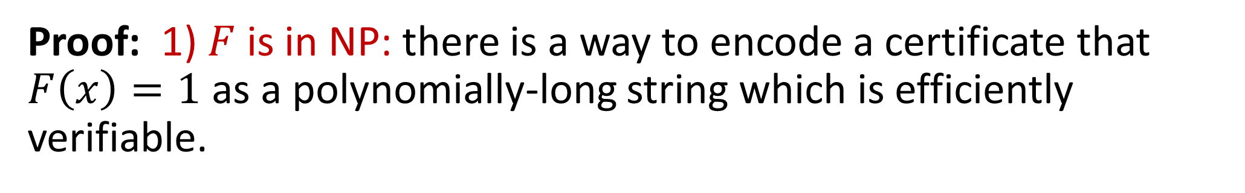

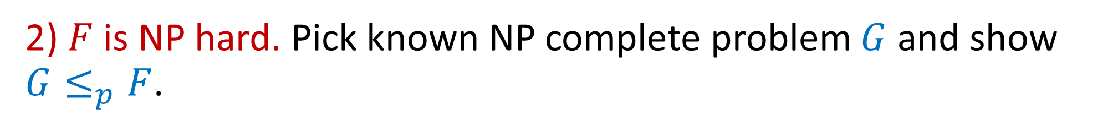
Describing reductions:
Thm: $F:\{0,1\}^{∗}→\{0,1\}$ is NP complete.
Proof: 1) $F$ is in NP: there is a way to encode a certificate that $F\left(x\right)=1$ as a polynomially-long string which is efficiently verifiable.
Usually 1-2 sentences (follows from definition)
2) $F$ is NP hard. Pick known NP complete problem $G$ and show $G≤_{p}F$.
a) Describe algorithm of reduction: input, output, operation.
b) Algorithm is polynomial time (usually straightforward)
c) Claim 1: Completeness. If $G\left(x\right)=1$ then $F\left(R\left(x\right)\right)=1$
d) Claim 2: Soundness. If $F(R\left(x\right))=1$ then $G(x)=1$

Slide 5
P vs NP

Slide 6

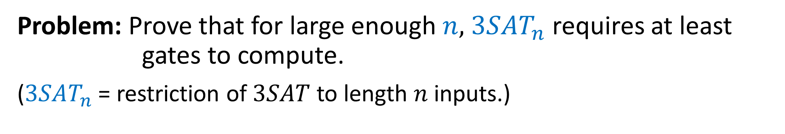
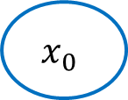
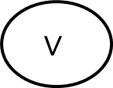
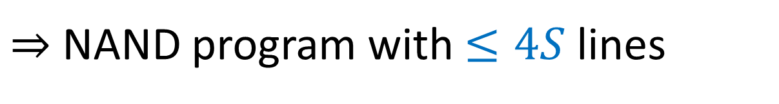
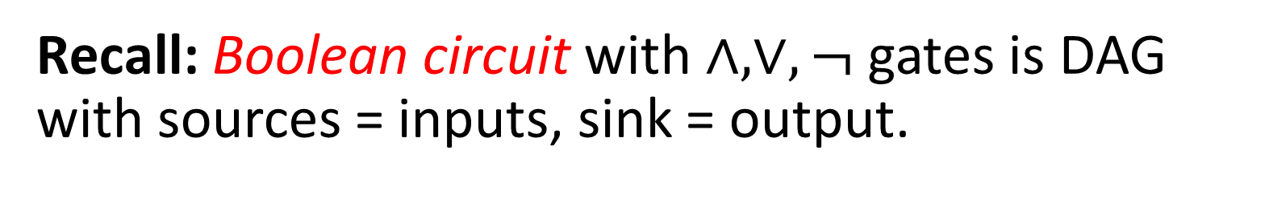

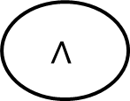
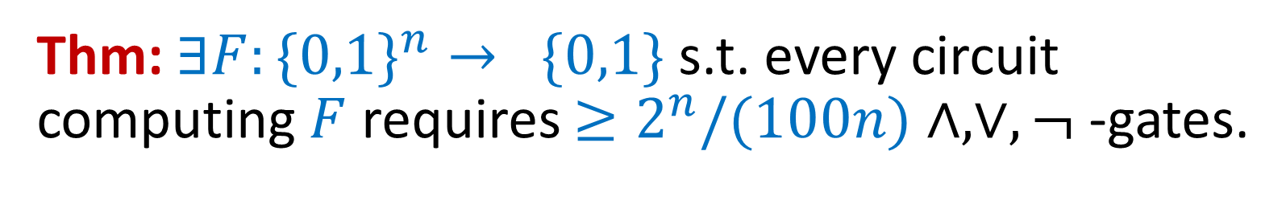

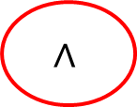

$$x_{0}$$
$$x_{1}$$
Recall: Boolean circuit with $∧, ∨,¬$ gates is DAG with sources = inputs, sink = output.
$$∧$$
$$∨$$
$$¬$$
$$¬$$
Thm: $∃F:\{0,1\}^{n}→ \{0,1\}$ s.t. every circuit computing $F$ requires $≥2^{n}/(100n)$ $∧, ∨,¬$ -gates.
$$∧$$
Pf: Circuit with $S$ $\{∧, ∨,¬\}$ -gates $⇒$ Circuit with $≤4S$ NAND gates
$⇒$ NAND program with $≤4S$ lines
Problem: Prove that for large enough $n,$ $3SAT_{n}$ requires at least gates to compute.
($3SAT_{n}$ = restriction of $3SAT$ to length $n$ inputs.)
$2^{n}/(1000n)$

Slide 7

$$x_{0}$$
$$x_{1}$$
Recall: Boolean circuit with $∧, ∨,¬$ gates is DAG with sources = inputs, sink = output.
$$∧$$
$$∨$$
$$¬$$
$$¬$$
Thm: $∃F:\{0,1\}^{n}→ \{0,1\}$ s.t. every circuit computing $F$ requires $≥2^{n}/(100n)$ $∧, ∨,¬$ -gates.
$$∧$$
Pf: Circuit with $S$ $\{∧, ∨,¬\}$ -gates $⇒$ Circuit with $≤4S$ NAND gates
$⇒$ NAND program with $≤4S$ lines
Problem: Prove that for large enough $n,$ $3SAT_{n}$ requires at least gates to compute.
($3SAT_{n}$ = restriction of $3SAT$ to length $n$ inputs.)
$2^{n}/(1000n)$

Slide 8




$$x_{0}$$
$$x_{1}$$
Recall: Boolean circuit with $∧, ∨,¬$ gates is DAG with sources = inputs, sink = output.
$$∧$$
$$∨$$
$$¬$$
$$¬$$
Thm: $∃F:\{0,1\}^{n}→ \{0,1\}$ s.t. every circuit computing $F$ requires $≥2^{n}/(100n)$ $∧, ∨,¬$ -gates.
$$∧$$
Pf: Circuit with $S$ $\{∧, ∨,¬\}$ -gates $⇒$ Circuit with $≤4S$ NAND gates
$⇒$ NAND program with $≤4S$ lines
Problem: Prove that for large enough $n,$ $3SAT_{n}$ requires at least gates to compute.
($3SAT_{n}$ = restriction of $3SAT$ to length $n$ inputs.)
$$n^{2}$$
$$n^{\log{n}}$$
$$4.9n$$
$$1000n$$
$2^{n}/(1000n)$

Slide 9


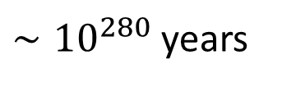




NP
Connectivity
P
MinCut
IP
ISET
LP
NPC
2SAT
3SAT
MaxCut
$$Θ(n)$$
$$Θ(n^{2})$$
$$n^{Θ\left(1\right)}$$
$$2^{Θ\left(n\right)}$$
$∼{10}^{280}$ years
$$1μs$$
$$1ms$$
secs, mins

Slide 10
NP
Connectivity
P
MinCut
IP
ISET
LP
NPC
2SAT
3SAT
MaxCut
$$Θ(n)$$
$$Θ(n^{2})$$
$$n^{Θ\left(1\right)}$$
$$2^{Θ\left(n\right)}$$
$∼{10}^{280}$ years
$$1μs$$
$$1ms$$
secs, mins

Slide 11
The world where P=NP
Personalized medicine (automatic drug from DNA of patient and cancer cells).
Long range weather predictions
Learn from minimal number of examples.
Automatic art generation.
Automatically find math proofs, scientific discovery.
Break all crypto.

Slide 12


“SAT Easy / Algorithmica”
“SAT Hard / Cryptomania”
$$3SAT∈TIME\left(O\left(n\right)\right)$$
*
$$3SAT∉TIME\left(2^{o\left(n\right)}\right)$$
Sci fi level calculations
Efficiency / data / accuracy tradeoffs
Drug discovery
(Maybe) no “master” algorithm
Optimal ML / AI.
Crypto! Encryption, signatures, crypto-currencies, zero knowledge proofs, multiparty secure computation, fully homomorphic encryption, ….
Break all crypto
Automatic thm proving, program generation.
Find better SAT algorithms!

Slide 13

If P=NP, which of the following is not known to be solved efficiently?
Find shortest path from s to t in a graph
Find longest simple path from s to t in a graph
Find number of length k paths from s to t in a graph
Find smallest NAND program to compute shortest paths

Slide 14

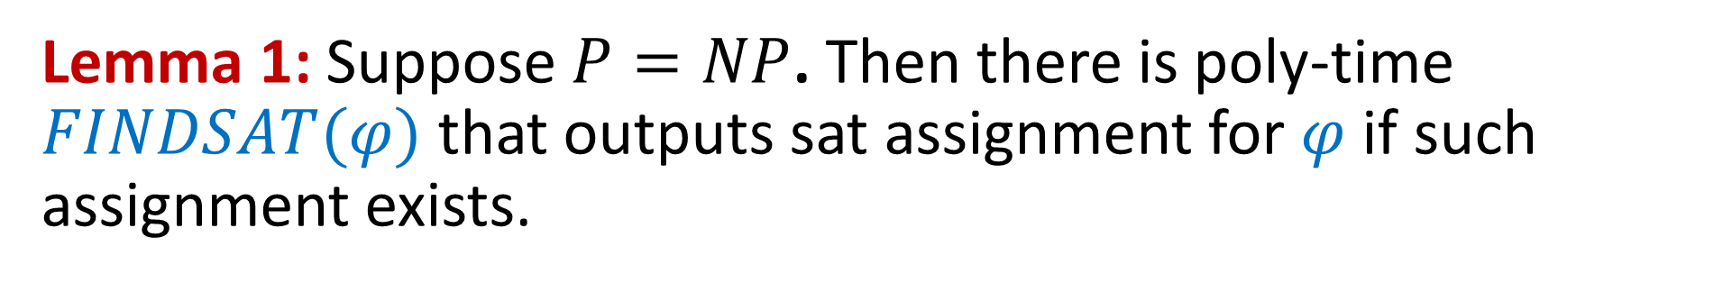

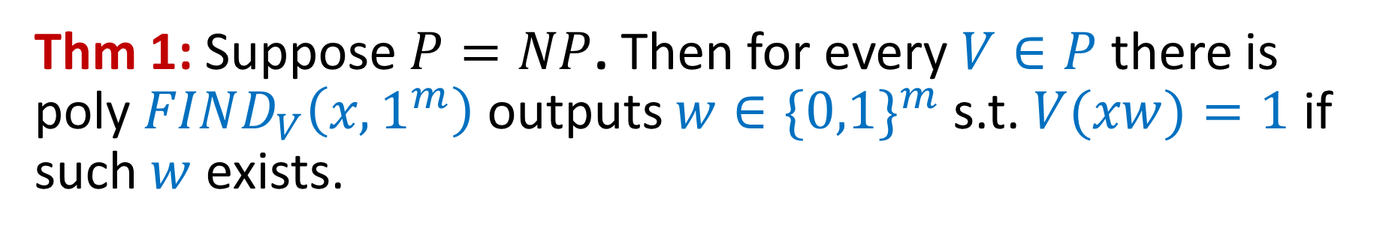

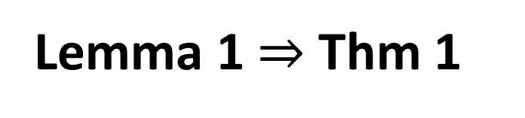

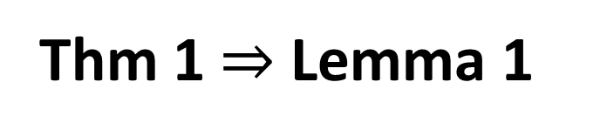

Search vs Decision
Thm 1: Suppose $P=NP$. Then for every $V∈P$ there is poly $FIND_{V}\left(x,1^{m}\right)$ outputs $w∈\{0,1\}^{m}$ s.t. $V(xw)=1$ if such $w$ exists.
Lemma 1: Suppose $P=NP$. Then there is poly-time $FINDSAT(φ)$ that outputs sat assignment for $φ$ if such assignment exists.
Thm 1 $⇒$ Lemma 1
Lemma 1 $⇒$ Thm 1
$$φ$$
$$x$$
$$V$$
3CNF
Cook-Levin Thm
Alg
$$y$$
$$w$$
Analysis

Slide 15
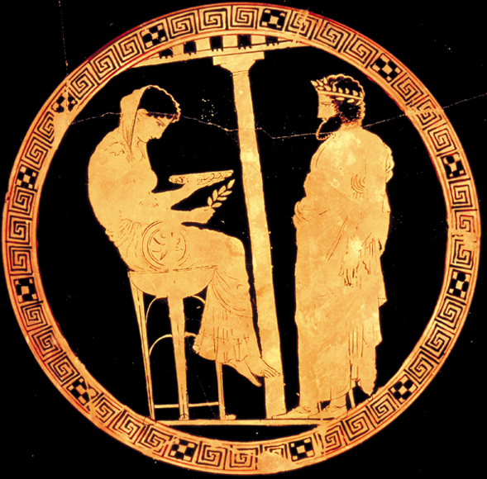
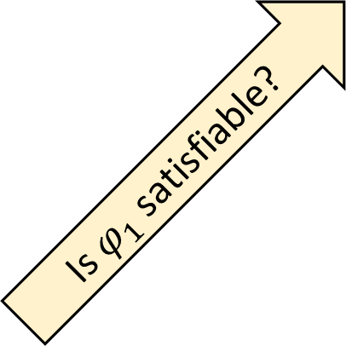
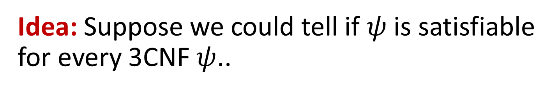

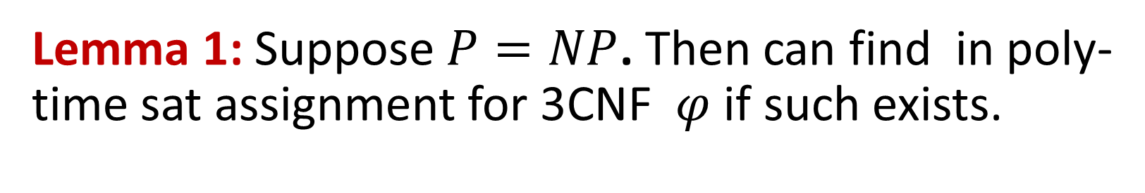
Lemma 1: Suppose $P=NP$. Then can find in poly-time sat assignment for 3CNF $φ$ if such exists.
Idea: Suppose we could tell if $ψ$ is satisfiable for every 3CNF $ψ$..
Is $φ_{0}$ satisfiable?
No
$$φ=\left(x_{0}∨¬x_{7}∨x_{3}\right)∧\left(¬x_{0}∨¬x_{1}∨x_{7}\right)∧\left(x_{2}∨x_{5}∨¬x_{12}\right)∧⋯$$
Is $φ_{1}$ satisfiable?
Yes
$$φ_{0}=\left(0∨¬x_{7}∨x_{3}\right)∧\left(1∨¬x_{1}∨x_{7}\right)∧\left(x_{2}∨x_{5}∨¬x_{12}\right)∧⋯$$
$$φ_{0}=\left(¬x_{7}∨x_{3}\right)∧\left(x_{2}∨x_{5}∨¬x_{12}\right)∧⋯$$
$$φ_{1}=\left(1∨¬x_{7}∨x_{3}\right)∧\left(0∨¬x_{1}∨x_{7}\right)∧\left(x_{2}∨x_{5}∨¬x_{12}\right)∧⋯$$
$φ_{1}=\left(¬x_{1}∨x_{7}\right)∧\left(x_{2}∨x_{5}∨¬x_{12}\right)∧⋯$
$$φ_{10}=\left(¬x_{1}∨x_{7}\right)∧\left(0∨x_{5}∨¬x_{12}\right)∧⋯$$
$$φ_{11}=\left(¬x_{1}∨x_{7}\right)∧\left(1∨x_{5}∨¬x_{12}\right)∧⋯$$

Slide 16

Optimization from NP=P
THM: If P=NP then can find longest path in graph.
Proof: For $k=n,n−1,n−2,…$ find if there is $k$ long path
.. then find path using search to decision.
Weighted path: use binary search
check if $∃$ path of total weight $≥W$

Slide 17

Quantifier Elimination
Suppose that we know alg $A$ that solves 3SAT in ${10}^{9}n^{2}$ time.
..but there exists $B$ that solves 3SAT in $1000n$ time.
We can use $A$ to find $B$!

Slide 18
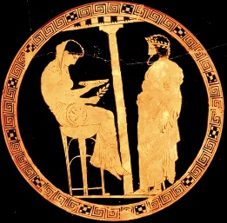
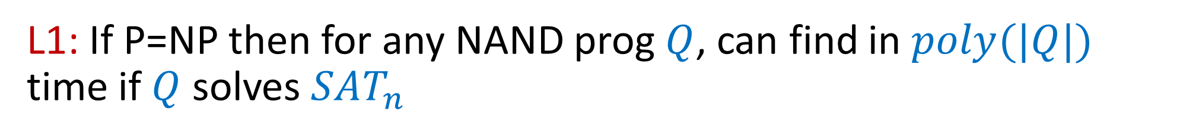
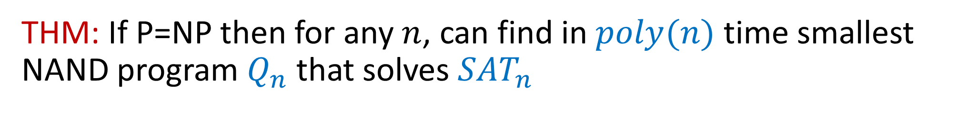
Quantifier Elimination / Polynomial Hierarchy
THM: If P=NP then for any $n$, can find in $poly(n)$ time smallest NAND program $Q_{n}$ that solves $SAT_{n}$
L1: If P=NP then for any NAND prog $Q$, can find in $poly(|Q|)$ time if $Q$ solves $SAT_{n}$
Pf: If $P=NP$ then exists poly-time prog $SATALG$ solving $3SAT$.
$Q$ fails to solve $SAT_{n}$ iff $∃φ∈\{0,1\}^{n}$ s.t. $Q\left(φ\right)≠SATALG(φ)$
NP statement! Can solve via
$NOSOLVESAT∈P$ and hence $SOLVESAT∈P$!

Slide 19

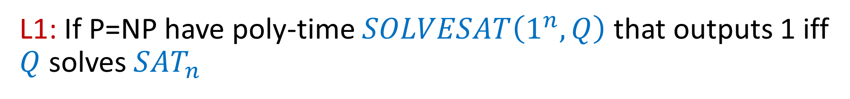
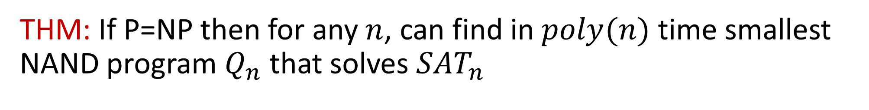
THM: If P=NP then for any $n$, can find in $poly(n)$ time smallest NAND program $Q_{n}$ that solves $SAT_{n}$
L1: If P=NP have poly-time $SOLVESAT\left(1^{n},Q\right)$ that outputs 1 iff $Q$ solves $SAT_{n}$
Def: $F\left(1^{n},1^{s}\right)=1$ if $∃Q$ s.t. $\left|Q\right|≤s$ and $SOLVESAT\left(1^{n},Q\right)=1$
In words: $F\left(1^{n},1^{s}\right)=1$ if there is an $s$-sized circuit for $SAT_{n}$
Claim: If $SOLVESAT∈P$ then $F∈NP$.
Proof: By definition of $NP$.
Cor: If P=NP we can find smallest $s$ and $\left|Q\right|≤s$ showing $F\left(1^{n},1^{s}\right)=1$

Slide 20
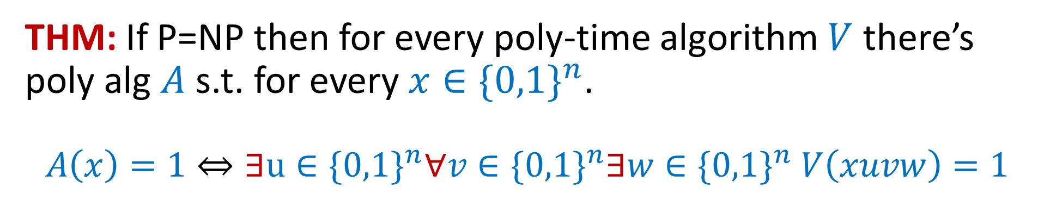
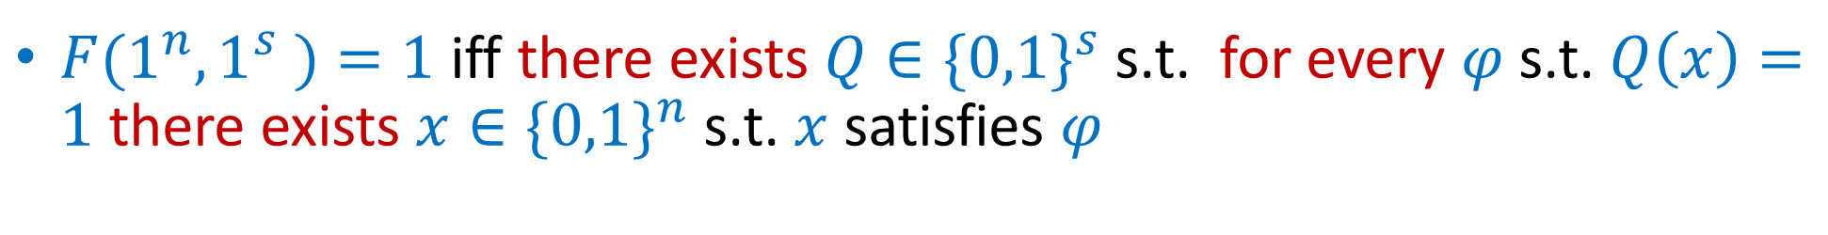
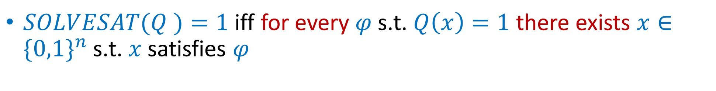
Generalization
$3SAT(φ )=1$ iff there exists $x∈\{0,1\}^{n}$ s.t. $x$ satisfies $φ$
$SOLVESAT(Q )=1$ iff for every $φ$ s.t. $Q\left(x\right)=1$ there exists $x∈\{0,1\}^{n}$ s.t. $x$ satisfies $φ$
$F(1^{n},1^{s} )=1$ iff there exists $Q∈\{0,1\}^{s}$ s.t. for every $φ$ s.t. $Q\left(x\right)=1$ there exists $x∈\{0,1\}^{n}$ s.t. $x$ satisfies $φ$
THM: If P=NP then for every poly-time algorithm $V$ there’s poly alg $A$ s.t. for every $x∈\{0,1\}^{n}$. $$A\left(x\right)=1⇔∃u∈\{0,1\}^{n}∀v∈\{0,1\}^{n}∃w∈\{0,1\}^{n} V\left(xuvw\right)=1$$
Polynomial Hierarchy (PH): all problems that can be expressed with a constant number of quantifiers.

Slide 21
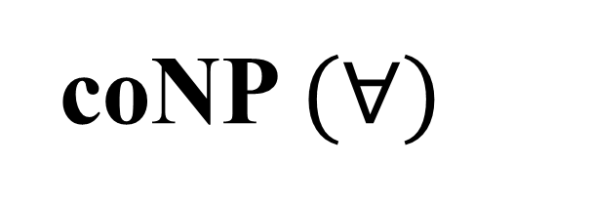


EXP
NP $(∃)$
P
$$∃∀$$
PH
PSPACE
coNP $(∀)$

Slide 22
If $P=NP$ then $P=PH$
EXP
NP $(∃)$
$$∃∀$$
P=NP=PH
P
PH
PSPACE
coNP $(∀)$

Slide 23
Can’t rule out $P=PSPACE$
EXP
P=NP=PH=PSPACE
P=NP=PH
PSPACE

Slide 24
EXP
P=NP=PH=PSPACE

Slide 25
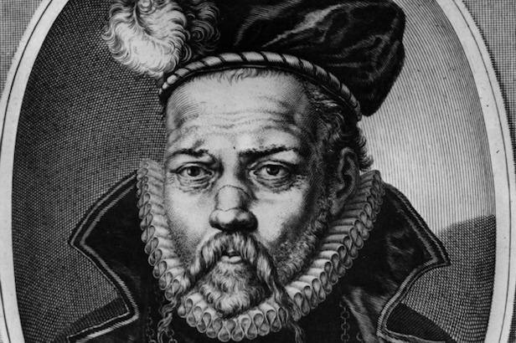
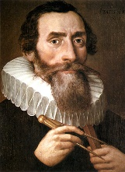
Doing Science if NP=P
Tycho Brahe (1546-1601): Danish astronomer
Detailed and accurate observations w/o telescope
Johannes Kepler (1571-1630):
Found math model for Brahe’s observations:
Planet revolve in ellipse with sun as one of the foci
A major step in the scientific revolution

Slide 26




Doing Science if NP=P
$THEORY:\{0,1\}^{∗}→ \{0,1\}^{∗}$
INPUT: Observations $o_{0},o_{1},…,o_{m}$
OUTPUT: Smallest program $P$ s.t. $P\left(′′\right)=o_{0}o_{1}…o_{m}$
Occam’s Razor: Simplest explanation is the correct one.
If P=NP: Automatically find simplest explanation.
Today: Guess tractable forms of programs, use much more data
(e.g., 10m images for Google “cat detection” paper)

Slide 27
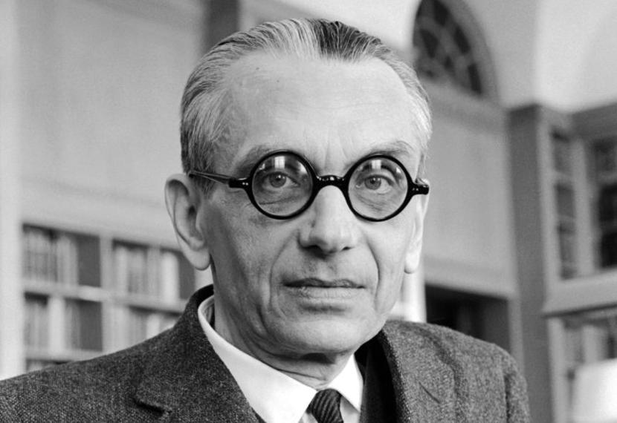
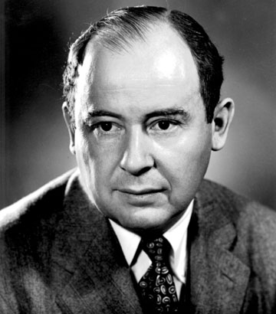
Doing math if P=NP
“If [P=NP] then … the mental work of a mathematician concerning Yes-or-No questions could be completely replaced by a machine.”
Kurt Gödel to John von Neumann, 1956

Slide 28





Doing Math if NP=P
$PROOF:\{0,1\}^{∗}→ \{0,1\}^{∗}$
INPUT: Theorem statement $S$
OUTPUT: Smallest proof $π$ s.t. $V\left(S,π\right)=1$
But how do we formalize math?
$FORMALIZE:\{0,1\}^{∗}→ \{0,1\}^{∗}$
INPUT: LaTeX source $S$ of a math paper.
OUTPUT: Formal proof matching paper result

Slide 29
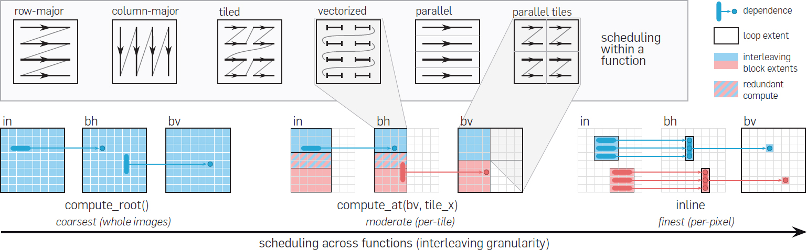



Programming if NP=P
$PROGRAM:\{0,1\}^{∗}→ \{0,1\}^{∗}$
INPUT: Specification $S$ of a task
OUTPUT: Fastest program $P$ achieving task.
Any other performance measure, match architecture, no security bugs,…
See Halide programming language
P=NP helps with finding specs as well…

Slide 30
“SAT Easy / Algorithmica”
“SAT Hard / Cryptomania”
$$3SAT∈TIME\left(O\left(n\right)\right)$$
*
$$3SAT∉TIME\left(2^{o\left(n\right)}\right)$$
Sci fi level calculations
Efficiency / data / accuracy tradeoffs
Drug discovery
(Maybe) no “master” algorithm
Optimal ML / AI.
Crypto! Encryption, signatures, crypto-currencies, zero knowledge proofs, multiparty secure computation, fully homomorphic encryption, ….
Break all crypto
Automatic thm proving, program generation.
Find better SAT algorithms!

Slide 31
What we believe (not to scale)
EXP
NP
Computable
P
NPC

Slide 32
Next up: Probability

Slide 33

Diversion: Describing algorithms
A[0]
A[1]
A[2]
A[3]
A[4]
A[5]
A[6]
A[7]
A[8]
A[9]
A[10]
A[11]
A[12]
A[13]
A[14]
A[15]
A[16]
A[17]
A[18]
A[19]
What does $O\left(n^{2}\right)$ algorithm mean?
Formal def: NAND<<
foo
bar
i
j
while … if … bar = A[i]
A[j] = bar*foo …
Informal: C, Python, pseudocode,…
Mostly: care about poly time only – NAND++, NAND<<, Turing Machines, C, Python, all the same
Tighter running time analysis = more details in algorithm

