Slide 1


Slide 2
The YCHYCAEIT paradigm
To prove a function is computable, use NAND<< or even higher level descriptions (“pseudocode” / “algorithm”).
To prove a function is unomputable (or meta theorems on computation), use NAND++ or whatever model makes it easiest.

Slide 3
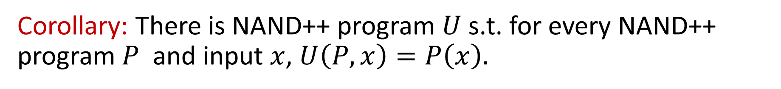

If you can think it…
… you can pseudocode it …
… you can Python it …
… you can NAND<< it …
… you can NAND++ it.
(or Turing-Machine it, or $λ$ calculus it, etc..)
Corollary: There is NAND++ program $U$ s.t. for every NAND++ program $P$ and input $x$, $U\left(P,x\right)=P\left(x\right).$
$P$ can have more lines than $U$!

Slide 4

The Talk

Slide 5
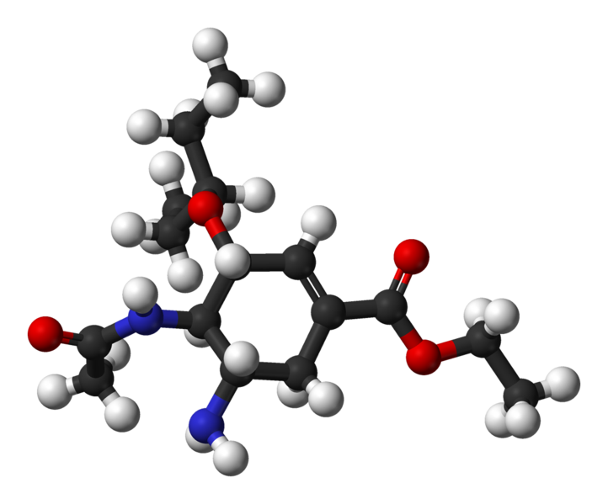
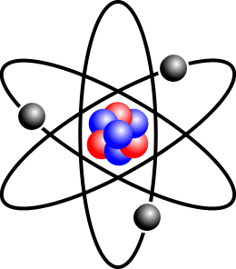
Physics

Slide 6

Chemistry

Slide 7

Biology

Slide 8
Psychology

Slide 9
Economics

Slide 10
Computer Science

Slide 11
Computer Science

Slide 12
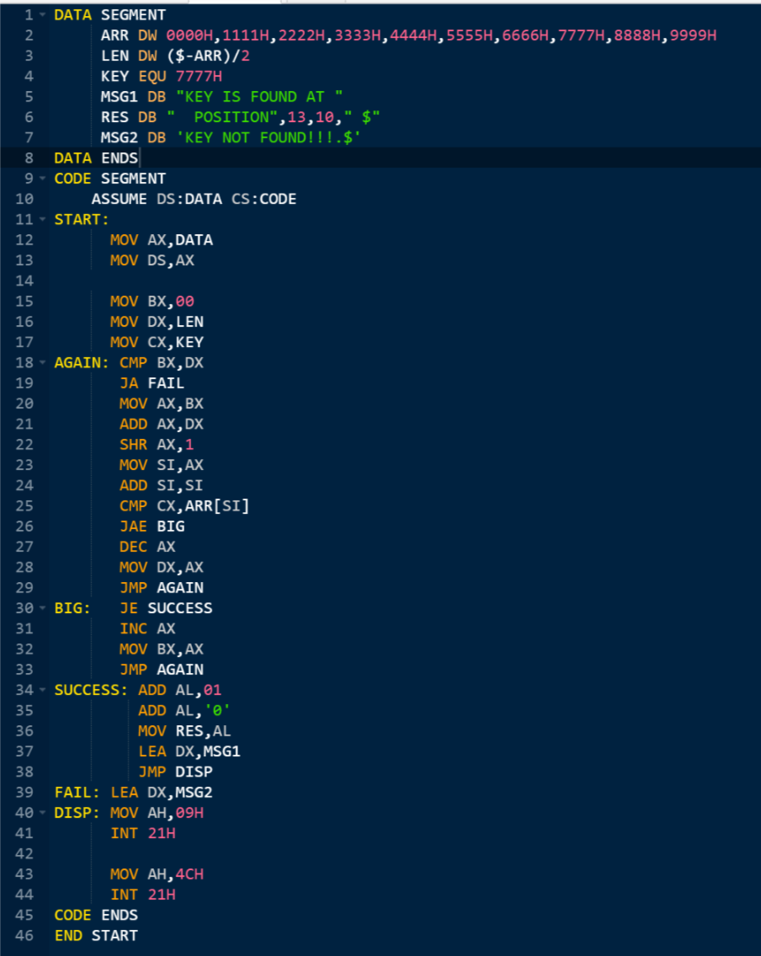
Computer Science

Slide 13
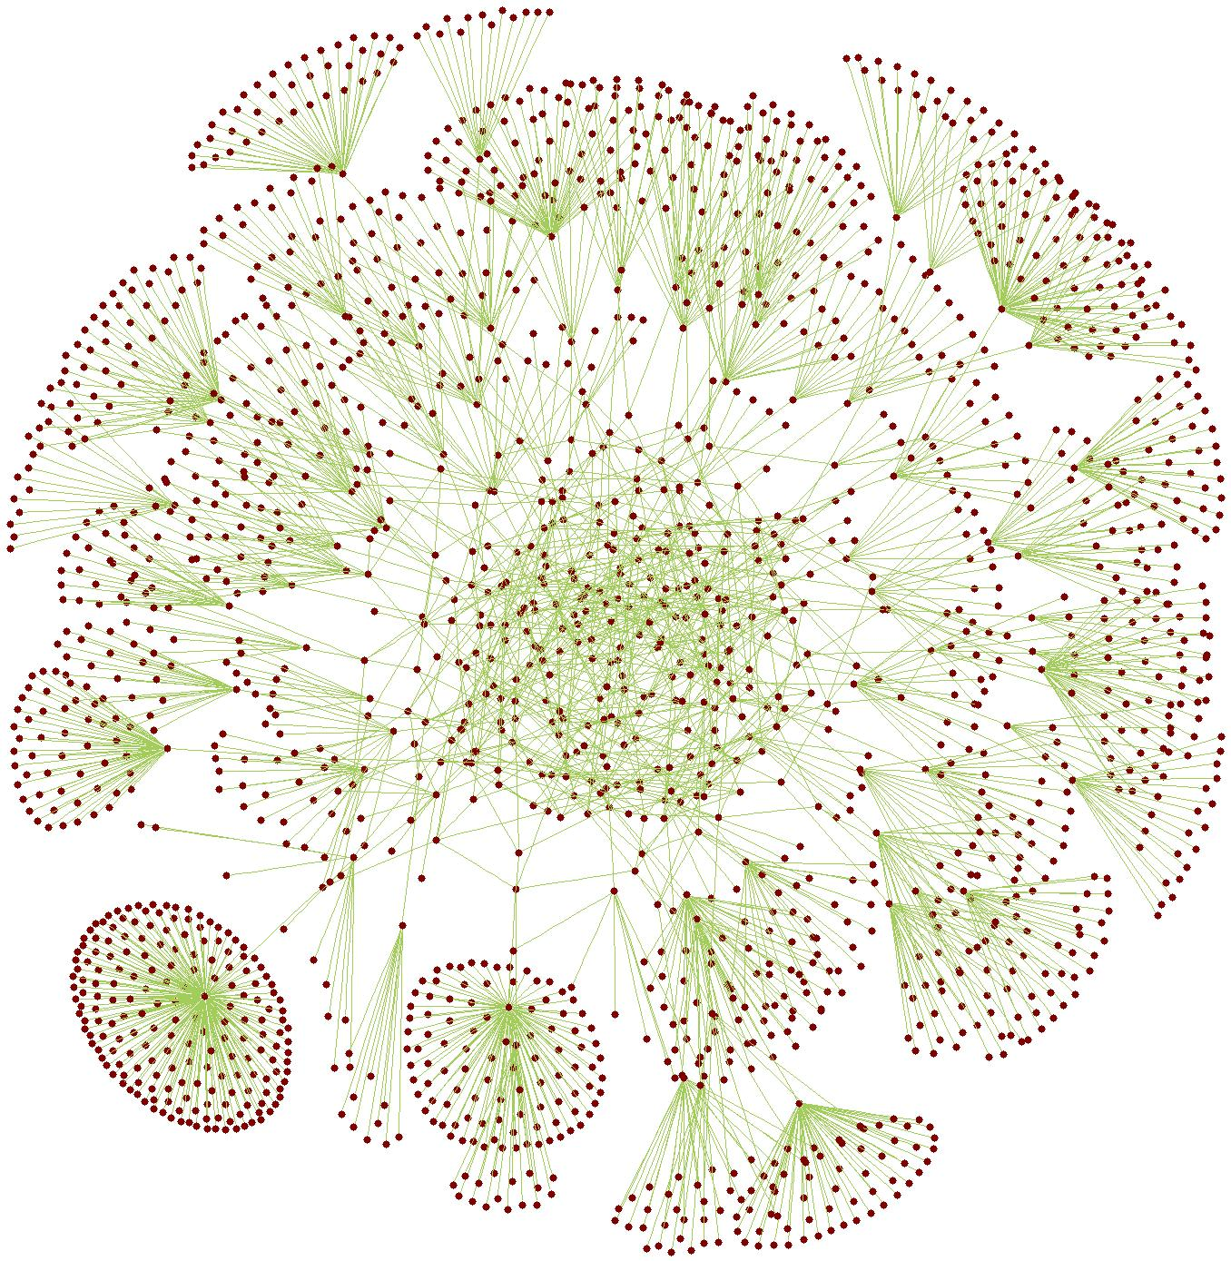
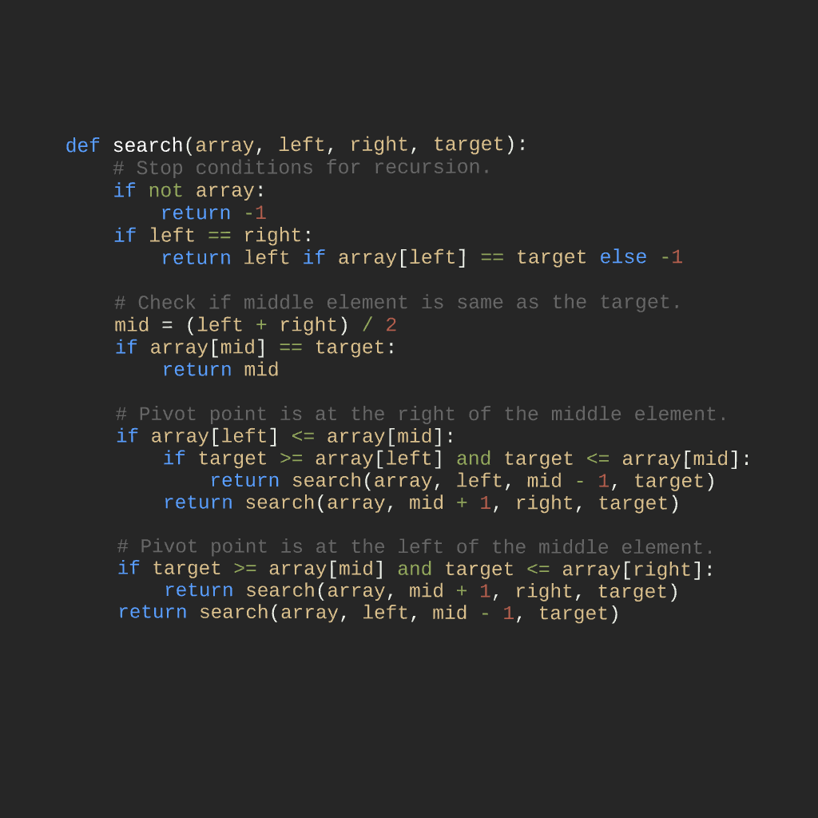
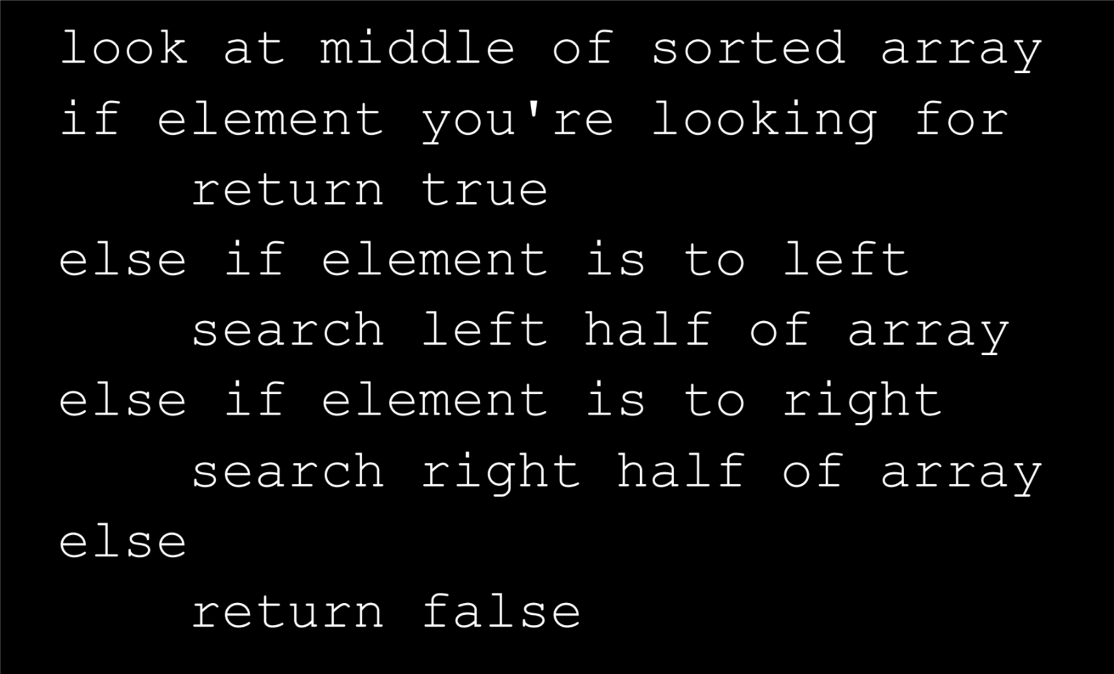
Computer Science

Slide 14
Computer Science

Slide 15
Levels of description of algorithms
High level: Describe algorithmic idea using high level data structures, objects, making no reference to particular computational model such as NAND++/Python/etc…
Intermediate / “implementation” level: Describe in “pseudocode” how the program operates. Appeal to syntactic sugar and other known transformations.
Low level: Full formal description of NAND / NAND++ code / states of Turing machine…

Slide 16
Levels of description of objects
High level: Assume a representation is given (i.e., let G be a graph).
Intermediate / “implementation” level: Describe the basic features of the representation (i.e., adjacency list or adjacency matrix for graphs).
Low level: Full description how an object is represented as a sequence of bits.

