Slide 1
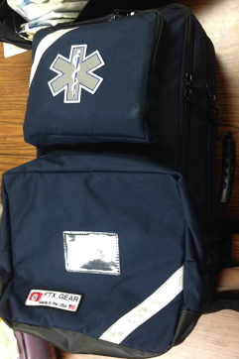
Backpack In-Service
Brian Miers

Slide 2
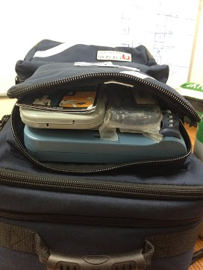
AED Pocket
Contents:
AED
AED Pads
Extra AED Battery
Pediatric Key
Razor
AED Instructions

Slide 3
Laptop Pocket
Contents:
Toughbook
Charger

Slide 4
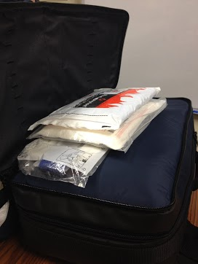
Oh #&*% Pocket
Contents:
Burn Sheet
Multi-Trauma Dressing
C-Collar
Foil Blanket
(3) Face Shields

Slide 5
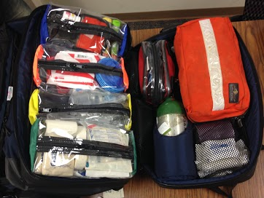
Main Compartment
Contents:
4 Velcro Sleeves
Airway & Breathing Bag
Red Sleeve
Small O2 Tank

Slide 6
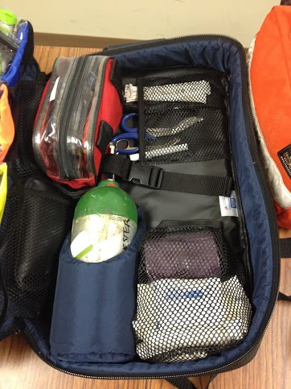
Main Compartment
Contents:
Adult BP Cuff
Bariatric BP Cuff
(2) ACE Bandages
(3) Kerlix
(3) 2in Roller Gauze
(3) 3-4in Roller Gauze
SAM Splint

Slide 7
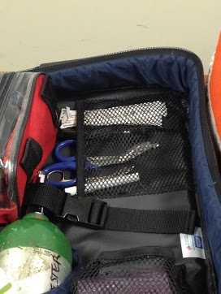
Under the Airway and Breathing Bag
Contents:
Pen Light
(2) Tongue Depressors
Trauma Shears
Lister Scissors
Flashlight
Pen

Slide 8
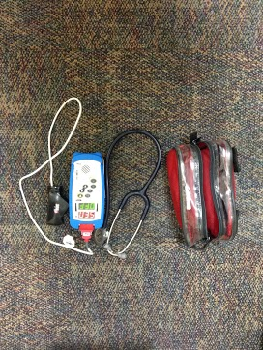
Red Sleeve: Vitals
Contents:
Stethoscope
Pulse Oximeter

Slide 9
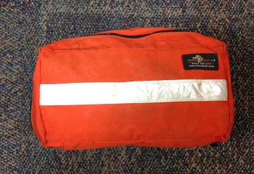
Airway and Breathing Bag

Slide 10
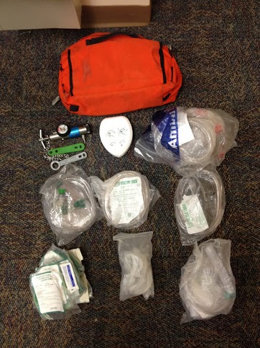
Airway and Breathing Bag
Contents:
Regulator
(2) O2 Tank Keys
CPR Mask
Adult BVM
(2) Adult NRB
(2) Adult Nasal Cannulas
(1) O2 Tubing
(2) Nebulizers
Set of 5 OPAs
Set of 5 NPAs (with Lubricant)

Slide 11
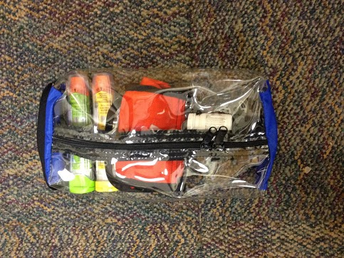
Blue Sleeve: Drugs

Slide 12
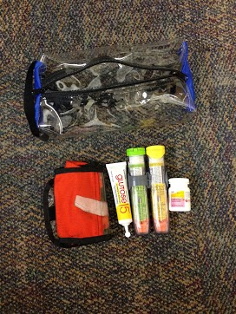
Blue Sleeve: Drugs
Contents:
Aspirin
Albuterol
Epi-pen (Adult/Child)
Glucose

Slide 13
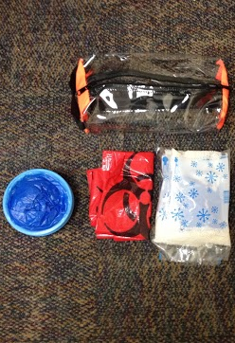
Orange Sleeve: ETOH
Contents:
(3) Cold Packs
(3) Barf Bags
(5) Biohazard Bags

Slide 14
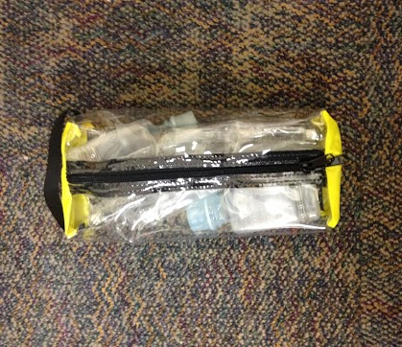
Yellow Sleeve: Saline

Slide 15
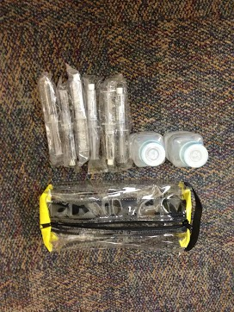
Yellow Sleeve: Saline
Contents:
(2) 250mL Bottles of Sterile Water
(6) 10mL Saline Flush

Slide 16
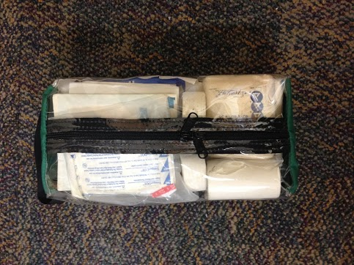
Green Sleeve: Gauze

Slide 17
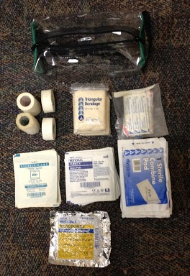
Green Sleeve: Gauze
Contents:
(2) 1-inch Tape
(2) 3-inch Tape
(4) Triangular Bandages
Band-Aid Bag
(6) 3x3 Gauze Pads
(10) 4x4 Gauze Pads
(6) 5x9 Gauze Pads
(1) Vaseline Gauze Pad

Slide 18
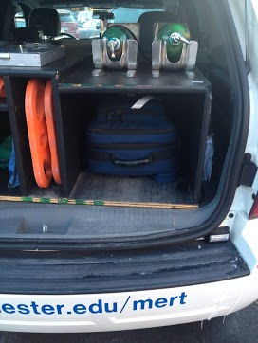
Yes, it fits in the Vehicle.

Slide 19
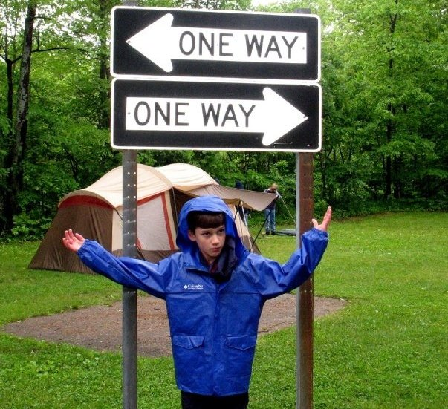
Any Questions?

