Slide 1
Chart Training
Brought to you by your lovely 2015 training department :)

Slide 2
Why We Chart
-Charting is required by law
-As a record of what was done on our calls
-Legal actions (suits/subpoenas) can occur years after the date of a call.
Charts provide a method of reminding the crew of the events of the call.
-As a way of documenting reasons for protocol deviations
-For QA/QI and training to determine what skills need to be refreshed with the field staff at in-services

Slide 3
Part 1:Demo Call

Slide 4
Call Scenario….
- Dispatch to Tiernan Hall room 428 for the intoxicated male
- Scene Description: Pt is sitting on floor with head in a trash can. Patient’s two roommates and Public Safety are present on scene

Slide 5
Patient Information
- Chief complaint: “I am a star!”
- Pt is CAOx1 to person - responsive to voice and confused speech
- S = vomiting for twenty minutes
- A = cantaloupe, cats, hazelnuts, crabs
- M = Adderall, Melatonin (took it that night as per roommates)
- P = Broken wrists, thumbs, leg
- L = Dfo
- E = (as per roommates, pt was out and came back thirty minutes ago and starting vomiting, so we called)

Slide 6
- H = 2 beers (if prompted, 12)
- O = 4 hours
- W = Beer
- D = Melatonin as per roommates and another sleeping medication written in another language that neither the pt nor the roommates are able to describe
- E = On the roof of Rush Rhees
- Vitals - pupils sluggish, dilated / BP 100/60 / Pulse 106 / Respirations 12
- SpO2 - 94

Slide 7
Pt Demographics -
3315 ardmore road
Shaker Heights, OH 44120
(216) 280-3195
10/20/1991

Slide 8
Part 2: emsCharts

Slide 9
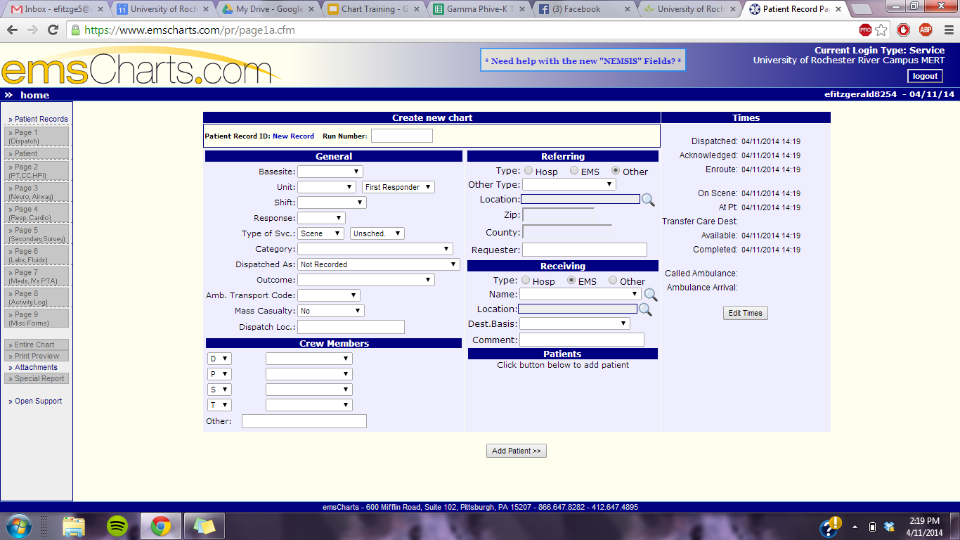

Slide 10
Page 1: Dispatch
GOAL: What did you know before you got there?
Common mistakes to avoid:
-Disp loc. is where 801 was at time of call, not call location.
-Ref. is the call loc. and if you were dispatched, =UR DPS.
-Disp. info is the type of call you think you’re responding to; Category is what you actually find once you get on scene.
- Leave Amb. Transport Code blank
Don’t forget to add:
-Times that your 803 collected.
-The run number (get from office, first 2 #’s are calendar year =14).
-Crew Roles (801=P, 802=S).

Slide 11
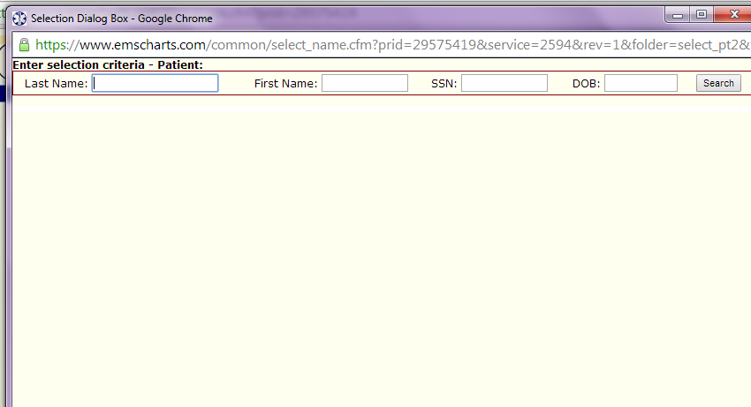

Slide 12
Patient Search
-Always press search for existing pt and put in information, if no pt is found, push add pt.
-If you only know some of the letters of a pt’s name, putting a % in front of your entry will search for any matches (applies to any search in emsCharts).

Slide 13
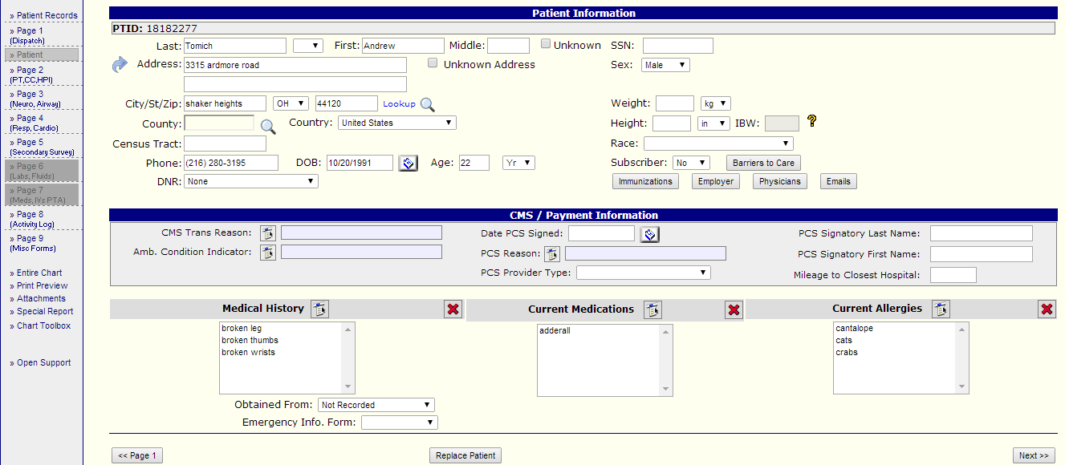

Slide 14
Patient
GOAL: Who is the Patient?
Common Mistakes:
-Payment section should be blank.
-If the patient tells you they have no Allergies/meds/Med Hx, you should put none as reported by pt in the box.
-If a bystander tells you the pt has no Allergies/meds/Med Hx, you should simply put none in the box
Don’t forget to add:
-Demographics, allergies, meds, and medical history.
-Barriers to care: If a language barrier exists and could affect another crew on another call with this pt., document it.

Slide 15
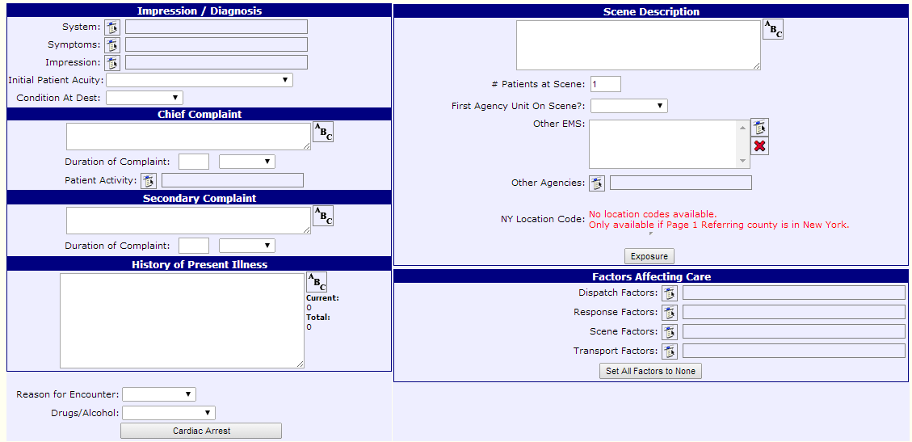

Slide 16
Page 2: HPI/CC
GOAL: What did you see/hear when you got there?
Common Mistakes:
-First Agency Unit on Scene= Yes unless you are jumping on to a call with another crew.
-Other Agency= no unless Metro/other agency was on scene BEFORE you.
Don’t forget to include:
-Factors Affecting Care: Language Barriers, adverse weather, etc…
-Alcohol/Drug use.

Slide 17
HPI Guidelines
Structure:
State what people told you about the scene, include relevant information from DPS, bystanders, the pt, etc
The whole point is to paint a picture of what happened/why we were called.
HOWDE useful here for ETOH
For trauma, describe each injured site separately, complete with its own OPQRST and description of DCAPBTLS
CMS should be stated
Backboarded/ major trauma pt’s state CMSx4 just generally
For localized injury. Left arm sustained 1 inch laceration to inner wrist, pt complained of 1/10 pain to area, pt had CMS to area.
For medical, describe anything you found from assessments
ie. Pt reported no pain upon palpation of abdomen, or pt complained of 5/10 pain to RLQ of abdomen upon palpation
For both, describe any objective findings you found unusual on the pt
Include CAO information and all pertinent negatives
Give brief assessment of vitals
If all stable, write Pt’s vitals were stable.
If one was concerning, not that and put possible explanation
Pt’s elevated bp possibly due to pain.

Slide 18
HPI
Medical Example:
Bystanders stated they found pt wandering around in the street and she did not know where she lived or who she was. Pt was disoriented, they brought her into their garage and called for EMS. Pt was assessed as CAOx1, knew her name but not her birthday, address, or where she was or how she got there. Pt had no obvious injuries, vitals stable, no SOB, no LOC, chest pain, tingling in extremities, dizziness, was in no pain, had not fallen, had not suffered H/N/B strike or sustained any injury. Upon transporting pt into the ambulance, pt's son walked up to the ambulance and stated "you found my grandma." Son stated that his grandma has dementia and wandered out of the house twenty minutes prior to EMS arrival. Pt's son confirmed that pt had dementia and was CAO to her baseline, and reported her medical history and demographics. Son did not have proxy, pt's sister has proxy but could not be reached, so pt was transported to the hospital because she was already in EMS care. A social service consult was requested at HH due family's lapse in caring for the pt.

Slide 19
Trauma Example:
Pt stated she was walking, slipped on the grass, fell and landed on her left side. Pt stated she hit her shoulder and smacked her head on the pavement. Pt had a one inch bleeding laceration to the left side of her forehead. Pt complained of 7/10 pain to her forehead that radiated down her neck. Pt had slight kyphosis of the spine. Spinal immobilization was performed due to age and MOI. Pt had an obvious dislocation to the left shoulder, with extremely limited range of motion to the area. Pt complained of 5/10 pain to the area. Pt was CMSx4. Pt was CAOx3, no LOC, no SOB, no chest pain,no dizziness, no tingling to the extremities, no N/V/D. Pt's vitals were stable.

Slide 20
Special for RMA
Include RMA description at the end of the HPI for an RMA pt.
For transport pt’s DON’T describe the care transfer in HPI

Slide 21
RMA Example:
Fire stated that the pt was stable and to wait at the top of the ravine until they lifted the pt up. Pt's neighbor, who was a nurse, had climbed down the 30 ft ravine to assess pt and stated he was "completely stable and alert." Once pt had been lifted up the ravine in the stokes basket, the first thing pt stated was "I am fine, I don't want to go to the hospital." Pt stated he had slipped, fallen on his butt and slid slowly down the ravine, using trees to slow him along the way. Pt was CAOx3, pt denied H/N/B strike and pain, pt denied any pain to all areas. Pt denied LOC, SOB, N/V/D, dizziness, tingling in extremities. Pt's vitals were stable, pt was PMSx4. After a rapid trauma assessment, EMS determined pt had no injuries. EMS recommended pt be transported to the hospital to be assessed for possible injuries that may not have yet presented themselves. EMS advised pt to call them back if anything changed or if he changed his mind about seeking further medical attention. Pt read, understood, and signed the RMA form, pt's wife signed as a witness.

Slide 22
Scene Description
Components:
Description of pt’s location within the scene
Please note any strange scene condition (ie the ground was covered in snow)
State other people present on scene
Pt’s CAO status
Comment on pt’s LOC (no LOC or LOC)
Comment on pt’s breathing (no SOB versus SOB)
Comment on ability to speak (full and complete sentences versus unable to speak versus pt speaking was inappropriate and slurred)
Comment on obvious life-threats or pt agitation, if pt not directly in danger and not irritated, state in no obvious distress.

Slide 23
Example Scenario:
18 yo pt fell, landed on right side and hit head, is sitting on the grass upon MERT arrival.
Scene Description:
AOSTF 18yo female sitting on the grass holding a hand to her head. Pt was CAOx3, no LOC, no SOB, speaking in full and complete sentences, in no obvious distress. Pt’s friend and one DPS officer was present on the scene.

Slide 24
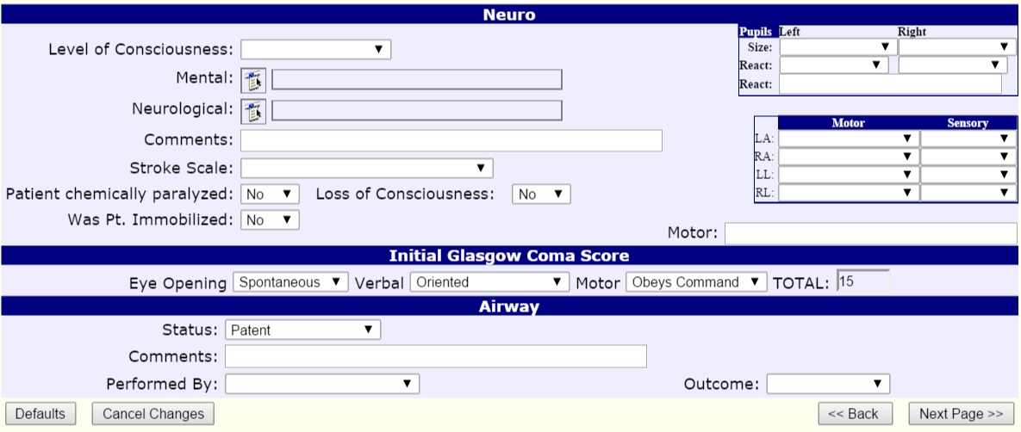

Slide 25
Page 3: Neuro, Airway
GOAL: What did you find in your initial assessment?
Common Errors:
-Pupil size should be given in mm. there is a scale on the pen light. use it unless the scene would make doing so impossible.
-Was pt. immobilized=no UNLESS the pt. was immobilized when you arrived on scene (IN WHICH CASE WRITE IT IN THE COMMENTS).
Don’t forget to include:
-Write out all of what pt. was oriented to in neuro comments (person/place/time).
-Who is maintaining the airway; usually pt. unless another FR is stabilizing the airway.
- Stroke Scale NA if not done

Slide 26
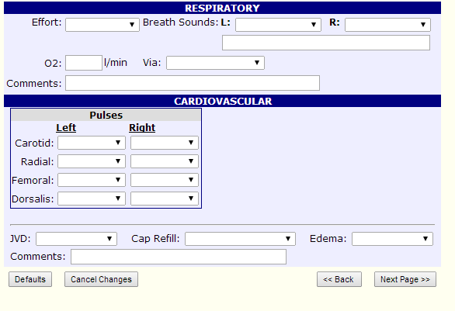

Slide 27
Page 4: Resp, Cardio
GOAL: What did you find in your initial assessment?
Common Errors:
-O2=No UNLESS you found the pt. with oxygen ALREADY administered.
-Check pulses at an anatomic location BILATERALLY if the call allows.
Don’t forget to include:
-Write findings of lung auscultation in box underneath breath sound dropdowns.

Slide 28
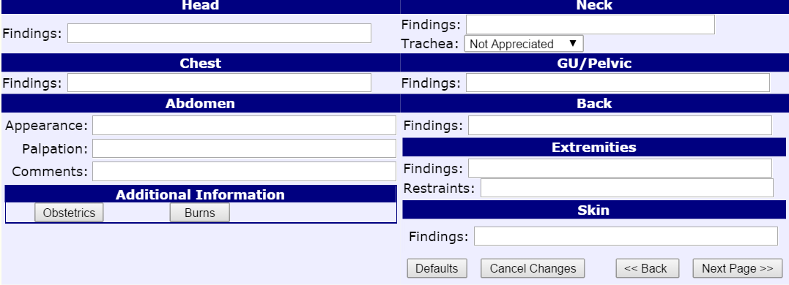

Slide 29
Page 5: Secondary Survey
GOAL: What did you find in your focused assessment?
If nothing wrong with the body area, write Negative DCAPBTLS to all exposed areas.
If there is something, describe it the same as you did in the HPI

Slide 30
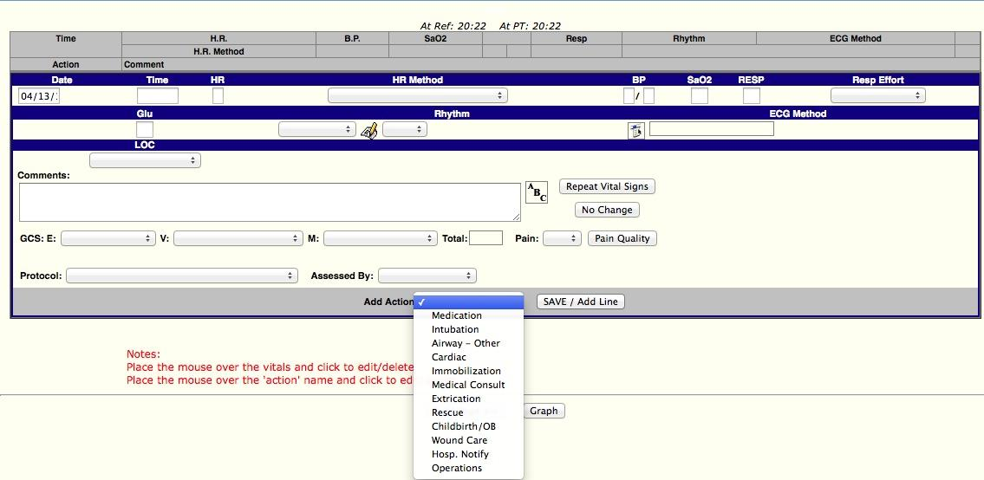

Slide 31
Page 8: Activity Log, Part 1
GOAL: What Vital Signs did you get on the pt.?
Common Mistakes:
-Glu/Rhythm/ECG are not in MERT protocols. They should be BLANK.
-Entries should be separated by protocol, not time. If you did things with different protocols simultaneously, each action gets its own entry (see next slide for more info).
Don’t forget to include:
-To get baseline VS on every pt. If you can’t, say why in the comments. At a minimum, visually observable info. (gcs/breathing effort/etc) should be entered.

Slide 32
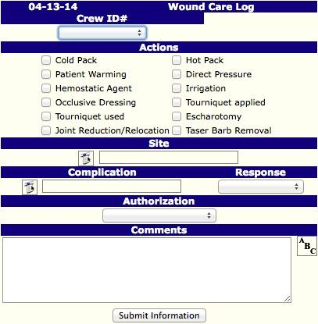
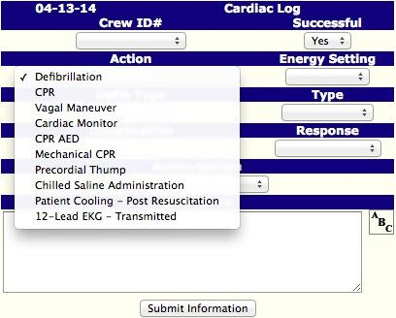
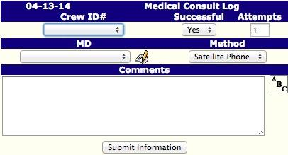
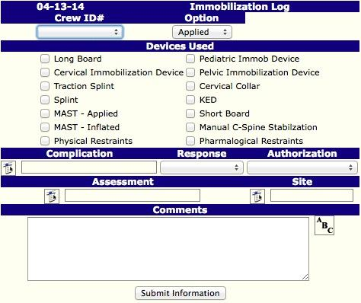
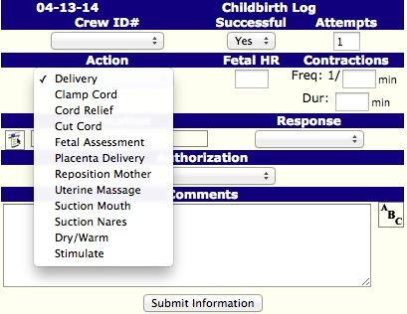
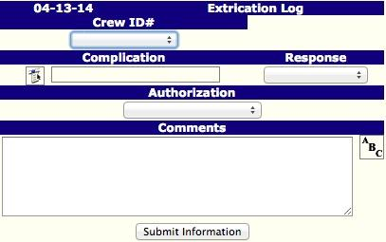

Slide 33
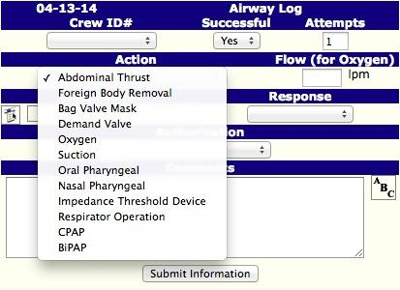
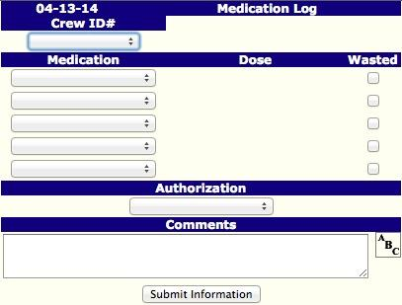

Slide 34
Page 8: Activity Log, Part 2
GOAL: What actions did you take after your assessment?
Common Mistakes:
-Drop down actions should be used regarding actions in place of comments when available.
-There are protocols available beyond the BLS scope of practice. DO NOT USE THEM. Ex: Selective Spinal Immobilization=YES, Spinal Immobilization Clearance= NO.
-Use appropriate protocols, don’t write UPCP for every entry.
-Oxygen=medication, NOT airway for BLS providers.
Don’t forget to include:
-A comment about transfer of care with Rig # and ALS/BLS denoted, or:
-A comment about RMA.

Slide 35
Page 8: Points in Activity Log
Time on scene
At this time, copy/paste all of scene description except for the description of number of DPS and bystanders on scene. Give brief description of chief complaint.
ie. from the scene description example: AOSTF 18yo female sitting on the grass holding a hand to her head. Pt was CAOx3, no LOC, no SOB, speaking in full and complete sentences, in no obvious distress. Pt had fell, landed on left side, and hit their head. Pt complained of 5/10 pain to her head.
Vitals Times
Times of interventions and QUICK description of them
ie. RC MERT applied ice pack and ace bandage, checked CMS before and after
Interventions that need add action:
Spinal Immobilization
Medical Control
Medicine Administration
Times RMMS was called and arrived on scene
Arrived on scene time should include rig number
Time RMA was signed and description of RMA procedure

Slide 36
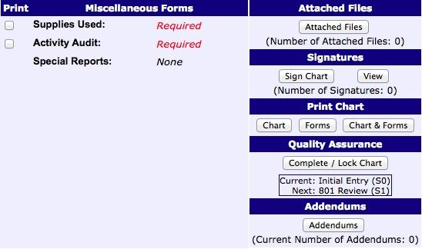

Slide 37
Page 9: Misc. Forms
GOAL: Clean up/finalize chart
Common Mistakes:
-If you answer yes to ANY activity audit question, you MUST fill out the appropriate special reports.
Don’t forget to include:
-The RMA as an attachment.
-To have both crew members sign the chart.
-To have the 801 lock the chart.

