Slide 1
HIPAA and BBP
MERT In-Service

Slide 2

HIPAA

Slide 3
HIPAA
What is HIPAA?
Heath Insurance Portability and Accountability Act
Passed in 1996
Has many components, includes descriptions of when you may/may not disclose Patient Health Information (PHI)
Why does MERT care about it?
Requires agencies to keep all personal information private
Trust in health-care providers, systems
Violations are serious, will result in disciplinary action

Slide 4
MERT and HIPAA
Problem of CAMPUS SIZE
We live on a small campus, everyone knows everyone else.
Many calls are in public areas, patients can be seen / recognized.
Information and rumors can move around very quickly.
Solution
Minimize bystanders who are not directly related to patient care.
Absolutely DO NOT tell friends the patient’s name or location of call.
NEVER talk to others about a patient’s personal medical information or identify a specific patient.
Refrain from talking about any specifics of calls that could allow others to connect a call and a person.

Slide 5
Your Primary Obligation
Your primary obligation is to treat the patient.
You may talk to necessary bystanders to obtain necessary patient information.
Talking about the patient with your crew in the presence of bystanders DURING THE CALL is OK when necessary.
You may disclose all patient information to Rural/Metro if they are called to the scene, as they are directly involved in the patient’s care.
Remember: A part of treatment is disclosing everything you need to disclose! It’s just about to whom you disclose it.
“Are they directly involved in the patient’s medical care?”

Slide 6
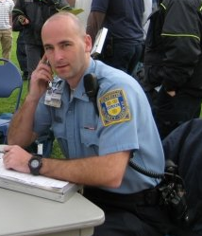
Security and HIPAA
Security has different role than other UR officials.
There is usually at least one security officer present at a MERT call.
Security may at times be DIRECTLY involved in patient care.
This officer may ask and needs to know all DEMOGRAPHIC information about the patient.
The officer may also ask for the patients medical condition to relay it to Rural Metro if necessary.

Slide 7
Friends, Parents, RAs and the Administration
Private patient information should NEVER be given to anyone not directly involved in patient care.
If an RA comes up to you after a call and asks what happened, you MAY NOT tell him/her.
If a parent calls you about their child (your patient), you MAY NOT tell the parent anything if the patient was 18 or older.
If a school official such as a Dean asks for information about the call, you MAY NOT tell him/her.
If a friend comes up to you after a call and asks what happened to their friend, you MAY NOT tell him/her.
When unsure of whether you should release patient information, tell the person to contact the Director of Operations and give the person the Director’s name.

Slide 8
When You Need Someone To Talk To
Some calls are emotionally disturbing.
It is OK to talk about calls with the other members of the crew who treated that patient.
If you are upset, don’t hesitate to meet with your crew chief and go over what happened.
If you need to talk to someone else about what happened, choose someone not affiliated with the university, such as a parent or friend.
Remember, HIPAA still applies.

Slide 9

HIPAA and Legal Issues
Violation of HIPAA is punishable by law.
Do not do it and do not ask others to do it.
Failure to comply with HIPAA may result in expulsion from MERT as well as other legal actions.

Slide 10
Good Idea / Bad Idea
Friend: Hey, Josh how was your MERT shift? Did you get any calls?
Josh: It was okay. We had a call for a student that sprained their ankle.
GOOD or BAD?

Slide 11
Good Idea / Bad Idea
Friend: Hey Josh. I saw you on MERT last night helping Erica outside Wilson Commons. What happened?
Josh: She fell and hit her head. I guess she smoked too much marijuana and passed out.
GOOD or BAD?

Slide 12

Blood Bourne Pathogens

Slide 13
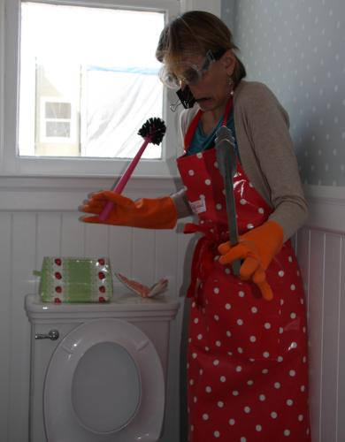
Disease-Carrying Substances
BLOOD – wet OR dry
Blood can also be present in vomit, urine, or feces.
BODY FLUIDS –
SALIVA
SEMEN
VAGINAL SECRETIONS
CEREBROSPINAL FLUID
SYNOVIAL PLEURAL FLUID
PERITONEAL FLUID
PERICARDIAL FLUID
AMNIOTIC FLUID
TISSUE –
Intact or unfixed tissue (including organs) from living or dead people.

Slide 14
Methods of Exposure
Accidental injury by contaminated sharps.
Contact with open cuts, nicks, and abrasions.
Contact with mucous membranes including:
Mouth
Nose
Ears
Eyes

Slide 15
Common Airborne Viruses
Tuberculosis
Common Cold
Influenza
Whooping Cough
Measles
Select Blood Bourne Viruses
HIV
Hepatitis B
Hepatitis C

Slide 16
Contaminated Surfaces
Surfaces can be contaminated without visible signs.
HIV can survive on surfaces at room temperature for at least a week.
Clean all areas that were potentially exposed with appropriate cleaning solutions.
Do not touch potentially contaminated surfaces with bare hands.

Slide 17
Ways To Prevent Transmission
Wear gloves on EVERY call, whether there appears to be body fluids or not.
Wear other protective equipment when necessary such as Gowns (in OB kit) or Face Shields.
Do not keep food or drink on counters where infectious materials may be present.
Use gloves when cleaning potentially contaminated areas.

Slide 18
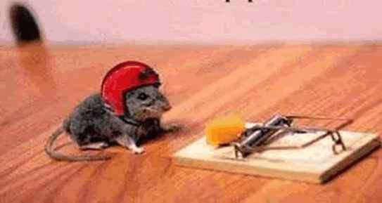
Personal Protective Equiptment (PPE)
Personal Protective Equipment:
GLOVES
MASK
APRONS
FACESHIELDS
GOWNS
EYEWARE
CPR POCKET MASKS
ANY OTHER EQUIPMENT
WHICH MAY REDUCE CONTACT
WITH SKIN OR OTHER POTENTIALLY
INFECTIOUS MATERIAL
Always wear your PPE!

Slide 19

Disposing of Contaminated Items
Contaminated (anything that touches a body fluid) items must be placed in red biohazard bags.
Biohazard bags should be disposed of in the biohazard bin in the UHS office.
Contaminated equipment should be cleaned with appropriate cleaning solution.
Contact Equipment Manager (Rose Kennedy) with contaminated equipment questions.

Slide 20
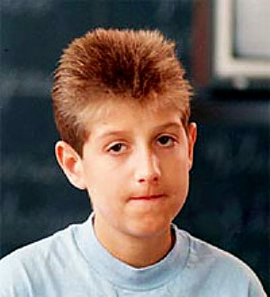
Ryan White Care Act
Requires EMS corps to have a designated officer for exposure control
The designated officer will request that the hospital test for communicable disease
If the hospital finds a communicable disease during the care of a patient...
They will contact provider within 48 hrs.
(Except for HIV)

Slide 21
In Case of Exposure
If you think you may have been exposed you must contact the Assistant Director of Operations, Greta Smith, who is MERT’s Exposure Control Officer
Information for how to go about documenting exposure and the current exposure control officers phone number is on the bulletin board in the Spurrier Office.

Slide 22
Universal Precautions
Treat ALL blood and body fluids as potentially infectious.
Wear gloves on EVERY call even if the person does not look like they have any bodily fluids on them/near them.

