Slide 1


Serious Alcohol Intoxication: Management and Treatment
Porter Ladley
RC MERT Training Week 2015

Slide 2
Goals
The Body and Alcohol Consumption
Review of Basic Intox Assessment
Serious Intox Concerns
Case Reviews

Slide 3

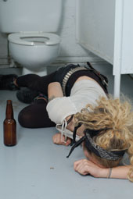
Alcohol on Campus
Highest percentage of our call volume
35% this past year, higher in years before
About 50/50 Transport/Refusal
Severity of MERT’s intox calls has decreased over the past years.
Greater policing of fraternities, parties moving off campus
We get plenty of practice with intox assessments!

Slide 4
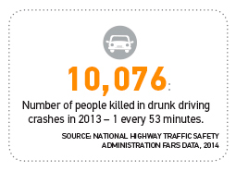
Alcohol Numbers, Nationally
1800 college students die each year from alcohol related incidents.¹
~600,000 students are injured in an alcohol related incident.²
700,000 assaulted by students, 97,000 are victims involved in sexual assault and rape
Bottom Line: Alcohol is a problem
for EMS everywhere
Notes:
http://www.nchip.org/
https://www.una.edu/manesafety/Alcohol%20Brochures/Collegefactsheet.pdf

Slide 5
Alcohol and the body

Slide 6
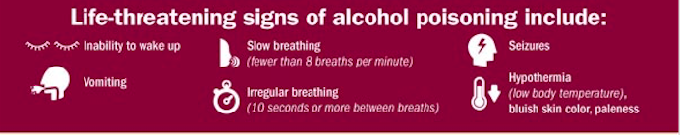
Effects of Alcohol
CNS Depressant
Facilitates GABA receptors in brain, causes sedative-like effects
Results:
Lower Doses: Euphoria, lower social inhibitions, etc.
Higher Doses: N/V, Ataxia (Appendicular, Gait, Trunk), Slow/Irregular Breathing, Hypothermia Risk, Coma, etc.

Slide 7
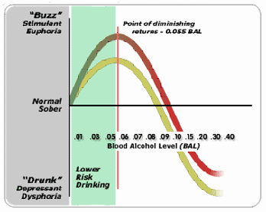
The Body and BAC
Blood Alcohol content can give a reference point for various symptoms
Varies greater for different people, still interesting
.05- Peak Positive Effects
.08- Legal Limit for
Driving

Slide 8
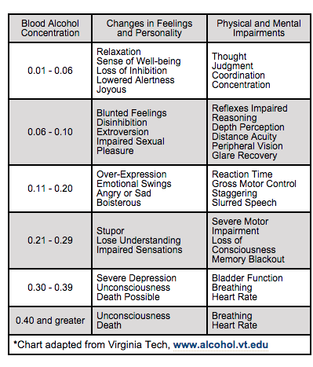
The Body and BAC
Euphoria
Lethargy
Confusion
Stupor
Coma

Slide 9

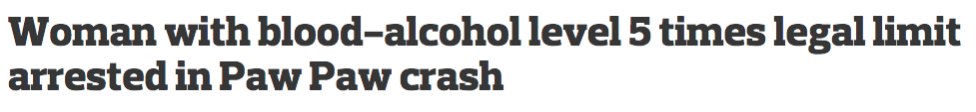
Fun Facts
Arrested for driving 55 in a
25 zone. BAC .467
BAC .39
1990’s: Polish Man steals grain alcohol from chemical plant, found dead with BAC 1.48
1982: Woman walks into UCLA ED, CAOx3 with BAC 1.33. Survived.
Notes:
http://www.thelancet.com/journals/lancet/article/PIIS0140-6736%2882%2991285-5/fulltext

Slide 10
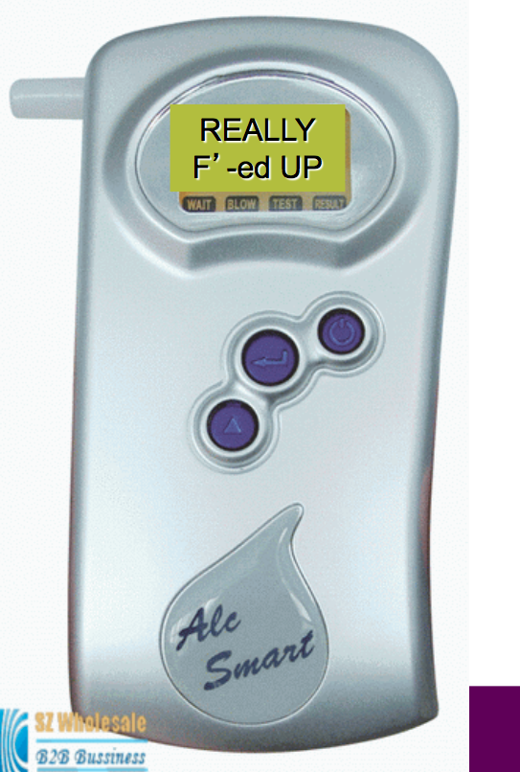

BAC Testing
Sadly, DPS doesn’t carry breathalyzers
Our assessment usually tells us
where people might be…

Slide 11
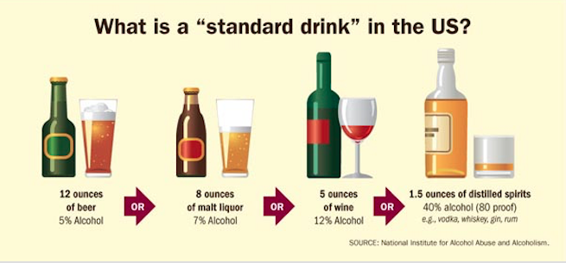
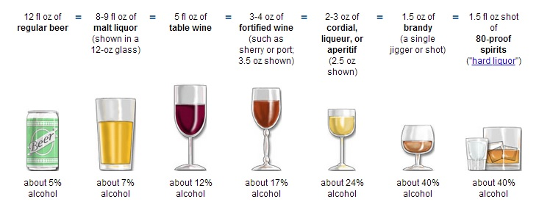
Alcohol Equivalency

Slide 12
Review: Basic assessment

Slide 13
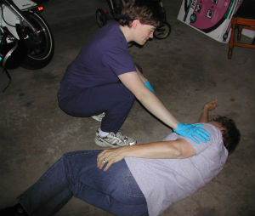
Basic Intox Assessment
CAOx3
Pertinent Negatives
Keep an eye out for trauma
SAMPLE
HOWDE
What is it?
Vitals
Always be aware for scene safety, particularly for potential behavioral/violent things

Slide 14
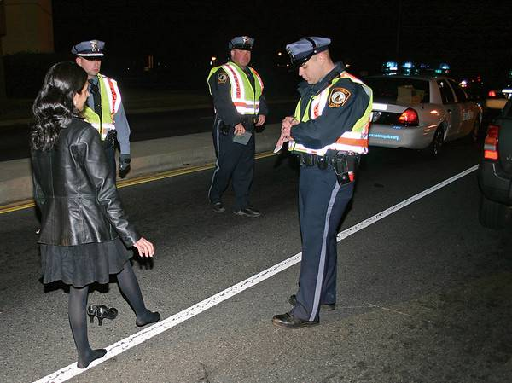
Refusing Intox
What do you need to refuse intox?
CAOx3
No recent Vomiting
Ability to Walk
Bystander present
DPS Approval!
What are the vitals ranges for refusal? (for any refusal…)
Pulse between 50 and 120
Systolic BP between 90 and 200
Respirations between 10 and 29
If you are thinking refusal, always ask age early on!!
MERT SOP’s

Slide 15
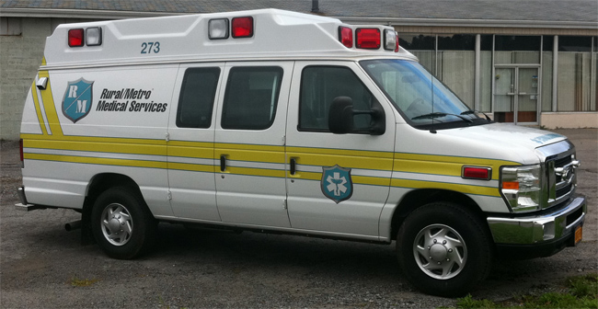

General Intox Thoughts
When in doubt, call R/MMS
Usually give 30-min buffer on vomiting
DPS can help test ability to walk
Be sure to talk with DPS before Tx decision
Usually 801s, 802s can as well!

Slide 16
Serious Intox

Slide 17
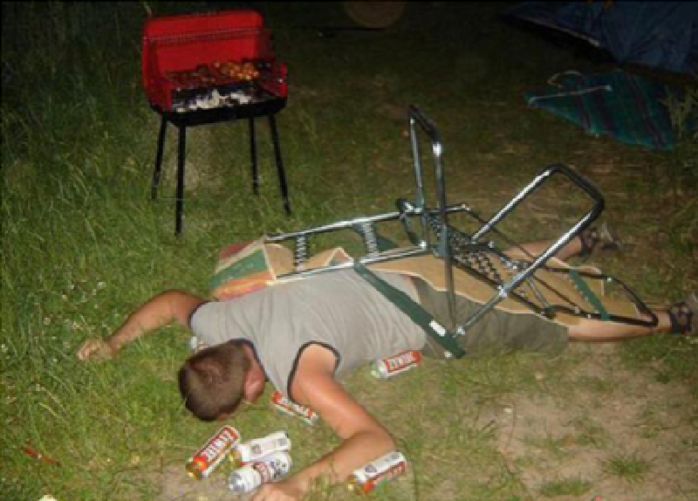


Serious Intox
When calls turn from straightforward to challenging…
Unconscious/Unresponsive
Breathing/Airway Problems
Psych/Violent Patients
Trauma

Slide 18
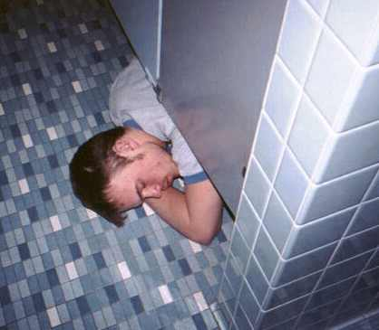
Unresponsive Patients
Patients on the verge of unresponsiveness (i.e. V or P)
Most important: Keep people talking
Ask your HOWDE/SAMPLE/OPQRST questions multiple times if needed
If your patient is lying down, try to sit them up
Better for aiway, breathing, vomiting…
Totally Unresponsive (i.e. U on AVPU)
TOTALLY unresponsive to all verbal/painful stimuli
Check ABC’s as normal
Move to LLR position if worried about vomiting, etc.
Use Pulse ox to monitor O2 sat, keep an eye on airway

Slide 19
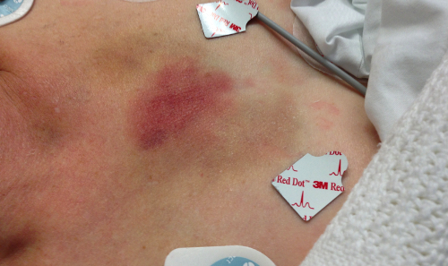
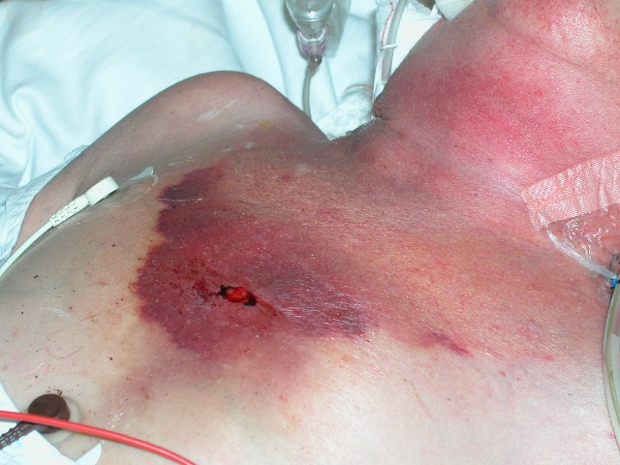
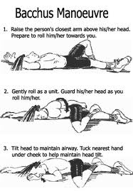
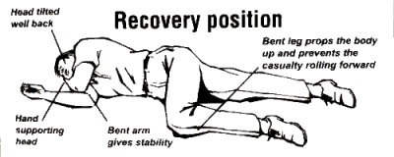
Unresponsive Patients
Sternal Rub:
LLR Position:

Slide 20
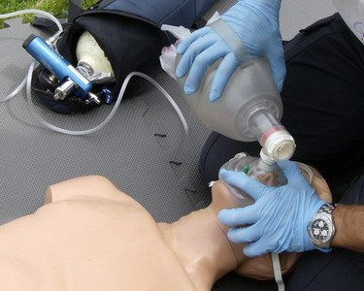
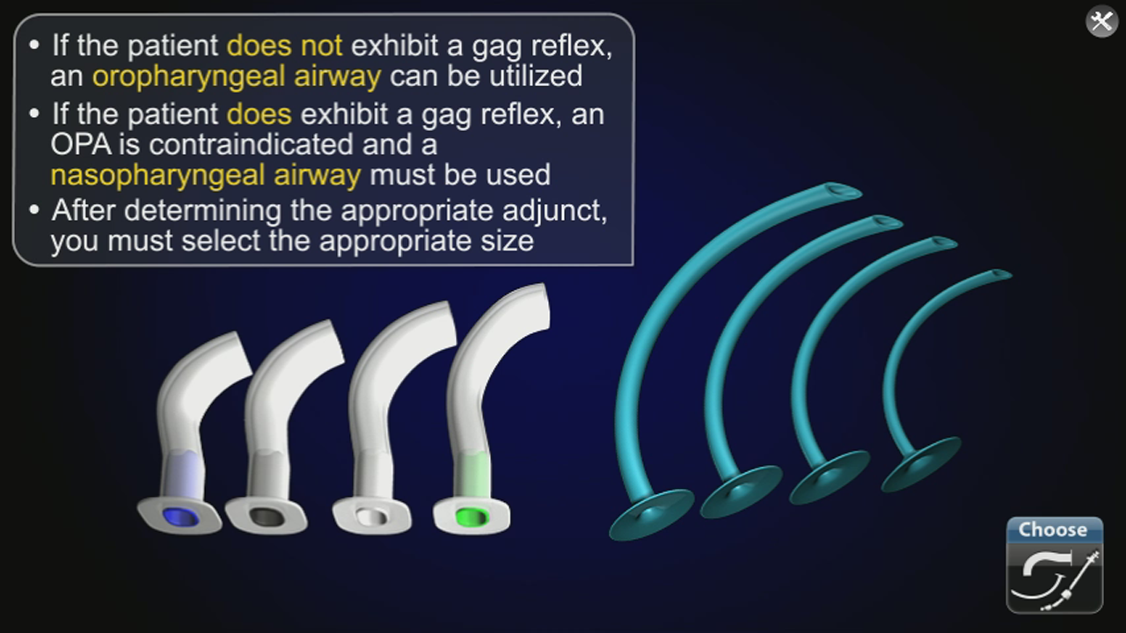
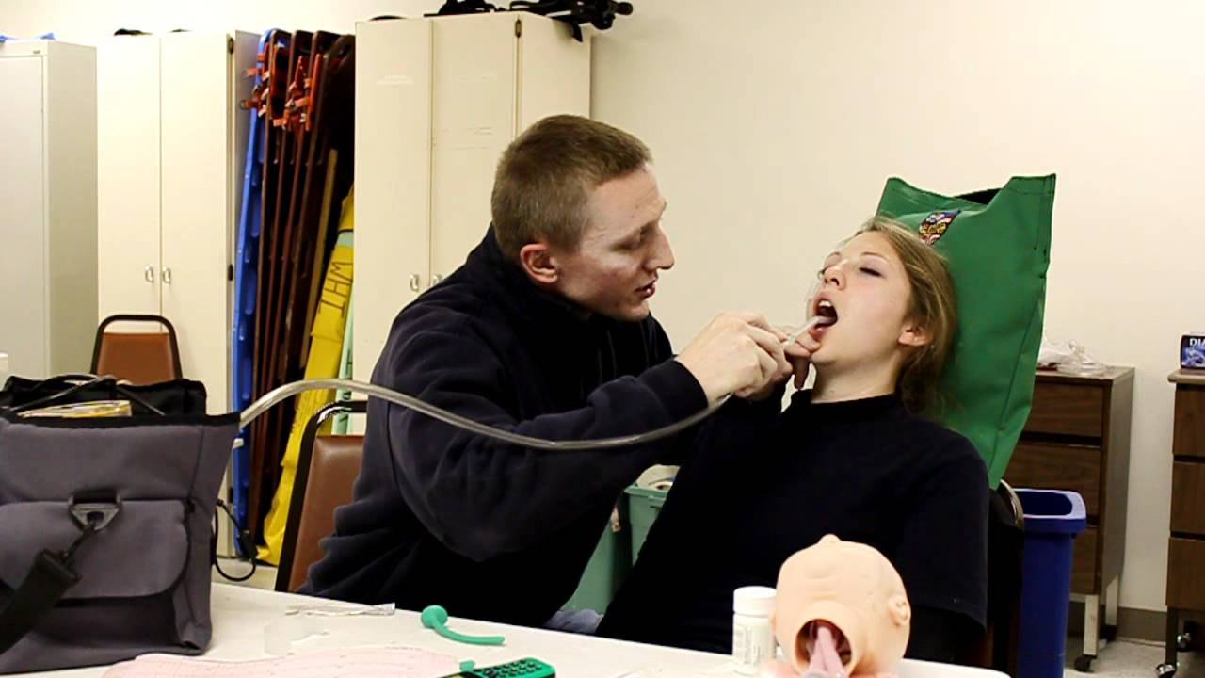
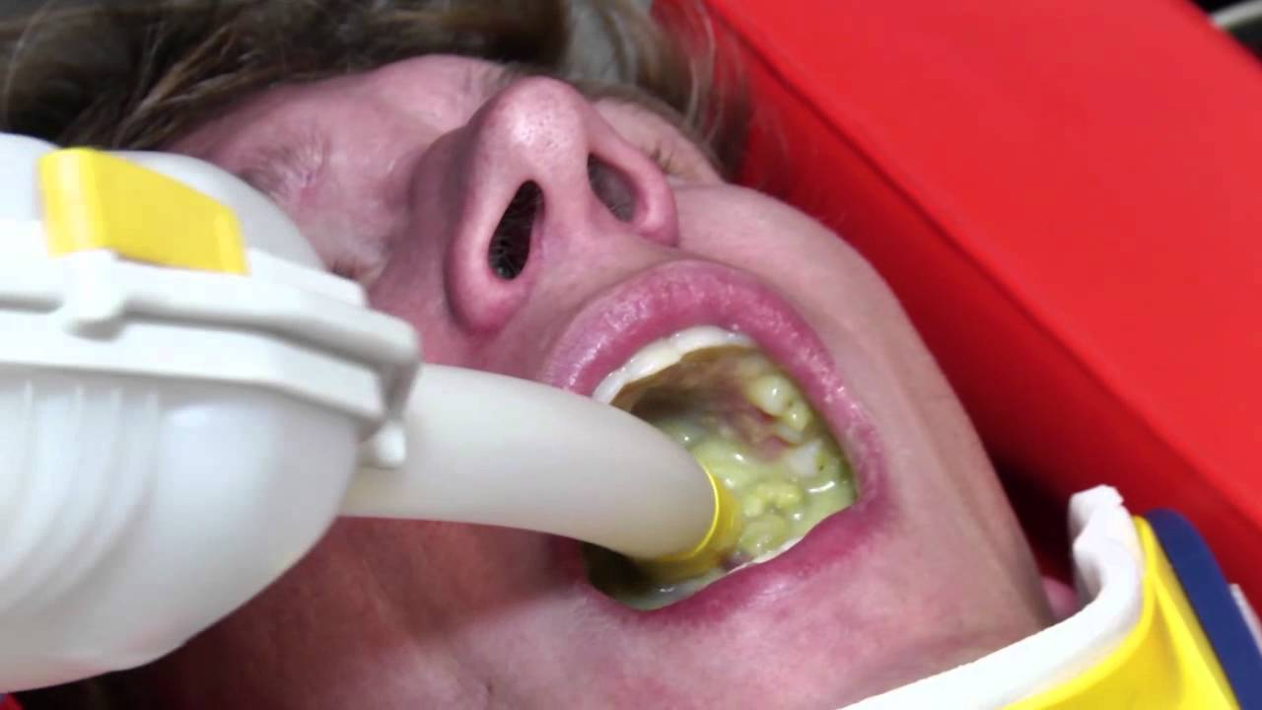
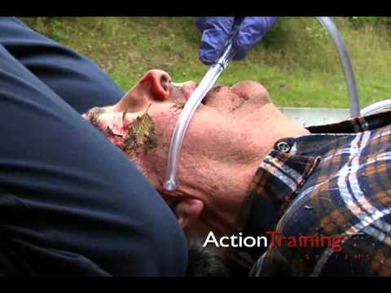
Unresponsive Patients
Apneic Patients
Airway Problems/Suction

Slide 21
Other Serious Problems
Psych/Behavioral
Intox patients sometimes double as violent/behavioral
Keep an eye out for potentially violent behavior (Scene Safety!)
Suicide/Depression: Remember our questions for potentially suicidal patients!
Other Drugs
Alcohol slows the body down, changes body’s intake of other drugs
Be thorough with SAMPLE
Trauma
Again, thorough history
Look out for falls, head/neck trauma, tingling/numbness, etc…

Slide 22
Mental Hygiene Arrest
If intox patients are violent/potential psych emergencies, DPS can perform MHA’s
Article 9.45
Mental Hygiene Law
-if the parent, spouse, or child of the person, a licensed physician, health officer, peace officer or police officer reports to him that such person has a mental illness for which immediate care and treatment in a hospital is appropriate and which is likely to result in serious harm to himself or others…
-It shall be the duty of peace officers, when acting pursuant to their special duties, or police officers, who are members of an authorized police department or force or of a sheriff's department to assist representatives of such director to take into custody and transport any such person.
Notes:
http://law.onecle.com/new-york/mental-hygiene/MHY09.45_9.45.html

Slide 23
Mental Hygiene Arrest
Basically a forced trip to the hospital
Used when DPS believes patients are a hazard to themselves or others.
For intox, usually people being violent and combative.
Also used for psych patients, forcing transport and evaluation.

Slide 24
Questions?

Slide 25
Scenarios

