Slide 1
MLREMS Drug Protocols
RC MERT 2015 Training Department

Slide 2
Medical Control Numbers
Adult Medical Control: 585-271-2769
Pediatric Medical Control: 585-756-3430
Put these numbers in your phone!

Slide 3

Talking to Medical Control
There’s a particular order in which you need to present things to Med Control
Your info (your name, your agency)
What you want (why are you calling?)
Patient’s age, gender, and chief complaint
Patient’s vitals
Any other information you think is particularly relevant
Don’t forget to get their name and ID#

Slide 4
Example Conversation
“Hi, I’m John Dorian with University of Rochester River Campus MERT. I’m looking for clearance to push epinephrine in a 21 year-old female patient with stridor and airway swelling. Her BP is 126/82, her pulse is 110, and her respiratory rate is 28.”
...(whatever they say)…
“Thank you. And what is your name and ID number?”

Slide 5
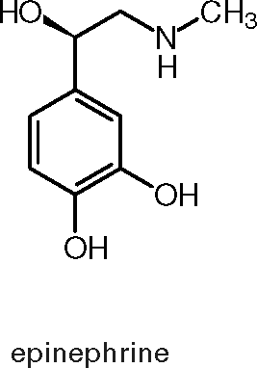
Epinephrine
Used to treat anaphylaxis
Dosages??
Adult
Pediatric

Slide 6
Epinephrine
Adult (>66ibs) 0.3mg
Pediatric (<66ibs) 0.15mg
Indications?

Slide 7
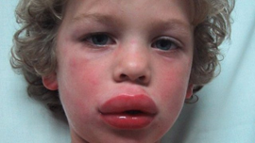
Epinephrine
Respiratory distress
Wheezing, stridor, accessory muscles, unusual lung sounds
Airway Swelling
Signs/symptoms of shock
Contraindications??

Slide 8
Epinephrine
None in the presence of anaphylaxis
Tell medical control about pregnant patient and patients with cardiac history

Slide 9
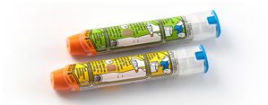
Epinephrine Administration
Patient previously prescribed Epi-Pen
Pt’s Epi-Pen on-scene
Assist pt in administering own Epi-Pen
Call Medical Control if the pt is not in critical condition
Pt’s Epi-Pen not on scene
Administer age-appropriate MERT Epi-Pen
Call Medical Control if the pt is not in critical condition
Patient not previously prescribed Epi-Pen
Contact Medical Control
WITH MEDICAL CONTROL APPROVAL, administer age-appropriate MERT Epi-Pen

Slide 10
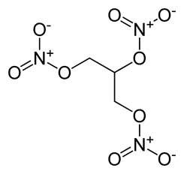
Nitroglycerin
Used to treat myocardial infarction
Dosages??
Adult
Pediatric

Slide 11
Nitroglycerin
Adult - Maximum of three doses of 0.4mg tablets
Pediatrics - Never indicated
Indications??

Slide 12
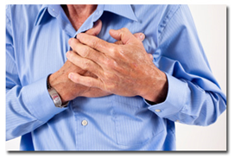
Nitroglycerin
Non-traumatic chest pain or chest pain equivalents
SOB, Nausea, Diaphoresis
Systolic BP >120mmHg
Contraindications??

Slide 13
Nitroglycerin
Systolic BP<120mmHg
Heart Rate <60
Erectile Dysfunction Medications
Cialis, Viagra, Levitra taken within the past 72 hours
Aspirin Usage with Nitro??

Slide 14
Nitroglycerin
Aspirin may be given in addition to nitro

Slide 15
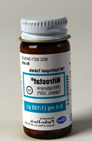
Nitroglycerin Administration
Pt must be prescribed sublingual Nitroglycerin
Medical Control must be contacted
WITH MEDICAL CONTROL APPROVAL, assist with administration of one tablet
Tablet should be placed under pt’s tongue and allowed to dissolve
Additional doses
Allowed ONLY IF systolic BP remains > 120mmHg
Allowed ONLY IF pain persists
Repeat dosage after 3 to 5 minute interval
Maximum of three doses (combination of both patient-administered and EMT-administered doses)

Slide 16
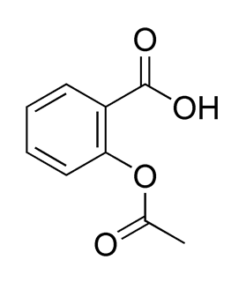
Aspirin
Used to thin blood for MI patients
Dosages??
Adult
Pediatrics

Slide 17
Aspirin
Adults - Four tablets at 81mg per tablet
Total Dose: 324mg
Pediatric - Not Indicated
Indications

Slide 18

Aspirin
Non-traumatic chest pain
Contraindications???

Slide 19
Aspirin
Allergy
Active Bleeding
GI Bleeding or Issues

Slide 20
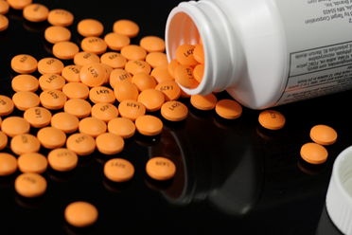
Aspirin Administration
Medical Control must be contacted prior to administration
WITH MEDICAL CONTROL APPROVAL, four tablets to be chewed and swallowed

Slide 21
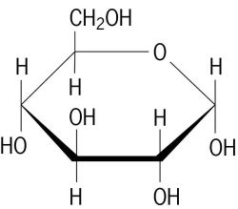
Glucose
Used to treat hypoglycemic emergencies
Dosages??
Adult
Pediatric

Slide 22
Glucose
Adult - 10-15 grams
Pediatric - same dose administered slowly
Indications??

Slide 23
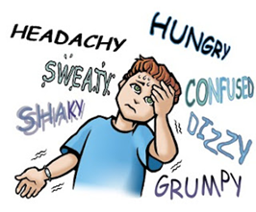
Glucose
Known history of diabetes
AMS
Pt has BG <80mg/dl or appears hypoglycemic
Contraindications??

Slide 24
Glucose
Inability to speak or swallow

Slide 25
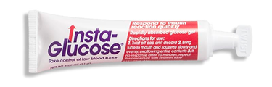
Glucose Administration
Adult
Place paste in between gum and cheek
Pediatric
Place paste in between gum and cheek
Several small administrations of paste may be used to accomplish full dose

Slide 26
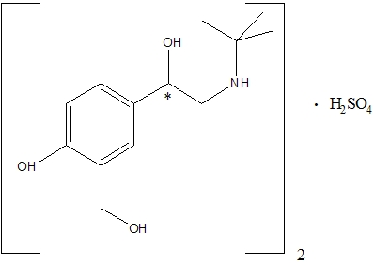
Albuterol
Used to treat respiratory distress with asthma
Dosages??
Adult
Pediatrics

Slide 27
Albuterol
Adult - 5mg nebulizer
Pediatrics (8 years old or younger) - 2.5mg nebulizer
Indications???

Slide 28
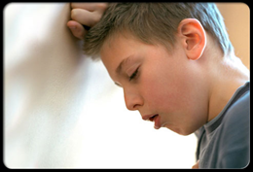
Albuterol
Signs and symptoms of respiratory distress
Patient is between 1 and 65 years of age
Patient has been diagnosed with asthma
Patient has been prescribed albuterol
Contraindications??

Slide 29
Albuterol
Patient does not meet all indications

Slide 30
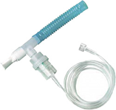
Albuterol
If patient has own inhaler / nebulizer
Assist in administration of device
If patient does not have own inhaler / nebulizer
Administer age-appropriate dose via nebulizer
Flow rate range: 4 to 6 LPM
The capsules each carry 2.5 mg
May repeat once if ALS still en route or not available
Always call Medical Control! They should be informed if pt has any cardiac history

Slide 31
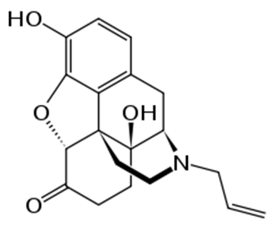
Naloxone
Competitive narcotic antagonist that reverses opioid agents - used in cases of respiratory and peripheral nervous system depression
Dosages???

Slide 32
Naloxone
Adult - 2mg IN
Which drugs does Narcan work against??

Slide 33
Naloxone
Heroin, morphine, codeine, oxycodone, methadone, vicodin, other opioids…
Indications??

Slide 34

Narcan
Respiratory depression, AMS, Pinpoint pupils in combination
Suspected OD on opioids, not responsive to painful stimuli, no or gasping breathing
Contraindications

Slide 35
Narcan
None, this patient is dying

Slide 36
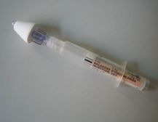
Naloxone Administration

Slide 37
Naloxone Administration
1 mg in each nostril via Mucosal Atomization Device
Take off yellow caps on holder
Take off purple medication cap
Open atomizer and attach it to holder
Screw medication into holder
Direct atomizer posteriorly (not toward the top of the head)
Squeeze hard enough to atomize and squeeze until half of the contents are gone
Go to the other nostril and repeat administration

Slide 38
VIDEO!!!!

Slide 39
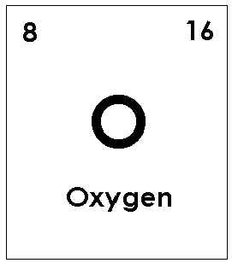
Oxygen
Used to supplement pt’s respirations
Dosage??

Slide 40
Oxygen
Administer appropriate amount for the situations
Indications??

Slide 41
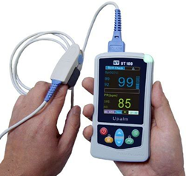
Oxygen
Oxygen saturation below 94%
Precautions???

Slide 42
Oxygen
COPD patients
NC should not be used with more than 6lpm
NRB must have a minimum of 12lpm

Slide 43
Oxygen Administration
4 ways to administer oxygen??

Slide 44
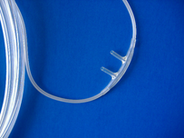
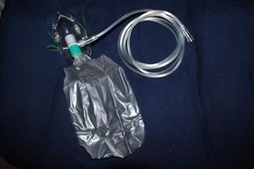
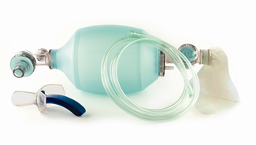
Oxygen Administration
NC flow rate 4-6lpm
NRB 12-15lpm
Nebulizer 6-8lpm
BVM 12-15lpm

