Slide 1
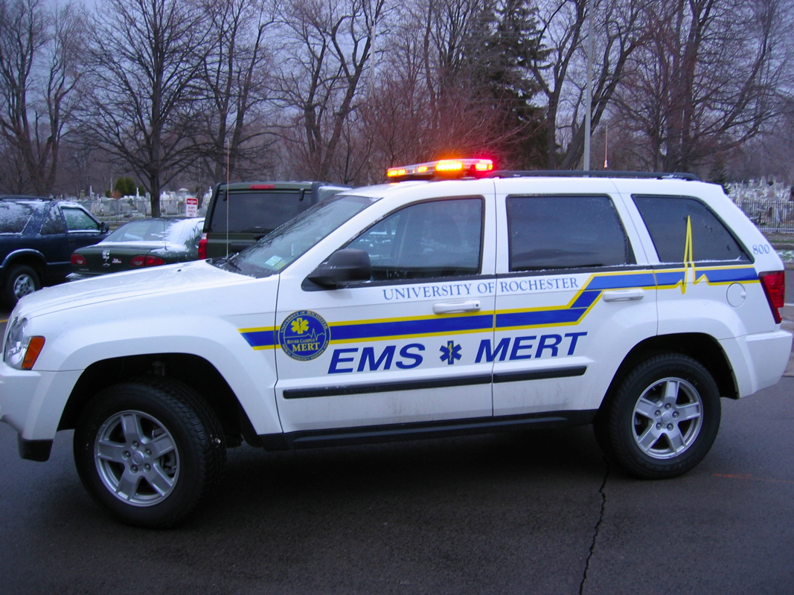
New Member Orientation Program
2012
Welcome!

Slide 2
Contact Info
Birx Allen
Director of Training
E-Mail:birx.allen@gmail.com
Alex Sundermann
Assistant Director of Training
E-Mail: asunderm@u.rochester.edu
Phone: 412-915-1202
Our job is to help you. Help us help you.

Slide 3
What is R/C MERT?
Medical Emergency Response Team
State-certified, non-transport agency
Provides Basic Life Support (BLS) to University of Rochester River Campus
24/7 coverage of UR’s River Campus
  Day shifts (0800-2000)
  Night shifts (2000-0800)

Slide 4
Ranks
801 / Crew Chief
  In charge of the crew
  Legally responsible for the call
  Must be a NY state EMT
802 / Crew Chief Trainee
  Training to be an 801
  Must be a NY state EMT
  “Runs” call
803 / You (for now…)
  Assists the 801 and 802
  Certified in CPR
  Takes vitals, sets up O₂, fills out PCR

Slide 5
E-Board Functions
Weekly meetings (open to the general membership)
Elected annually in February
Specific Jobs
  DO – Directs organization as a whole, operational functions
  ADO – Assists the DO, chairs disciplinary committee, acts as Exposure Control Officer
  DOT + ADOT – In charge of training, training events
  QA/QI Chairperson – In charge of auditing the organization’s paperwork for consistency and quality
  Webmaster – In charge of the website and scheduling
  Equipment Manager – Organizes equipment, restocks
  Public Relations Officer –Publicizes MERT, Public Image
  Secretary – In charge of the application process, paperwork, and meeting minutes

Slide 6
E-Board (cont.)
We want YOU on the E-Board
Don’t be afraid to run because you’re a freshman/sophomore/new
We want voices representing the 803s, the new members, people of each class year
If in February you *want* to do it and think you *can* do it, GO FOR IT!!

Slide 7
General Membership Meetings
There are GMMs bi-weekly (every other week)
  Attendance is MANDATORY
  Contact the SECRETARY (Adam) if you can not attend
  Missing multiple meetings without a valid reason will result in disciplinary action
Usually around 30 minutes, but can be longer if there is a special event
Meetings Include:
  Officer Reports
  Current MERT events / issues
  Necessary Training (in-services)

Slide 8
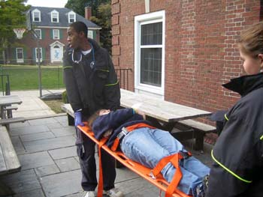
Night Shifts
Time: 2000-0800 (8:00PM – 8:00AM)
Every night of the academic semester
Night crews meet at the UHS office at 2000
Equipment return
  0800: most 801s will return
  equipment at this time
  2000: can always return at
  next night shift
  Other time worked out with 801

Slide 9
Shift Requirements
803s : required to take 1 shift per month
802s : required to take 2 shifts per month
  One weekend, one weekday
  Also required to fill the schedule, but usually enough for everyone to take 2 a month
801s : required to fill the schedule (fun)
  Usually amounts to around 4 shifts per month
  Depends on the number of current crew chiefs

Slide 10
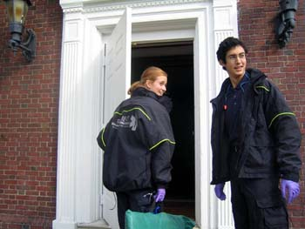
Shift Uniform
Shirt: new! MERT uniform
Pants: Blue pants
  NO JEANS (seriously!)
  EMT pants are nice, but not required
Shoes: closed-toed and close-heeled. Preferably black.
MERT jackets are available for sign-out while on shift
Fleeces available after membership for 3 semesters

Slide 11
Website Use
www.rochester.edu/mert
PowerPoint describing website use
  Can be found on the site under the Training tab
  Review it. Do it
Any questions or problems should be directed to Ally Abel- Webmaster
**Sign on and set up your account before the next class**

Slide 12
Reminders for NEXT SESSION:
Bring schedule for next class so we can schedule a checkout observation
Bring a wristwatch with a second hand
Review campus map (copies will be distributed)

