Slide 1
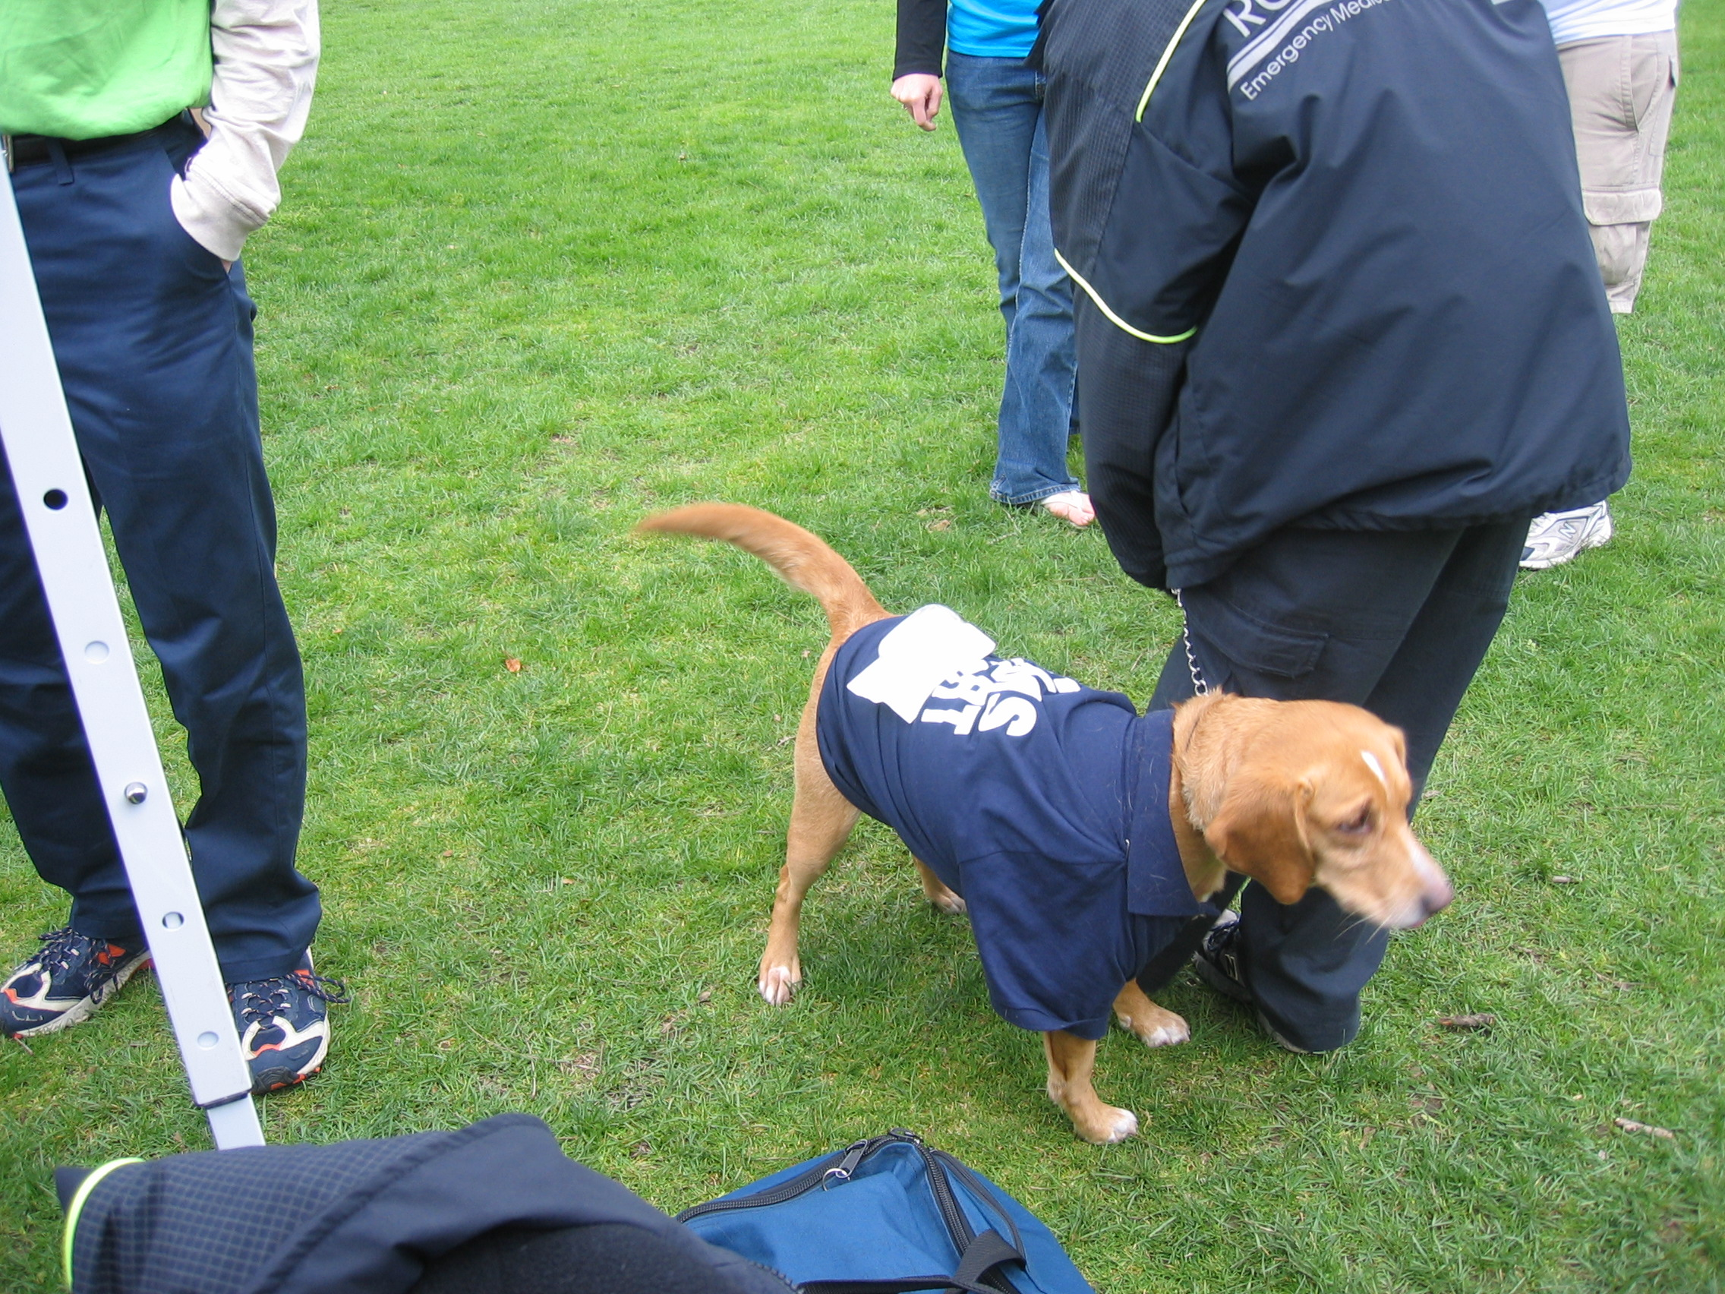
PCRs, Scene Safety, BSI, and Bleeding Control
New Member Orientation Program 2012, Lesson IV

Slide 2
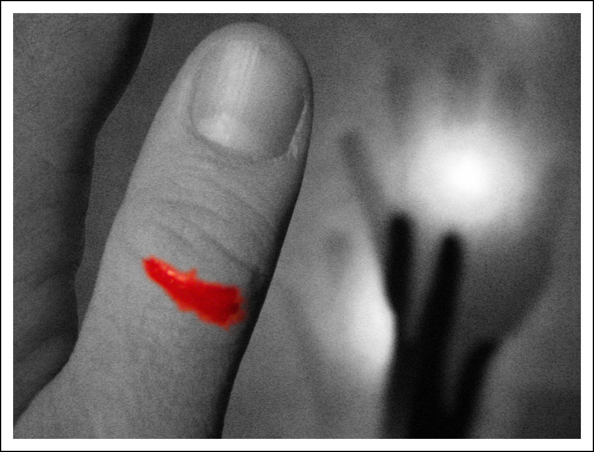
SCENE SAFETY, BSI, BASIC BLEEDING CONTROL

Slide 3
Objectives
Understand importance of scene safety
Understand importance of Body Substance Isolation in regards to blood
Recognize types of bleeding
Learn how to control a basic bleed
Practice bleeding control

Slide 4
Scene Safety
BEFORE ENTERING A SCENE, YOU MUST DETERMINE THAT THE SCENE IS SAFE.
Failure to do so can lead to personal danger for yourself and the rest of your crew
Usually Security will beat you to the scene, they are typically the biggest factor in assuring safety
However, do not assume because Security is there that the scene must be safe
Mentally evaluate each scene before walking in and beginning procedures

Slide 5
Body Substance Isolation
Referred to as “BSI”
Blood, open wounds, or any bodily fluid poses a high risk of infection to everyone
Protection via gloves and masks is paramount before treating any bleed, or before moving on to a second patient
After a call involving any bodily fluid (especially blood), WASH YOUR HANDS WELL TO BE SAFE!

Slide 6
Bleeding
Major cause of shock in patients
If too much blood is lost (internal or external loss) an insufficient blood volume is available to provide cells and tissues with nutrients and oxygen, this is SHOCK
Brain, kidneys, and spinal cord are most sensitive to this loss of blood
Shock leads to death
Death is bad

Slide 7
Types of External Bleeds
Arterial Bleed (from the arteries)
  Most difficult bleed to control
  Bright red in color
    Still oxygen-rich, coming from the heart
  Rapid spurts of blood
    Under high pressure

Slide 8
External Bleeds (Cont.)
Venous Bleed (from the veins)
  Dark red / maroon in color
    Deoxygenated blood going back to the heart
  Steady flow of blood
    Low pressure
    Easier to control for this reason
  The Bigger Problem: since pressure is so low, pressure in the vein may be lower than atmospheric pressure and suck air into the vein (embolism)
    This type of sucking wound can be fatal
    Venous bleed in neck is especially dangerous

Slide 9
External Bleeds (Cont.)
Capillary Bleed (from the capillaries)
  Mixture of bright red and maroon blood
  Slow and oozing flow of bleed
    Capillaries are small blood vessels under low pressure, hence the color and flow speed
  Considered a minor bleed and easy to control
  Can easily become infected

Slide 10
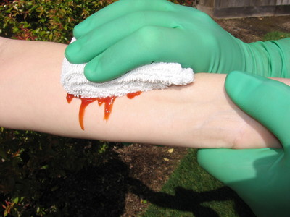
Controlling an External Bleed
DIRECT PRESSURE:
Apply direct pressure with the appropriate equipment, such as a 4x4 gauze pad.

Slide 11
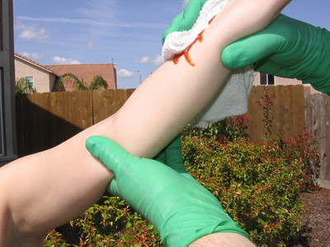
APPLY MORE: If the wound continues to bleed, apply another gauze pad. (Do not remove old gauze)
ELEVATION:
Elevate the bleeding area above the heart.

Slide 12
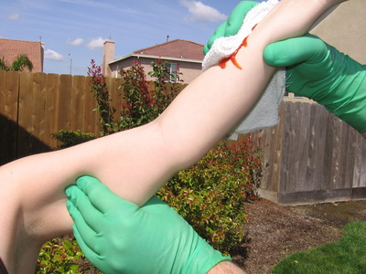
ARTERIAL PRESSURE: If the bleeding continues, apply pressure to the closest artery to the wound that’s between the bleed and the heart (this is only for extremity bleeds.)
BANDAGE: Bandage the dressing in place.

Slide 13
Very Important
Once you apply a gauze pad to a wound, DO NOT REMOVE IT!
  Bleeding ultimately stops because our bodies form a blood clot
  Many times, this clot may adhere to the gauze
  Removing the gauze may also remove the clot, and thereby initiate bleeding again
  Also, hospitals can estimate blood loss by the amount of blood in the gauze

Slide 14
Practical Application
Practice what you have learned in this presentation
Control a “bleed” to the wrist
Control a “bleed” to the thigh
Don’t forget scene safety!

Slide 15
PATIENT CARE REPORT
OR
PREHOSPITAL CARE REPORT

Slide 16
Pre-Hospital Care Report
Objectives of this Lesson
  Learn what a PCR is
  Learn what aspects of it pertain to the medic assistants (you)
  Learn how to properly fill out a PCR

Slide 17
What is a PCR?
Legal documentation of what went on during a call
Contains patient demographic information such as name, address, SS#, etc.
Medical Aspects:
  Vital signs, patient condition, patient’s medical history, what happened to the patient, what medics did to the patient on the call, etc.

Slide 18
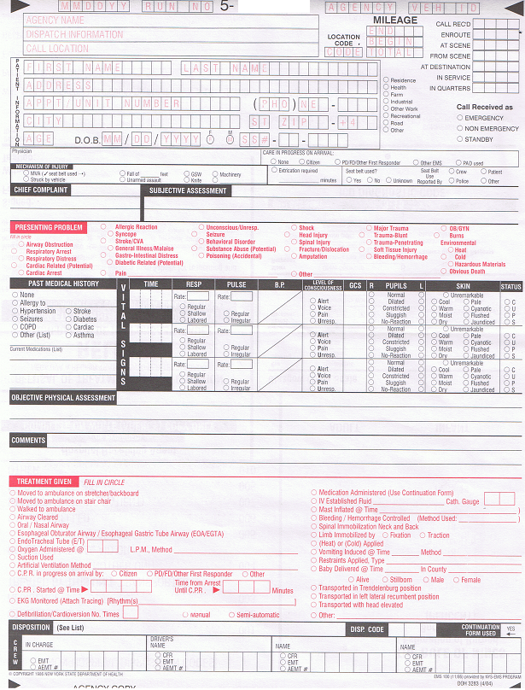
This is the PCR which MERT uses on every call
Medic assistants are responsible for only two areas:
  Demographics (top left)
  Vital Signs (middle)

Slide 19
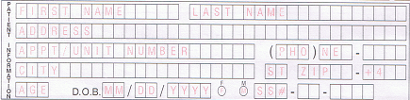
Patient Demographics
EVERYTHING MUST BE FILLED OUT IN CAPITAL LETTERS!
FILL OUT:
First name and last name
Address (CPU Box if possible)
Phone number (dorm phone number if possible)
City, state, zip code
Age, DOB, gender (make sure age matches DOB!)
Social Security number if possible (if not possible, zero-fill the boxes)

Slide 20
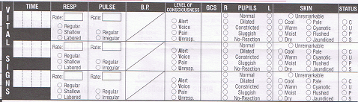
Vital Signs
Time
Pulse
LOC
Pupils
Skin
Status
Respirations
Blood Pressure
Glasgow Coma Scale

Slide 21
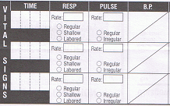
Vital Signs Pertaining to You
Fill out time (remember to use MILITARY TIME)
Fill out respiratory rate (quality may be accessed and filled out by 801 or 802)
Fill out pulse (quality may be accessed and filled out by 801 or 802)
Fill out blood pressure (systolic over diastolic)

Slide 22
Documentation
Fill in ALL boxes!!!
Ages need to span all three boxes
  Ex. 20 years old will be written as “020”
Time is in MILITARY TIME
  9:50 PM = 2150
  10:00 PM = 2200
  Seriously, MILITARY TIME

Slide 23
Real Life Experience
Since practice makes perfect, fill out a PCR for 3 other students
  Take demographic information
  Take pulse, respiratory rate, and BP
  Keep the PCRs for your own future reference!

Slide 24
EMS Charts
Online database containing calls with patient records, reports, and information
Less paperwork!
R/C MERT will be implementing this system near the end of the semester
You will no longer see PCRs after this new system is in
You DO NOT have to fill these out as an 803, but we would like you to get acquainted with the system

Slide 25
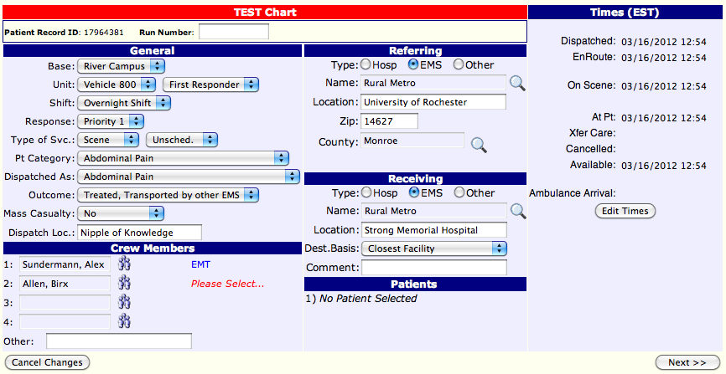
Dispatch Info
For now, this is all you will see

Slide 26
Reminders
Review for final NMOP test by reviewing all PowerPoints, Campus Map, and everything else you learned

