Slide 1

Sanuja Bose
August 26, 2015
RC MERT Training Week 2015

Slide 2
Objectives
1. Defining psychiatric/behavioral emergencies
2.Understanding some basic background on psychiatric disorders
3. Reviewing how to treat patients having some of the more common behavioral/psychiatric emergencies you see on a college campus
4. Successfully clearing scenarios

Slide 3
What is a Psychiatric Emergency?
“A situation in which a patient cannot refrain from acting in a manner that is dangerous to himself or herself or to others.” – Psychiatric Times 2010
“Behavior that threatens a person's health or safety and the health and safety of another person.” – Jones & Bartlett Learning 2013

Slide 4
What is a Behavioral Emergency?
“Some disorder of mood, thought, or behavior that interferes with activities of daily living.”– Jones & Bartlett Learning 2013
“A situation in which a patient’s behavior becomes so unusual, bizarre, threatening, or dangerous that it alarms the patient or family.” – Health Training Network
“Abnormal or atypical behavior that is unacceptable in a given situation with the potential that serious harm is imminent.” – Brady Emergency Care
“Behavioral emergency” and “psychiatric emergency” are sometimes used interchangeably, but are not synonymous.

Slide 5
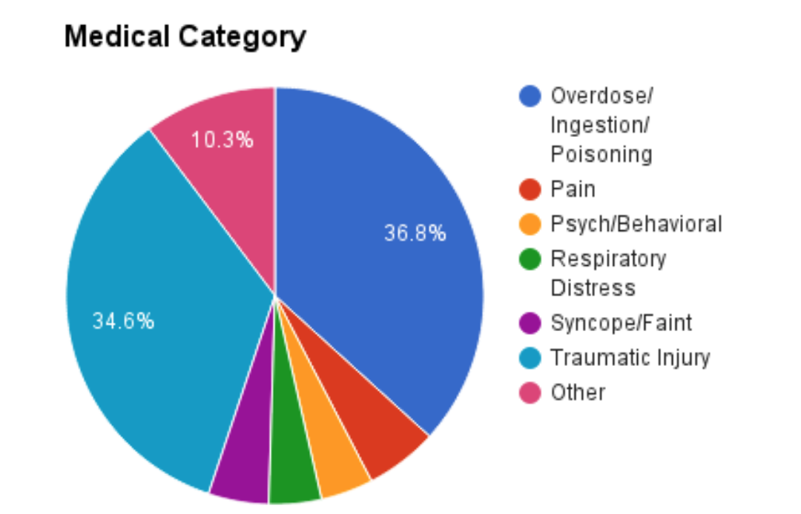
MERT’s Psych/Behavioral Calls
4%

Slide 6

Psychiatric Disorders
Account for ~25% of disability in the U.S.
“Common” Psychiatric Disorders
Depression
Anxiety Disorders
Posttraumatic Stress Disorder (PTSD)
Schizophrenia
Bipolar Disorder

Slide 7
Depression and Suicide
“In 2011… a nationwide survey of college students at 2- and 4-year institutions… found that about 30 percent of college students reported feeling ‘so depressed that it was difficult to function’ at some time in the past year.”
– National Institute of Health
In Fall 2011, more than 6% of college students reported seriously considering suicide
1% reported attempting suicide in the past year
Suicide is the third leading cause of death for teens and young adults, ages 10-24
Top three methods of suicide in young people: firearm (45%), suffocation (40%), poisoning (8%) (CDC 2015)
Men are more likely to die from attempted suicide (81% of deaths were males; 19% were females)

Slide 8
Anxiety Disorders
Generalized Anxiety Disorder
When anxiety regularly and significantly interferes with an individual’s life
Panic Disorder, Acute Stress Disorder
Different from normal fear and anxiety; more severe, prolonged, and often strikes without reason/warning
Behavioral Responses
Patient feels a loss of control, threatened, or as if he or she is going to die
Panic attack!

Slide 9
Panic/Anxiety Attacks
Abrupt onset of crippling fear or discomfort
Look for a combination of the following symptoms:
Tachycardia, palpitations, etc.
Hyperventilation
Diaphoresis
Dizziness
Trembling or shaking
Tetany/curled fingers
Shortness of breath
Chest pain or discomfort
Nausea or stomach pain
Paresthesia (numbness or tingling)
Fear of dying
Avoid tunnel vision! The aforementioned symptoms are obviously not exclusive to anxiety disorders
© Anxiety and Depression Association of America (ADAA), 2010-2015

Slide 10
Posttraumatic Stress Disorder (PTSD)
“A serious potentially debilitating condition that can occur in people who have experienced or witnessed a natural disaster, serious accident, terrorist incident, sudden death of a loved one, war, violent personal assault such as rape, or other life-threatening events.”
Flashbacks can cause panic attacks
© Anxiety and Depression Association of America (ADAA), 2010-2015

Slide 11
Sexual Assault
Affects nearly 1 in 5 women in the U.S. (CDC, 2012)
Approximately 11.5% of the 6 million women who currently attend undergrad in the U.S. have been raped
Survivors may suffer from:
PTSD (as many as 65%)
Depression (as many as 51%)
General Anxiety Disorder (as many as 40%)
© Campbell et al., 2009

Slide 12
Schizophrenia
1% of Americans have this illness
Look for the following symptoms:
Hallucinations (hearing, seeing, smelling, feeling things that are not there)
Delusions (false, unchangeable beliefs)
Thought disorders (unusual or dysfunctional ways of thinking; garbled speech; thought blocking)
Movement disorders (agitated body movements; repeated motions)
© Anxiety and Depression Association of America (ADAA), 2010-2015

Slide 13
Bipolar Disorder
Also known as “manic-depressive illness”
Affects men and women equally
Mood cycling begins between ages of 15-25
Causes unusual shifts in mood, energy, activity levels, and the ability to carry out daily tasks
Manic episode – overly joyful or overexcited, often with irritability
Depressive episode – extremely sad or hopeless state

Slide 14
Common Medications
Disorder | Common Medications
Depression | Prozac Zoloft Lexapro Celexa Cymbalta Wellbutrin Viibryd
Anxiety | Xanax Valium (diazepam) Klonopin Ativan Cymbalta Lexapro
Schizophrenia | Thorazine Haldol
Bipolar Disorder | Tegretol Depakote Lithium Lamictal
Some overlap. Ask your patient what their medication was prescribed for.

Slide 15
Altered Mental Status
Cause | Examples
Vital sign abnormalities | Shock, hypoxia, hyperthermia, hypertension
Toxic/metabolic | Intox, hypoglycemia, uremia, hyponatremia (⬇ Na⁺)
Structural | Intercranial hemorrhage, acute stroke
Infection | Sepsis, central nervous system infections
Psychiatric | Dementia, delirium, psychosis, mood disorders, etc.
J. David Ritchie, MD (Journal of Emergency Medical Services,2015)

Slide 16
Altered Mental Status
Alcohol
Epilepsy
Insulin
Overdose
Uremia
Trauma
Infection
Psychiatric/Poisoning
Stroke/Shock

Slide 17
Working with Psychiatric Emergency Patients

Slide 18
General Actions and Precautions
Scene safety is always #1
Be alert for changes in behavior (i.e. calm to violent)
Be alert for weapons/items that can be used as weapons
Have family members, friends, bystanders leave the room if the patient is agitated by their presence. Alternatively, have one of aforementioned persons stay in the room if that person is calming the patient
Always be in a position where you can easily retreat/have Public Safety take over

Slide 19
Patients with Suicidal Ideation
SCENE SAFETY
Introduce yourself. Ensure the pt. is CAOx3
Be kind and non-judgemental. Do not talk down to the patient. Establish rapport. Maintain eye contact at eye level
ABCs – look for physical injuries that might need attention
Patient history – ask about hx of depression, anxiety, suicide attempts, or other psychiatric illnesses
If the pt. has depression/another psychiatric condition, ask about medications
Ask if they are actually taking their medication as prescribed
Inspect the scene for evidence of alcohol, drug paraphernalia, and pill bottles
Ask the roommate for any additional information (atypical behavior, etc.)
If your patient expresses suicidal thoughts, or has attempted suicide, they must be mental hygiene arrested (MHA’d)

Slide 20
Mental Hygiene Law
According to the NYS Office of Mental Health:
Admission Standard | Who Evaluates at the Hospital Before Admission | Who Confirms | Duration of Hospital Stay
Emergency Standard: reasonable cause to believe that the person has a mental illness for which immediate observation, care and treatment in a hospital is appropriate and which is likely to result in serious harm to him/ herself or others. "Likelihood of serious harm" means: a substantial risk of physical harm to the person as manifested by threats of or attempts at suicide or serious bodily harm or other conduct demonstrating that the person is dangerous to him/herself (See reverse #6). Or a substantial risk of physical harm to other persons as manifested by homicidal or other violent behavior by which others are placed in reasonable fear of serious physical harm. | Staff MD must examine and determine that the person meets the Emergency Standard. | Staff psychiatrist must, within 48 hours after admission, examine the patient and confirm the first MD’s finding that the patient meets the Emergency Standard. | Up to 15 days.** Patient may be held involuntarily beyond 15 days if he/she meets the Involuntary Standard and is converted to a §9.27 involuntary admission.
Comprehensive Psychiatric Emergency Program (CPEP) Emergency Same description as above. | Staff MD of C.P.E.P. must, within 6 hours after the person is received in the C.P.E.P emergency room examine and determine that he/she meets the C.P.E.P. Emergency Standard. | Staff psychiatrist must, within 24 hours after the patient is received in the C.P.E.P. emergency room, examine the patient and confirm the first MD's finding that the patient meets the C.P.E.P. Emergency Standard. | Up to 72 hours (after which the patient must be discharged from C.P.E.P.). ** Patient may subsequently be held involuntarily if he/she meets the Involuntary Standard or Emergency Standard.

Slide 21
Signs of Risk for Suicide
Verbal
Pt. explicitly says he/she wants to kill him/herself
Pt. talks about wanting to die
Pt. talks about feeling hopeless or having no reason to live
*Straightforwardly ask a pt. if he or she has had thoughts about hurting him or herself.*
Physical/Environmental
Pt. has self-inflected cuts
Knives, razors, empty pill bottles, etc.
Friend/Roommate
Ask if he or she has witnessed any atypical behavior
Ask if he/she witnessed the pt. taking any pills, harming him/herself, sleeping for unusually excessive amount of time, etc.

Slide 22
What NOT Say to a Suicidal Patient
“I’ve been exactly where you are.”
“Only cowards commit suicide.”
“Considering suicide is selfish.”
“You are so young. Your whole life awaits you!”
“Think of how much you would hurt your family and friends.”
“It’s all in your head.”

Slide 23
Sexual Assault Patients
Do both a physical and mental assessment
Check for abrasions, bruises (upper limbs, head, neck in particular)
May have pain or bleeding from vagina/rectum, but may not want you to get near those areas because of what just occurred – respect that
Listen to your patient calmly and kindly
Remind your patient that the assault was not his/her fault
Ask whether he or she is having thoughts about hurting him/herself
You are not required or allowed to report – it is the patient’s decision
Transport

Slide 24
Patients Experiencing a Panic Attack
Be calm and speak calmly
Do not overcrowd the patient with your crew and massive amounts of equipment
Coach them in breathing
Slowly breathe in and out along with them
Say it verbally and do it physically
Question: When do you give hyperventilating patients oxygen?

Slide 25
Conclusion
The safety of you and your crew comes first
Any patient that is a danger to him or herself or to others must be MHA’d
Avoid having tunnel vision when dealing with behavioral emergencies or AMS
Don’t administer oxygen to people who are hyperventilating – be a breathing coach instead
Never judge or look down on a patient, regardless of his or her thoughts or actions
If a call has been particularly upsetting to you as an EMS provider, remember that your crew is a support system

Slide 26
Scenario #1
Dispatch: 18-year-old female having a panic attack.
Outcome: Pt. has history of panic attacks; does not know what caused this one; takes Klonopin, but stopped (without physician recommendation) two weeks ago.
Vital Sign | Result
Heart Rate | 110 bpm
Blood Pressure | 130/90 mmHg
Respiratory Rate | 26 breaths/min.
Skin Condition | Warm, pale, diaphoretic
Oxygen Sat. | 95%

Slide 27
Scenario #2
Dispatch:
22-year-old male throwing furniture around his room.
Outcome: Scene is initially not safe. Pt. has anger management problems but no known psychiatric disorder. Pt. mutters something about wanting to kill his girlfriend o.o
Vital Sign | Outcome
Heart Rate | 130 bpm
Blood Pressure | 150/100 mm Hg
Respiratory Rate | 18 breaths/min.
Skin Condition | Warm, good color, sweaty
Oxygen Sat. | 98%

Slide 28
Scenario #3
Dispatch:
20-year-old male whose wrists are bleeding.
Outcome: Pt.’s wrists are bleeding profusely. Upon further inspections, pt.’s thighs are also found to be bleeding. He has a history of depression, and takes Zoloft as prescribed. He previously attempted suicide a year ago, on the same date.
Vital Sign | Outcome
Heart Rate | 140 bpm
Blood Pressure | 90/60 mmHg
Respiratory Rate | 18 breaths/min.
Skin Condition | Warm, sweaty, good color
Oxygen Sat. | 98%

Slide 29
Scenario #4
Dispatch:
21-year-old female who has experienced unwanted touching.
Outcome: Pt. is CAOx1. She complains of someone repeatedly touching her without her permission, and also someone incessantly whispering in her ear. Pt. is hallucinating due to her schizophrenia. Pt. takes medication for it.
Vital Sign | Outcome
Heart Rate | 100 bpm
Blood Pressure | 130/80 mmHg
Respiratory Rate | 16 breaths/min.
Skin Condition | Warm, dry, good color
Oxygen Sat. | 100%

Slide 30
Scenario #5
Dispatch:
17-year-old male experiencing extreme confusion and incoherent speech (altered mental status).
Outcome: Pt. is CAOx1 and sounds as if he is hallucinating. Pt. has not eaten in 40 hours due to an eating disorder.
Vital Sign | Outcome
Heart Rate | 150 bpm
Blood Pressure | 140/90 mmHg
Respiratory Rate | 12 breaths/min.
Skin Condition | Warm, diaphoretic, pale
Oxygen Sat. | 96%

Slide 31
Scenario #6
Dispatch:
18-year-old female who has not gotten out of bed for 48 hours (according to her roommate).
Outcome: Pt. is CAOx3 (at the beginning), kind, and cooperative. Pt. is suicidal, but avoids questions about the matter with silence or unrelated answers. Pt. does not state that she has depression because it is undiagnosed, and she takes no prescribed medication. Pt. took 4000 mg ibuprofen a half hour before MERT’s arrival to get rid of “the pain.”
Vital Sign | Outcome
Heart Rate | 60 bpm
Blood Pressure | 80/60 mmHg
Respiratory Rate | 10 breaths/min.
Skin Condition | Warm, dry, slightly pale
Oxygen Sat. | 94%

