Slide 1

PCRs
How to write them
How to not get sued because you wrote them

Slide 2
Overview
The PCR
The Narrative and its parts
Abbreviations

Slide 3
The PCR
Always ensure that all fields in the PCR are filled.
The consistent fields:
  Run number (obtained from the database)
  Agency Number: 002789
  Vehicle ID (e.g. 000800, GEMS12)
  Location Code: 2701
Zero fill all fields with no information
  This does NOT include vital signs, call times, or any of the fields above
  Exception: Vehicle ID if responded on foot or at standby

Slide 4
The PCR
Fields to always leave blank
  Mileage
Remember to cross out (if not used):
  Extrication required, Seat belt used, MOI, unused vital sign rows
If there is more than one presenting problem, ensure that you note which is the primary complaint
Under our treatment given, “Other” will always be filled with “ABCs, vital signs, history taken and monitored”

Slide 5
The PCR
PCR Numbers
  The PCRs are no longer printed with numbers, so there is a running tally in the office
  The correct number is the last number written plus 1
    For example, if 5-000011 is the last number on the paper, write 5-000012 on the paper and on your PCR
  When you hand in your PCR, make sure your 801 “signs in” the PCR

Slide 6
The PCR
Chief Complaint
  Usually the first thing the patient says when you arrive on scene
  Written in “quotation marks”
    E.g. “I’m fine” or “I fell and hit my head” or “Your gloves are too rubber”
  If patient was unconscious/unresponsive, note this
  Any Questions?

Slide 7
The Narrative and its Parts
SOAPE
  Subjective Assessment
  Objective Assessment
  Assessment
  Plan
  Everything Else

Slide 8
Subjective Assessment
What goes here:
  Everything you see, hear, and suspect as a witness to the scene
    Subjective=Things you cannot prove with physical evidence
  Information from SAMPLE goes here
  Information from OPQRSTI goes here too if applicable
  Information from HOWDE goes here
  Pertinent negatives
      Always ask about falling, loss of consciousness, hitting head, head/neck/back pain, shortness of breath or difficulty breathing, chest pain, and N/V/D (nausea, vomiting, diarrhea)
      Other negatives relevant to the condition at hand
        Is it possible you might be pregnant? When was your last period?

Slide 9
Subjective Assessment
Example:
  AOSTF 20 y/o female sitting in a chair. Pt. chief complaint was “I’ve been throwing up since midnight.” Pt. had vomited into a bucket before MERT’s arrival. Pt. stated she was nauseous upon MERT’s arrival. Pt. stated she had “eaten a microwavable burrito” at 2330hrs and had started vomiting at 0000hrs. Pt. stated she had also seen some blood in her stool. Pt. stated she “could not keep any water down” since she had started vomiting. Pt. most comfortable positions were sitting upright and lying on the ground in a fetal position. Pt. stated she was taking birth control and that she was allergic to sulfa drugs. Pt. denied having any past medical history. Pt. denied falling, hitting her head, loss of consciousness, shortness of breath, or chest pain.

Slide 10
Subjective Assessment
As a general strategy, begin your narrative focused on the issue at hand and slowly broaden to the more generic things. The most pertinent information should come first.

Slide 11
Subjective Assessment
Any questions???

Slide 12
Objective Assessment
These are observations that you, the healthcare provider, made on the scene
Information here:
  LOC, CAO x 3/2/1/0
  ABCs
    Airway: Patent? Self-maintained?
    Breathing: Quality?
    Circulation: Quality? Radial or carotid pulses? Bleeding?
DCAP-BTLS
Skin color and condition
Pupil reactivity

Slide 13
Objective Assessment
Any other things you may have assessed
  CMS
  Findings of auscultation
  Findings of palpation

Slide 14
Objective Assessment
Example:
Pt. was CAO x3 (to person, place and time). Airway: Open patent and self-maintained. Breathing: Shallow and regular with no signs of inadequate breathing. Circulation: Strong, regular radial pulses present. Negative obvious bleeding. Palpation of the abdomen revealed guarding in the upper quadrants of the abdomen, especially the right upper quadrant. Auscultation of the abdomen revealed no abnormalities. Negative other DCAP-BTLS. Positive PERRL. Skin was warm and moist.

Slide 15
Objective Assessment
Any questions?

Slide 16
Assessment
This is your “field diagnosis”, usually one sentence or less explaining the patient’s problem
Remember, we are not doctors, so unless the issue is obvious, we will always have “possibly” in our field diagnosis.
Example: Pt. signs and symptoms due possibly to an anxiety attack
If unsure, state that the issue is unknown and state the conditions you have ruled out through your assessment

Slide 17
Assessment
Any questions?

Slide 18
Plan
This is the section where you state everything that you’ve done for the patient.
ABCs, vital signs and history taken and monitored should always be here.
  If you have an uncooperative patient, you should still be always able to attain a neurological assessment
    This means LOC, GCS, airway (if they’re swearing at you, they have a patent, self-maintained airway), and breathing
Everything else you did:
  Oxygen (flow rate and medium), backboarding, etc.

Slide 19
Plan
Example: ABCs, history, vital signs taken and monitored. O2 administered via NRB @ 15 LPM.
Questions?

Slide 20
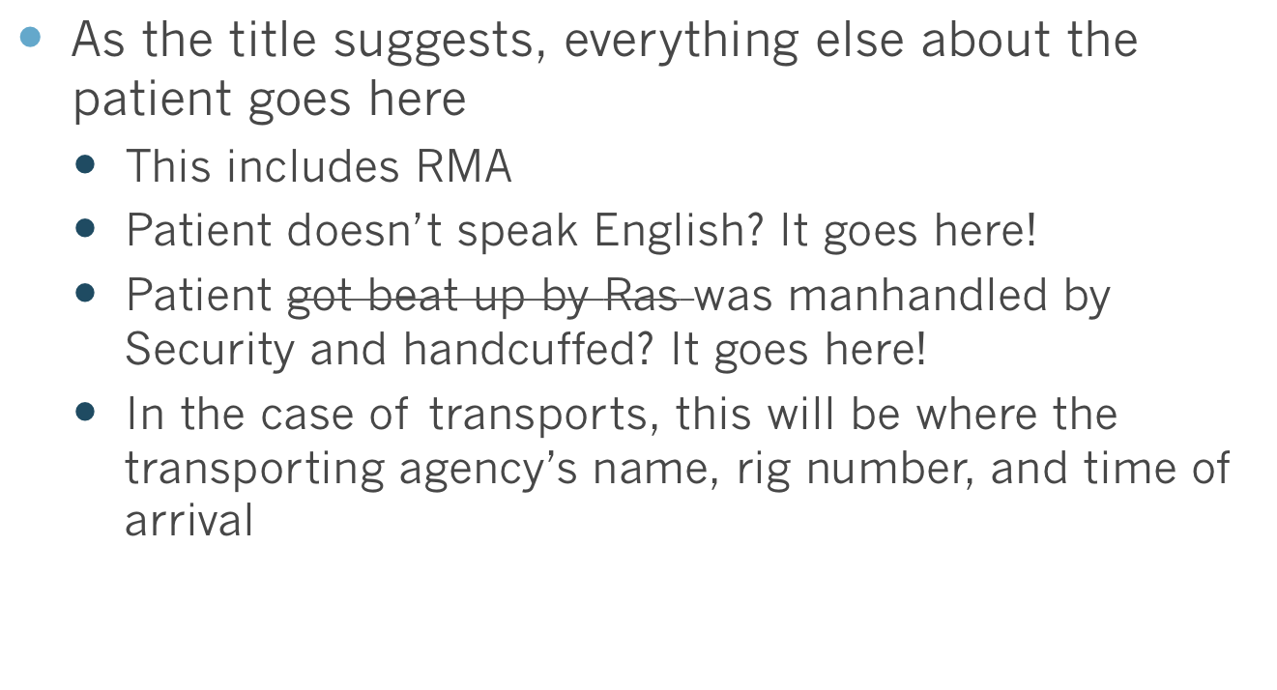
Everything else

Slide 21
Everything else
Example: Pt. pupil reactivity and skin color and condition were not obtained due to the pt. not wanting to move from her most comfortable position. Assisted RMMS in moving pt. and walking pt. down the stairs to the stretcher. Pt. care transferred without incident to RMMS rig 9339 at 0600hrs for transport to SMH ED.
Example 2: Pt. was offered transport to the ED via ambulance or Security. Pt. declined both. Pt. chose to RMA. Pt. read, understood, and explained back RMA to MERT. MERT explained the risks associated with not seeking further medical attention. Pt. understood and signed RMA with Security as witness. Pt. was released from MERT’s care without incident. (or into care of roommate…or something)

Slide 22
Everything else
Example 3: Pt. was offered transport to the ED via ambulance. Pt. declined. Pt. chose to RMA. Pt. read, understood, and explained back RMA to MERT. MERT explained the risks associated with not going to the hospital with an ambulance. Pt. understood and signed with Security as witness. Care transferred to Security without incident for escort to SMH ED.
Any questions?

Slide 23
Abbreviations
Acceptable abbreviations:
  AOSTF (arrived on scene to find)
  N/V/D (nausea, vomiting, diarrhea)
  Pt. (patient)
  Neg. (negative)
  Pos. (positive)
  MOI (mechanism of injury)
Unacceptable abbreviations:
  Symbols (+,-,=, etc.)
  LOI for last oral intake

Slide 24
Conclusions
PCRs are like stories. They should be written in a way that if you were called to court to talk about the patient, you should be able to look at the PCR and remember most details from the call.
Great documentations comes from great knowledge of SOPs, protocols and interventions by the EMT

Slide 25
Conclusions
Any general questions?

