Slide 1

Phil(’s) In-Service

Slide 2
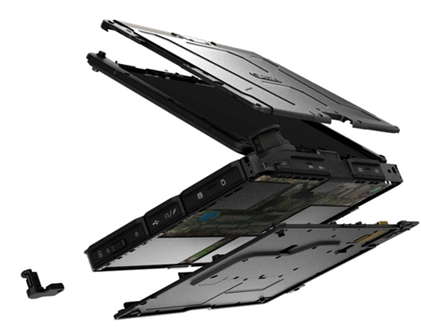
About
Windows 7
Touchscreen
Waterproof
Vibration and Drop Resistant
Meets Military standards
4.36 lbs with 11. 6 in screen
Standard Ports
Operating temp -6 – 140
Storage temp -40 – 160
Note- touchscreen becomes less responsive in cold

Slide 3
SOPs
10.3 Training
10.3.1 All Crew Chiefs and Crew Chief Trainees must be trained in use of V110 before use during calls.
10.3.2 Training will be carried out by the training department and will include how to handle and implement V110 during shifts.
10.4 Usage
10.4.1 V110 shall be used to record demographics, vitals, and dropdown menus on emscharts while on-scene. Information will be recorded by the Crew Chief as the information is obtained by the Crew Chief Trainee.
10.4.2 If R/C MERT is waiting on scene for Rural Metro Medical Services to transport the patient, the Crew Chief Trainee will use V110 to begin writing the call narrative and if time permits, finish the emschart.
10.4.3 V110 will additionally be used to obtain electronic signatures for both patient consent and refusal of medical assistance, which will be added to every emschart.
10.4.4 V110 can be used to finish an incomplete emschart in the UHS office. The computer already located in the UHS office may also be used to complete the chart.
10.4.5 V110 shall not be used for any purpose other than those listed above.
10.5 Location
10.5.1 V110 is capable of storage up to -40ºF and therefore can be kept in Vehicle 800 year-round.
10.5.2 The Crew Chief is responsible for bringing V110 to each call and ensuring proper use
10.5.3 During days when there is no crew on shift, the Crew Chief must bring V110 to the UHS office to charge.
10.5.4 Failure to charge V110 after a shift will result in an Incident Report and disciplinary action.
10.6 Technical Issues and Other Notes
10.6.1 When technical issues arise contact Equipment Officer immediately.
10.6.2 SOPs outlined above for V110 will go into effect when V110 goes into service

Slide 4
Start of Shift
Turn on and log into your internet and emscharts account
Keep emscharts logged in throughout night (keep web browser minimized throughout shift)
Remember to QA the charts from the night before
***On your first shift with it make sure you run at LEAST 1 practice call with your crew so you can try to get comfortable with it.
Put it in the backpack

Slide 5
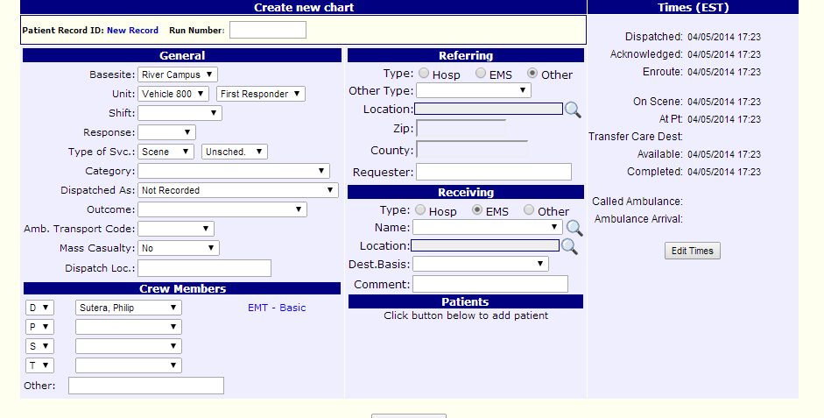
On Call
When on call create chart and fill out Basesite, Unit, and add yourself as a crew member

Slide 6
Add Patient
Next create patient and input pt. name (802s need to ask pt. name at the beginning of the call so we can start the chart so make it your first CAO question)
Cycle through the tabs to enter the information in the appropriate place
Make sure you are paying attention to the assessment!!!!!
At the end of the call input the rest of the demographics
Keep filling out chart as you are waiting for Metro
Signatures to come in the future!

Slide 7
End of Call and Shift
When you are done with the call finish the chart as you normally would
At the end of the shift put V110 back in its storage location (underneath the desktop computer in the office)
Remember to plug in the charger

Slide 8
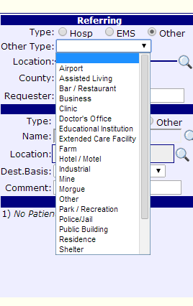
Efficiency Strategies
Use it either as a tablet oriented vertically or as a laptop (depending on your preference)
Use the stylus not your finger
For scroll down menus click on scroll bar with stylus
If in tablet mode use keyboard not write in
Take brief notes in HPI (update later)
802s must take note of everything on call as a backup

Slide 9
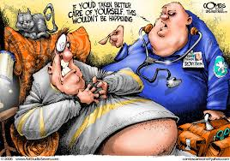
Any Questions??

