Slide 1
Abnormal Lung Sounds
MERT GMM 11.09.08

Slide 2
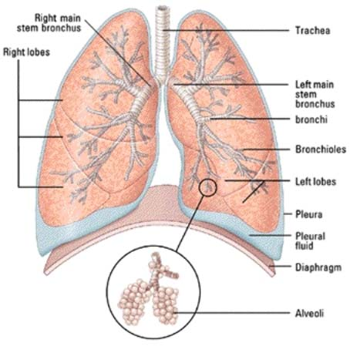
The Lungs

Slide 3
COPDs
Chronic Obstructive Pulmonary Diseases
Break it down: chronic diseases that obstruct the lungs
A few common examples:
Asthma
Bronchioles become narrowed
Overproduction of mucus
Chronic bronchitis
Bronchiole lining becomes inflamed
Mucus plugs and inflammation in the alveoli as well
Emphysema
Alveoli walls break down, lose surface area
Loss of elasticity to the lungs

Slide 4
Wheezes
High-pitched sounds that seem almost musical in nature
Sound created by air moving through narrowed passages in the lungs
Common in asthma, also other COPDs like emphysema or chronic bronchitis
Listen

Slide 5
Crackles
Fine crackling or bubbling sounds heard upon inspiration
Caused by fluid in the alveoli or opening of closed alveoli
Listen

Slide 6
Rhonchi
Lower-pitched sound resembling snoring or rattling
Caused by secretions in larger airway passages
Commonly heard in pneumonia, bronchitis, and when materials are aspirated into lungs

Slide 7
Stridor
High-pitched sound usually heard upon inspiration
Caused by partial obstruction of upper airway (trachea or larynx)
Listen

Slide 8
Jeopardy!
Break up into your teams
If you can’t remember your team number, look on the sheets on the table

