Slide 1

Basic Details of the Team and Problem Statement
Ministry/Organization Name/Student Innovation:
Government of Jammu and Kashmir
PS Code:SIH1352
Problem Statement Title: Traditional agriculture practices lack real-time monitoring and efficient operation on fields This leads to inefficiencies and low production levels. Team Name: Trackter
Team Leader Name: N Raghav
Institute Code (AISHE): U-1153
Institute Name: Shiv Nadar University Chennai
Theme Name: Agriculture, FoodTech & Rural Development

Slide 2
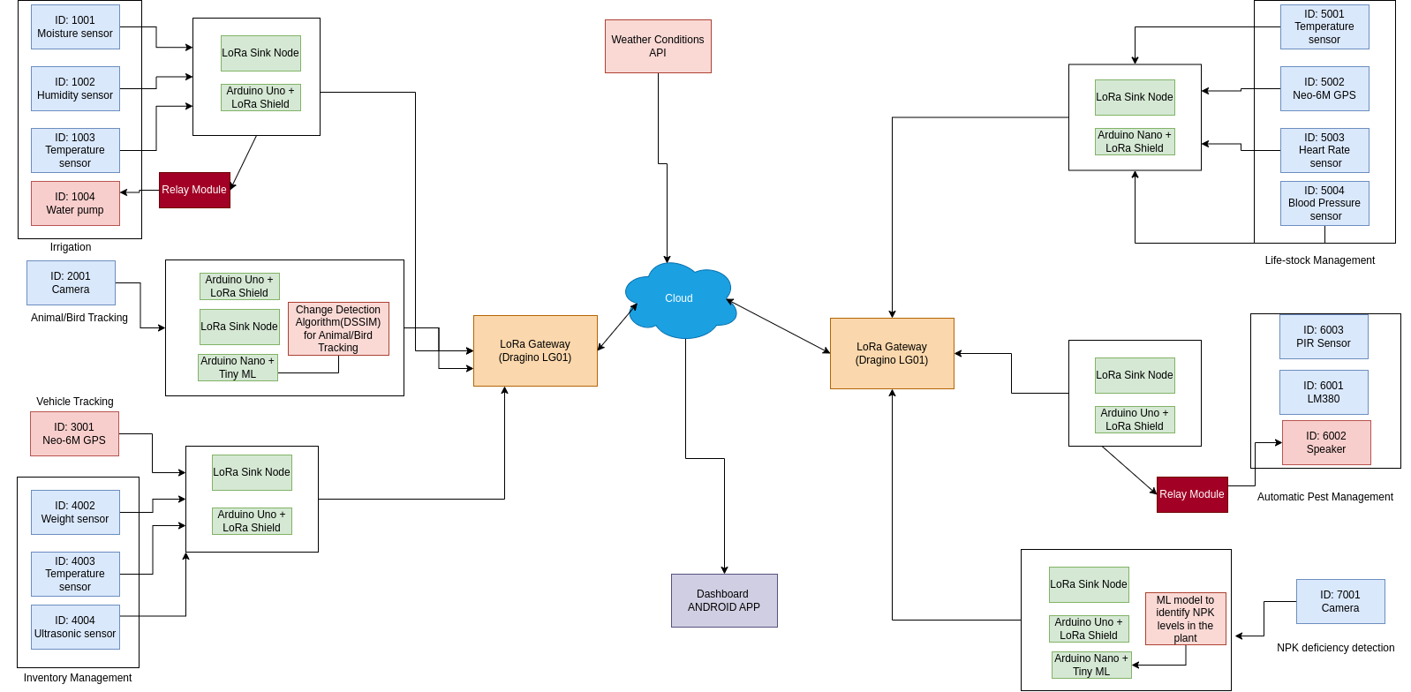
Idea/Approach Details
Describe your idea/Solution/Prototype here:
Saffron Specific system
Low-Cost Communication Protocol: LoRa (Long Range): Utilize LoRa technology for cost-effective long-distance communication.
Real-Time Agriculture Field Data: Collect real-time data from various sensors and devices in the field.
LoRa Gateways: Use LoRa gateways, such as Dragino LG01, to collect and transmit data from multiple IoT systems.
Irrigation System: Implement an intelligent irrigation system based on soil moisture, humidity,ultrasonic sensor and temperature sensors. Utilize weather data like snowfall cover from the internet to optimize watering.
Automated Pest Management: Detect pests and insects using PIR (infrared) sensors . Use ultrasonic waves for pest control, reducing the need for pesticides.
Livestock Management: Employ GPS collars with health monitoring for livestock management.
Vehicle Tracking: Track vehicles in real time using Arduino and GPS modules, with data displayed on a custom-designed webpage.
Animal/Bird Tracking: Capture images, perform change detection, and send distinct images via LoRa for animal and bird tracking.
Inventory Management: Utilize RFID sensors, weight sensors,, light sensors, temperature/humidity sensors, and ultrasonic sensors for efficient inventory management.
Weather Conditions: Fetch local weather information using HTML's Geolocation API and OpenWeatherMap's Weather API.
ML Model : Implement ML models for NPK (nitrogen, phosphorus, potassium) identification.
Explore the feasibility of introducing cloud platforms (e.g., Azure) to support ML model implementation and data utilization.
Dart(Dashboard)
JavaScript, HTML(Weather API)
Python
AWS IoT Core
Arduino UNO
LoRa Shield
Dragino LG01(Gateway)
LoRa
Arduino Nano
TinyML
Embedded C/C++
Describe your Hardware/Software Technology stack here:

Slide 3
Idea/Approach Details
Describe your Use Cases here
Describe your Dependencies / Show stopper here
Crop Monitoring and Optimization: Use real-time data from soil moisture, humidity, and temperature sensors to monitor crop conditions.
Water Resource Management: Implement an intelligent irrigation system that takes into account both soil conditions and weather forecasts. This can help reduce water usage and mitigate the risk of over-irrigation or drought conditions.
Pest Control: Detect pests in the field using PIR sensors and repel them using 80khz ultrasound.
Livestock : Use GPS collars and health monitoring sensors to track the location and health of livestock.
Fleet Management: Track location of vehicles used in agricultural operations in real time.
Animal/Bird Tracking: Capture images and perform change detection using LoRa-connected cameras to monitor crops from animal or bird damage.
Inventory Management: Implement RFID sensors and weight sensors to track inventory levels in real time. Monitor temperature and humidity for perishable goods. Improve inventory accuracy and reduce waste.
Local Weather Data: Collect local weather information using Geolocation and OpenWeatherMap's Weather API. Use this data to make informed decisions about planting, harvesting, and other agricultural activities.
Nutrient Management: Implement machine learning models to identify nutrient levels (NPK - nitrogen, phosphorus, potassium) in the soil. Optimize fertilizer application based on soil analysis, reducing costs and environmental impact.
Cloud Integration for Data Analytics: Using AWS IoT Core for cloud . Use machine learning and data analytics to gain insights into crop performance, resource utilization, and predictive maintenance.
Lack of Reliable Connectivity: In rural or remote areas, there might be challenges in maintaining a stable and reliable multiple LoRa connections, which is crucial for real-time data transmission and remote control.
Inadequate Power Supply: If there are no reliable power sources or backup systems in place, the IoT devices, sensors, and communication modules might face frequent disruptions.
Cost Overruns: The implementation of IoT technologies, especially across a large agricultural area, could lead to unexpected expenses. This may include the cost of sensors, communication modules, and cloud services.
Data Security and Privacy Concerns: Safeguarding sensitive agricultural data from cyber threats and ensuring compliance with privacy regulations is critical. A breach in security or non-compliance could halt the project.
Interoperability Issues: If the various components and devices in the IoT ecosystem do not seamlessly communicate or integrate with each other, it could lead to compatibility problems and hinder the overall functionality.
Lack of Expertise and Training: Farmers and agricultural workers may require training to effectively use and maintain the IoT system. A lack of understanding or expertise could lead to underutilization or improper operation.
Unreliable Sensor Data: If the sensors used to collect field data (e.g., soil moisture, temperature) are inaccurate or prone to malfunction, it could lead to incorrect decisions and ineffective automation.
ML Model Inaccuracy: If the ML model for NPK identification is not properly trained or fails to accurately predict nutrient levels, it could lead to improper irrigation and nutrient management.
Lack of Redundancy and Backup Systems: In case of hardware failures or network outages, having redundant systems or backup plans is crucial to prevent extended downtime.

Slide 4
Team Member Details
Team Leader Name: N Raghav
Branch: BTech Stream: CSE-IoT Year: III
Team Member 1 Name: Abhay C Mathen
Branch: BTech Stream: AI&DS Year: III
Team Member 2 Name: Levin MS
Branch: BTech Stream: AI&DS Year: III
Team Member 3 Name: Madhavv Arul
Branch: BTech Stream: CSE-IoT Year: II
Team Member 4 Name: Type : MK Lokesh Kumar
Branch: BTech Stream: CSE-Cybersecurity Year: II
Team Member 5 Name: Shrinithi V
Branch: Stream: CSE-IoT Year: III
Team Mentor 1 Name: Type Your Name Here
Category (Academic/Industry): Expertise (AI/ML/Blockchain etc): Domain Experience (in years):
Team Mentor 2 Name: Type Your Name Here
Category (Academic/Industry): Expertise (AI/ML/Blockchain etc): Domain Experience (in years):

