Slide 1
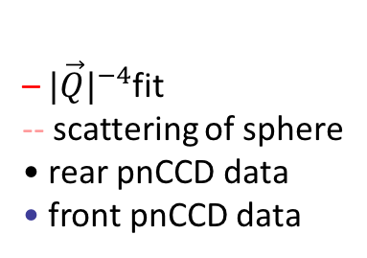
–${|\vec{Q}|}^{−4}$fit
-- scattering of sphere
• rear pnCCD data
• front pnCCD data
0 fs delay
800 fs delay

