Slide 1
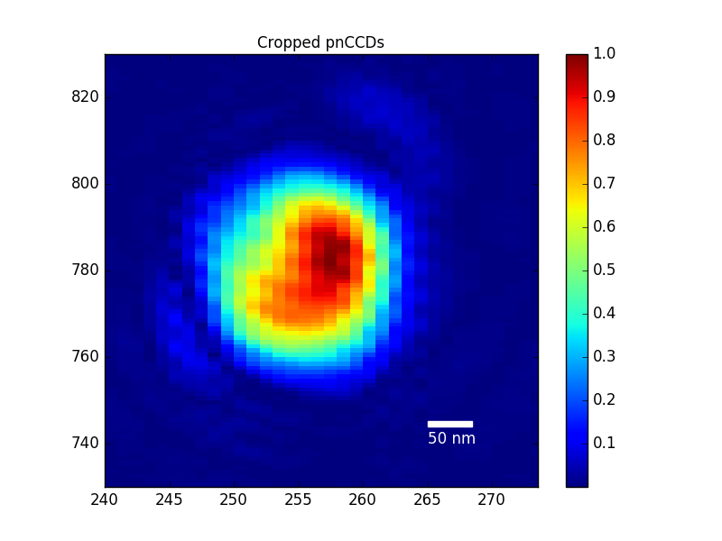
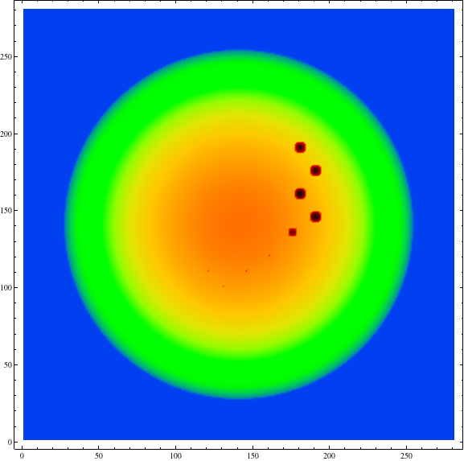

b) Reconstruction
a)
50 nm
c) Simulation
1
50 nm
0

