Slide 1
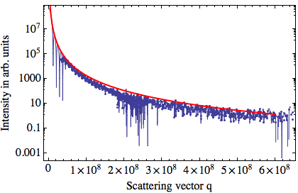
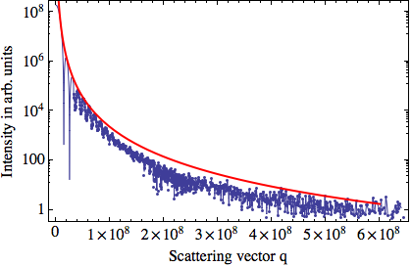
– q⁻⁴ fit
– extrapolation . exp. data
0 fs delay
800 fs delay
in m⁻¹
in m⁻¹

