Slide 1
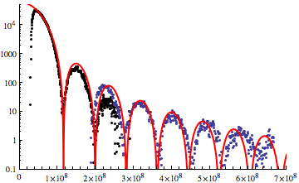
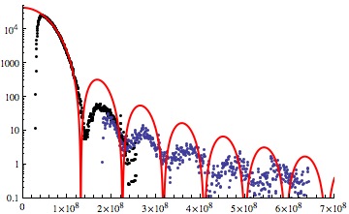
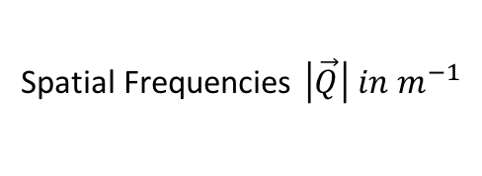


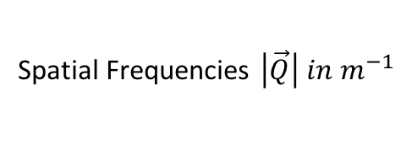
I($\vec{Q}$)
I($\vec{Q}$)
Δt = 0 fs
Δt = 800 fs
Spatial Frequencies $\left|\vec{Q}\right| in m^{−1}$
Spatial Frequencies $\left|\vec{Q}\right| in m^{−1}$

