Slide 1
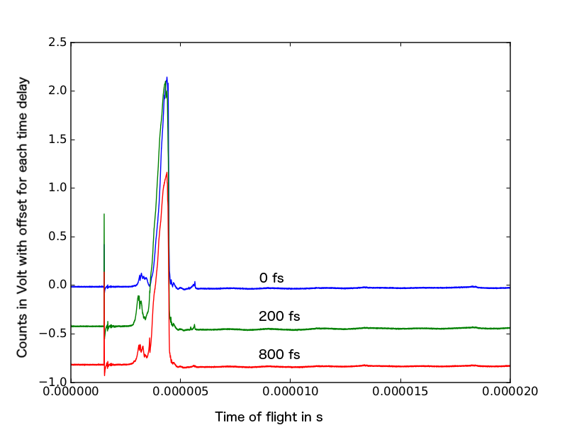
He⁺
Xe charge fragments
He²⁺
He₂⁺

