Slide 1
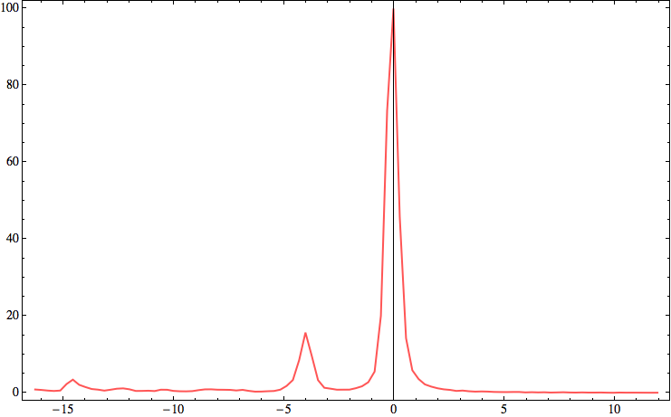
1s – 2p2p (¹D₂)
Intensity in arb. units
Satellites
1s2p – 2p2p2p
1s – 2p2p (¹S₀)
Relative energy in eV

