Slide 1
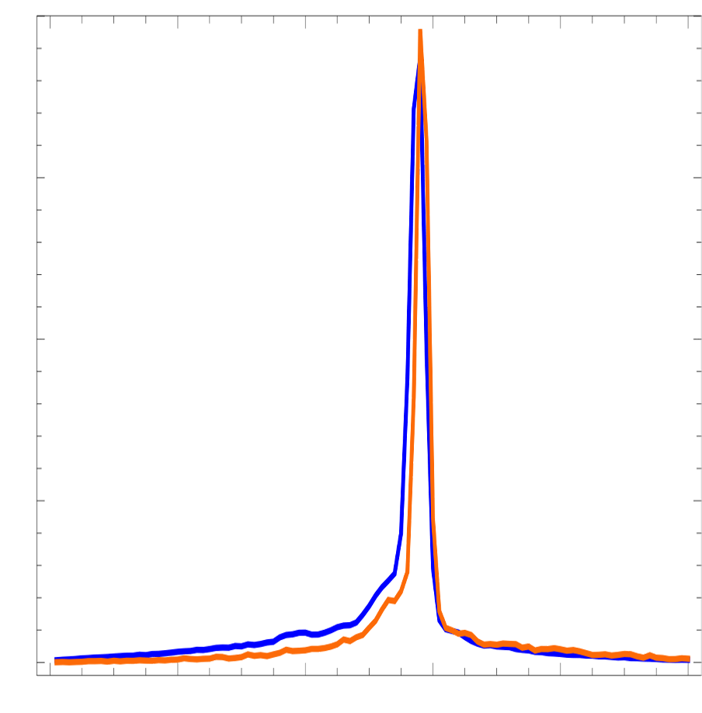
Single shot
515.5
512
508.5
Photon energy in eV
Average signal
Orange:
Kick at undulator 18
FWHM: 179 meV
Blue:
Kick at Undulator 20
FWHM: 199 meV
Intensity in arb. units
515.5
512
508.5
Photon energy in eV

