Slide 1
Two Pulses – Two Colors: SASE and Seeded
Intensity in arb. units
Intensity in arb. units
515.25 eV
512 eV
508.75 eV
515.25 eV
512 eV
508.75 eV

Slide 2
Average Online Feedback: Taper & Compression
Taper: High-Bandwidth
Compression: Low-Bandwidth
Intensity in arb. units
Compression: High-Bandwidth
Taper: Low-Bandwidth
Intensity in arb. units
1078 eV
1065 eV
1052 eV
1078 eV
1065 eV
1052 eV

Slide 3
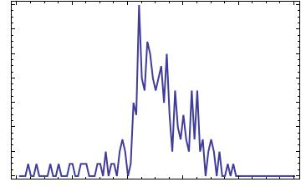
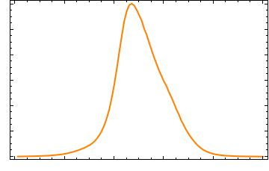
Single-Shot - „sweet spot“
Intensity in arb. units
1078 eV
1065 eV
1052 eV
1078 eV
1065 eV
1052 eV

Slide 4
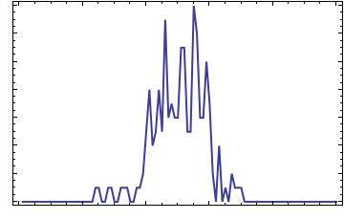
Single-Shot - „sweet spot“
Intensity in arb. units
1078 eV
1065 eV
1052 eV
1078 eV
1065 eV
1052 eV

Slide 5
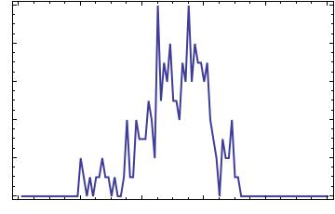
Single-Shot - „sweet spot“
1078 eV
1065 eV
1052 eV
Intensity in arb. units
1078 eV
1065 eV
1052 eV

Slide 6
Single-Shot – Looking at seeded shots
Intensity in arb. units
515.5 eV
512 eV
508.5 eV
515.5 eV
512 eV
508.5 eV

Slide 7
Intense Single-Shot – Space Charge Effect Starts to Dominate
Intensity in arb. units
1078 eV
1065 eV
1052 eV
1078 eV
1065 eV
1052 eV

Slide 8
Gas Attenuator Oscillations
Counts
Events

Slide 9
PES – Kinetic Energy Influence
Intensity in arb. units
E0=
1065eV
84 %
21 %
4 %
E0=
1700 eV
Intensity in arb. units
100 %
25%
17 %
E0+13eV
E0
E0 -13eV
E0+13eV
E0
E0-13eV
E0+13eV
E0
E0-13eV

Slide 10
Seeded Shots Average: Ultimate Resolution
Blue:
150meV resolution
For single shot analysis
Orange:
37meV resolution
To look at average spectra
Intensity in arb. units
FWHM of seeded beam:
193meV
515.25 eV
512 eV
508.75 eV

Slide 11
Seeded Shot Average: BY Kick at Undulator 18/20
Orange:
Kick at undulator 18
FWHM:
179meV
Blue:
Kick at undulator 20
FWHM:
199meV
Intensity in arb. units
515.25 eV
512 eV
508.75 eV

Slide 12
Auger Spectra – Ultimate resolution
Slit 0.4mm
Slit 0.8 mm
Slit 1.3 mm
Intensity in arb. units
δ=2.78
δ=3.11
δ=3.06
Intensity in arb. units
δ=1.24
δ=0.87
δ=1.23
Intensity in arb. units
δ=1.22
δ=0.91
δ=1.22
Intensity in arb. units
818eV
805eV
792eV
818eV
805eV
792eV
818eV
805eV
792eV

Slide 13
