Slide 1
Predicting Incident Priorities & Forecasting Incident Volume in ITSM
By
Madesh Sivakumar

Slide 2
Project Overview
Objective:
Predicting Incident Priority: To optimize incident management by preemptively addressing critical issues.
Forecasting Incident Volume: To better allocate resources and plan for future incident loads.

Slide 3
Dataset and Preprocessing:
Dataset Overview:
Source: Data from the ITSM Incident Management Process (Kaggle).
Size: 141,712 events, 24,918 incidents with 36 attributes.
Key Attributes: Incident state, priority, urgency, resolved time, etc.
Preprocessing Steps:
Handling Missing Data: Brief mention of the strategies used.
Encoding: Label encoding was used for categorical data.
Standardization: Standardized numeric features to ensure consistent scaling.

Slide 4
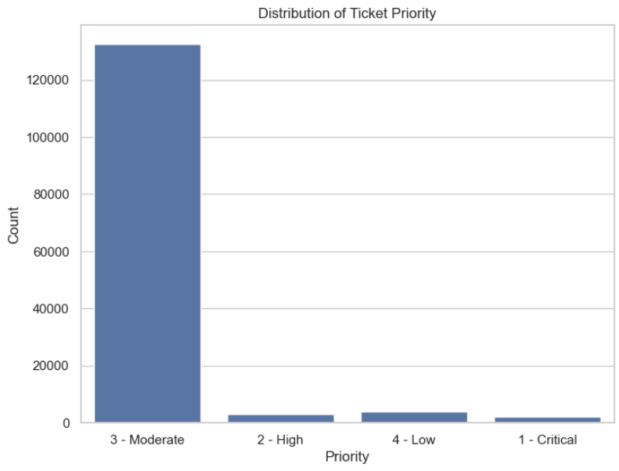
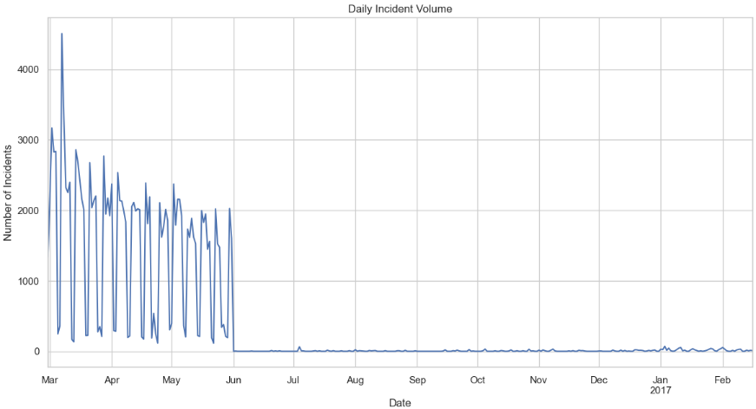
Exploratory Data Analysis:
Visual Insights:
Priority Distribution: Analysis of how different priorities are distributed across the dataset.
Incident Trends: Time-series analysis of incidents over time to identify patterns.
Key Insights:
High-priority incidents show a clear peak during certain periods, which could be due to specific events or misconfigurations.
The dataset shows a cyclical pattern in incidents, suggesting periodic stress on the infrastructure.

Slide 5
Methodology:
Models Used:
Classification: SVM, Decision Tree, Random Forest, K-Nearest Neighbor for predicting incident priority .
Time Series Forecasting: ARIMA model used for forecasting incident volume.
Performance Metrics:
Accuracy: The overall accuracy of the models.
Precision, Recall, F1-Score: Performance on key metrics.
Confusion Matrix: Highlighting how well the model classified the priority levels.

Slide 6
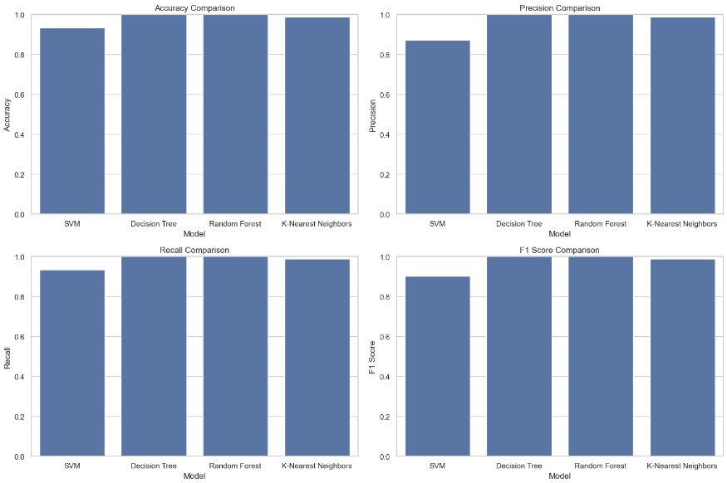
Result: Comparison graphs for accuracy, precision, recall, and F1 score for all models .

Slide 7
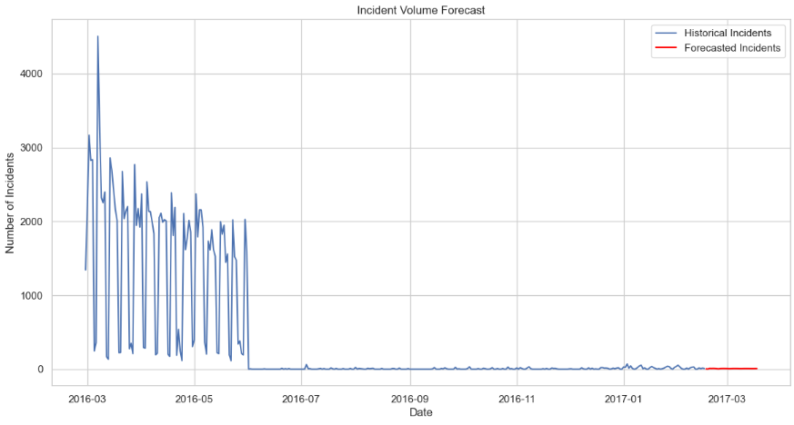
Result: Forecasting Incident Volume .

Slide 8
Conclusion and Future Work :
Summary:
Objectives Achieved: The project successfully predicted incident priorities, forecasted incident volumes .
Model Performance: SVM and Random Forest performed best for classification tasks; ARIMA provided reasonable forecasts.
Future Work:
Advanced Models: Exploring more complex models like deep learning for better accuracy.
Additional Data: Incorporating more diverse datasets or real-time data for improved forecasting.
Automation: Developing a real-time system for continuous monitoring and prediction.

Slide 9
Thank You

