Slide 1

Pill Mate
An IoT-Enabled Smart Medication Adherence System
with Sensor-Based Verification and Automated Dispensing
Team Members: Kishore. K | Madesh. B | Narain Kishore. M
Project Coordinator & Guide: Dr. T. Kiruba Devi | Mr.Surya | Dr. M. Chandran
Department of Data Science
IoT Healthcare
ESP32
Smart Pillbox
Medication Adherence

Slide 2
Abstract
Medication non-adherence remains a critical challenge in managing long-term conditions, with nearly half of all patients failing to take prescribed medications as directed. Existing reminder tools cannot verify whether a dose was actually taken.
Pill Mate is an IoT-based smart medication adherence system built on the ESP32 microcontroller, combining automated servo-driven dispensing, infrared sensor-based intake verification, real-time clock scheduling, and cloud-connected caregiver monitoring via Firebase. The system provides automated dispensing, audio-visual reminders, intake verification, and online real-time alerts.
Prototype evaluation achieved 99% alarm accuracy, 98% dispensing accuracy, 95% IR detection accuracy, and caregiver notification within 5 seconds — delivering a reliable, low-cost, and user-friendly closed-loop medication management solution.

Slide 3







Presentation Outline
What we will cover today
Problem Statement
Results & Metrics
01
05
The medication non-adherence crisis
Performance evaluation data
Literature Review
Comparative Analysis
02
06
Gaps in existing solutions
Pill Mate vs. prior systems
System Design
Conclusion & Future Work
03
07
Hardware, software & architecture
Impact and roadmap
Working Prototype
04
Hardware integration & app interface
2 / 12

Slide 4


Problem Statement
Medication Non-Adherence — A Critical Healthcare Challenge
GLOBAL SCALE
Reminders ≠ Verification
~50%
Pill organizers, blister packs, and apps remind patients but cannot confirm the medication was actually taken.
of patients do NOT take
medications as prescribed
No Sensor-Based Confirmation
Existing systems lack physical detection to verify pill removal or ingestion at compartment level.
Preventable hospitalizations,
accelerated disease progression
& increased costs of care
No Real-Time Caregiver Loop
Missed doses go undetected — caregivers have no timely mechanism to intervene when a dose is skipped.
3 / 12

Slide 5
Literature Review & Research Gap
What existing systems lack
Prior System | Contribution | Gap / Limitation
Minaam & Abd-ELfattah [1] | IoT alerts via Android app | No intake verification, needs continuous internet
Chawariya et al. [3] | Audio/visual alert system | Alert only — no dispensing or confirmation
Jayseelan & Shanmugam [5] | Cloud-synced smart pillbox | No sensor-based ingestion verification
Kim & Park [7] | Bluetooth smart pillbox | Self-reported compliance, no hardware verification
Rao [8] | Arduino dispensing system | No remote monitoring capability
Key Gap Identified: No existing system integrates all five critical functions — automated scheduling, controlled dispensing, sensor-based intake verification, real-time caregiver notification, and offline operation — in a single low-cost device.
4 / 12

Slide 6

Proposed System — Pill Mate
An integrated, closed-loop IoT medication management platform
Pill Mate is an ESP32-powered IoT device that schedules, dispenses, verifies, and reports medication intake in one integrated, affordable platform.
01
02
03
04
Reminder Module
Dispensing Module
Verification Module
IoT Monitoring Module
RTC-based audio & visual alerts at scheduled dose times using piezo buzzer + LED array
Servo motor opens correct compartment at the right time; locks otherwise to prevent unauthorized access
IR sensor detects pill removal within the response window; registers dose as taken or missed
Cloud records event log; push notification to caregiver within <5 sec on missed dose; online queuing
Pill Mate is the ONLY system that combines all 4 modules in a single, low-cost, online device.
5 / 12

Slide 7
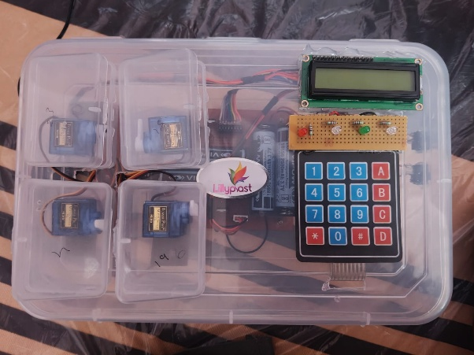


Hardware Architecture
Key components of the Pill Mate prototype
ESP32 Microcontroller
Servo Motor
Dual-core processor handling scheduling, sensor queries, servo control & Wi-Fi simultaneously — no extra hardware needed
Mechanical gating of pill compartments; opens on schedule, returns to locked position after window expires
I2C LCD Display
Buzzer + LEDs
Multi-modal audio & visual alerts functional in loud or dark environments
Shows current time, next scheduled dose & system status; requires only 2 GPIO connections
6 / 12

Slide 8
Software Architecture & System Workflow
Four-stage linear pipeline per dose cycle
STAGE 1
STAGE 2
STAGE 3
STAGE 4
REMINDER
DISPENSE
VERIFY
REPORT
RTC triggers audio/visual alert at scheduled time
Servo opens compartment; closes after window
IR detects pill removal — taken or missed?
Cloud log + push notification to caregiver
Companion Mobile App
Offline Resilience
On-Device Scheduling
Live dashboard with dosing history, upcoming doses, and missed-dose alerts via push notification
ESP32 queues adherence records in EEPROM when online; syncs to cloud on reconnection
Physical keypad lets patients input dose schedules directly; LCD confirms entries instantly
7 / 12

Slide 9
Working Prototype
Hardware integration and companion app interface
Hardware Prototype
Companion Mobile Application
ESP32 microcontroller as central processing unit
Servo motor for mechanical compartment gating
I2C LCD display for patient-facing status
Buzzer + LED array for multi-modal alerts
Physical keypad for direct schedule input
All components integrated into a compact housing
Live dashboard showing patient dosing history
Upcoming dose schedule view for caregivers
Missed dose incident list with timestamps
Push notifications on missed dose (<5 sec delay)
Remote monitoring without physical presence
Event log with complete auditable dose records
Works when device is online — syncs on reconnect
Fig. 1 — Pill Mate Hardware Prototype
Fig. 2 — Caregiver Companion App Interface
8 / 12

Slide 10
Results — Performance Metrics
Prototype evaluation under controlled indoor testing
99%
Alarm Accuracy
RTC-based scheduling — negligible deviation from prescribed timing
98%
Dispensing Accuracy
Consistent mechanical servo performance across multiple test cycles
<5 sec
Notification Delay
Cloud push alert to caregiver upon missed dose — clinically negligible
9 / 12

Slide 11
Comparative Analysis
Pill Mate vs. existing systems across 5 capability dimensions
System | Auto Dispensing | Intake Verification | Remote Monitoring | Online Operation | Low Cost
Minaam & Abd-ELfattah [1] | ✗ | ✗ | ✓ | ✗ | ✓
Chawariya et al. [3] | ✗ | ✗ | ✗ | ✓ | ✓
Jayseelan & Shanmugam [5] | ✗ | ✗ | ✓ | ✗ | ✓
Kim & Park [7] | ✓ | ✗ | ✓ | ✗ | ✗
Rao [8] | ✓ | ✗ | ✗ | ✓ | ✓
Pill Mate (Proposed) | ✓ | ✓ | ✓ | ✓ | ✓
Pill Mate is the only system achieving all 5 dimensions simultaneously.
10 / 12

Slide 12


Conclusion & Future Work
Impact and roadmap for Pill Mate
CONCLUSION
CONCLUSION
CONCLUSION
Closed-Loop Medication Management
Superior Performance
First-of-Its-Kind Integration
Pill Mate closes the gap between reminding and verifying by integrating intake detection with automated dispensing.
99% alarm accuracy, 98% dispensing reliability, and <5 second caregiver notification validated on prototype.
No reviewed system achieves all five capabilities. Pill Mate is the only solution that is automated, verifiable, connected,online, and low-cost.
Future Work
ML-based anomaly detection for compartment access outside scheduled windows
Multi-patient support for clinical and assisted-living deployments
EHR integration so physicians access real-world adherence data
Weight sensor modality to supplement for stronger ingestion confirmation
11 / 12

Slide 13
Thank You
We welcome your questions and feedback

