Slide 1
Document Intelligence Platform
AI Engineer Internship — Case Study Submission
Intelligent Document Extraction, Validation & API Platform

Slide 2
What it does
Ingests invoices, balance sheets, P&L statements, and cash flow statements (PDF/JPG/PNG), extracts structured fields and line items, validates the numbers against required accounting formulas, and exposes everything through a REST API and a web dashboard.
4
5
2
32
Document types
Pipeline stages
Extraction strategies
Automated tests
Invoice · Balance Sheet · P&L · Cash Flow
Validation → OCR → Extraction → Reconciliation → Persist
LLM (Claude) with automatic heuristic fallback
File validation, formulas, full API flows — all passing
Built for NeoStats — case study requirements implemented exactly as specified, then verified against the real provided dataset.

Slide 3
Processing pipeline
1
2
3
4
5
File Validation
→
OCR / Text
Extraction
→
AI Field
Extraction
→
Financial
Validation
→
Persist &
Respond
Type, size, page count,
corruption checks
Native text first,
Tesseract fallback
LLM-first,
heuristic fallback
Formula
reconciliation
SQLite / Postgres,
structured JSON
Every stage lives in its own service module — a failure at any stage is caught and reported as a clear, structured error rather than a stack trace.
Response contract
Every field is { value, page_number, source_text } — missing data is null, never invented
processing_status (PASS/FAILED) reflects extraction success
validation.overall_status (PASS/FAIL/NOT_APPLICABLE) reflects formula reconciliation — independent of extraction success

Slide 4
Two extraction strategies, one interface
Heuristic Extractor
LLM Extractor (Claude)
Default · always available · zero external dependency
Auto-enabled when ANTHROPIC_API_KEY is set
Regex/rules-based field & table parser
Runs entirely locally — no API key, no network call
Section-aware statement line parser (tracks CAPITAL AND LIABILITIES / ASSETS / INCOME / EXPENDITURE headers, tolerant of OCR noise)
Invoice parser handles wrapped rows, label/value split across lines
Makes the service fully testable & demoable out of the box
Sends OCR/native text to Claude with a document-type-specific schema prompt
Strict instruction: never invent or infer — missing fields must be null
Requires page_number + source_text evidence for every returned value
Materially better accuracy on irregular, multi-column, or unfamiliar layouts
Any LLM provider can be swapped in behind the same interface
processing_metadata.extraction_method reports which path ran for every document.

Slide 5
Financial validation — real results on the provided dataset
Every check reports formula, operands, calculated vs. reported value, variance, and status. Run against the actual HDFC Bank statements in the sample dataset:
Document
Formula
Calculated
Reported
Status
Balance Sheet
Total Capital & Liabilities ≈ Total Assets
2,530,432.44
2,530,432.44
PASS
Profit & Loss
Total Income − Total Expenditure ≈ Net Profit before Minority Interest
46,148.70
46,148.70
PASS
Cash Flow
Opening Cash + Net Increase ≈ Closing Cash
197,147.81
197,147.81
PASS
Invoice
Subtotal + Tax − Discount ≈ Total Amount
867.47
916.47
FAIL
The invoice FAIL is a genuine finding, not a bug: the source document includes an S&H charge outside the required formula — the system correctly flags the discrepancy instead of silently passing.

Slide 6
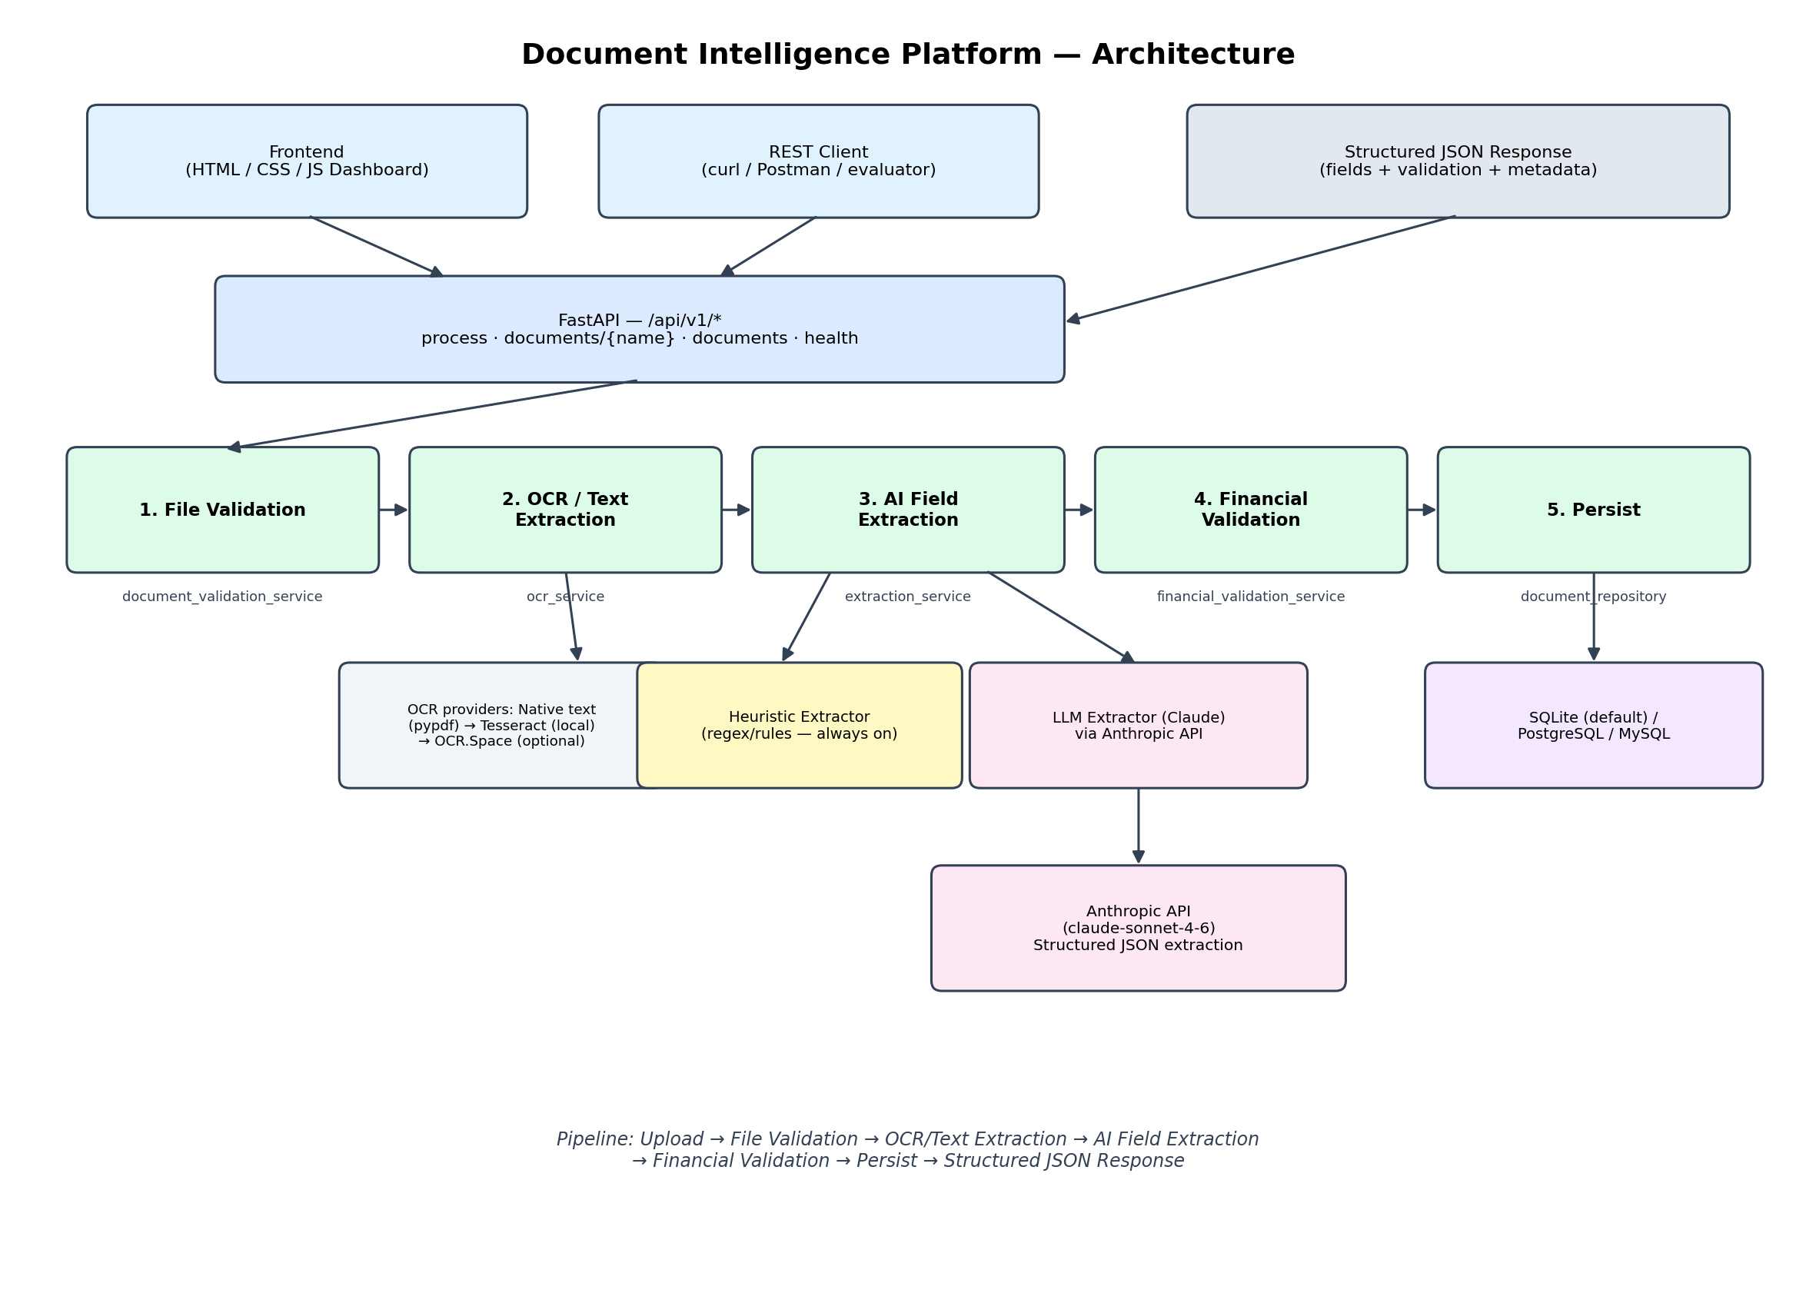
Architecture

Slide 7
Tech stack & repository structure
Stack
Repository layout
API: FastAPI + Pydantic (Python 3.12)
OCR: pypdf (native text) + Tesseract + poppler
Extraction: Claude (Anthropic API) or heuristic regex engine
Storage: SQLAlchemy — SQLite by default, Postgres/MySQL-ready
Frontend: static HTML / CSS / vanilla JS dashboard
Tests: pytest — 32 tests (unit + full API integration)
backend/app/
main.py entrypoint
core/ config, db, logging
models/, schemas/ ORM + Pydantic contracts
services/
document_validation_service.py
ocr_service.py
extraction_service.py
heuristics/ regex fallback extractors
financial_validation_service.py
document_service.py orchestrator
repositories/ DB access
api/routes/ REST endpoints
tests/ 32 pytest tests
frontend/ dashboard HTML/CSS/JS
docs/, sample_outputs/ diagram, AI usage, real results

Slide 8
Ready to deploy
Zero-setup local run: pip install -r requirements.txt && uvicorn app.main:app
Deploys to Render / Railway / Fly.io unchanged — just add tesseract-ocr + poppler-utils
Full docs: README.md · docs/AI_USAGE_DECLARATION.md · docs/KNOWN_LIMITATIONS.md

