Slide 1
EXPOSYS DATA LABS INTERNSHIP
DIABETES PREDICTION
using KNN Classifier
By
Madhan Dasari
mail: dasarimadhan2000@gmail.com

Slide 2
CONTENTS
Project description
Introduction
Diabetes prediction
Requirements
About KNN
Project implementation
Conclusion

Slide 3
DESCRIPTION
Diabetes is a type of chronic disease which is more common among the
people of all age groups. Predicting this disease at an early stage can help
a person to take the necessary precautions and change his/her lifestyle
accordingly to either prevent the occurance of disease or control disease
(For people who already have disease)
Task:
1. Prepare the data-set
2. Build a model which

Slide 4
Introduction
Diabetes mellitus is a syndrome characterized by metabolic disorder and abnormal rise in the concentration of blood sugar caused by insulin deficiency, or low insulin sensitivity of tissues, or both of them. Diabetes leads to serious complications or even premature death. However, to diagnosing diabetes, several time-consuming tests and analysing critical factors are done. Now days, machine learning algorithms are used to classify and diagnosis the diseases, in order to eliminate the problem and reduce the required cost. Besides that, using the machine learning algorithm leading to meaningful and accurate decisions. Medical data sets that contain irrelevant data (noise) are used to train and evaluate the machine learning algorithms. The noise are affects the decision results of the used algorithm. This model analyses and overcome the accompanied problems of the diabetes through removing the noise and predicting the diabetics using medical data set and machine learning algorithms

Slide 5
Diabetes Prediction
Diabetes prediction system is very useful system in the healthcare field. An accurate system for diabetes prediction is proposed in this paper. The proposed system used K-nearest neighbours (KNN) algorithm for eliminating the undesired data, thus reducing the processing time. By experiments, the proposed system achieved high classification result which gives 81% using Pima Indians Diabetes (PID) dataset.

Slide 6
Requirements for the Project: -
Knowledge on building a ML model
Knowledge about KNN Algorithm
Python 3
IDE (JUPYTER/ COLAB)

Slide 7
K NEAREST NEIGHBOURS ALGORITHM
K-Nearest neighbours is one of the simplest Machine Learning algorithms based on Supervised Learning technique.
K-NN algorithm assumes the similarity between the new case/data and available cases and put the new case into the category that is most similar to the available categories.
K-NN algorithm stores all the available data and classifies a new data point based on the similarity. This means when new data appears then it can be easily classified into a well suite category by using K- NN algorithm.
K-NN algorithm can be used for Regression as well as for Classification but mostly it is used for the Classification problems.

Slide 8
[contd..]
K-NN is a non-parametric algorithm, which means it does not make any assumption on underlying data.
It is also called a lazy learner algorithm because it does not learn from the training set immediately instead it stores the dataset and at the time of classification, it performs an action on the dataset.
KNN algorithm at the training phase just stores the dataset and when it gets new data, then it classifies that data into a category that is much similar to the new data.
Example: Suppose, we have an image of a creature that looks similar to cat and dog, but we want to know either it is a cat or dog. So for this identification, we can use the KNN algorithm, as it works on a similarity measure. Our KNN model will find the similar features of the new data set to the cats and dogs images and based on the most similar features it will put it in either cat or dog category.

Slide 9
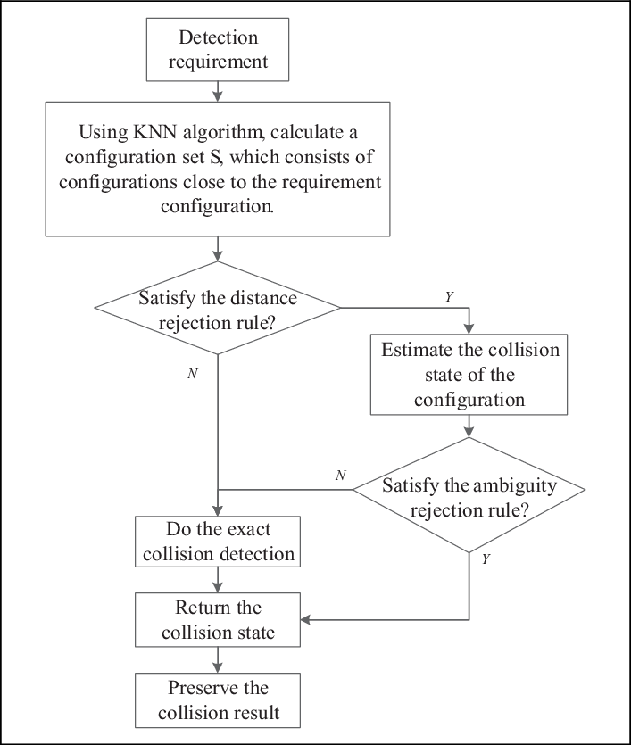
FLOW CHART OF WORKING OF KNN

Slide 10
Implementation Procedure: -
STEP 1: - LOADING THE DATA
Load PDI dataset using pandas
STEP 2: - PREPROCESSING
Rename columns and change the class labels
STEP 3: - CLEANING
Check null values, clean non-zero attributes

Slide 11
STEP 4: - FEATURE SELECTION:
Find correlation between attributes and select necessary features
STEP 5: - MODEL BUILDING:
build KNN model and fit the training data and test it
STEP 6: - TEST MODEL:
Save model and Test the model for user inputs

Slide 12
Conclusion
A fast and accurate diabetes prediction system is proposed in this project by using KNN algorithm. The proposed system used 768 instances within 8 attributes for each one of PID dataset. The used data is preprocessed in order to remove the unwanted data, and lead to faster processing time. Moreover, the dividing technique of the dataset into subset, made an optimal classification result. The proposed system focused on the features analysis and classification parts. The propositions of these parts lead to an optimal achievements. The results of experiments illustrated the effects of using the algorithms of the proposed system through achieving a higher classification rate of 82%.

Slide 13
THANK YOU

