Slide 1

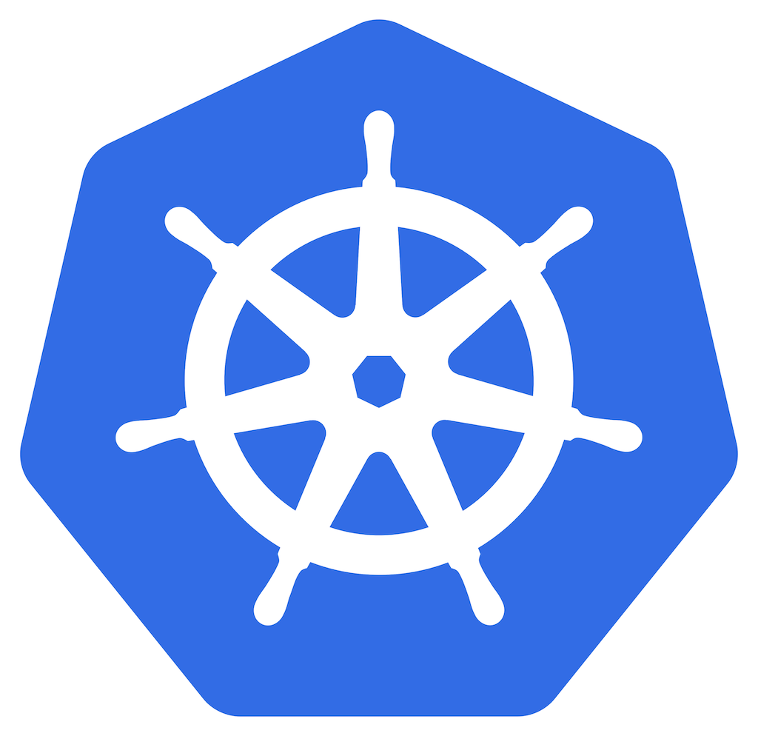
Kubernetes K8S

Slide 2
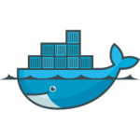
Kubernetes:
KUBERNETES
K8S

Slide 3
WHY KUBERNETES
Earlier we used Docker Swarm as a container orchestration tool that we used to manage
Multiple containerized applications on our environments.
FEATRUES | DOCKER SWARM | KUBERNETES
Setup | Easy | Complex
Auto Scaling | No Auto Scaling | Auto Scaling
Community | Good community | Greater community for users like documentation, support and resources
GUI | No GUI | GUI

Slide 4
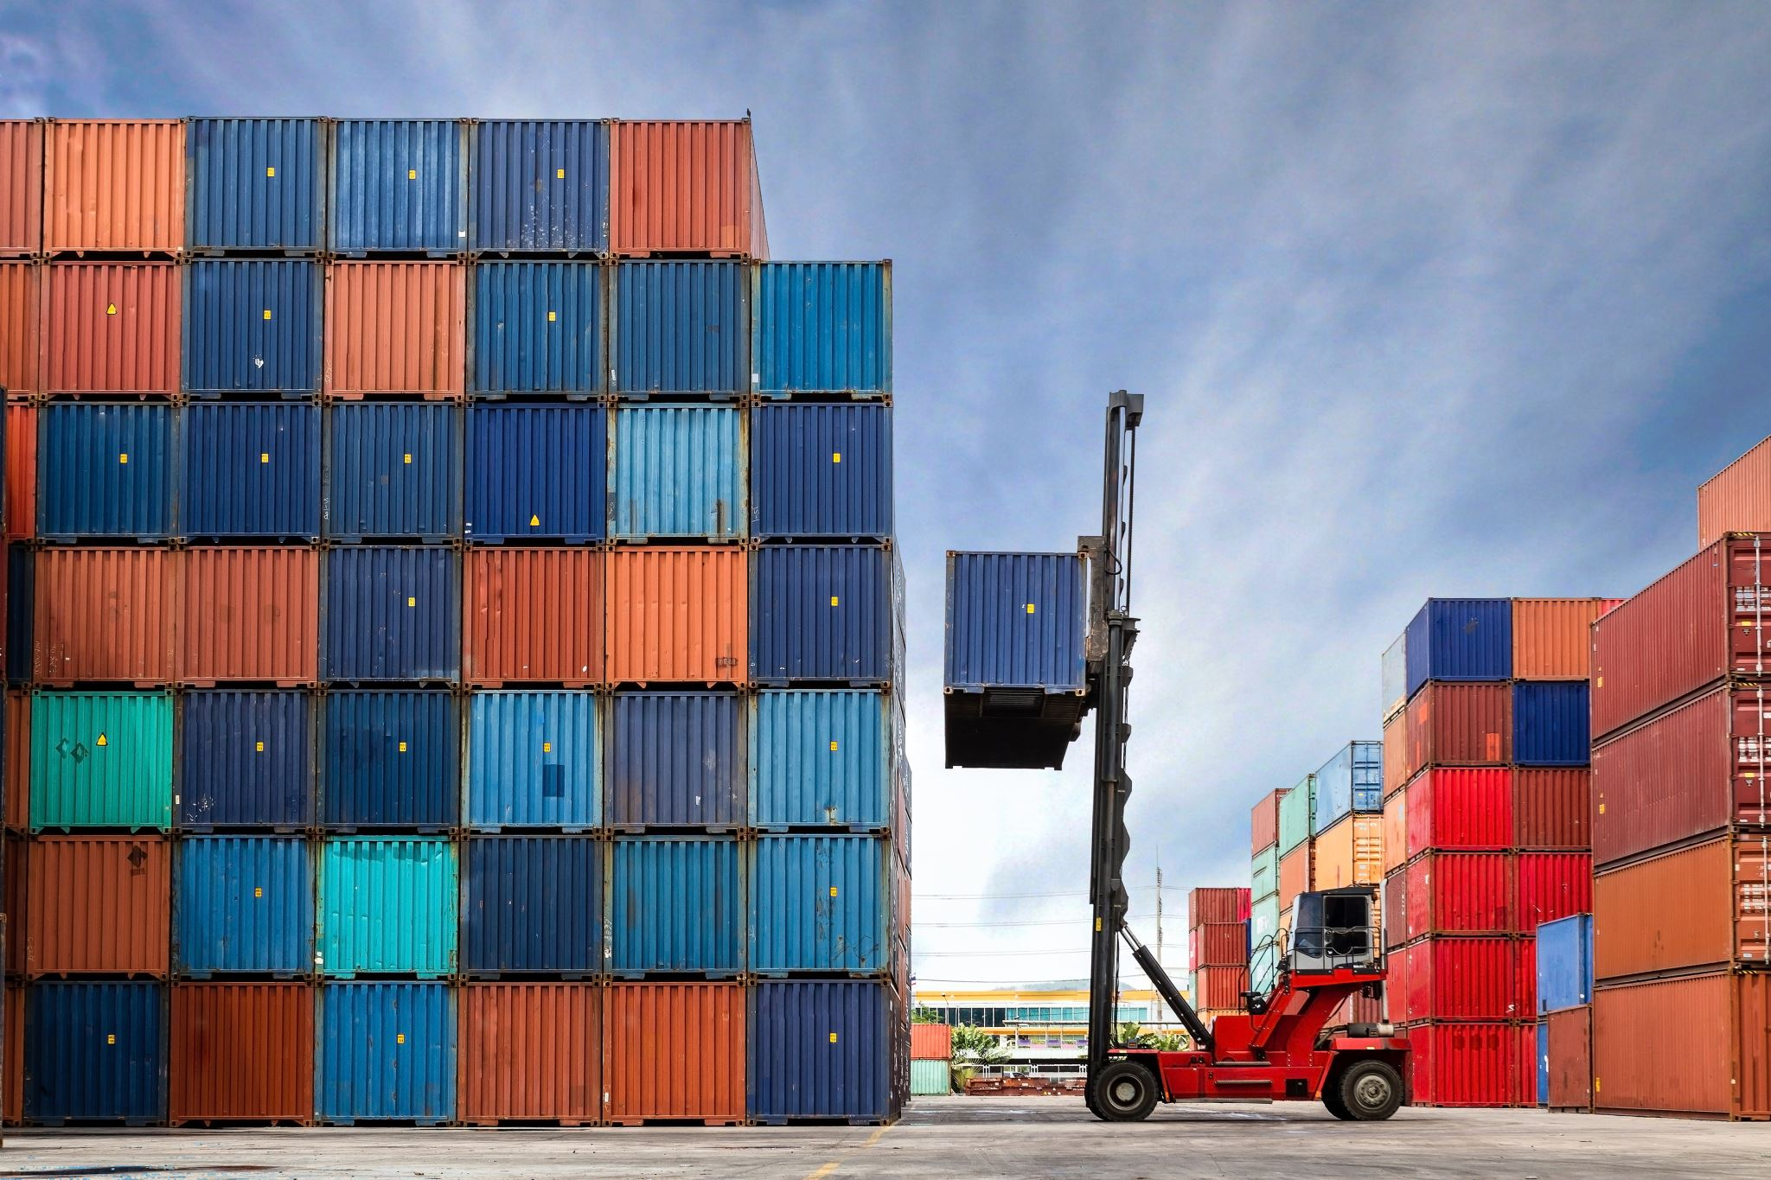
KUBERNETES:
It is an open-source container orchestration platform.
It is used to automates many of the manual process like deploying, managing and scaling containerized applications.
Kubernetes was developed by GOOGLE using GO Language.
Google donated K8’s to CNCF in 2014.
1st version was released in 2015.
WHY KUBERNETES:
Containers are a good and easy way to bundle and run your applications.
In a production environment, you need to manage the containers that run the applications and ensure that there is no downtime. In docker we used docker swarm for this, but any how docker has drawbacks!
So we moved to KUBERNETES.

Slide 5
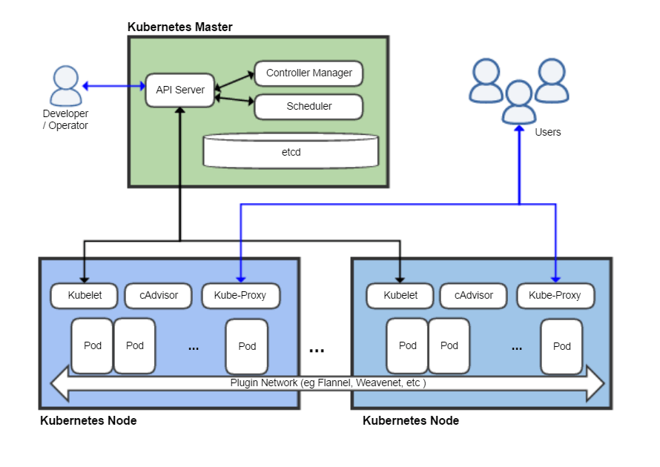

Slide 6
CLUSTER:
It is a group of servers it will have both manager and worker nodes.
Master Node is used to assign tasks to Worker Nodes.
Worker Node will perform the task.
We have 4 components in Master Node
API Server
ETCD
Controllers-manager
Schedulers
We have 4 components in Worker Node
Kubelet
Kube-Proxy
Pod
Container

