Slide 1

Lingayas Institute of Management and Technology
Approved by AICTE, Affiliated to JNTU Kakinada, Accredited with A Grade by NAAC and
UG-CSE is accredited by NBA
Department of Computer Science and Engineering
Major Project presentation on
INTERACTIVE PRODUCT ENQUIRY CHATBOT WITH VIDEO CALL INTEGRATION
Batch No : 23
1 . 20NA1A0546 - A Madhan Mohan Reddy 2 . 20NA1A0522 - M Durga Mahesh
3 . 20NA1A0586 - Sk Muzammil
Under the guidance of :
Mylapalli kanthi rekha

Slide 2
CONTENT
ABSTRACT
OBJECTIVES
INTRODUCTION
LITERATURE SURVEY
METHODOLOGY
ARCHITECTURE
RESULTS
CONCLUSION

Slide 3
ABSTRACT
The project developed an Interactive Product inquiry chatbot with Video Call Integration to improve customer engagement and accessibility in product inquiries. It uses image-based product identification, object detection, and text-to-speech conversion for user interaction. Key features include real-time camera preview, picture capture, object detection using TensorFlow.js and COCO-SSD, and text-to-speech conversion for accessibility. Implemented Ionic React for the front, Capacitor plugins for device features, and TensorFlow.js for object detection. Challenges included integration and optimisation, with future plans for natural language processing and database integration. The chatbot aims to provide a dynamic and engaging shopping experience.

Slide 4
OBJECTIVE
The main objective of this project is to develop an interactive chatbot system equipped with video call functionality and text-based conversation to assist users in obtaining detailed product information. human-like interaction for improved user engagement and satisfaction

Slide 5
INTRODUCTION
The Interactive Product Enquiry Chatbot integrates image-based product identification, object detection, and text-to-speech to enhance customer engagement in e-commerce.
Users can capture product images via device camera, enabling real-time object identification powered by TensorFlow.js and COCO-SSD model.
Text-to-speech conversion enhances accessibility, catering to visually impaired users by providing auditory feedback on detected objects.
Built on Ionic React for frontend and Capacitor plugins for device features, the chatbot ensures seamless interaction.
This innovative approach redefines e-commerce customer engagement, offering a dynamic and inclusive shopping experience through visual and auditory feedback.

Slide 6
LITERATURE SURVEY
Existing literature underscores the efficacy of text-based chatbots in e-commerce but acknowledges their limitations in handling product inquiries requiring visual context.
Studies advocate for integrating image recognition technologies like TensorFlow.js and COCO-SSD into chatbots to enable real-time product identification and enhance user experience.
Accessibility concerns are addressed through text-to-speech conversion functionalities, ensuring inclusivity for visually impaired users in chatbot interactions.
Frameworks such as Ionic React and Capacitor plugins facilitate the development of responsive frontend interfaces and access to device features.

Slide 7
METHODOLOGY
Requirement Analysis: User needs, industry trends, e-commerce, visual context.
Technology Selection: TensorFlow.js, image recognition, object detection, text-to-speech, scalability.
System Design: Architecture, frontend, backend, external APIs, integration.
Implementation: Ionic React, Capacitor plugins, camera, TensorFlow.js.
Testing and Validation: Functionality, performance, usability, accuracy.
User Feedback Integration: Refinement, interface, features, user experience.
Deployment and Integration: Production environment, seamless integration, documentation, support.

Slide 8
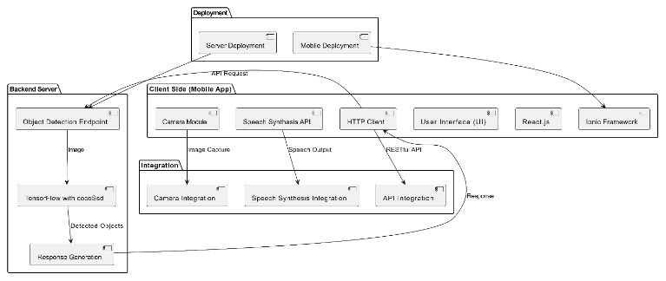
ARCHITECTURE

Slide 9

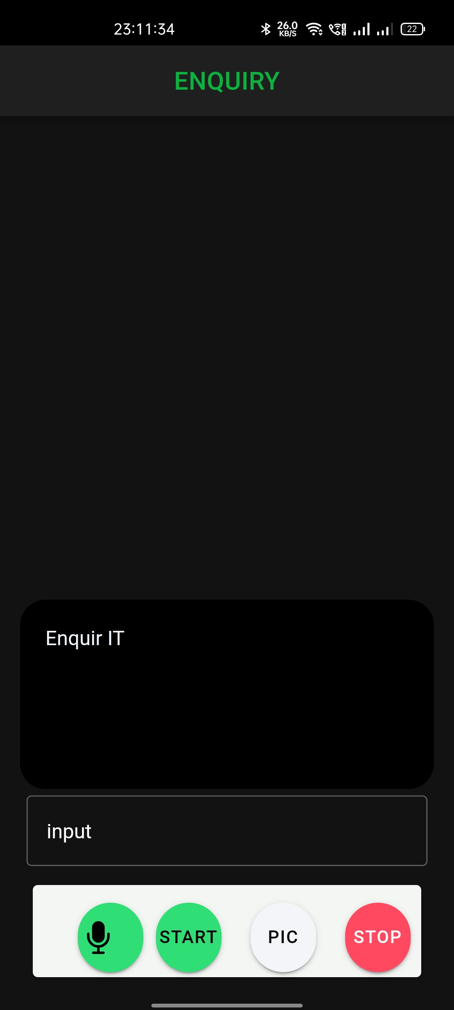
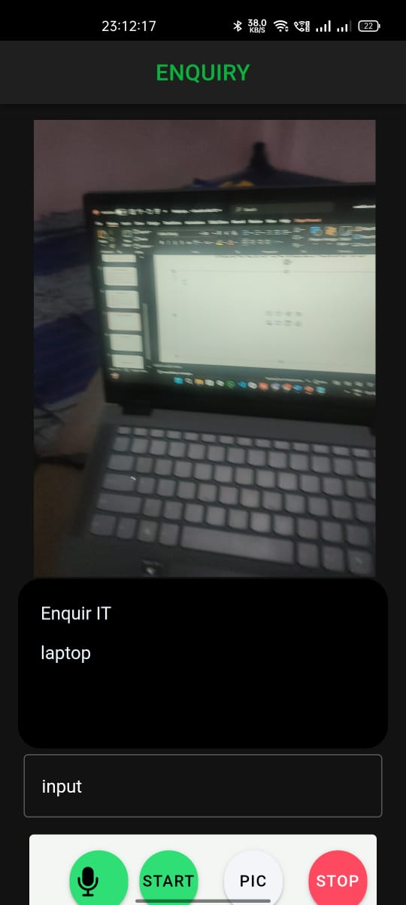
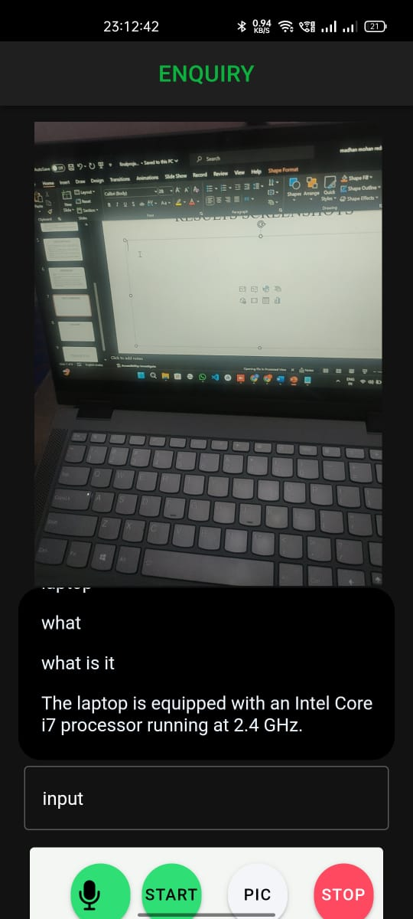
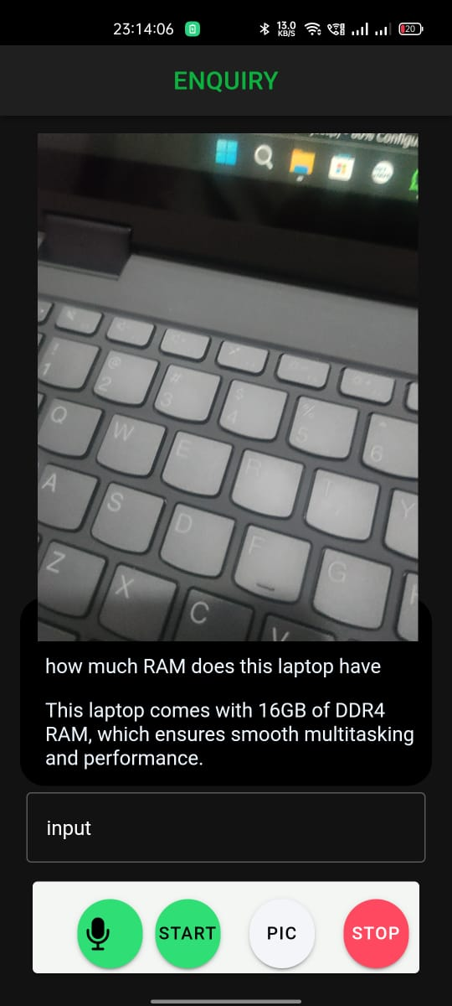
RESULTS SCREENSHOTS
fig1 Login Page fig 2 Home Page fig 3 Object Detection fig 4,5 Enquiry about Product

Slide 10
CONCLUSION
The Android Ionic app for object detection, utilizing TensorFlow's cocoSsd model, demonstrates effective use of cutting-edge technology to address real-world challenges.
Features like user authentication, camera preview, and speech capabilities enhance user experience and accessibility, ensuring seamless interaction.
The modular system architecture enables scalability and flexibility for future feature additions and performance improvements.

Slide 11
FUTURE WORK
Comprehensive testing ensures reliability, accuracy, and security, while iterative user feedback drives continuous enhancement and adaptation.
As the app evolves, future work includes exploring advanced object detection models, real-time tracking, cloud-based processing, augmented reality integration, customization options, collaborative features, edge computing, and machine learning integration to further elevate user experience and functionality.

Slide 12
THANKYOU

