Slide 1
MADHAN BABU
KEYLOGGER AND SECURITY
3/21/2024 Annual Review

Slide 2
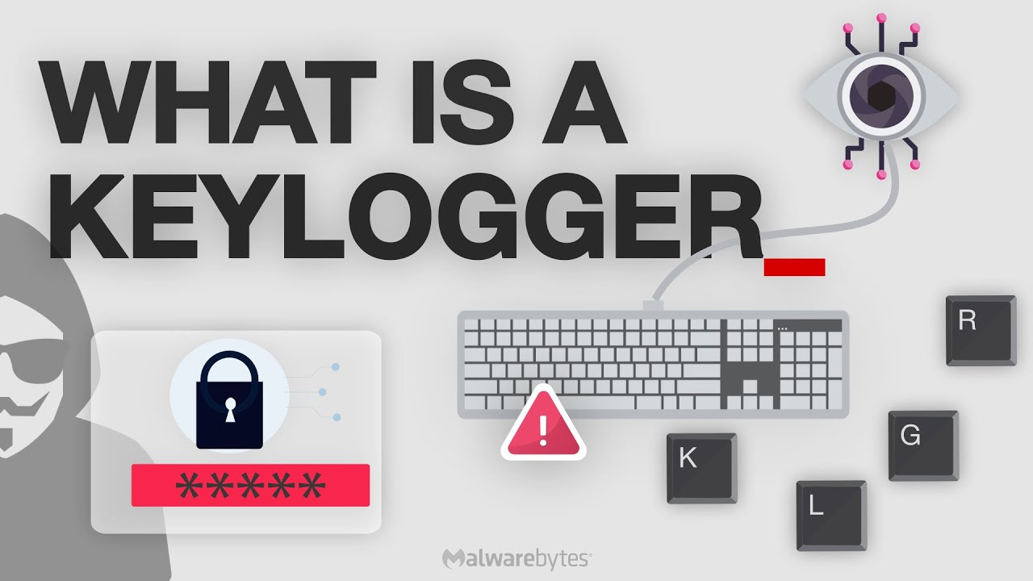
KEYLOGGER AND SECURITY
A keylogger is a type of software or hardware device designed to record keystrokes on a computer or mobile device. Its primary purpose is often to capture sensitive information such as passwords, credit card numbers, or other confidential data typed by users. Keyloggers can be used for legitimate purposes like monitoring children's online activities or employee computer usage in a corporate setting, but they can also be malicious tools used by hackers to steal personal information.
3/21/2024 Annual Review

Slide 3


AGENDA
Theft of Sensitive Information
Surveillance and Espionage
Unauthorized Access and Control
Monitoring and Control in a Domestic Context
Blackmail and Extortion
Behavioral Analysis and Targeting
Keyloggers can serve legitimate purposes in specific contexts, their malicious use poses significant threats to privacy, security, and personal safety. Understanding their agendas helps individuals and organizations take proactive measures to protect against unauthorized access and mitigate the risks associated with these intrusive tools
3/21/2024 Annual Review

Slide 4

PROBLEM STATEMENT
Keyloggers pose a significant cybersecurity threat due to their ability to surreptitiously capture keystrokes and potentially compromise sensitive information such as passwords, credit card details, and personal communications.Effective protection against keyloggers requires a multifaceted approach including robust cybersecurity measures, user education on recognizing phishing attempts.
OBJECTIVES:
Identify and categorize keyloggers.
Assess security risks.
Develop detection and prevention strategies.
Explore legal and ethical considerations.
CHALLENGES:
Detection Complexity.
Evolving Threats.
User Awareness.
Balance security and privacy.
3/21/2024 Annual Review

Slide 5

PROJECT OVERVIEW
Objective: To understand, detect, and prevent keylogger attacks, enhancing cybersecurity and protecting sensitive data for individuals and organizations.
Scope:
Identify Keyloggers:Categorize types: software (application-based, kernel-based, hypervisor-based) and hardware (inline devices, wireless keyloggers),
Develop Stategies:Detection: Use of anti-malware, network monitoring, hardware inspection.Prevention: Regular updates, two-factor authentication, virtual keyboards, user education.
Response Framework:Steps upon detection: disconnect from internet, run full system scans, change passwords, seek professional help.
Assets Risk:Examine impacts: data theft, privacy invasion, identity theft, corporate espionage.
3/21/2024 Annual Review

Slide 6

WHO ARE THE END USERS?
Law Enforecement Agencies
Parents and Guardians
Educational Institutions
Cybersecurity Professionals
Individuals
3/21/2024 Annual Review

Slide 7

YOUR SOLUTION AND ITS VALUE PROPOSITION
Solution: Implementing preventive measures and detection strategies, organizations and individuals can significantly reduce the risks associated with keyloggers and enhance overall cybersecurity posture.
Value Proposition:
Privacy Protection
Enhanced Security
Data Security
Compliance with laws
Purpose Limitation
3/21/2024 Annual Review

Slide 8

THE WOW IN YOUR SOLUTION
Compliance and Legal Adherence
Privacy Protection
Comprehensive Prevention
Ethical Standards
This approach not only secures against keylogger risks but also sets a new standard in proactive cybersecurity, instilling confidence and peace of mind in our clients.
3/21/2024 Annual Review

Slide 9
MODELLING
Threat Modeling: Identify potential vulnerabilities and attack vectors keyloggers may exploit.
Detection Model: Implement algorithms and tools to detect keylogger presence based on behavioral patterns and anomalies.
Prevention Model: Develop strategies such as software updates, network monitoring, and user education to prevent keylogger installation and operation.
Response Model: Establish protocols for immediate action upon keylogger detection, including isolation, removal, and system recovery.
3/21/2024 Annual Review

Slide 10
RESULTS
Enhanced Detection: Improved capability to identify and mitigate keylogger threats promptly.
Reduced Vulnerabilities: Minimized risk of data breaches and unauthorized access.
Improved Compliance: Ensured adherence to legal and ethical standards in monitoring practices.
Heightened Awareness: Increased knowledge and vigilance among users regarding keylogger risks and preventive measures.
3/21/2024 Annual Review

Slide 11
PROJECT LINK
https://github.com/Madhan-mdn/Madhan.git

