Slide 1
CS6650 Smart Sensing of IOT Devices
RIoT
Relative Localisation of IoT Devices
Team:
Madhan Sanikommu ee18b063
Archana Kutumbaka cs18b023
Prashasth R B cs18b039
Prof.
Ayon Chakraborty

Slide 2
Aim
Relative Localisation using EDM(Euclidean Distance Matrix) of Static Nodes
How
Classical MDS(Multi Dimensional Scaling)
Is it that easy?
Not when Noise is involved!
Missing Data!!
Why solve?
molecular conformation in bioinformatics
wireless sensor network localization
And many more!
Approach
To be continued...

Slide 3
Mathematical Motivation for our Project

Slide 4
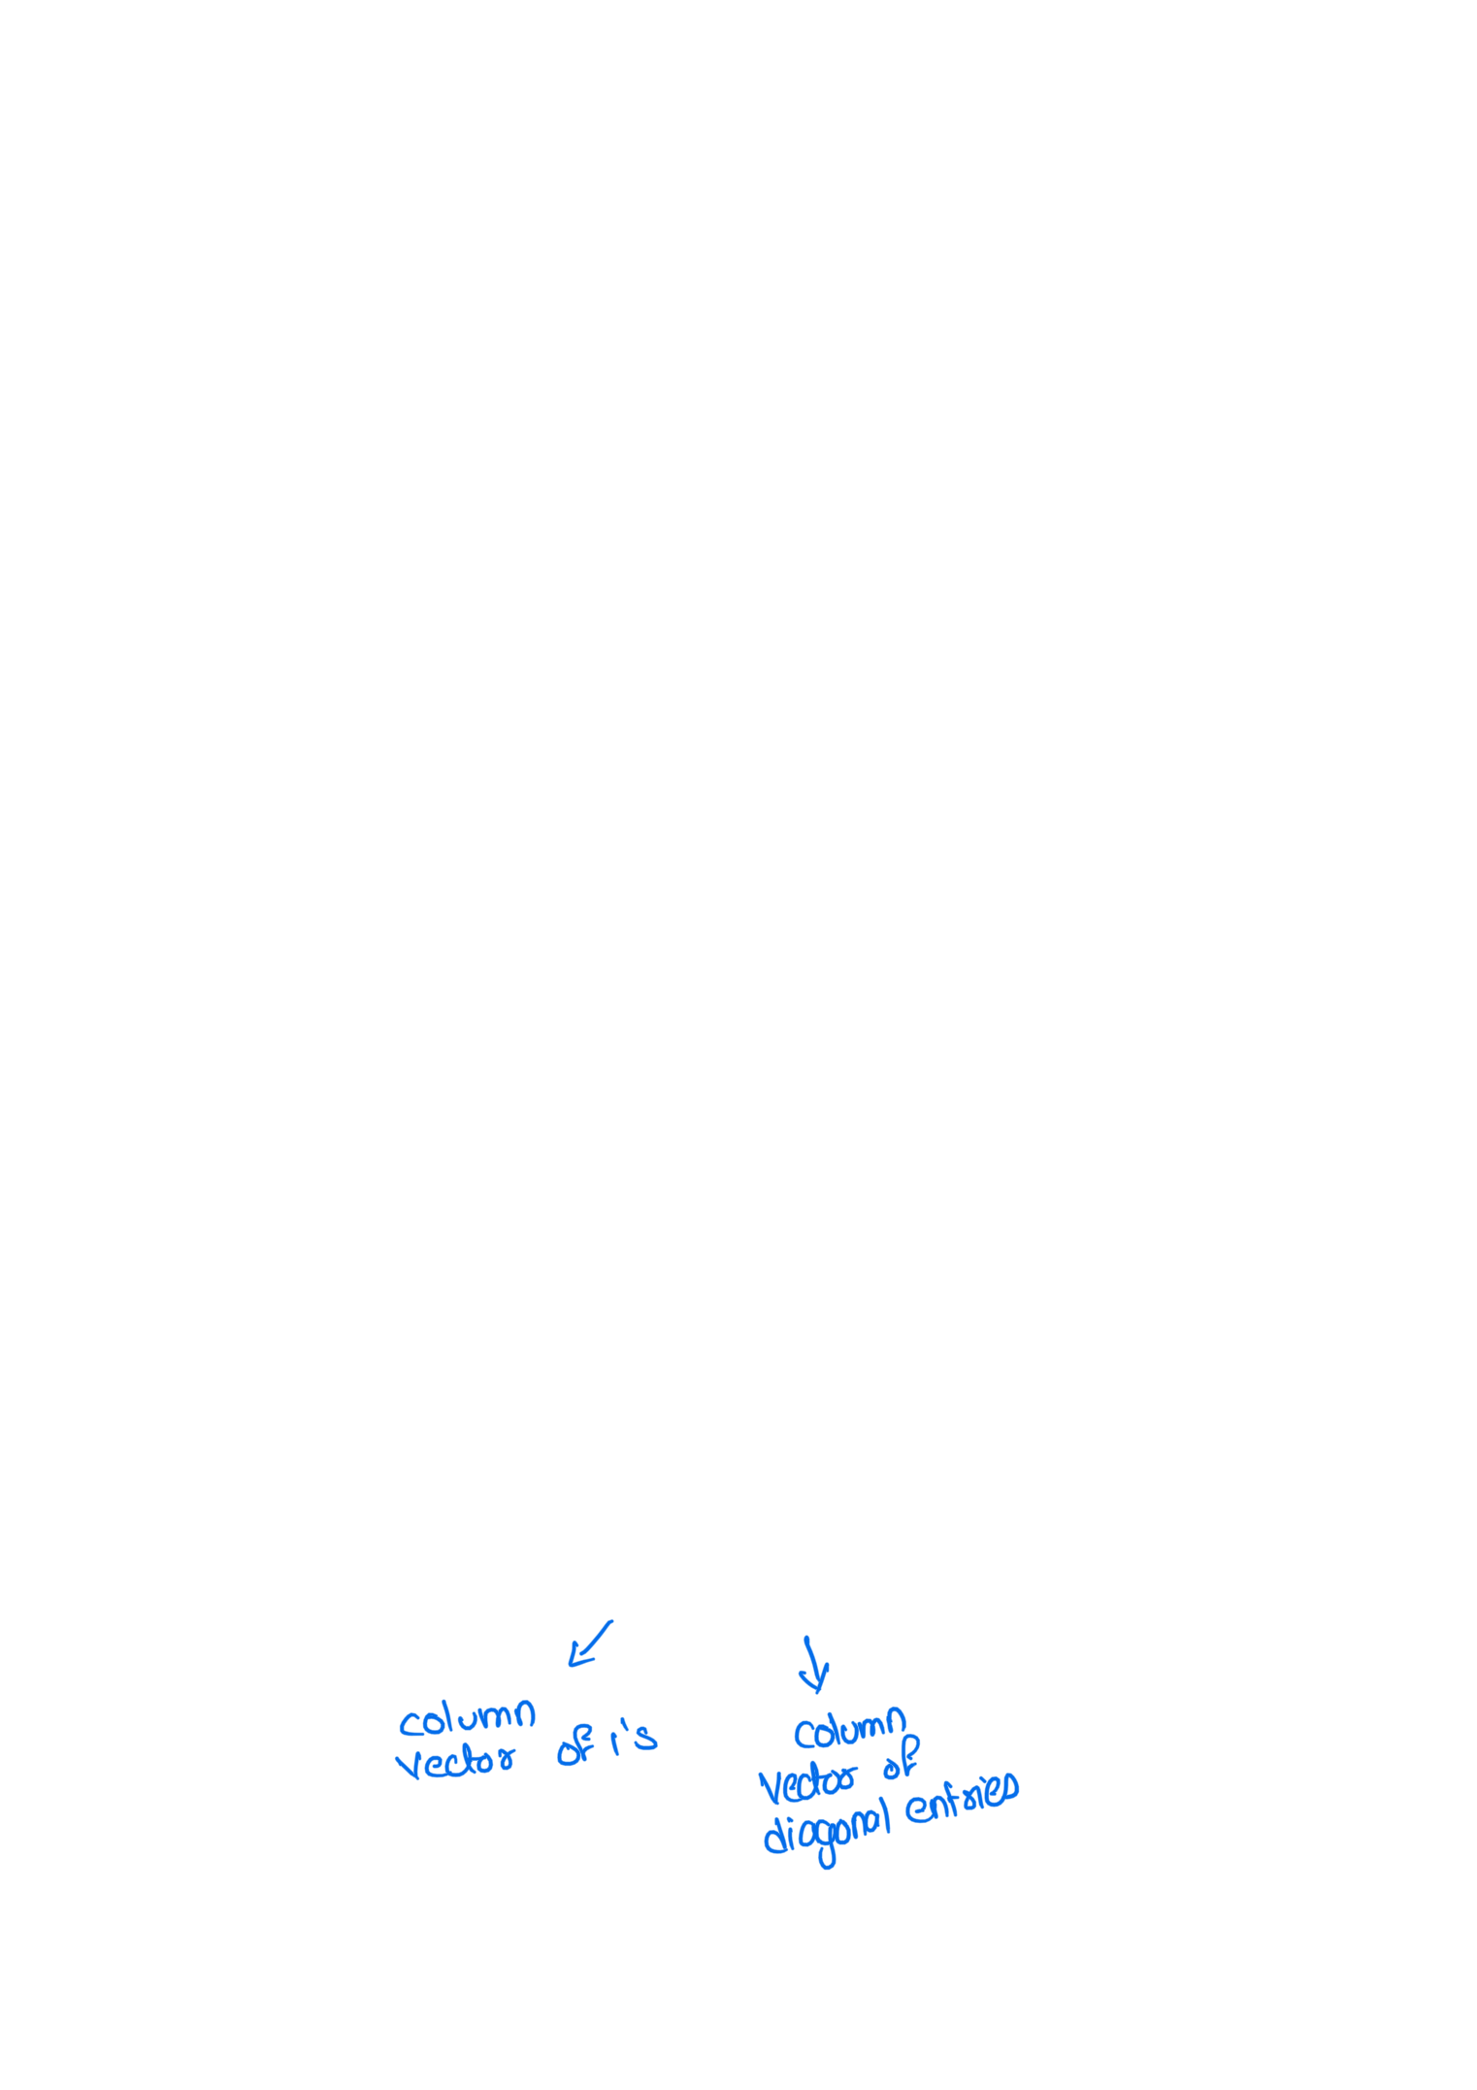

Slide 5


Slide 6


Slide 7


Slide 8


Slide 9


Slide 10


Slide 11


Slide 12


Slide 13


