Slide 1

Integrated Patient Portal
with DocAssist.
A faster, safer way to see the whole patient picture —
built once, already proven across six real, different systems.
Prepared for our clinical leadership meeting

Slide 2






Right now, every patient means
six separate logins.
Labs
MRI
X-Ray
One doctor.
One patient in front of them.
CT Scan
ECG
Treatment
6 systems. 0 shared view.

Slide 3



How we actually connect six different systems
A different ID everywhere
One index matches the person
Each format translated on the spot
Same patient — a different number in every department's system
Instantly, so nothing depends on names or guesswork
Every vendor's own shape, converted to one shared shape
Built fresh every time you ask — never a stale overnight copy.

Slide 4
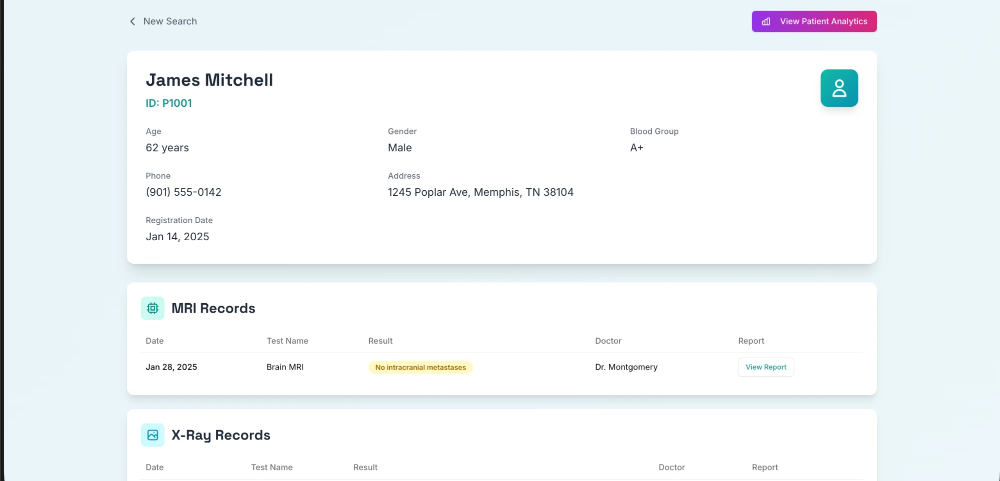
One page. Not six separate logins.
This is a real screenshot — the actual running system, one patient, every department, one page.

Slide 5


Whatever format it's in today, this adapts to it
Imaging — MRI, X-Ray, CT
DICOM
Labs
Relational database
ECG
Waveform flat-file
Every hospital
data source
Treatment / EHR
HL7 FHIR-style
Different vendors. Different formats. Already proven: six genuinely different systems, unified — not a mockup.

Slide 6



How healthcare actually solves this — at any scale
Small clinic or practice
Large hospital system
$30K – $150K
$500K – $2M
Weeks to get running
Months to years
Same underlying approach either way — a layer that connects systems that were
never built to talk to each other. Built right-sized for a center like this.

Slide 7


Built around your systems, not ours
Your systems stay exactly as they are
Nothing to rip out, nothing to replace
We build the bridge — not a new front door
Already proven: six genuinely
different systems, one view.

Slide 8



Meet DocAssist.
Ask a question about any patient, in plain English.
Get an answer grounded in their real chart — not a guess.
Reads across every department
Cites its sources every time
Cloud-based or fully private — your choice

Slide 9





How DocAssist builds every answer
Question asked
Right records found
Facts computed
Answer drafted
Checked before shown
Plain English, no special syntax
Pulled from all six systems — only what's relevant
Trends and risk flags calculated, never left to memory
Turned into clear, plain-language writing
Automatic safety checks flag anything uncertain
A real example — not the AI's memory, an actual calculation

Slide 10
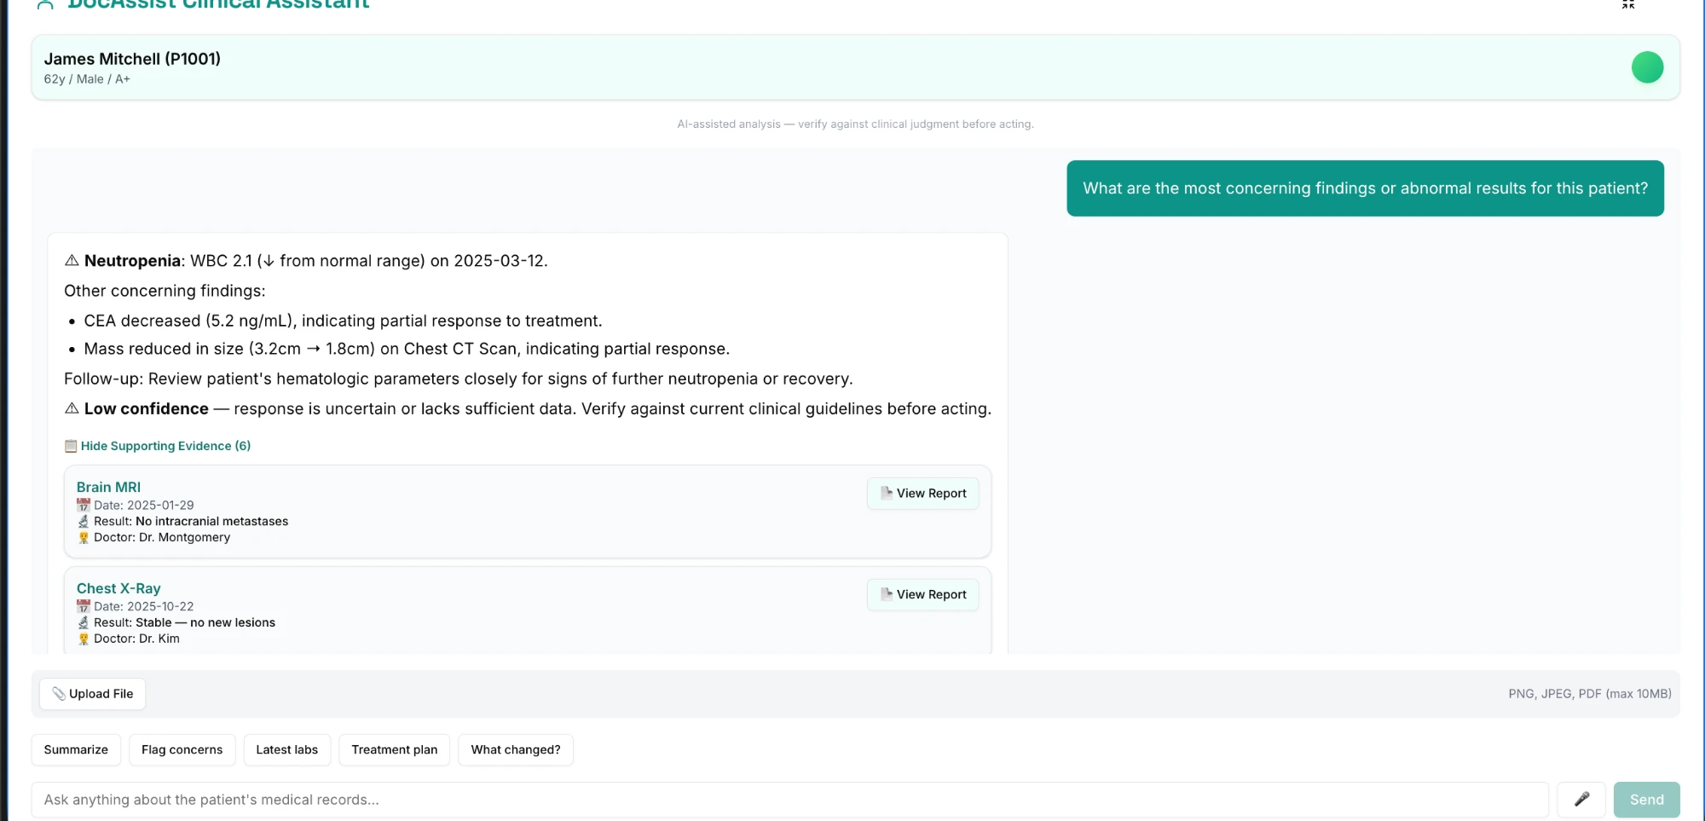
Trust, made visible
Flags what it's unsure
about — automatically
Cites its sources —
every single time
A real answer from the running system — not staged.

Slide 11

Let's see it live.
One question. Real records. Instant answer.

Slide 12
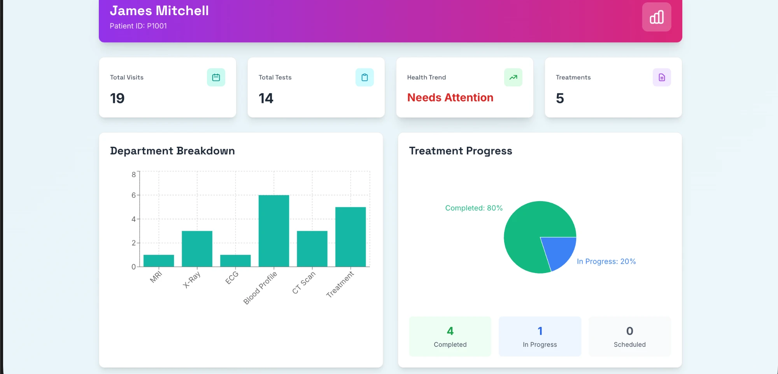



Everything, visualized
Every visit, one timeline
No more piecing it together from six tabs.
Trends surfaced automatically
Not buried in a table, not missed.
Reports one click away
The actual image, right where the answer is.

Slide 13


Built so you can trust every answer
Your data can stay fully inside your network
No requirement to send anything off-site.
Every look at a chart is logged
An audit trail that protects your staff too.
The system flags. It never decides.
You always have the final call.

Slide 14

Secure. Reliable. Flexible. Fast.
Secure
Reliable
Flexible
Fast
Role-based access and a full audit trail today — and we'll follow HIPAA guidelines end-to-end, working directly with your compliance team.
Every answer is checked against the real chart before it's shown. Known gaps are being fixed in the open, not hidden.
Already unifies six genuinely different systems — built so new capabilities can be added without a rebuild.
Every department is queried in parallel, not one at a time. A smart cache is next, for instant repeat answers.

Slide 15



Getting real access happens in stages — not all at once
Test data first
Your IT signs off
Then live, one department at a time
We connect to a sandbox, not live records
Your team reviews and approves before anything real
Never a big-bang switch-over
The same integration pattern hospitals already run — nothing new for them to adopt.

Slide 16



A small first step, not a big leap
Pilot
Prove it
Expand
One department, real data, a few weeks
Measure time saved and doctor feedback
Add departments on your timeline

Slide 17

What's on your mind?
What's the one thing slowing your team down most right now?
We'd rather build the right thing than just an impressive one.
Your feedback shapes what we build next.

