Slide 1

EMPLOYEE PERFORMANCE ANALYSIS
USING EXCEL
Presented by : B. MADHAN Register No : 312208139 Department : Commerce College : Sir Theagaraya College

Slide 2
PROJECT TITLE
Sales Department Wise salary
calculation

Slide 3
AGENDA
Problem Statement
Project Overview
End Users
Our Solution And Proportion
Dataset Description
Modelling Approach
Results And Description
Conclusion

Slide 4
PROBLEM STATEMENT
The inconsistent performance across sales departments is leading to suboptimal overall organizational performance and customer experience. Specifically, some departments are underperforming compared to their targets, while others are excelling. This disparity affects overall profitability, resource allocation, and strategic decision-making.

Slide 5
OVERVIEW ABOUT SALES DEPARTMENT WISE.
The aim of a "Sales Department Wise" analysis is to evaluate and enhance the performance of individual sales departments within an organization. This involves examining each department’s specific metrics, strategies, and challenges to improve overall efficiency and effectiveness.

Slide 6

WHO ARE THE END USERS
Employees Employers Organization Business people

Slide 7

OUR SOLUTION AND IT’S VALUE PROPOSITION
Filtering- remove missing values
Conditional Formating-blanks
Pivot table- Summary Of The Sales Department Wise
Formulas – IFS
Graphs- FINAL REPORT

Slide 8
DATA DESCRIPTION
Seller: Salesperson's name.
Department: Department to which the salesperson belongs. Revenue: Revenue generated by the salesperson on the respective day. Revenue Goal: Salesperson's revenue goal for the respective day.
Margin: Gross profit margin achieved by the salesperson on the respective day.
Margin Goal: Salesperson's profit margin goal for the respective day.
Date: Date on which the sales were recorded.
Sales Quantity: Number of customers who actually made a purchase.
Customers: Total number of customers served.

Slide 9
Modeling
Date Set: Kaggle, Sales Department Wise Feature Selection:
Data Cleaning: Missing Values Irrelevant
Formula: Performance Calculation, Low, Med, High Pivot Table: Summary, Business Unit, Gender , Employment Type, Employee Id, Performance
Chart : Report: Slicer

Slide 10
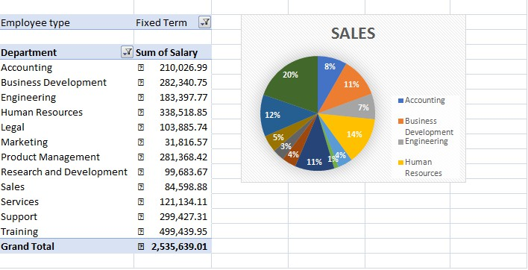
RESULT

Slide 11
CONCLUSION
The sales department's performance has been instrumental in driving our company’s growth and profitability. Each team within the department has demonstrated strengths in various areas, from customer acquisition to account management and strategic sales initiatives. The analysis reveals that while there have been notable successes, there are also areas requiring improvement.
To sustain and build on our successes, it is essential to address the identified challenges and leverage the opportunities for growth.
Enhancing training programs, optimizing sales processes, and increasing cross-departmental collaboration will be critical in achieving our sales targets and improving overall performance.

