Slide 1
BREAST CANCER CLASSIFICATION
Under:
Dr.Vergin Raja Sarobin M,
SCSE Dept,
VIT Chennai.
By:
GVS Madhan Chaithanya,
17MCA1032,
VIT Chennai.

Slide 2
Problem Statement:
Breast Cancer the most common cancer among women worldwide.
Accounting for 25% of all cases.
2.1 million people were effected in 2015.
The chances of survival has significantly increases by early diagnosis.
Key challenge in cancer detection is to classify:
Malignant
Benign
Using of Machine Learning techniques.
It can dramatically improves the accuracy of diagnosis.

Slide 3
Motivation:
Research indicates that most experience physicians:
Diagnose cancer with 79% accuracy.
Using of ML techniques:
91% accuracy is achieved by correct diagnosis.
Our task is to classify tumours into benign or malignant using some features from several images.

Slide 4
Motivation(cont..):
Using Classification Algorithms of ML:
Support Vector Machine
K-NN(K-Nearest Neighbours)
Naïve Bayes
Decision Tree
Using CNN (if possible)

Slide 5
Literature Survey: 1:
Breast Cancer Detection with Reduced Feature Set
AhmetMert,1 Niyazi KJlJç,2 Erdem Bilgili,1 and Aydin Akan
Hindawi Publishing Corporation Computational and Mathematical Methods in MedicineVolume 2015, Article ID 265138, 11 pages (http://dx.doi.org/10.1155/2015/265138)

Slide 6
Literature Survey: 2:
Support vector machines combined with feature selection for breast cancer diagnosis.-Mehmet Fatih Akay
Expert Systems with Applications (2009) 3240–3247
[0957-4174/$ - see front matter 2008 Elsevier Ltd. All rights reserved. doi:10.1016/j.eswa.2008.01.009]

Slide 7
Literature Survey: 3:
Breast Cancer Classification Using Machine Learning
Meriem AMRANE1 Saliha OUKID2 Computer Science Department.
IEEE Conference ©2018.

Slide 8
Literature Survey: 4:
Breast Cancer Diagnosis by using k-Nearest Neighbor with Different Distances and Classification Rules
[International Journal of Computer Applications (0975 - 8887)Volume 62 - No. 1, January 2013]

Slide 9
Requirements:
OS : windows 10.
Coding: Python-3.
Platform : Anaconda Distribution
Jupyter (or)
Spyder
Dataset:
https://archive.ics.uci.edu/ml/datasets/Breast+Cancer+Wisconsin+%28Diagnostic%29

Slide 10


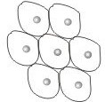
Cancer Diagnosis Procedure:
TUMOUR IMAGES
FEATURES
CLASSIFICATION
FINE NEEDLE ASPIRATE(FNA)
MALIGNANT
RADIUS
TEXTURE
PERIMETER
AREA
SMOOTHNESS
BENIGN

Slide 11
ML Terms(Dataset):
MALIGNANT
RADIUS
TEXTURE
PERIMETER
AREA
SMOOTHNESS
CLASSIFIER
BENIGN

Slide 12
Dataset:
Number of instances: 569
Class distribution:
212 Malignant
357 Benign

Slide 13
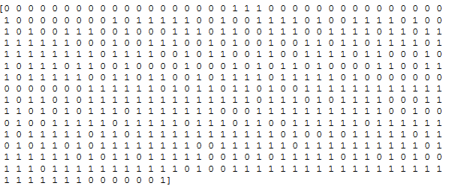
Expected Output:
Based on this:
What we do
How we treat the classifier(training it)
When teach it – how we classify it
Looking into 30 features from that we are teaching the target class.
0 - Malignant
1 - Benign
It’s a binary kind.

Slide 14
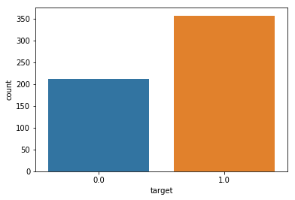
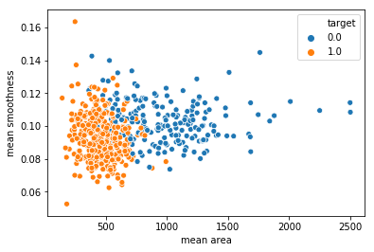
Visualizing the Data:

Slide 15
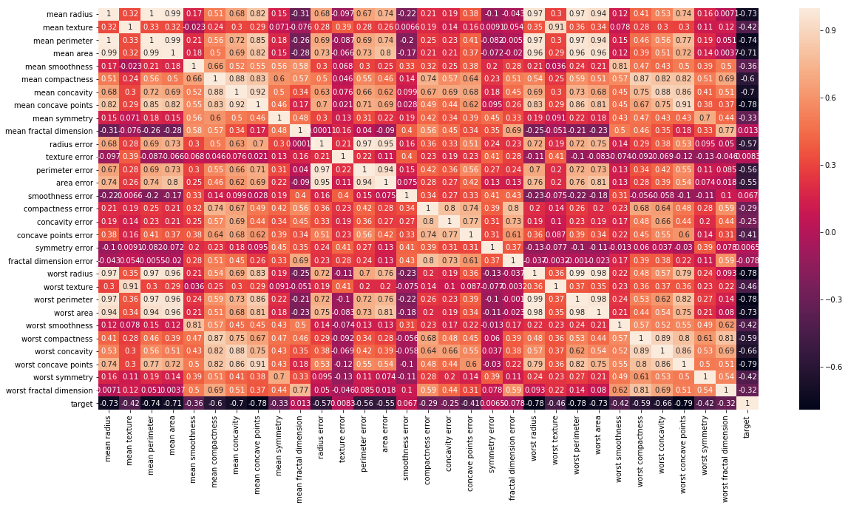
Correlation of Feature Names:

Slide 16
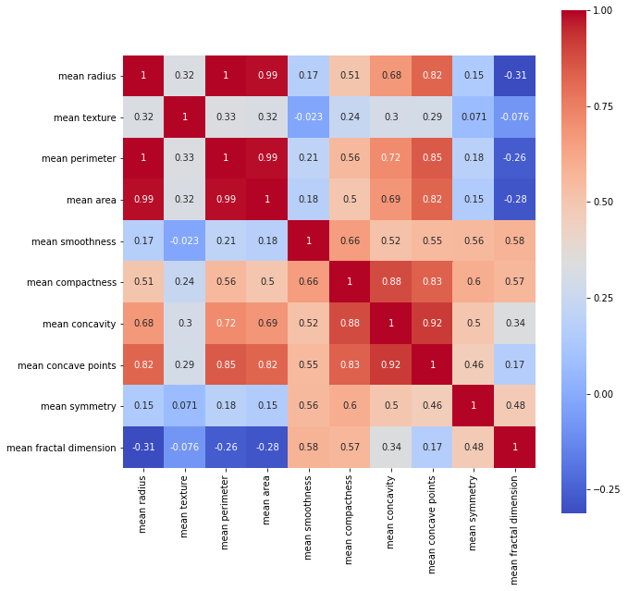
Correlation of Feature Mean:

Slide 17
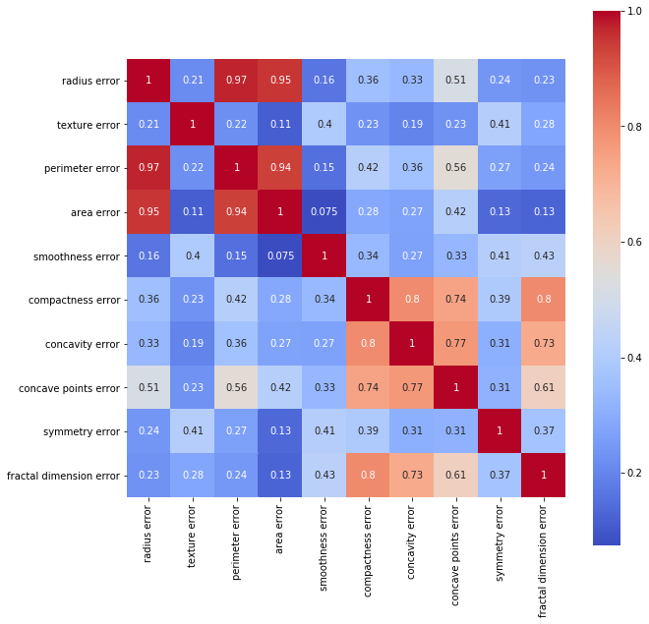
Correlation of Feature Errors:

Slide 18
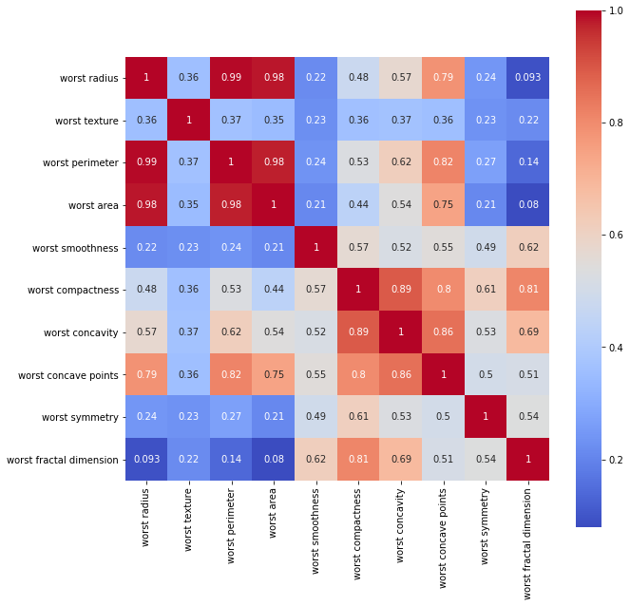
Correlation of Features Worst:

Slide 19
Model Training & Testing:
X_train, X_test, y_train, y_test = train_test_split(X, y, test_size = 0.25, random_state = 5)
print(X_train.shape, X_test.shape, y_train.shape, y_test.shape)
Output:

Slide 20
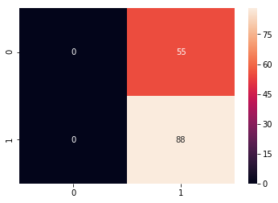
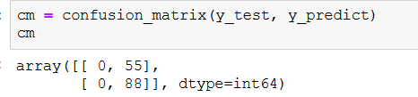
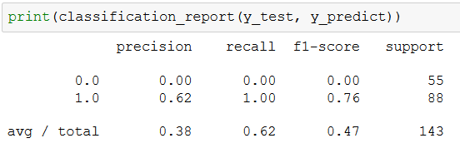
SVM Results:
Directly applying SVM

Slide 21
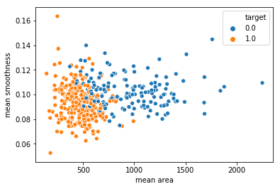
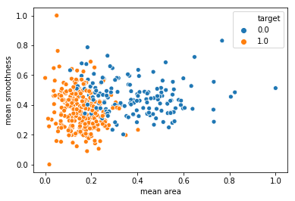
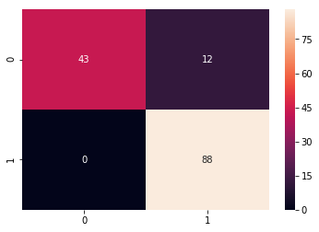
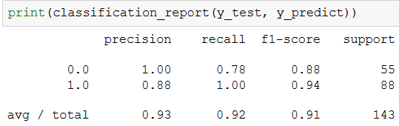
SVM Results(Cont)
Improving the Model by applying Data Normalization

Slide 22
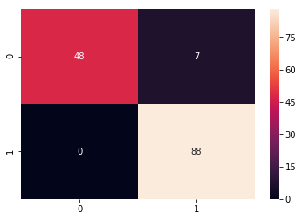
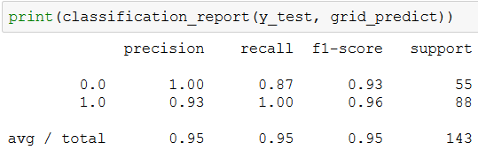
SVM Results(cont):
Improving the model by using – ‘C’ , ‘gamma’ parameter through by applying kernel = ‘rbf’.
param_grid = {'C':[0.1,1,10,100], 'gamma':[1,0.1,0.01,0.001], 'kernel':['rbf']}

Slide 23
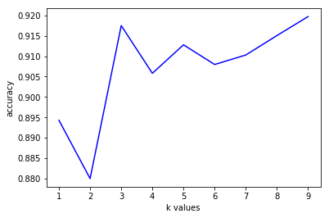
KNN Results:
By applying the cross validation score model

Slide 24
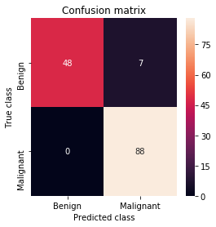
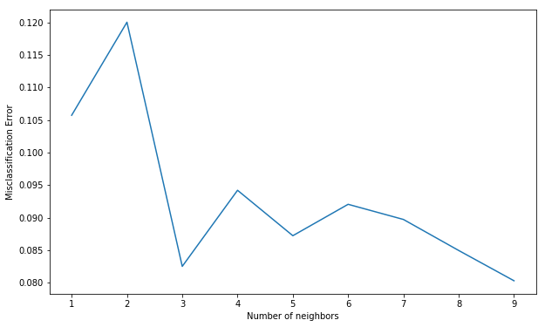
KNN Results:
By applying misclassification error.
Output : The optimal number of neighbors is 9

Slide 25
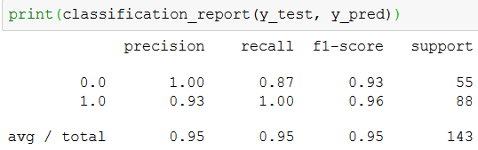
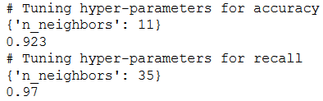
KNN Results:
By applying grid search of accuracy and recall.

Slide 26
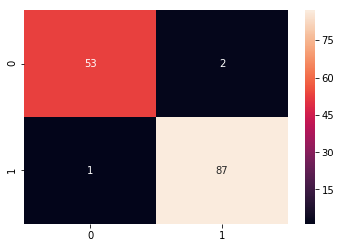
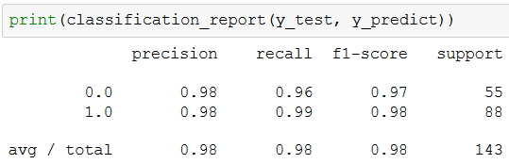
Logistic Regression:
By applying the default things we get

Slide 27
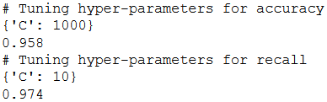
Logistic Regression:
By applying the parameter grid for accuracy and recall we get

Slide 28
Project Plan For Final :
Showing the results by using:
Decision Tree Classifier & Random Forest Classifier.
By tuning the parameters also.
Lastly providing the comparative best one.

Slide 29
References:
[1] Breast Cancer Detection with Reduced Feature Set. AhmetMert,1 Niyazi KJlJç,2 Erdem Bilgili,1 and Aydin Akan2 1Department of Electrical and Electronics, Piri Reis University, 34940 Istanbul, Turke2Department of Electrical and Electronics, Istanbul University, 34320 Istanbul, Turkey(Hindawi Publishing Corporation Computational and Mathematical Methods in MedicineVolume 2015, Article ID 265138, 11 pages(http://dx.doi.org/10.1155/2015/265138)
[2] Breast Cancer Classification Using Machine Learning. Meriem AMRANE1Saliha OUKID 2 Computer Science Department, LRDSI Laboratory, University of Blida 1, Blida, Algeria Ikram GAGAOUA3 Tolga ENSAR􀃸4 Computer Engineering, Istanbul University,Istanbul, Turkey[78-1-5386-5135-3/18/$31.00 ©2018 IEEE
[3] Breast Cancer Classification of Image using Convolutional Neural Network.[978-1-5386-3039-6/18/$31.00©2018 IEEE]
[4] Breast Cancer Diagnosis by using k-Nearest Neighbor with Different Distances and Classification Rules[International Journal of Computer Applications (0975 - 8887)Volume 62 - No. 1, January 2013]
[5]Support vector machines combined with feature selection for breast cancer diagnosis. Mehmet Fatih Akay *Department of Electrical and Electronics Engineering, Cukurova University, Adana 01330, Turkey. [0957-4174/$ - see front matter 2008 Elsevier Ltd. All rights reserved. doi:10.1016/j.eswa.2008.01.009]
[6] https://www.cancer.gov/about-cancer/diagnosis-staging/diagnosis
[7] https://www.cancer.org/treatment/understanding-your-diagnosis/tests/testing-biopsy-and-cytology-specimens-for-cancer/how-is-cancer-diagnosed.html

Slide 30
Thank You

