Slide 1




FIRE INCIDENT ANALYSIS
Madhan Jothimani, YongxinYe, Simin Bai
College of Professional Studies, Northeastern University
ALY6140 20407: Python & Analytics Technology
Professor Zhi He
February 12, 2025

Slide 2

INTRODUCTION
Fire incidents cause significant property damage, making predictive models essential for forecasting high-loss events. This study analyzes fire incident data to identify key factors contributing to severe losses, aiming to improve prediction accuracy and support fire prevention strategies. Three modeling methods are used: logistic regression for classifying event severity, random forest for predicting high-loss likelihood, and time series analysis for identifying temporal patterns and seasonal trends in fire incidents, and building a Plotly choropleth map to visualize fire incidents across Boston neighborhoods.

Slide 3
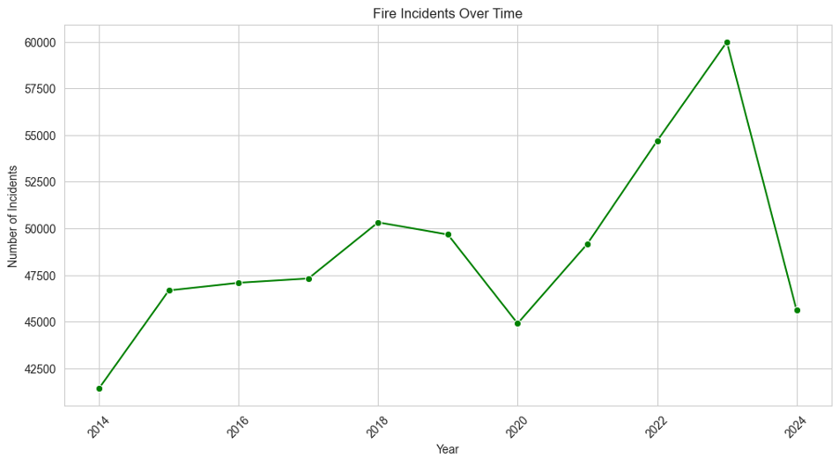
EXPLORATORY DATA ANALYSIS
Steady increase until 2018, followed by a decline in 2019-2020 (COVID-19 impact).
Sharp rise in 2021-2023, peaking in 2023 (~60,000 incidents).
2024 shows a decline, possibly due to improved safety measures.

Slide 4
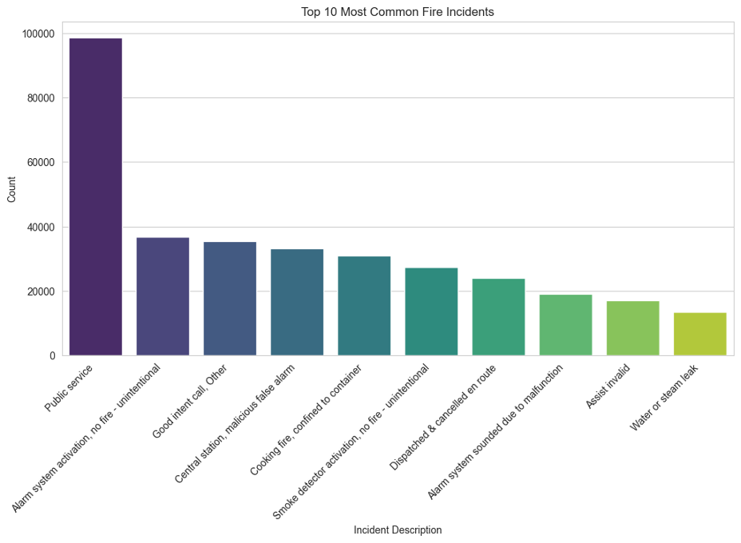
EXPLORATORY DATA ANALYSIS
Most Common Fire Incidents
Public service calls dominate (~100,000 occurrences).
False alarms and cooking-related fires are significant.
Emergency responses often involve non-fire incidents.

Slide 5
PREDICTIVE MODELS——RANDOM FOREST
Questions
What are the main reasons for high property losses in fires?

Slide 6
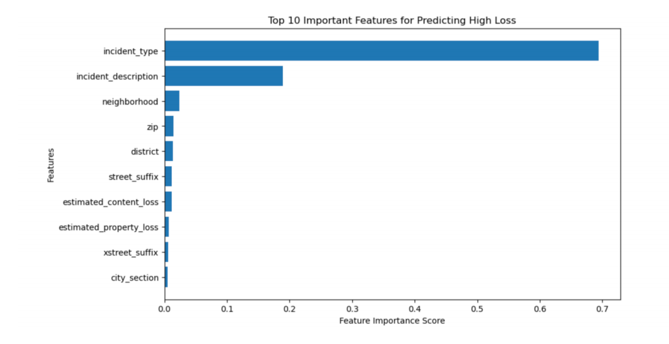
PREDICTIVE MODELS-- RANDOM FOREST
Random Forest Model for High-Loss Fire Prediction
The x-axis represents feature importance scores, where higher values indicate stronger influence in predicting high-loss fire incidents.

Slide 7
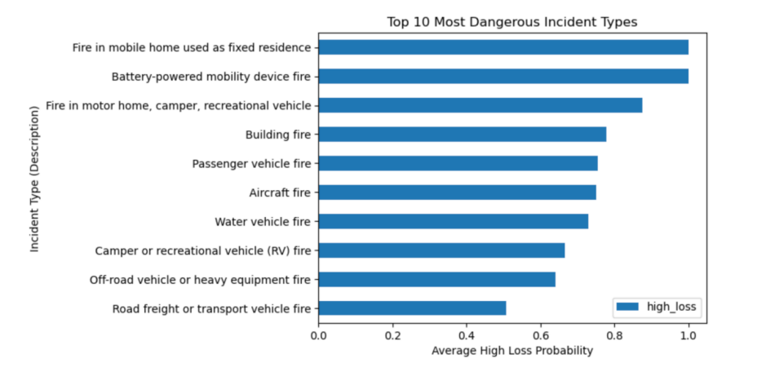
PREDICTIVE MODELS-- RANDOM FOREST
Key Predictors for High-Loss Fire Incidents
The highest risk categories：
Fires in mobile homes
Battery-powered mobility devices
Recreational vehicles

Slide 8
PREDICTIVE MODELS——LOGISTIC REGRESSION
Questions
How can we classify fire incidents based on severity ?

Slide 9
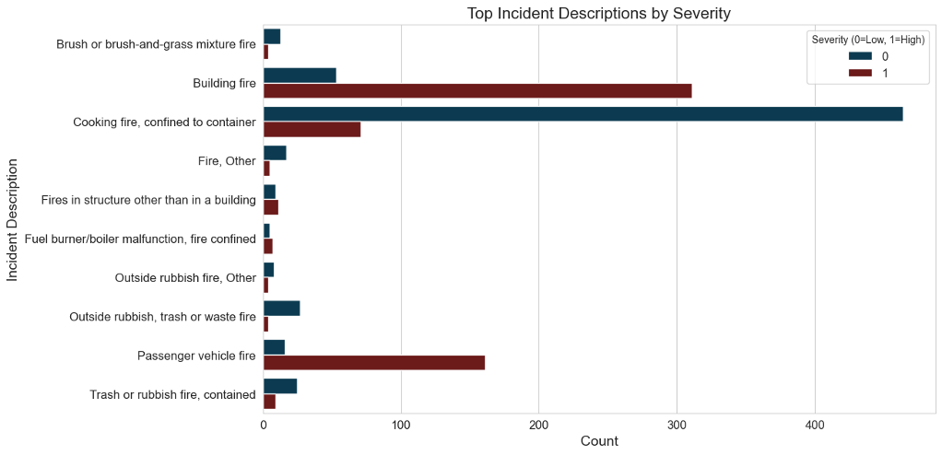
PREDICTIVE MODELS—— LOGISTIC REGRESSION
We calculated a threshold value by computing the Property loss and content loss, which helped us in classifying incidents based on severity.

Slide 10
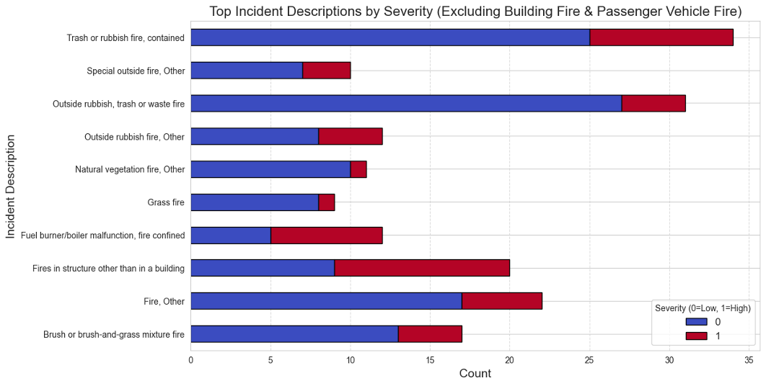
PREDICTIVE MODELS——TIME SERIES ANALYSIS
Most Frequent Incidents: Trash/rubbish fires and outside waste fires—mostly low severity.
High-Severity Risks: Structural fires, boiler malfunctions, and undefined fires have a significant portion of severe cases.
Vegetation & Grass Fires: Less frequent but can escalate in severity.

Slide 11
PREDICTIVE MODELS——TIME SERIES ANALYSIS
Questions 1
What are the temporal patterns in fire incidents, such as seasonality or trends over the years?

Slide 12

PREDICTIVE MODELS——TIME SERIES ANALYSIS
Capture long-term dependencies through self-attention mechanisms and its lower error in capturing outlier fluctuations than traditional models (e.g. ARIMA, Prophet)can better analyze the nonlinear mutation of data
Captures seasonal trends and predicts future fire occurrences.
Provide data support for the accurate prevention and control of Boston fire.
Predicted fire occurrences for 2025, showing a similar seasonal pattern

Slide 13
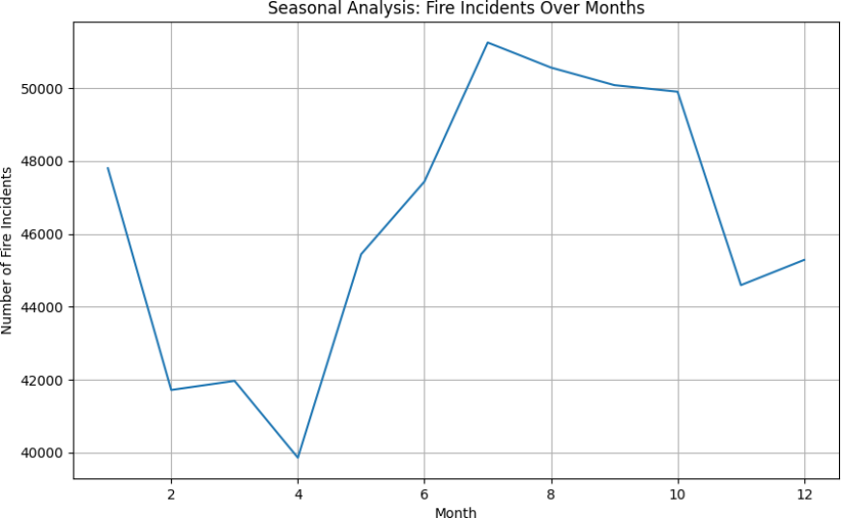

PREDICTIVE MODELS——TIME SERIES ANALYSIS
We can see from the analysis of 2014-2024 Boston fire data by time series model, the peak period of Boston fire analysis is from June to October (summer to early autumn); The highest peak occurred in July (about 57,000). The low point ranges from January to
April, with the lowest value occurring in April (about 40,000 cases).
Impact of high summer temperatures, surging electricity consumption and increased outdoor activities.

Slide 14

PREDICTIVE MODELS——TIME SERIES ANALYSIS
Hyperparameters: 20 epochs, batch size 32, Adam optimizer with learning rate 0.001.
Learning Rate Scheduling: Step decay (gamma=0.1 every 5 epochs).
The model training process
Accuracy: Achieved 92.3% test accuracy, indicating robust classification performance.

Slide 15
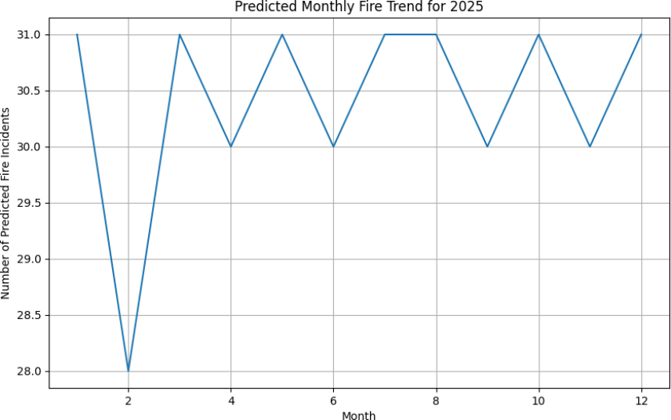
PREDICTIVE MODELS——TIME SERIES ANALYSIS
Using the resulting historical seasonality to forecast the fire situation in Boston in 2025, the monthly trend is the lowest in February (28 incidents), possibly due to people being restricted from outdoor activities by extreme snowfall.
Then comes the value has been fluctuating between 30 and 31.
The continuous peak peak occurred in July-August (31 incidents), which is consistent with historical seasonal patterns.

Slide 16
GEOSPATIAL ANALYSIS: HIGH-RISK AREAS IN BOSTON
Questions 2
What parts of Boston are more prone to have a fire or a serious fire incident?

Slide 17
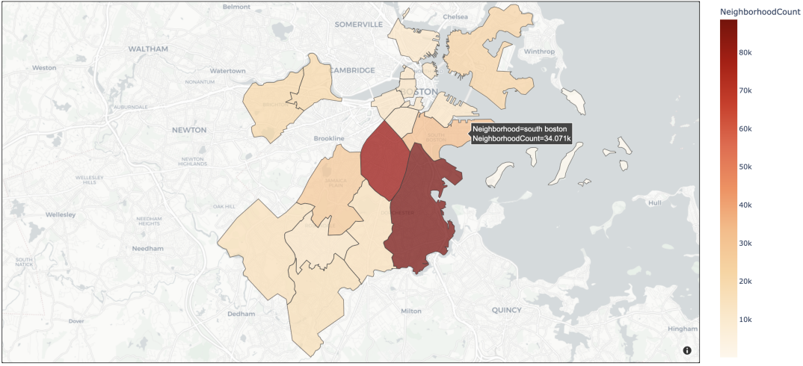

PLOTLY CHOROPLETH MAP OF FIRE OCCURRENCES IN BOSTON
Roxbury
Dorchester

Slide 18



GEOSPATIAL ANALYSIS: HIGH-RISK AREAS IN BOSTON
Roxbury and Dorchester identified as the most fire-prone areas.
Factors contributing to fire risk:
• Aging infrastructure and older buildings.
• High population density.
• Crime rates and abandoned properties increasing arson risk.

Slide 19
CONCLUSION
Our study integrates random forest, logistic regression, and time series analysis to predict high-loss fire incidents. The random forest model identifies key predictors, such as fires in mobile homes, battery-powered mobility device fires, and vehicle-related fires, which are most likely to result in significant financial loss. Logistic regression classifies fire incidents by severity, aiding in risk prioritization. Time series analysis reveals seasonal trends, showing fire incidents peak in summer (June-October). By combining these models, we improve prediction accuracy, optimize resource allocation, and enhance fire prevention strategies for high-risk events like EV fires and outdoor equipment failures.

Slide 20
REFERENCE
1.City of Boston. (2024, December 9). Fire Incident Reporting [Dataset]. City of Boston's Open Data
Portal.https://data.boston.gov/dataset/fire-incident-reporting/resource/91a38b1f-8439-46df-ba47-
a30c48845e06
2. Marco Casalaina. (2024, November 11). The Future of AI: Generative AI for Time Series
Forecasting. Retrieved from https://techcommunity.microsoft.com/blog/aiplatformblog/the-future-of?
ai-generative-ai-for-time-series-forecasting-a-look-at-nixtla-time/4289510
3. Milanović, S., Marković, N., Pamučar, D., Gigović, L., Kostić, P., & Milanović, S. D. (2021). Forest Fire
Probability Mapping in Eastern Serbia: Logistic Regression versus Random Forest Method. Forests,
12(1), 5-. https://doi.org/10.3390/f12010005
4. Rathnayake, R. M. D. I. M., Sridarran, P., & Abeynayake, M. D. T. E. (2020, March). Factors contributing
to building fire incidents: A review. In Proceedings of the International Conference on Industrial
Engineering and Operations Management, Dubai, United Arab Emirates (pp. 10-12).
https://www.ieomsociety.org/ieom2020/papers/138.pd
5. IBM Technology. (2022). What is Random Forest? [Video]. YouTube.
https://youtu.be/gkXX4h3qYm4

Slide 21
THANK YOU

