Slide 1
Web Services Basics
Nandakumar Kuthalaraja (392330)
Developer | CenturyLink
TATA Consultancy Services

Slide 2
Agenda
Web Services Basics
Intro to Apache Axis
Web Services in Java
  Developing a Service
    Top Down Approach
    Bottom Up Approach
  Consuming a Service
Web Services in .NET
  Developing a Service
  Consuming a Service

Slide 3
Outline
Web Services Basics
  What is Web Service?
  Web Services Architecture
  Reasons To Use of Web Service
  XML Messaging
    XML-RPC
    SOAP
  What is WSDL?
  Development plan for Service Requestor
  Development plan for Service Provider
TATA Consultancy Services

Slide 4
Outline
Intro to Apache Axis
  What is Apache Axis?
  Architecture of Apache Axis
  Features of Apache Axis
TATA Consultancy Services

Slide 5
What is Web Service?
Definition:
  Software components that can be published, located, and run over the Internet using Extensible Markup Language (XML)
Used to:
  Allow other applications to call modules of code remotely with XML
  Send XML messages
TATA Consultancy Services

Slide 6
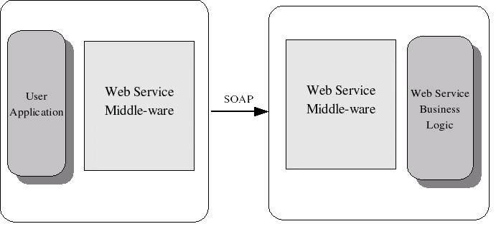
WebService Architecture
TATA Consultancy Services

Slide 7
Web Services Architecture
There are two ways we can view Web Services
architecture
  Web Service Roles
  Web Service Protocol Stack
TATA Consultancy Services

Slide 8
Web Service Roles
There are three major roles
Logically Centralized directory of services
Service
Registry
2) Discover services
1) Register service
Service
Requestor
Service
Provider
3) Invoke service
Consumer of the Web Service
Provider of the Web Service
TATA Consultancy Services

Slide 9
Web Service Protocol Stack
Discovery UDDI
Responsible for centralizing services
Description WSDL
Responsible for describing the public interface to a specific web service
XML Messaging XML-RPC,SOAP,XML
Responsible for encoding messages in common XML format
Transport HTTP,SMTP,FTP,BEEP
Responsible for transporting messages
TATA Consultancy Services

Slide 10
Reasons To Use
Applications can be built that are:
  Platform-independent
  Distributed
  Secure
Web services will become the common architecture for system and application integration
  Based on open industry standards
Companies and government agencies will be able to easily communicate with customers and external partners
Loosely-coupled and flexible systems are more useful than hard-wired and monolithic ones
TATA Consultancy Services

Slide 11
Reasons To Use
Developers will be able to integrate applications:
  Quickly
  Easily
  Inexpensively
Software development and maintenance time will be reduced
  Increase efficiency
Data can be secured using industry standard security methods:
  Secure Socket Layer (SSL) protocol
  Public-key certificates
  WS-Security
TATA Consultancy Services

Slide 12
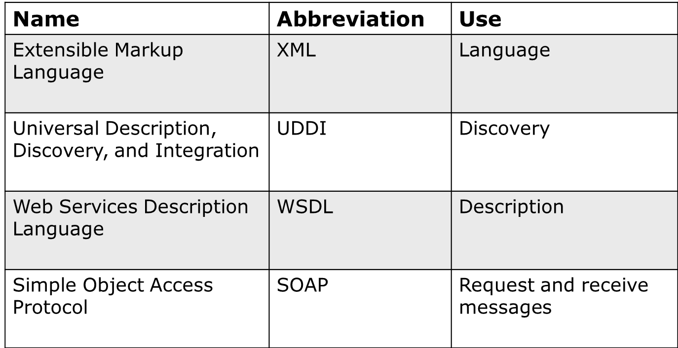
Web Service Technologies
TATA Consultancy Services

Slide 13
XML Messaging
There are two ways of XML Messaging
XML-RPC
SOAP
TATA Consultancy Services

Slide 14
What is XML-RPC ?
is a simple protocol that uses XML messages to perform RPC
Request are encoded in XML and send via HTTP
Response are encoded in XML and received via HTTP
is a easiest way to get started with web services
TATA Consultancy Services

Slide 15
Sample XML-RPC Request
<methodCall>
<methodName>
com.agram.sayHello
</methodName>
<params>
<param>
<value>Java</value>
</param>
</params>
</methodCall>
TATA Consultancy Services

Slide 16
Sample XML-RPC Response
<methodResponse>
<params>
<param>
<value>
<string>Hello Java</string>
</value>
</param>
</params>
</ methodResponse >
TATA Consultancy Services

Slide 17
What is SOAP?
Simple Object Access Protocol
SOAP is slightly more complicated than the XML-RPC
SOAP extended XML-RPC
It uses XML namespaces and XML Schemas.
TATA Consultancy Services

Slide 18
SOAP Message
Envelope is like a wrapper for content
Header is a optional element that could contain control information
Body element includes requests and responses
Body element will include a Fault element in the event of an error
SOAP Message
Envelope
Header
Body
TATA Consultancy Services

Slide 19
Sample SOAP Request
<SOAP-ENV:Envelope
xmlns:xsd="http://www.w3.org/2001/XMLSchema"
xmlns:SOAP-ENV=http://schemas.xmlsoap.org/soap/envelope/
xmlns:xsi="http://www.w3.org/2001/XMLSchema-instance">
<SOAP-ENV:Body>
<ns1:sayHello
xmlns:ns1="http://agram.com/">
<name xsi:type="xsd:string">Java</name>
</ns1:sayHello>
</SOAP-ENV:Body>
</SOAP-ENV:Envelope>
TATA Consultancy Services

Slide 20
Sample SOAP Response
<SOAP-ENV:Envelope
xmlns:xsd="http://www.w3.org/2001/XMLSchema"
xmlns:SOAP-ENV=http://schemas.xmlsoap.org/soap/envelope/
xmlns:xsi="http://www.w3.org/2001/XMLSchema-instance">
<SOAP-ENV:Body>
<ns1:sayHelloReponse
xmlns:ns1="http://agram.com/">
<result xsi:type="xsd:string">Hello Java</result> </ns1:sayHelloResponse>
</SOAP-ENV:Body>
</SOAP-ENV:Envelope>
TATA Consultancy Services

Slide 21
What is UDDI?
Web service equivalent of the Yellow Pages
Organizations register their Web services in a global directory so clients can find them
Scope:
  Applications will be able to dynamically discover
  new Web services and automatically call them
Functionality:
  Provides a layer of software abstraction between
  Web services and client applications
  Example – The URL address of a Web service changes
UDDI is a Web service (uses XML and SOAP)
TATA Consultancy Services

Slide 22
What is WSDL?
Web Services Description Language
Has 6 major elements
  definitions – defines the name of the web service
  types – describes all the data types that will be transmitted
  message – defines the name of the message that will be transmitted
  portType – defines the operations
  binding – defines how the message will be transmitted
  service – defines where the service is located
TATA Consultancy Services

Slide 23
Development plan for Service Requestor
1) Find web service via UDDI
2) Retrieve service description file
3) Create XML-RPC or SOAP client
4) Invoke remote service
TATA Consultancy Services

Slide 24
Development plan for Service Provider
1) Create the core functionality
2) Create XML-RPC or SOAP service wrapper
3) Create service description file
4) Deploy service
5) Register new service via UDDI
TATA Consultancy Services

Slide 25
What is Apache Axis?
“Axis is essentially a SOAP engine – a
framework for constructing SOAP
processors such as clients , servers,
gateways etc”
- Axis Website
TATA Consultancy Services

Slide 26
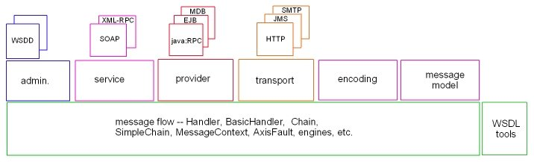
Architecture of Apache Axis
TATA Consultancy Services

Slide 27
Architecture of Apache Axis
Admin Sub-system
    handles administration and configuration of the server
Service Sub-system
    implements the RPC exchange protocol
Provider Sub-system
    is the interface between Axis server and the external component methods that are to be exposed as webservice
Transport Sub-system
    receives and delivers the message from the service sub system
Encoding Sub-system
    manages encoding/decoding and serilization/deserilization between XML data types and Java Classes
Message Sub-system
    defines the structure of the different elements of a SOAP message and provides functionality for binding and parsing the different elements of these messages
TATA Consultancy Services

Slide 28
Features of Apache Axis
Successor to Apache SOAP
It can run as a standalone server or as an a server that plugs into Servlet engine like Tomcat
Automatic WSDL generation for deployed services
Java2WSDL – to generate WSDL from Java interface
WSDL2Java – to generate Java classes from WSDL
Easy deployment
Uses JAX-RPC API
TATA Consultancy Services

Slide 29
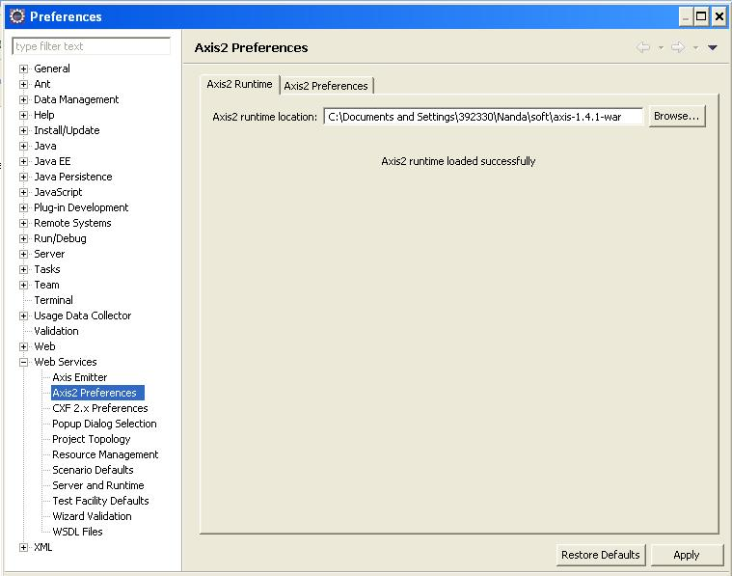
Setting Apache AXIS2 into the Eclipse Workspace
Get the binary/war distribution of AXIS2 1.4.1 from the internet and set the ECLIPSE preference by,
Window->Preferences

Slide 30
Approaches in creating Web Services (Java)
Bottom Up Approach
Top Down Approach
TATA Consultancy Services

Slide 31
Bottom Up Approach
TATA Consultancy Services

Slide 32
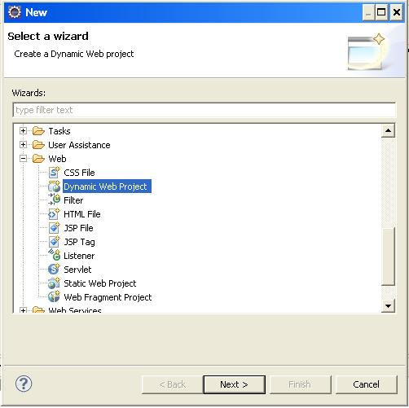
1. To develop a basic Java Bean for the Web Services.
Select Dynamic Web Project

Slide 33
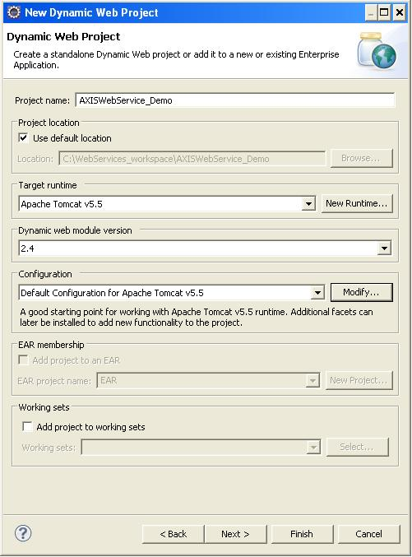

Slide 34
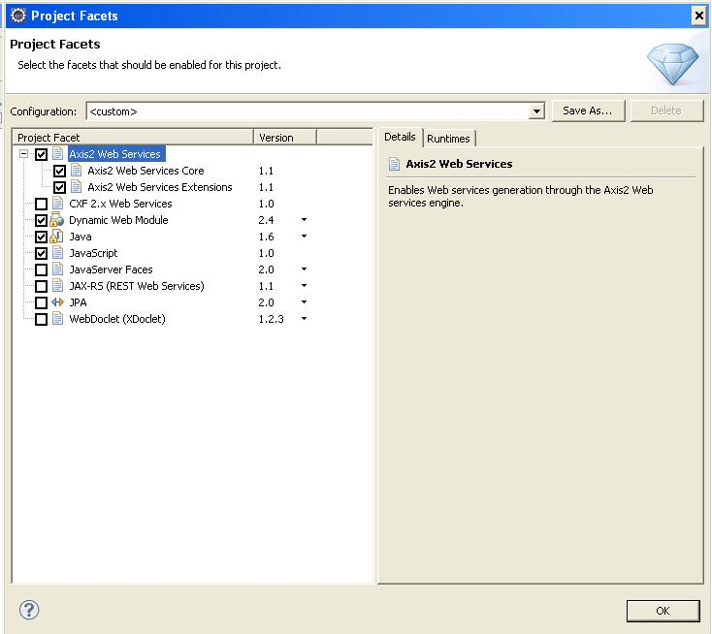
2. To set the Project Facets for Axis Run time

Slide 35
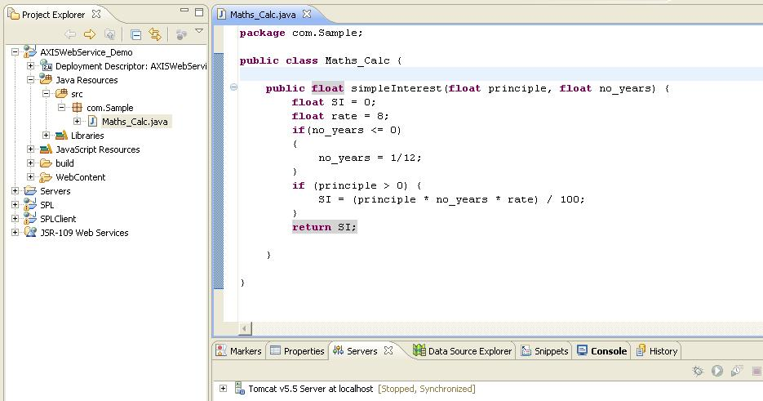
3. Write the Bean with the service method and save it

Slide 36
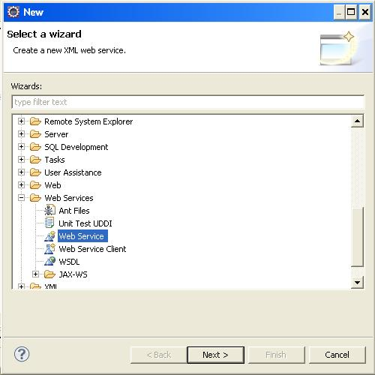
4. Creating a Web Service

Slide 37
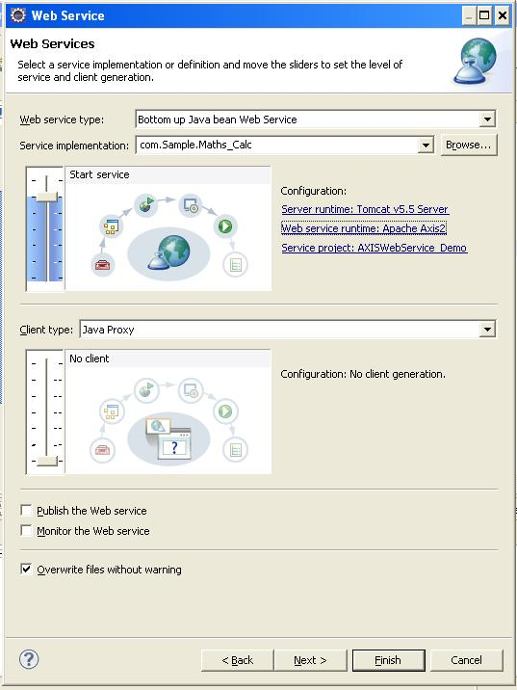
Press Next

Slide 38
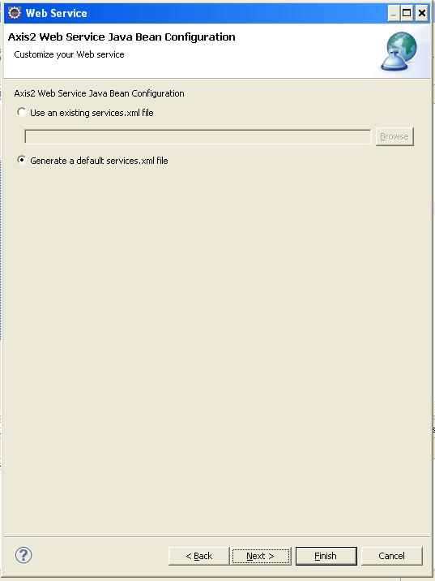
Press Next

Slide 39
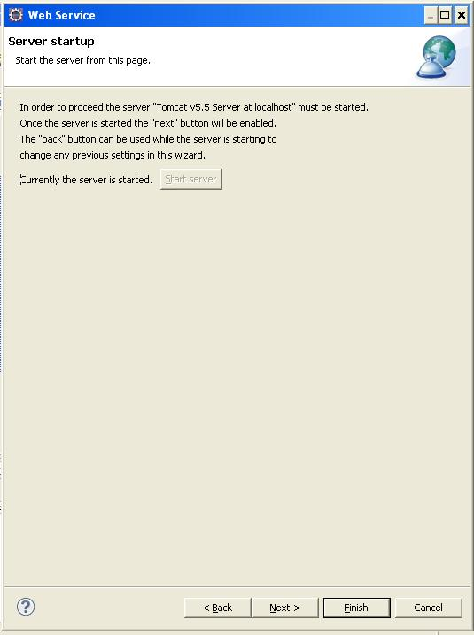
Start the server
Press Finish

Slide 40
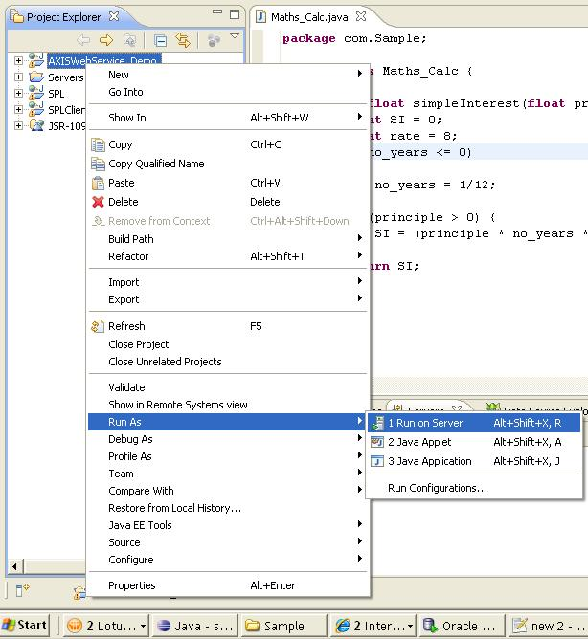
Run the Dynamic Web Project in the server - Tomcat

Slide 41
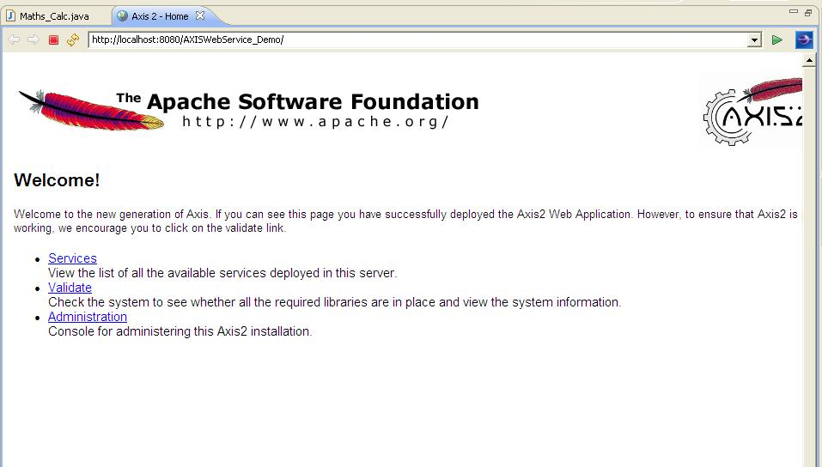
Web Service is running – Select Services

Slide 42
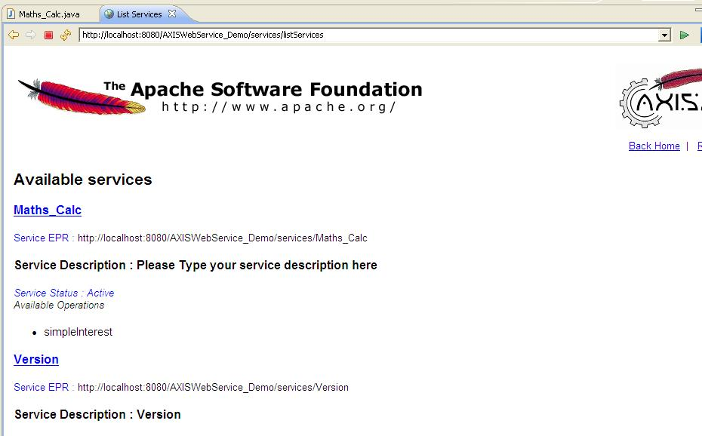
Web Service is running – Select Service method

Slide 43
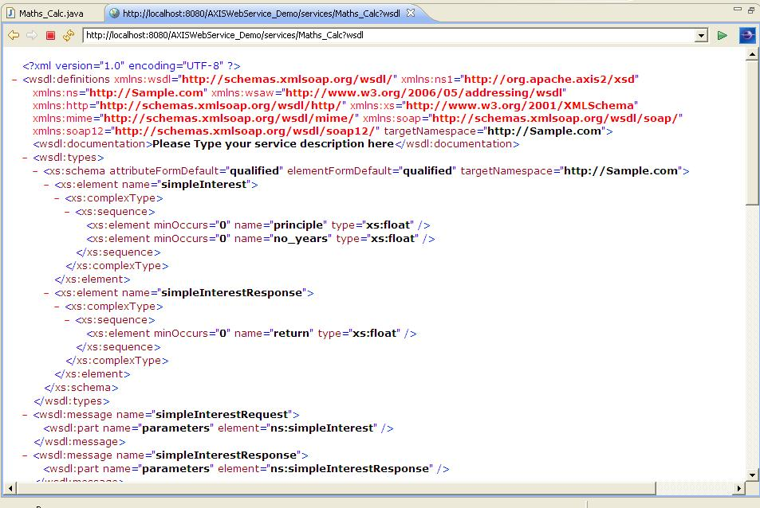
Web Service is running – copy the WSDL URL

Slide 44
Consuming a Web Service (Java)
TATA Consultancy Services

Slide 45
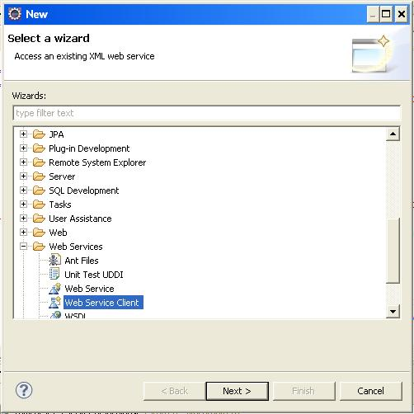
Testing the Web Service – Select Web Service Client
To create a client which will consume our created service

Slide 46
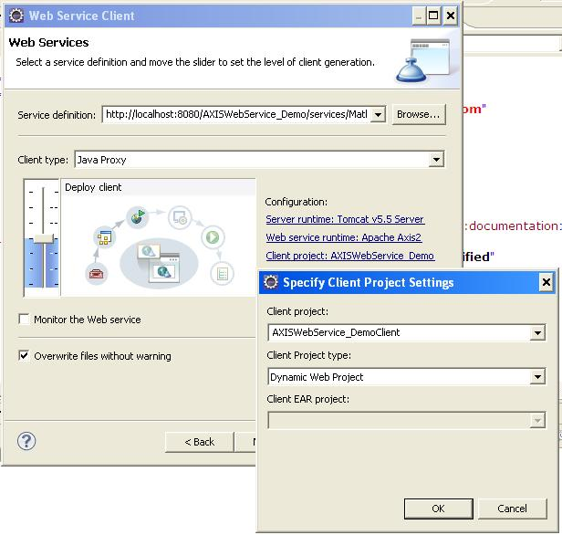
Testing the Web Service –
Specify the Client project name and as Dynamic Web Project

Slide 47
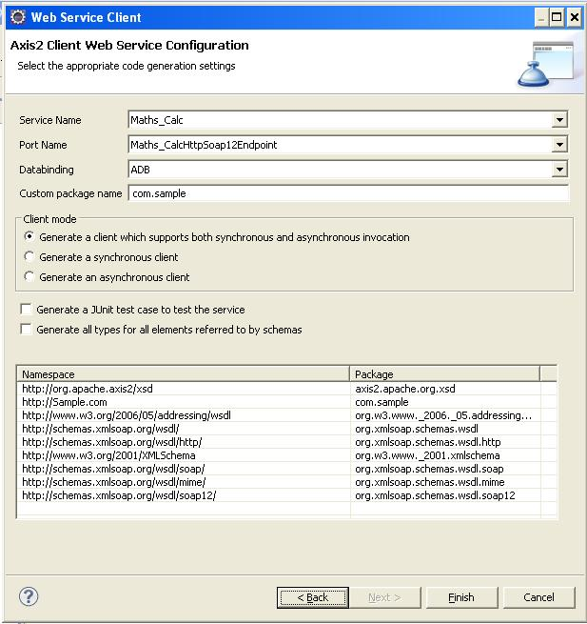
Select as default. Press Finish

Slide 48
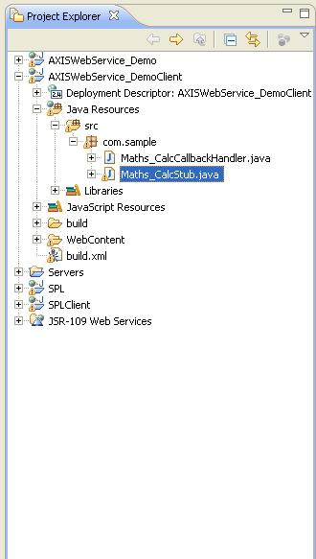
Testing the Web Service
Client stub is created automatically

Slide 49
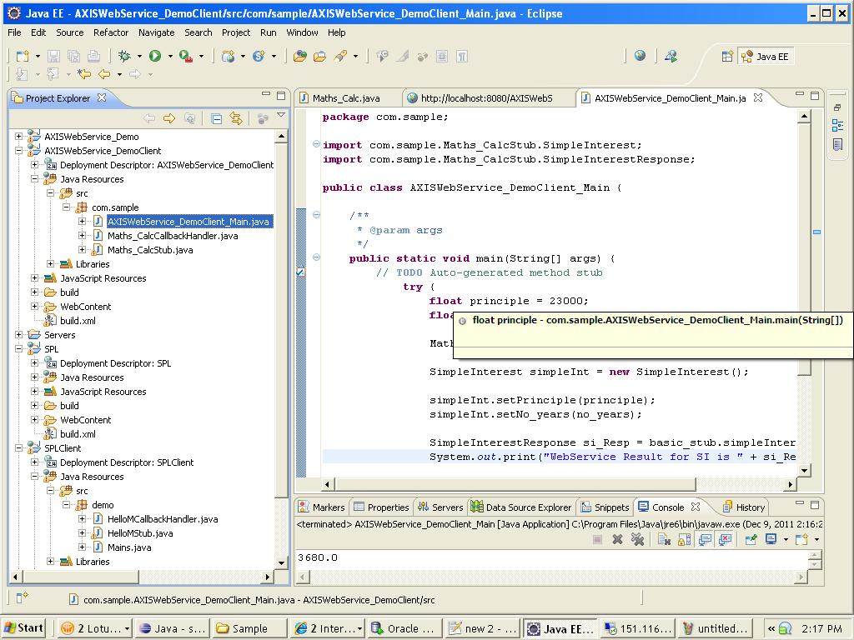
Write a class with main method to do the required functionality and utilizing the web service's method.

Slide 50
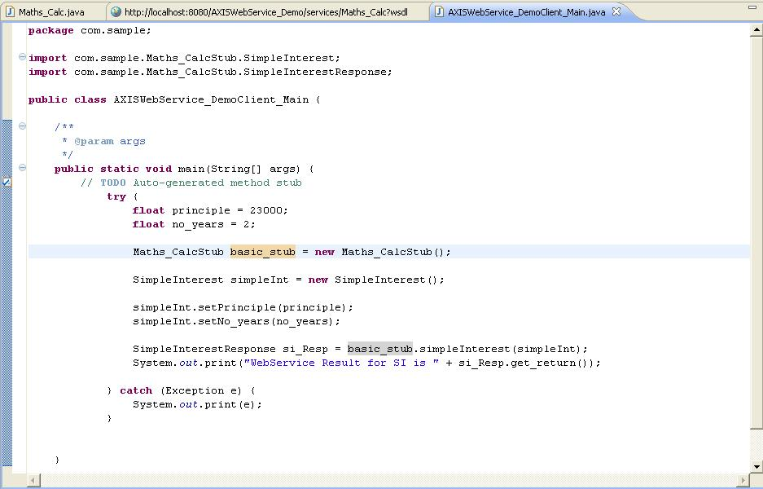
Class with main method --- Code to utilize the Web Service method

Slide 51
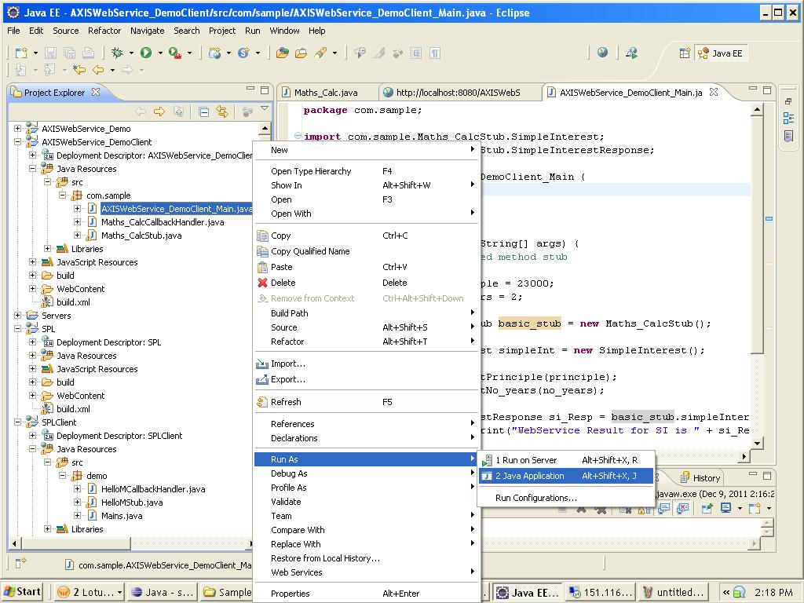
Run as Application

Slide 52
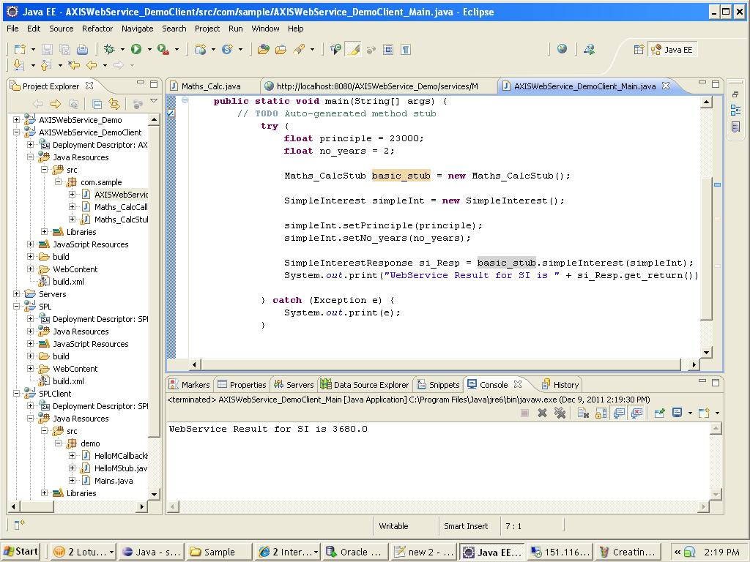
Got the Result from the Web Service method

Slide 53
Top Down Approach
TATA Consultancy Services

Slide 54
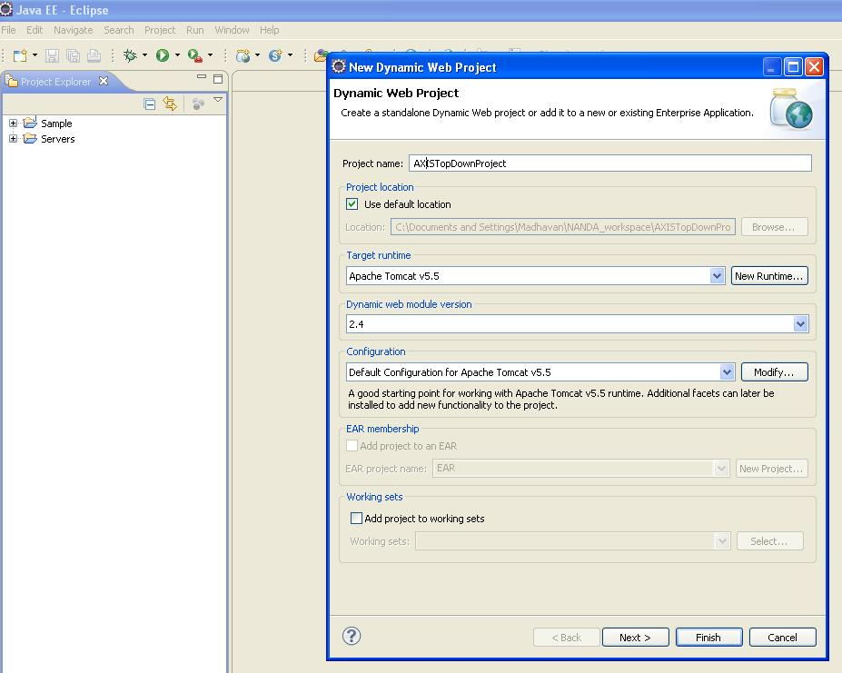
Creating a Dynamic Web Project
TATA Consultancy Services

Slide 55
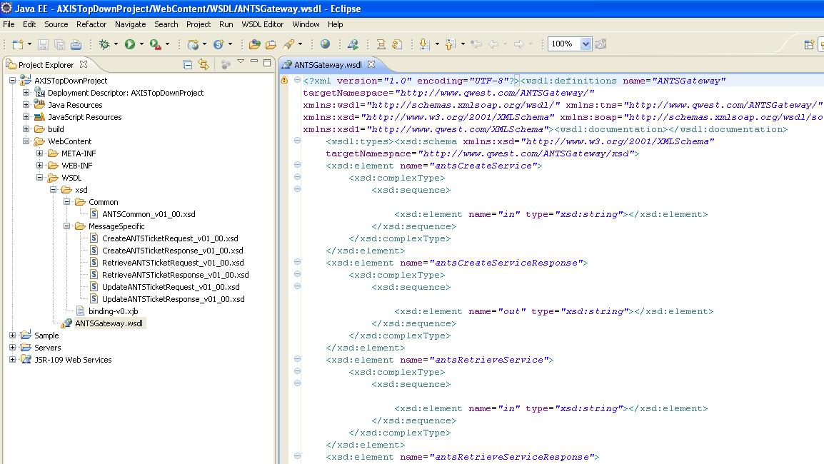
Writing the XSDs and referencing them in the WSDL
TATA Consultancy Services

Slide 56
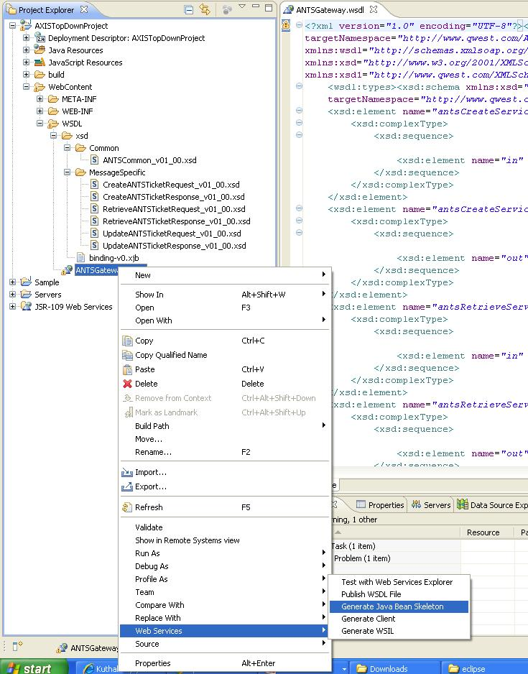
Generating Java Stubs from the plugin
For the WSDL written.
TATA Consultancy Services

Slide 57
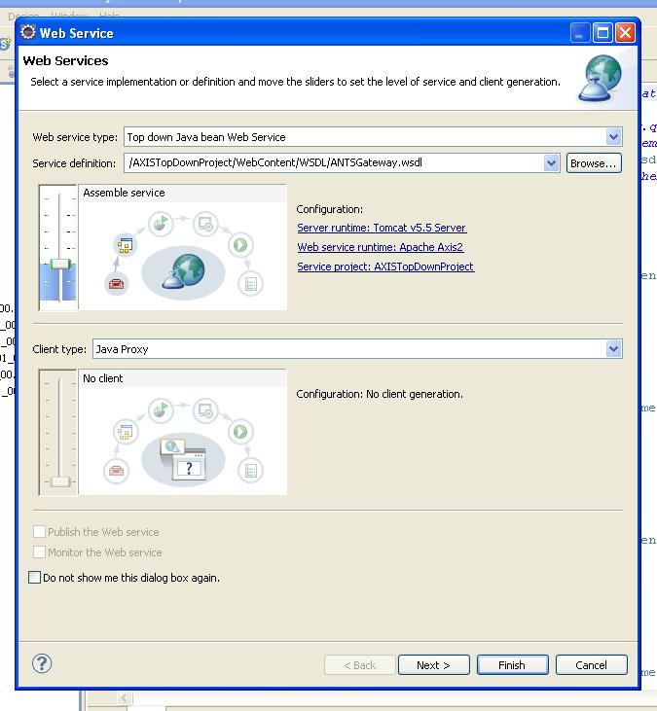
WSDL 2 Java
TATA Consultancy Services

Slide 58
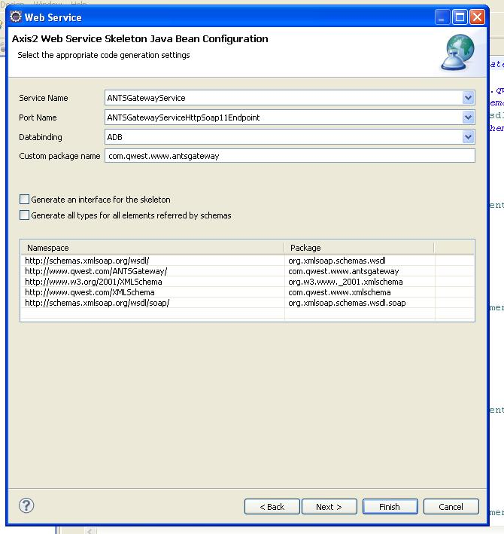
Generated packages for various
Namespaces
Binding Used is ADB
TATA Consultancy Services

Slide 59
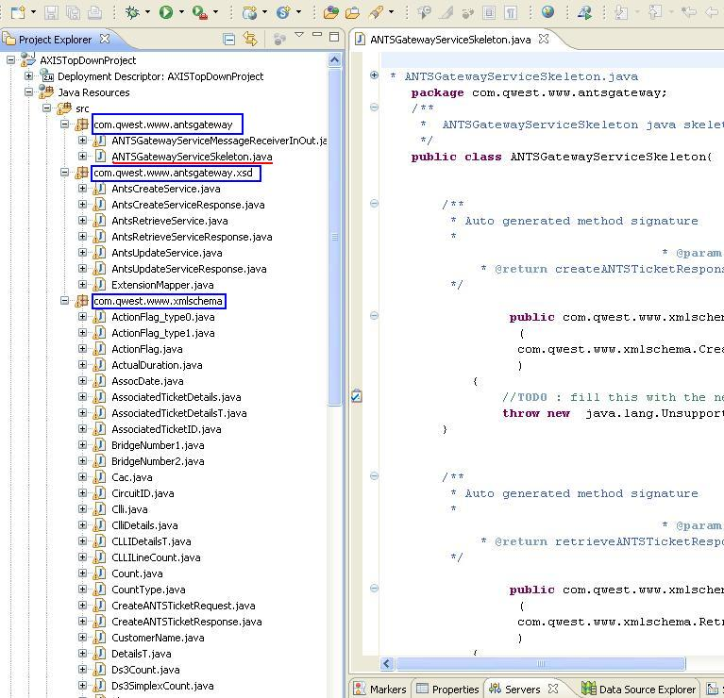
Generated java classes for
Various Namespaces
TATA Consultancy Services

Slide 60
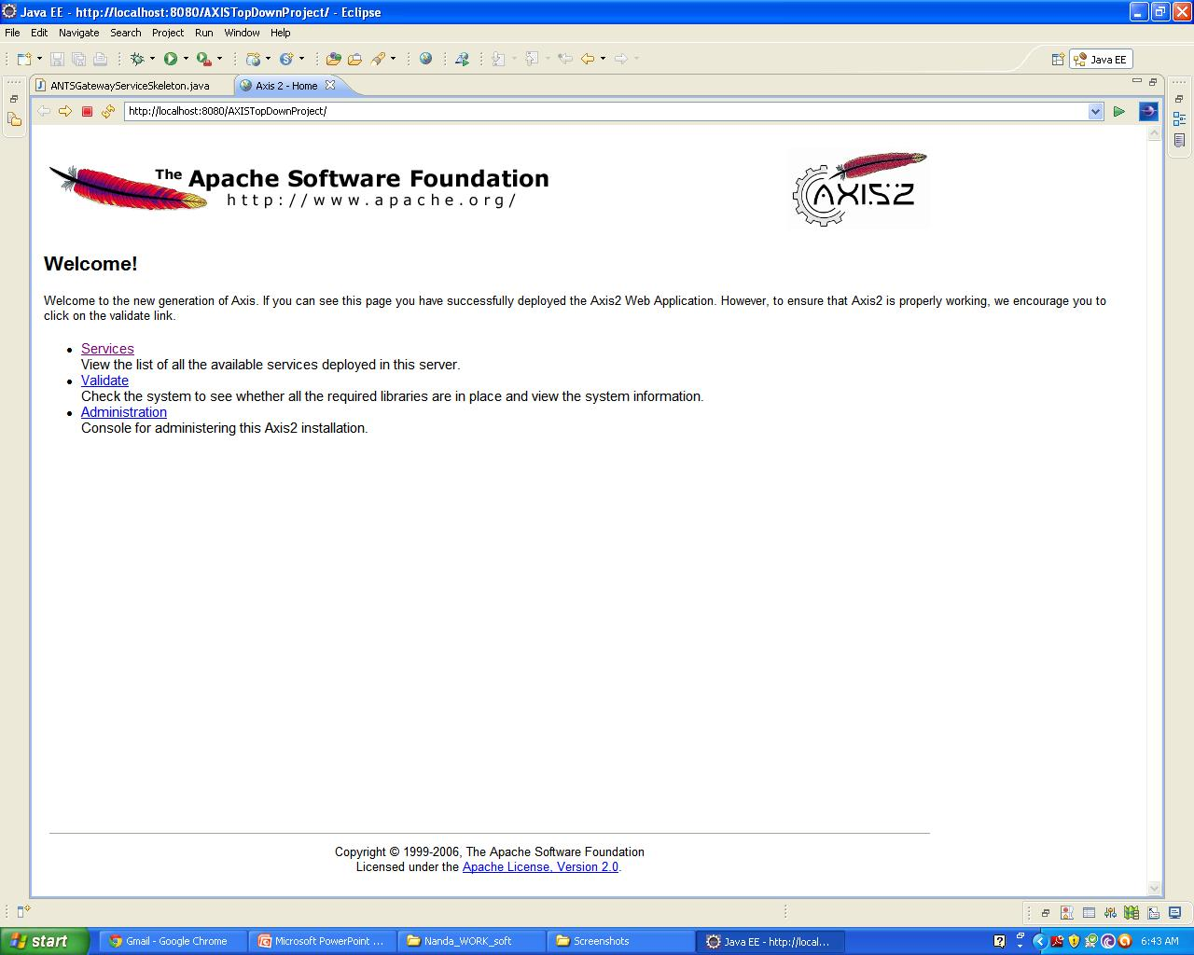
Services Running
TATA Consultancy Services

Slide 61
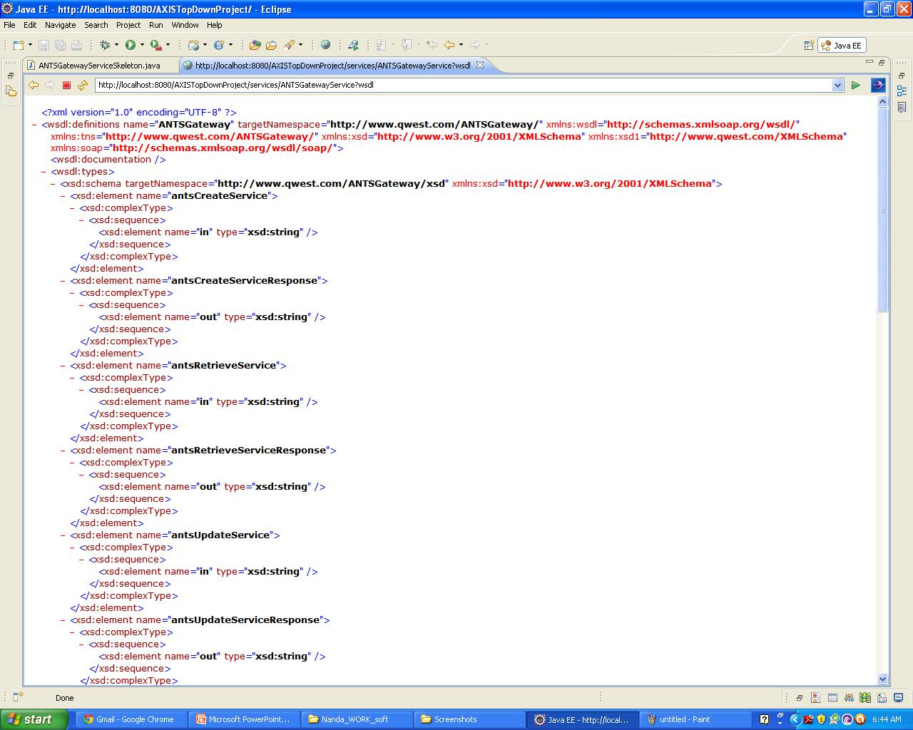
WSDL hosted
TATA Consultancy Services

Slide 62
Creating a Web Service (.NET)
TATA Consultancy Services

Slide 63
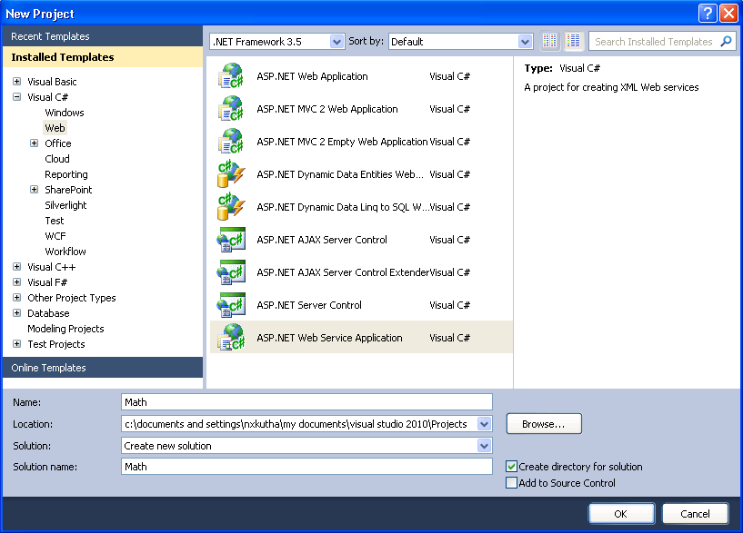
Creating a web service project
TATA Consultancy Services

Slide 64
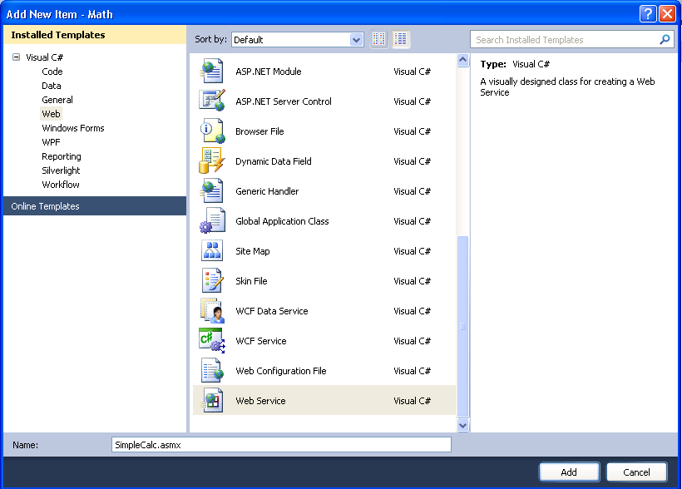
Creating a web service item (ASMX)
TATA Consultancy Services

Slide 65
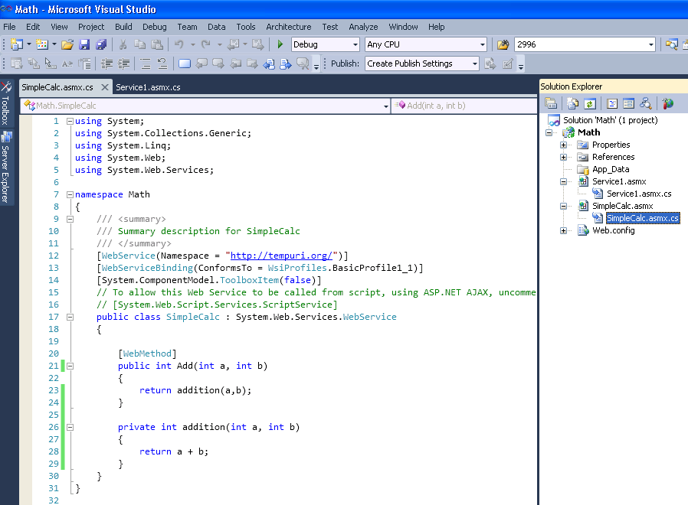
TATA Consultancy Services

Slide 66
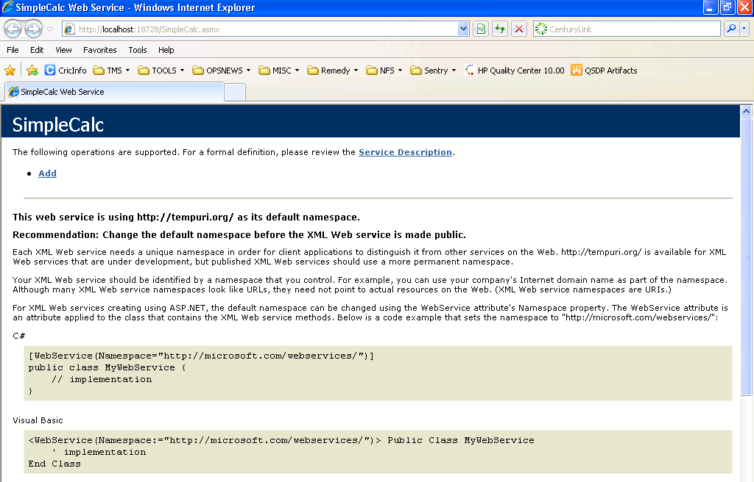
Deploying the Web Service in IIS
TATA Consultancy Services

Slide 67
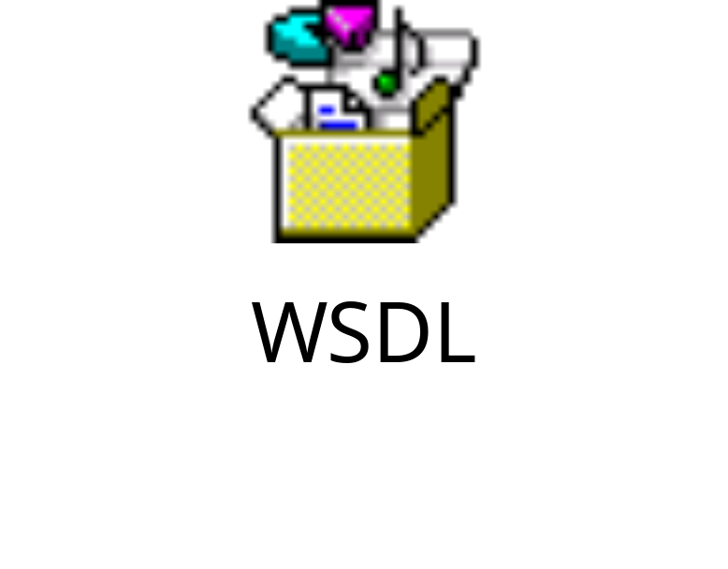
WSDL generated for Created Web Service
TATA Consultancy Services

Slide 68
Consuming a Web Service (.NET)
TATA Consultancy Services

Slide 69
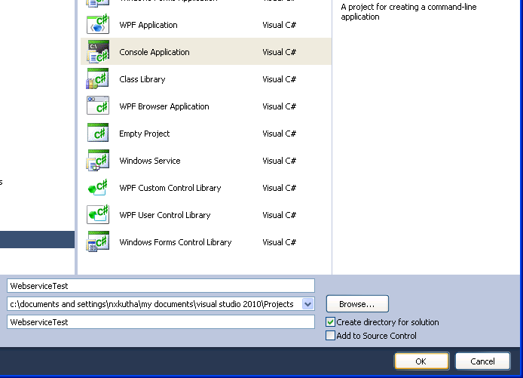
Creating a Console project
TATA Consultancy Services

Slide 70
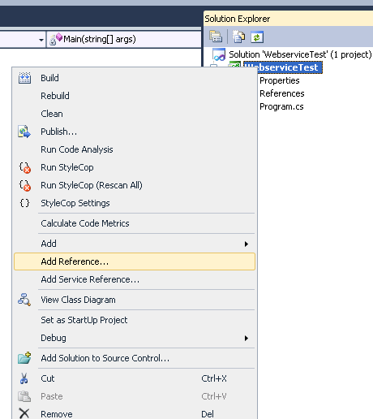
Adding Service Reference to created Project
TATA Consultancy Services

Slide 71
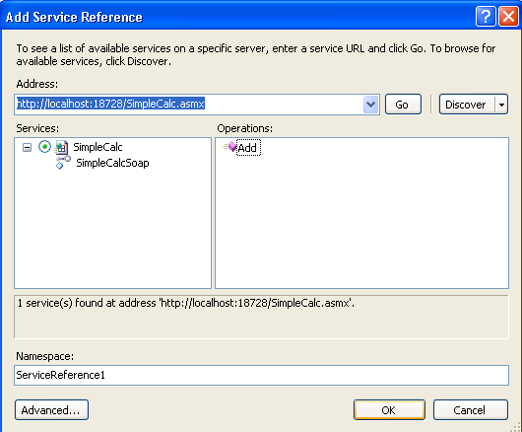
Load the Web Service URL and Add as Service Reference
TATA Consultancy Services

Slide 72
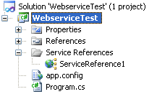
TATA Consultancy Services

Slide 73
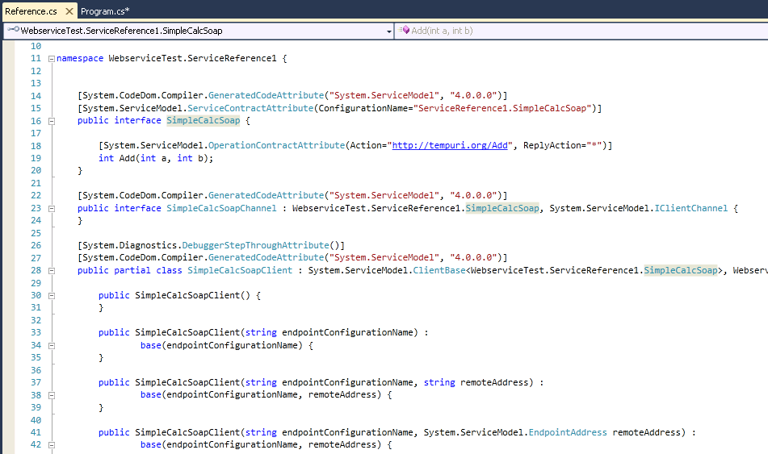
Auto Generated Web Service Stub
TATA Consultancy Services

Slide 74
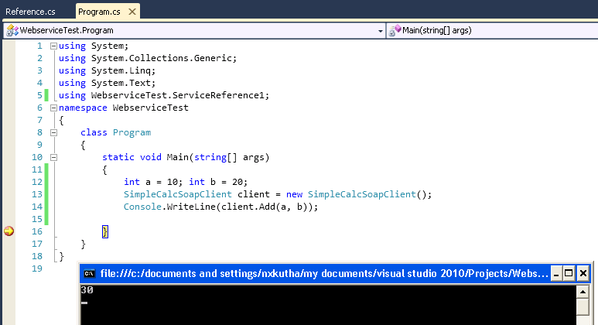
Invoking the Service (when Service is running)
TATA Consultancy Services

Slide 75
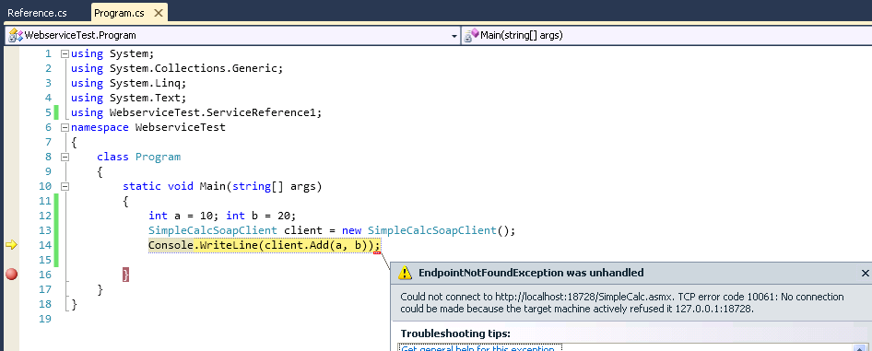
Invoking the Service (when Service is not-running)
TATA Consultancy Services

Slide 76
Thank You

Slide 77
Resources
JAX-RPC home - http://java.sun.com/xml/jaxrpc/index.html
Web Services & Java home - http://java.sun.com/j2ee/webservices/index.html
Java Web Services tutorial - http://java.sun.com/xml/docs.html#tutorials
Apache Axis - http://xml.apache.org/axis/index.html
SOAP 1.1 - http://www.w3.org/TR/SOAP
WSDL 1.1 - http://www.w3.org/TR/wsdl

