Slide 1
CSC5593 - Advanced Computer Architecture
Comparison and Performance Analysis of Cache Coherence Protocols using Gem5 Simulator #Team 6
Manish Rudra Vijayakumar
Madhan Vibeeshanan
Keerthana Sharon Kannan

Slide 2
Overview
Cache Coherence Problem
Cache Coherence
Cache Coherence Methods
Different Cache Coherence Protocols
Benchmark Analysis
Implementation

Slide 3
Cache Coherence Problem
Two different cores have two different values for the same location.
Must guarantee that all the processors see correct data despite multiple readers and writers.
Cache coherence leads to another category of cache miss named coherence miss along with compulsory, capacity and conflict misses.
Coherence miss occurs when the local cache copy of a node is updated, and all other copies are invalidated.

Slide 4
Cache Coherence
Cache Coherence ensures that the changes in the values of the shared operand are propagated throughout the system in a timely fashion.
Cache coherent processor has the most current value.
Cache Coherence Requirements:
Write Propagation – Broadcast to peer caches
Transaction serialization – Read/Writes must be seen by all processors in the same order.

Slide 5
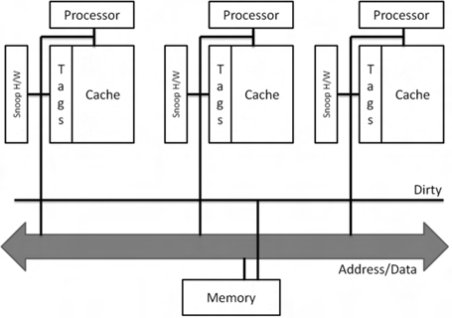
Snoopy Coherence

Slide 6
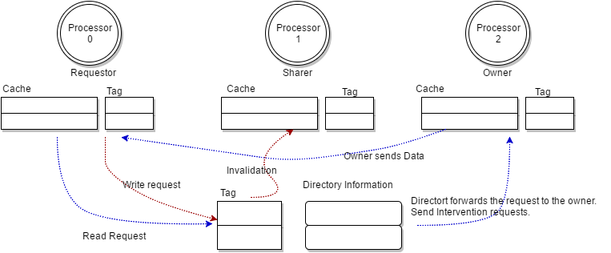
Directory Coherence

Slide 7
Cache Coherence Protocols
To deal with the coherence problem inside shared-memory multiprocessors.
Coordinate distributed caches, so as to provide consistent view of memory to processors.
Cache Coherence Protocols:
MESI Two Level Cache Protocols
MESI Three Level Cache Protocols
MOESI CMP Directory
MOESI CMP Token

Slide 8
MESI Cache Protocol
MESI is based on MSI protocol additional of one more state called Exclusive State.
The protocol supports silent eviction of clean cache blocks from private L0/L1 caches.
Reduces write-back traffic to the L2 cache controller.
Two/Three level cache hierarchy.
L0/L1 cache is private to a core (based on hierarchy).
L1/L2 cache is shared among the cores (based on hierarchy).
L0/L1 cache is split into Instruction cache and Data cache.
Controllers - L1 cache controller, L2 cache controller, Directory controller and DMA controller

Slide 9
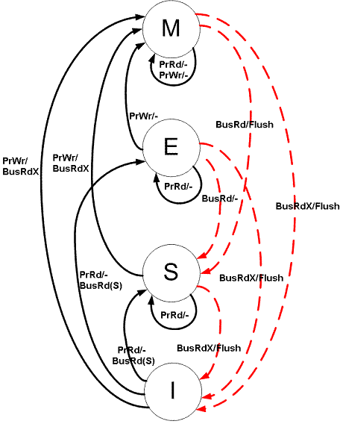
MESI State Transition

Slide 10
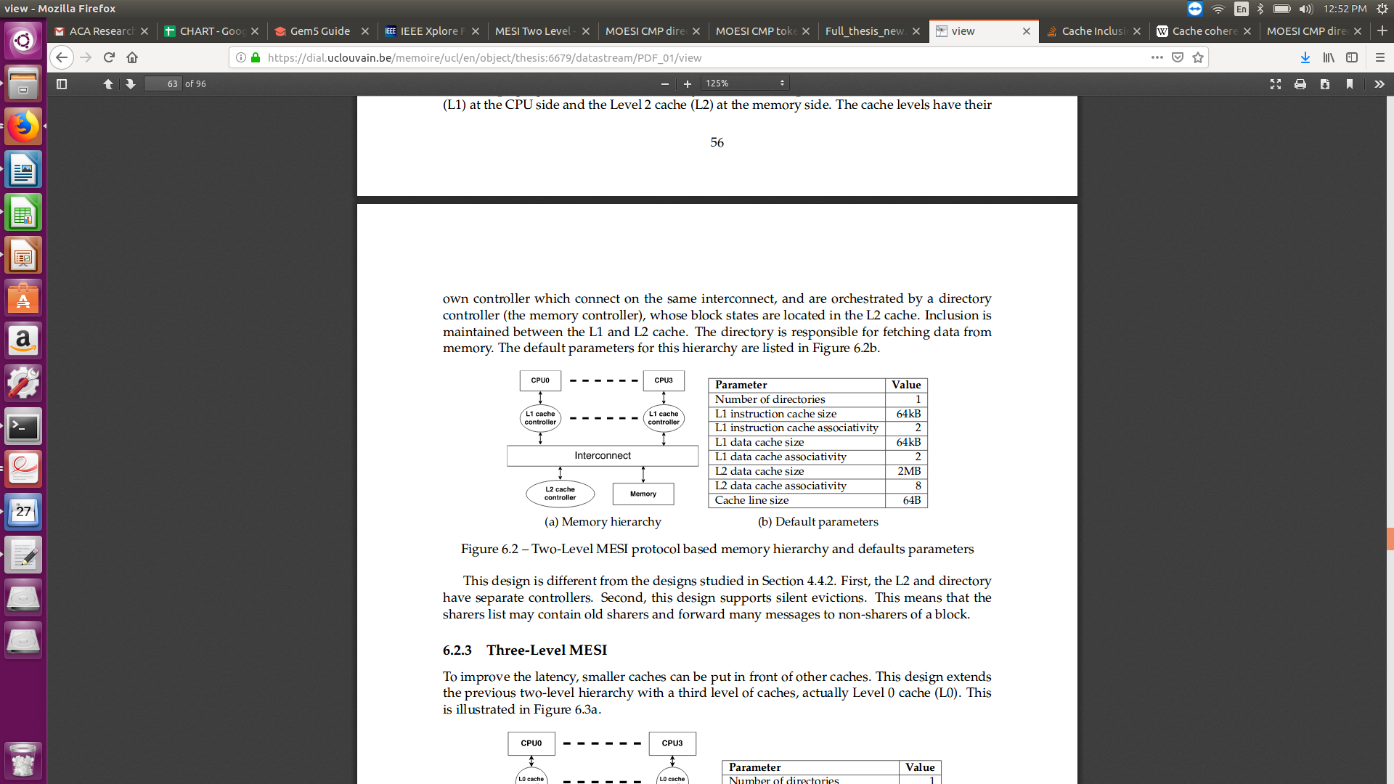
MESI Two Level Cache Protocol

Slide 11
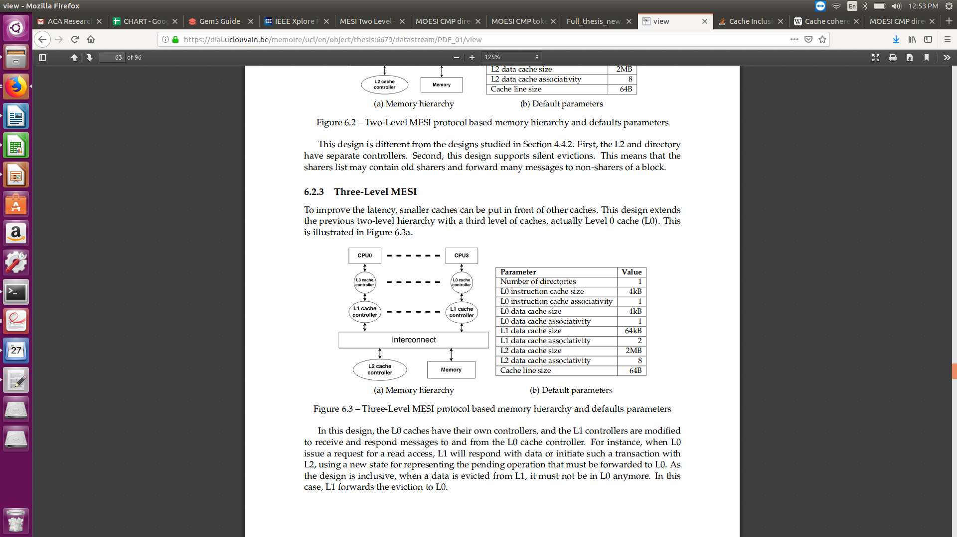
MESI Three Level Protocol Cache Protocol

Slide 12
MOESI Cache Protocol
Elaborated version of MESI protocol.
Owner of the block
Broadcast the changes of the block to all other caches sharing the line.
Having owned state will avoid the unnecessary traffic to the memory.
Avoids the need of writing a dirty bit set block back to main memory when another processor tries to read the block.

Slide 13
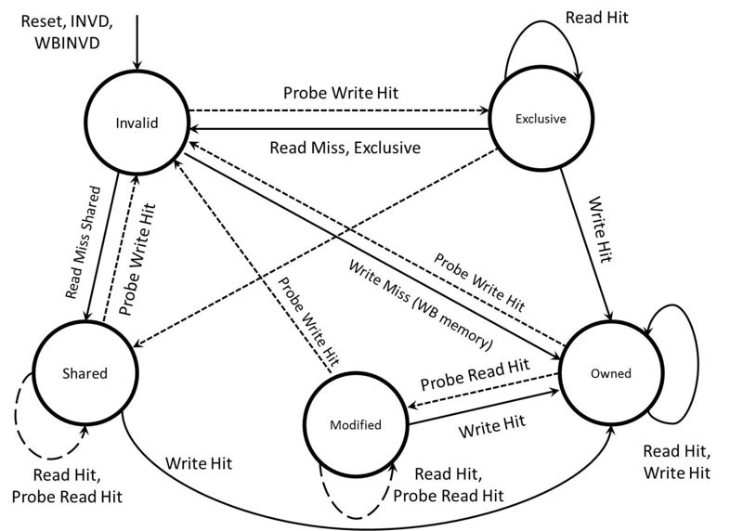
MOESI State Transition

Slide 14
MOESI_CMP_Directory Cache Protocol
MOESI_CMP_Directory 2 Level Caches private caches, non-inclusive hierarchy.
Tradition MOESI protocol with additional states:
MM
MM_W
M_W

Slide 15
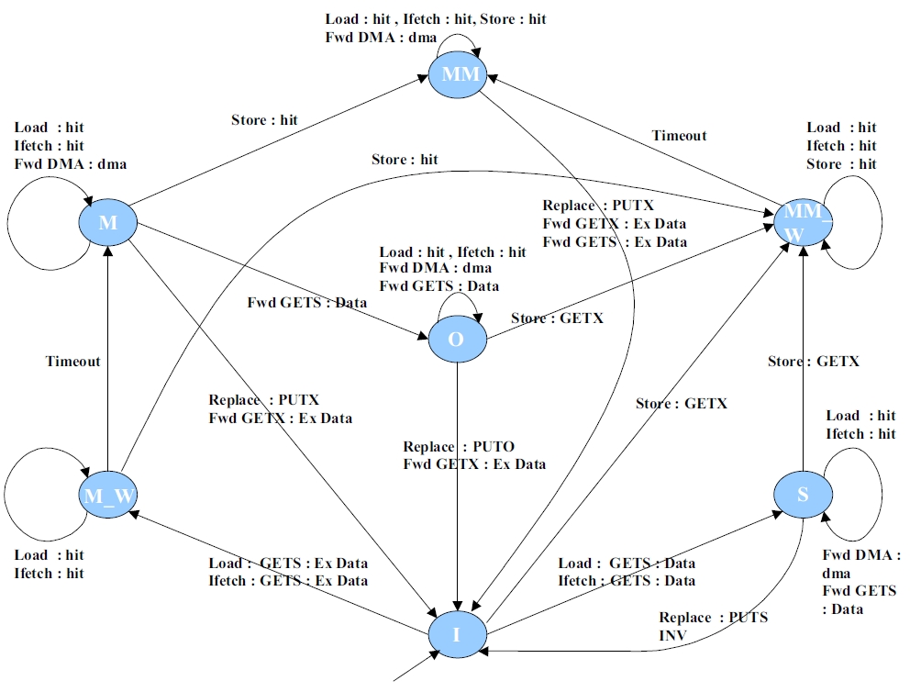
MOESI_CMP_Directory State Transition

Slide 16
MOESI_CMP_Token Cache Protocol
MOESI_CMP_Token - 2 Level Caches hierarchy
This protocol maintains coherence permission by explicitly exchanging and counting tokens.
These four variants need to be maintained for optimized token coherence:
Each block has T token including one owner token.
A processor can perform write operation on the block only, if it holds all the tokens.
A processor can perform read operation on the block only, if it holds at least one token of corresponding block and contain valid data.
Coherent message will contain data only if it hold owner token.

Slide 17
Objectives
Simulate snoopy based cache coherence on Gem5 (Classic model) and observe the behavior with respect to different parameters.
Simulate directory based coherence on Gem5 (Ruby model) and protocol evolution.
Integrate Gem5 with a benchmark to analyse the different coherence protocols in Ruby model

Slide 18
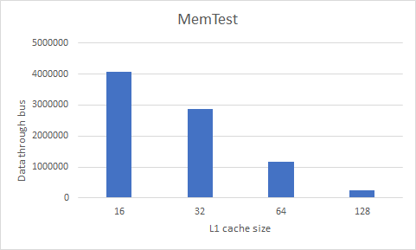
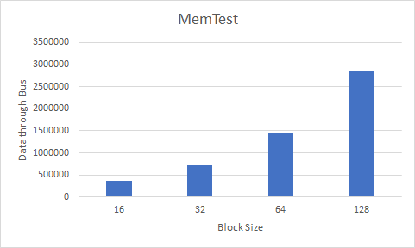
Classic Model

Slide 19
Benchmark
SPEC 2017 - Standard Performance Evaluation Corporation
Leela - Go play Engine featuring position estimation, selective search trees.
ImageMagick - Create, edit, compose or convert Bitmap images
LBM - ( Lattice Boltzmann Method) Simulate incompressible fluids in 3D
Povray - Chess board ( Similarity between actual image and allotted positions)
Exchange2 - Develop 9*9 Sudoku puzzles

Slide 20
Default Values
L1 Data cache Size | 64kB
L1 Data Cache Associative | 2
L1 Instruction cache size | 32kB
L1 Instruction cache Associative | 2
L2 Size | 2MB
L2 Associative | 8
Block Size | 64MB
Memory Size | 512MB
Maximum Workload | 10000

Slide 21
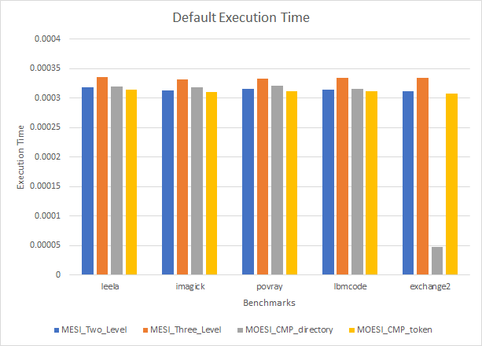
Analysis

Slide 22
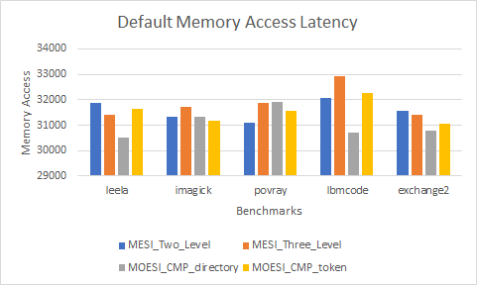
Analysis

Slide 23
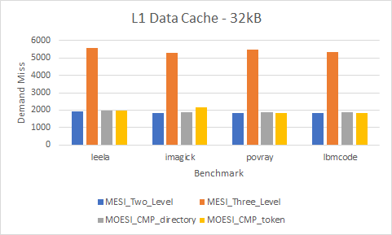
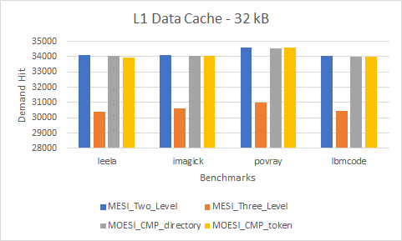
Analysis

Slide 24

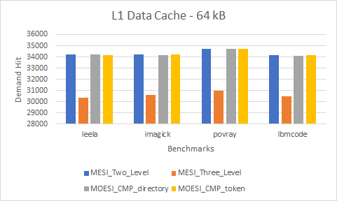
Analysis

Slide 25
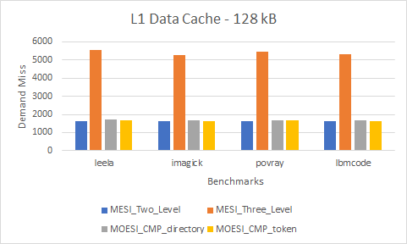
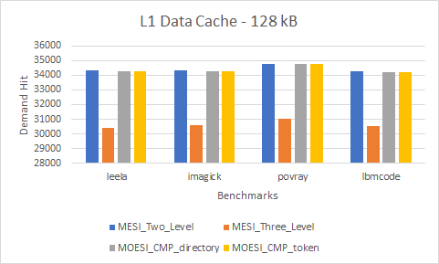
Analysis

Slide 26
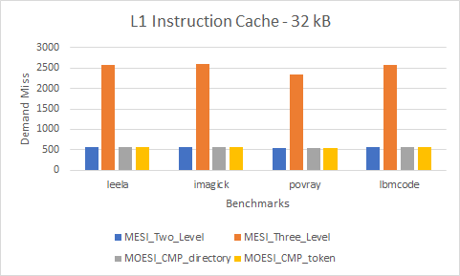
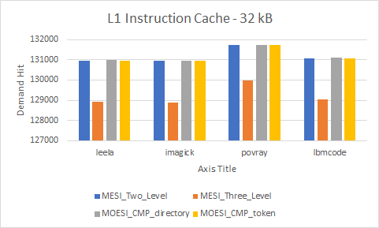
Analysis

Slide 27
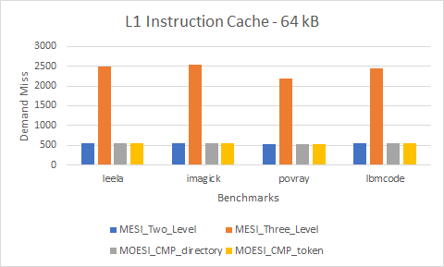
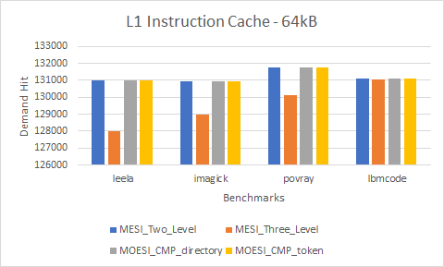
Analysis

Slide 28
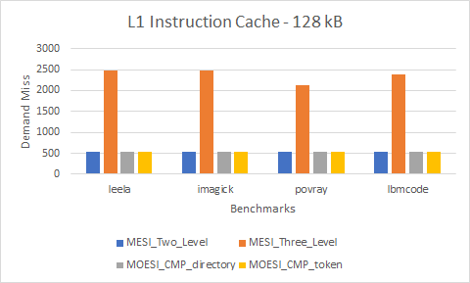
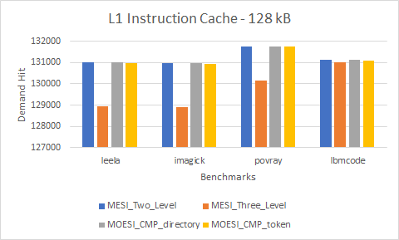
Analysis

Slide 29
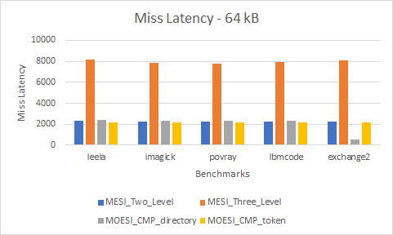
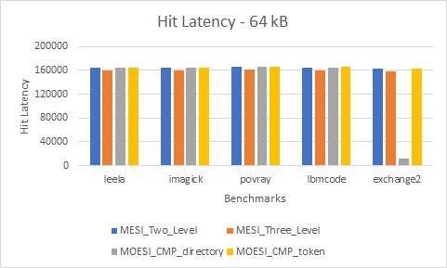
Analysis

Slide 30
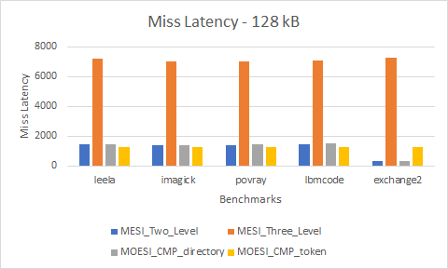
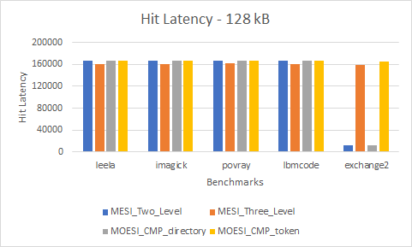
Analysis

Slide 31
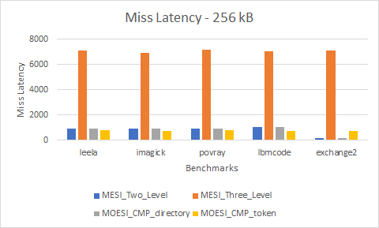
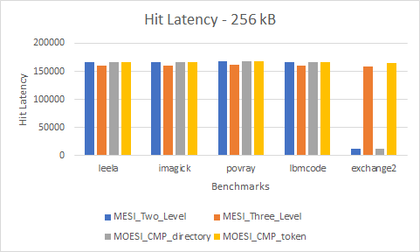
Analysis

Slide 32
Observation
In terms of performance, MOESI CMP Token cache coherence protocol is the most effective.
Performance of directory coherence is better than snooping coherence protocols because of the creation of bottlenecks.
MESI 3-level protocol is the least efficient in terms of performance

Slide 33
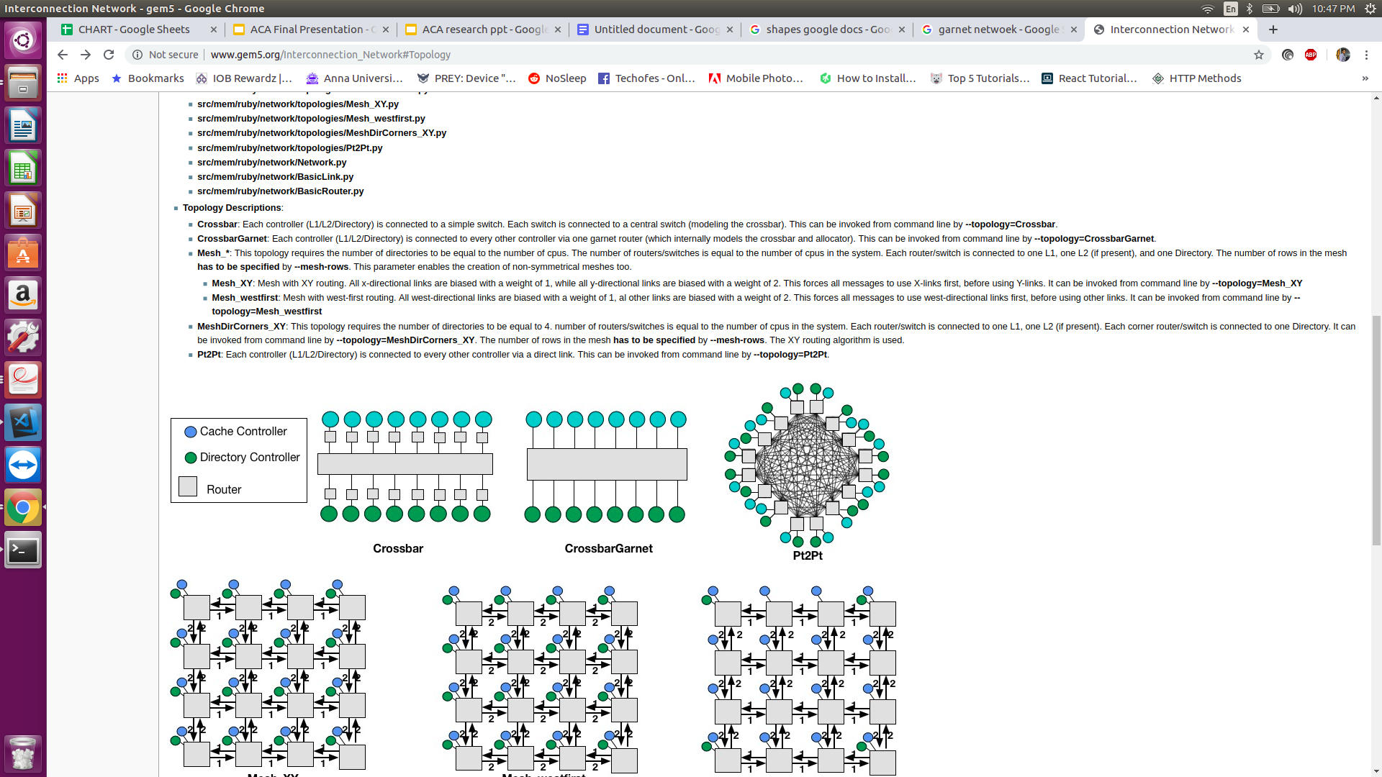
Implementation
Initial Plan:
OS: Ubuntu 18.04 on VM
Gem5 configurations:
mode: Syscall Emulation(SE) mode
ISA : X86 architecture
Memory Systems: Classic and Ruby
Replacement Policy: LRU
Network Topology: Crossbar
Benchmark: Splash-2 (benchmark application like fft, lu and radix)

Slide 34
Implementation contd.
OS: Ubuntu 16.04 dual boot
Gem5 configurations:
mode: Syscall Emulation(SE) mode
ISA : X86 architecture
Memory Systems: Classic and Ruby
Replacement Policy: LRU
Network Topology: Crossbar
Benchmark: Spec 2017 (leela, imagick, povray, lbm, exchange2)

Slide 35

Benchmarks we didn’t use: Why?
PARSEC:
Runs only in Full System(FS) Mode..
It is used to test ALPHA
No proper resource to help with gem5 integration.
Splash-2:
Runs in Full System(FS) and SysCall Emulation(SE) mode.
Binaries require an ALPHA system
Lot of complications while integrating.

Slide 36

Why Spec 2017?
It runs on SysCall Emulation(SE) model.
Gem5 supports Spec2017 with X86.
It has 43 applications.
It is up to date.

Slide 37
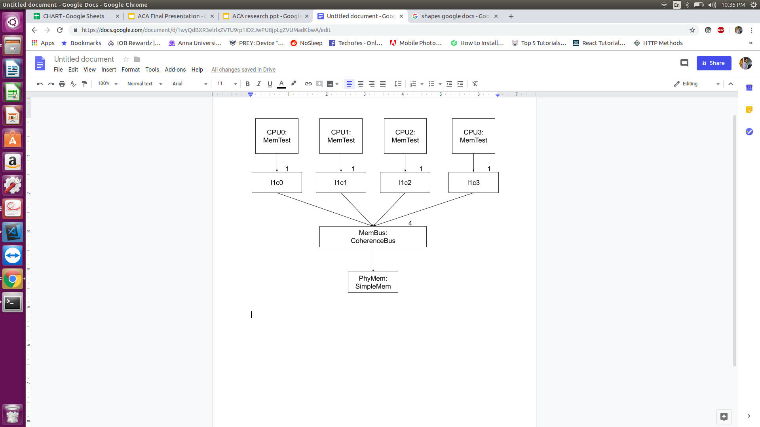
Files used or modified
Classic Model:
./gem5/configs/example/memtest.py
Test memory performance for classic model.
Simulates result based on the cache topology.
Command to run: ./build/X86/gem5.opt configs/example/memtest.py -l 10000 -c 4:1
Output File: ./m5out/stats.txt

Slide 38
Files used or modified Contd.
Ruby Model:
./configs/example/se.py
Run benchmark with the input parameters.
./configs/example/benchmarks.py
Acts as connection between Gem5 and Spec 2017
Command to run:
./build/X86/gem5.opt configs/example/se.py --benchmark=leela --ruby --caches --maxinsts=100000 --l1d_size=64kB --l1i_size=32kB --mem-size=512MB --cacheline_size=64

Slide 39
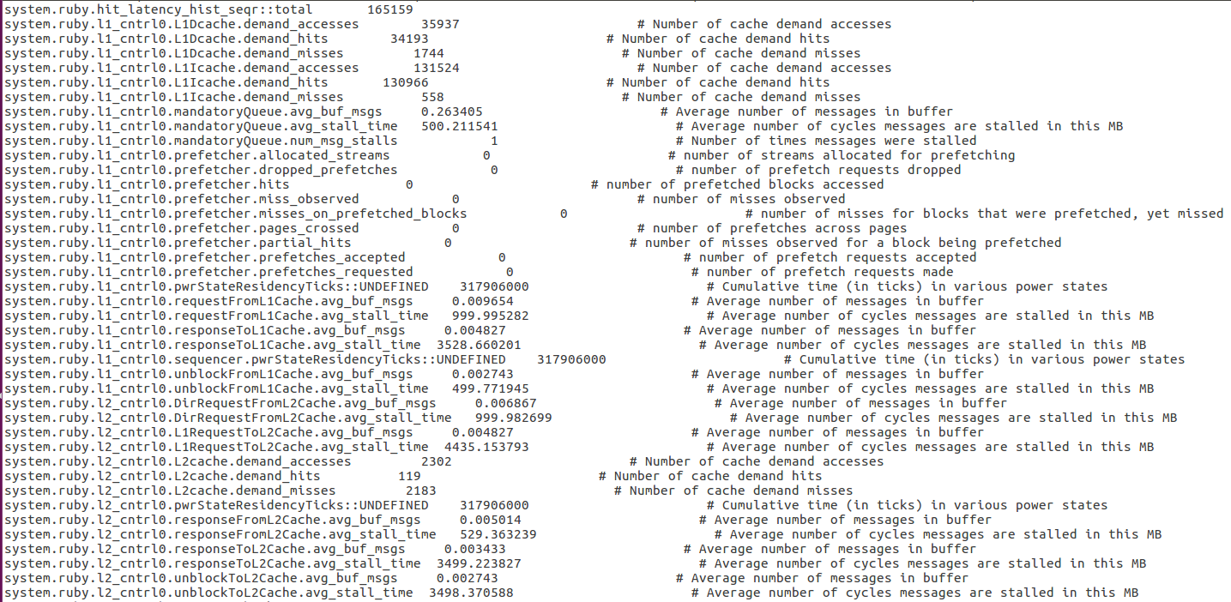
Output File Sample:

Slide 40
Complications faced
Mandatory pre-requirements were not specified.
No response from the users thread.
Integration of Gem5 with other benchmarks was not easy.
Ubuntu dual boot crashed.

Slide 41
Reference
[1]. N. B. Mallya, G. Patil and B. Raveendran, "Simulation based Performance Study of Cache Coherence Protocols," 2015 IEEE International Symposium on Nanoelectronic and Information Systems, Indore, 2015, pp. 125-130.doi: 10.1109/iNIS.2015.52. [2]. J. K. Archibald, “The Cache Coherence Problem in Shared-Memory Multiprocessors”, Ph.D. Dissertation, Dept. Comput. Sci., Uni. Of Washington, 1987.
[3]. M.R. Marty, “Cache Coherence Techniques for Multicore Processors”, Ph.D. Dissertation, Dept. Comput. Sci., Uni. Of Wisconsin-Madison, 2008.
[4]. http://gem5.org/Cache_Coherence_Protocols
[5]. https://www.spec.org/cpu2017/

Slide 42


