Slide 1






PROJECT 36 | DBMS REVIEW 3 | FINAL
EMPLOYEE PAYROLL AND STATUTORY DEDUCTION MANAGEMENT SYSTEM
Final application, security, results and viva readiness
16 tables
Payroll engine
Payslips
Transfers
Reports
74 + 11 tests
PRESENTED BY G MADHAN 25WU0102344
Department
AI ML RHINOS
Notes:
Good morning. I am G Madhan from AI ML Rhinos. This is the final review, DBMS Review 3, for Project 36, the Employee Payroll and Statutory Deduction Management System. In Review 1 I presented the design and in Review 2 the database and prototype. Today I will show the finished application, run through the payroll workflow, show the SQL and reports, the test results, the honest limitations, and the concepts I am ready to answer questions on.

Slide 2

Final Project Overview
Problem (Review 1)
Solution
Manual or spreadsheet payroll gives calculation errors, inconsistent statutory deductions, untracked loans and no reliable payslip history.
A normalised 16-table database with constraints, triggers and views, a payroll engine that writes gross, deductions and net per employee per month, and a secure Flask web interface.
16
12 / 12
74 + 11
6
3
tables (3NF)
requirements built
tests: SQLite + MySQL
triggers, 3 views
roles with login
Users: ADMIN (everything, rates, users, explorer), HR / payroll officer (manage data, run payroll), EMPLOYEE (own payslips only). Scope: a local demo, not hardened for the internet.
Notes:
The problem from Review 1 is unchanged: small and mid-sized organisations still calculate salary in spreadsheets, which causes mistakes in loss of pay, statutory deductions and loan recovery, and leaves no reliable payslip or audit trail. The solution is a relational database that is the single source of truth, plus a web application on top of it. All twelve requirements from Review 1 are implemented. Since Review 2 I added login with three roles, database triggers that lock paid payroll and write an audit trail, reporting views, a Database Explorer for the administrator, and I tested the MySQL scripts on a real MySQL 8 server. All data in the demo is synthetic.

Slide 3

Objectives vs Delivered Functionality
# | Review 1 requirement | Where in the app | Status
1 | Employee records | Employees, profile page | Done
2 | Departments and designations | Master data pages | Done
3 | Salary structures | Basic, HRA, DA, special | Done
4 | Attendance summaries | Per period; LOP derived | Done
5 | Earnings | Bonus, overtime, incentive | Done
6 | Statutory and other deductions | AUTO and MANUAL rows | Done
7 | Loans and repayments | EMI, balance, history | Done
8 | Payroll periods | OPEN > PROCESSED > PAID | Done
9 | Gross, deductions, net | payroll.py, one transaction | Done
10 | Payslips | Printable, numbered | Done
11 | Bank transfer details | Simulated, no bank API | Done (simulated)
12 | Payroll reports | 7 reports + CSV export | Done
Beyond Review 1: login with roles, triggers, audit trail, views, Database Explorer (later slides).
Notes:
This table maps every functional requirement from Review 1 to what exists in the application. All twelve are implemented and each has a page or SQL evidence behind it. The bank transfer requirement is implemented as simulated records: the system creates a transfer row per payslip and lets the officer mark them paid, but there is no real bank connection. Loan management goes slightly beyond Review 1 with a repayment history table.

Slide 4













Completed Modules
Employees
Departments
Salary
Attendance
CRUD, search, profile
Designations, master data
Structure per employee
Working, present, leave
Earnings / deductions
Loans
Payroll periods
Payslips
Auto + manual rows
EMI and repayments
Process, transfer, pay
Printable payslip
Bank transfers
Reports
Login and roles
Database Explorer
Pending then paid
7 reports, rates, CSV
ADMIN, HR, EMPLOYEE
Schema, triggers, SQL
Notes:
The application is organised into eight modules that follow the sidebar. Master data covers departments and designations. Employees has search, add, edit, delete and a profile page. Salary and attendance hold the monthly inputs. Earnings and deductions hold bonuses and manual deductions, while statutory deductions are generated automatically and shown read-only. Loans track EMI and outstanding balance. Payroll periods drive processing. Payslips and bank transfers are the outputs. Reports includes the editable illustrative rates page for the administrator. New since Review 2 are login with roles and the Database Explorer.

Slide 5

Final ER Diagram
Core payroll tables (14). Login and audit tables: next slide.
Payroll Config
Department
Designation
Payroll Period
1 : N
1 : N
1 : N
Payslip
Salary Structure
Employee
Payroll Detail
1 : 1
1 : 1
1 : N
1 : 1
Bank Transfer
1 : N
1 : N
1 : N
1 : N
1 : N
Attendance
Earnings
Deductions
Loan
Loan Repayment
1 : N
Core entity
Master data
Monthly input
Payroll output
Notes:
This is the final entity relationship diagram. The twelve Review 1 entities are all here, plus two additions: Loan Repayment and Payroll Config. App User and Audit Log are on the next slide. Department and Designation each have many employees. Employee has exactly one salary structure and many attendance, earnings, deduction and loan rows. A payroll period has many payroll detail rows, one per employee per month, and each payroll detail has exactly one payslip and one bank transfer. A loan repayment links a loan to the payroll run in which it was deducted, or to nothing when it is a manual repayment.

Slide 6

Login, Triggers and Views
employee
0..1 login
app_user
(role, hash)
SQLite trigger: lock paid payroll
CREATE TRIGGER trg_payroll_detail_lock_update
BEFORE UPDATE ON payroll_detail
FOR EACH ROW
WHEN (SELECT status FROM payroll_period
WHERE payroll_period_id =
OLD.payroll_period_id) <> 'OPEN'
BEGIN
SELECT RAISE(ABORT,
'Payroll history is locked:
the period is no longer OPEN');
END;
salary_structure
employee (status)
audit_log
payroll_config
3 audit triggers (AFTER UPDATE)
Views v_payroll_summary, v_department_cost, v_loan_ledger
Tested on SQLite and on a real MySQL 8 server (SIGNAL variant)
payroll_period
(status)
payroll_detail
3 lock triggers (BEFORE INSERT/UPDATE/DELETE)
Notes:
Two tables were added after Review 2. App User stores login accounts: username, role and a salted password hash, never the password. An employee account is linked to an employee row. Audit Log has no foreign keys on purpose: it is written only by database triggers. There are six triggers. Three audit triggers fire after an update of a salary structure, an employee's status, or a payroll rate, and write the old and new values to Audit Log. Three lock triggers fire before an insert, update or delete on payroll detail and refuse the change when the payroll period is no longer OPEN, so paid payroll cannot be altered even by someone who bypasses the application. The trigger on the right is the SQLite version; MySQL uses SIGNAL instead of RAISE, so I wrote the two files separately. There are also three views for reporting. I tested all of this on SQLite and on a real MySQL 8 server.

Slide 7

Final Relational Schema
Table | Primary key | Foreign keys | Rows
department | department_id | - | 6
designation | designation_id | - | 8
payroll_config | config_key | - | 8
employee | employee_id | department_id, designation_id | 30
salary_structure | salary_structure_id | employee_id (unique) | 30
payroll_period | payroll_period_id | - | 3
attendance_summary | attendance_id | employee_id, payroll_period_id | 90
earnings | earning_id | employee_id, payroll_period_id | 18
deductions | deduction_id | employee_id, payroll_period_id | 251
loan | loan_id | employee_id | 6
payroll_detail | payroll_id | employee_id, payroll_period_id | 87
loan_repayment | repayment_id | loan_id, payroll_id (nullable) | 14
payslip | payslip_id | payroll_id (unique) | 87
bank_transfer | transfer_id | payroll_id (unique) | 58
app_user | user_id | employee_id (nullable) | 7
audit_log | audit_id | - (written by triggers) | 0
Constraints in the schema: 16 PK | 17 FK | 14 UNIQUE | 23 CHECK | 8 indexes
Notes:
This table summarises the final relational schema: sixteen tables, sixteen primary keys and seventeen foreign keys. App User and Audit Log are the two tables added after Review 2. Most tables are in third normal form. Payroll detail is the one deliberate exception: it stores a snapshot of the calculated gross, deductions and net for each employee and month, so that a payslip never changes later even if the salary structure or rates are edited. Loss of pay days are not stored because they can be derived from working days, days present and paid leave. Row counts are the counts in the current demo database.

Slide 8

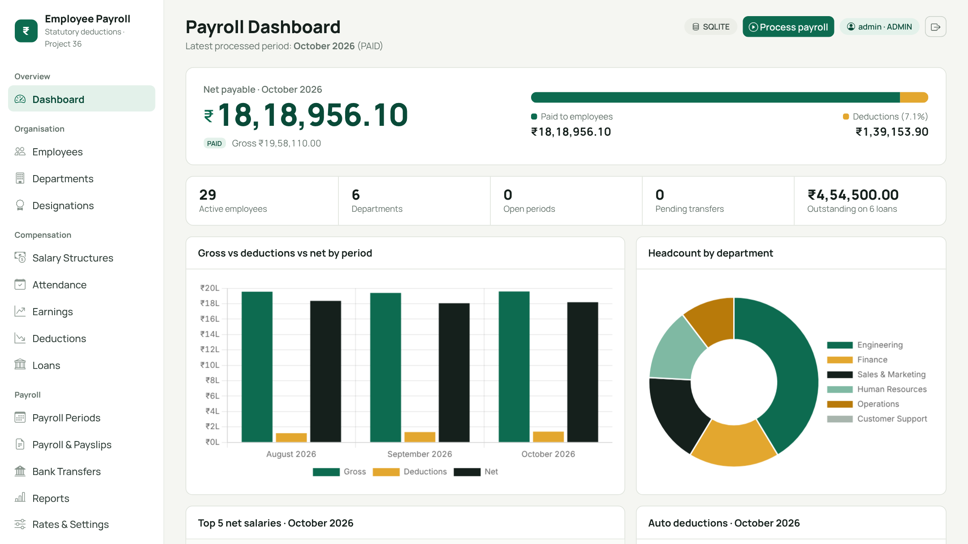
Final Application: Dashboard
Live SQL: every tile and chart is an aggregate query
Latest period: October 2026, 29 employees paid
Totals: Rs 19,58,110.00 gross, Rs 18,18,956.10 net
Charts: three months, headcount by department
Synthetic data only: names, e-mails and bank accounts are invented for the demonstration.
Notes:
This is the finished dashboard after October 2026 has been processed. The tiles and charts are live SQL aggregates, not typed-in numbers: active employees, gross, deductions and net for the latest processed period, departments, open loans and outstanding balance, and pending transfers. The charts compare gross, deductions and net across the three payroll months and show headcount by department. The screenshot was taken from the running application against the synthetic demo database.

Slide 9
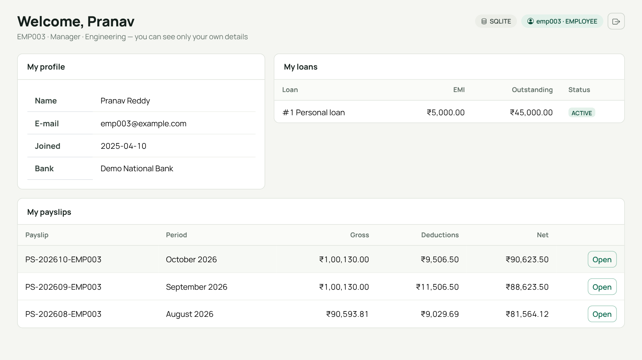
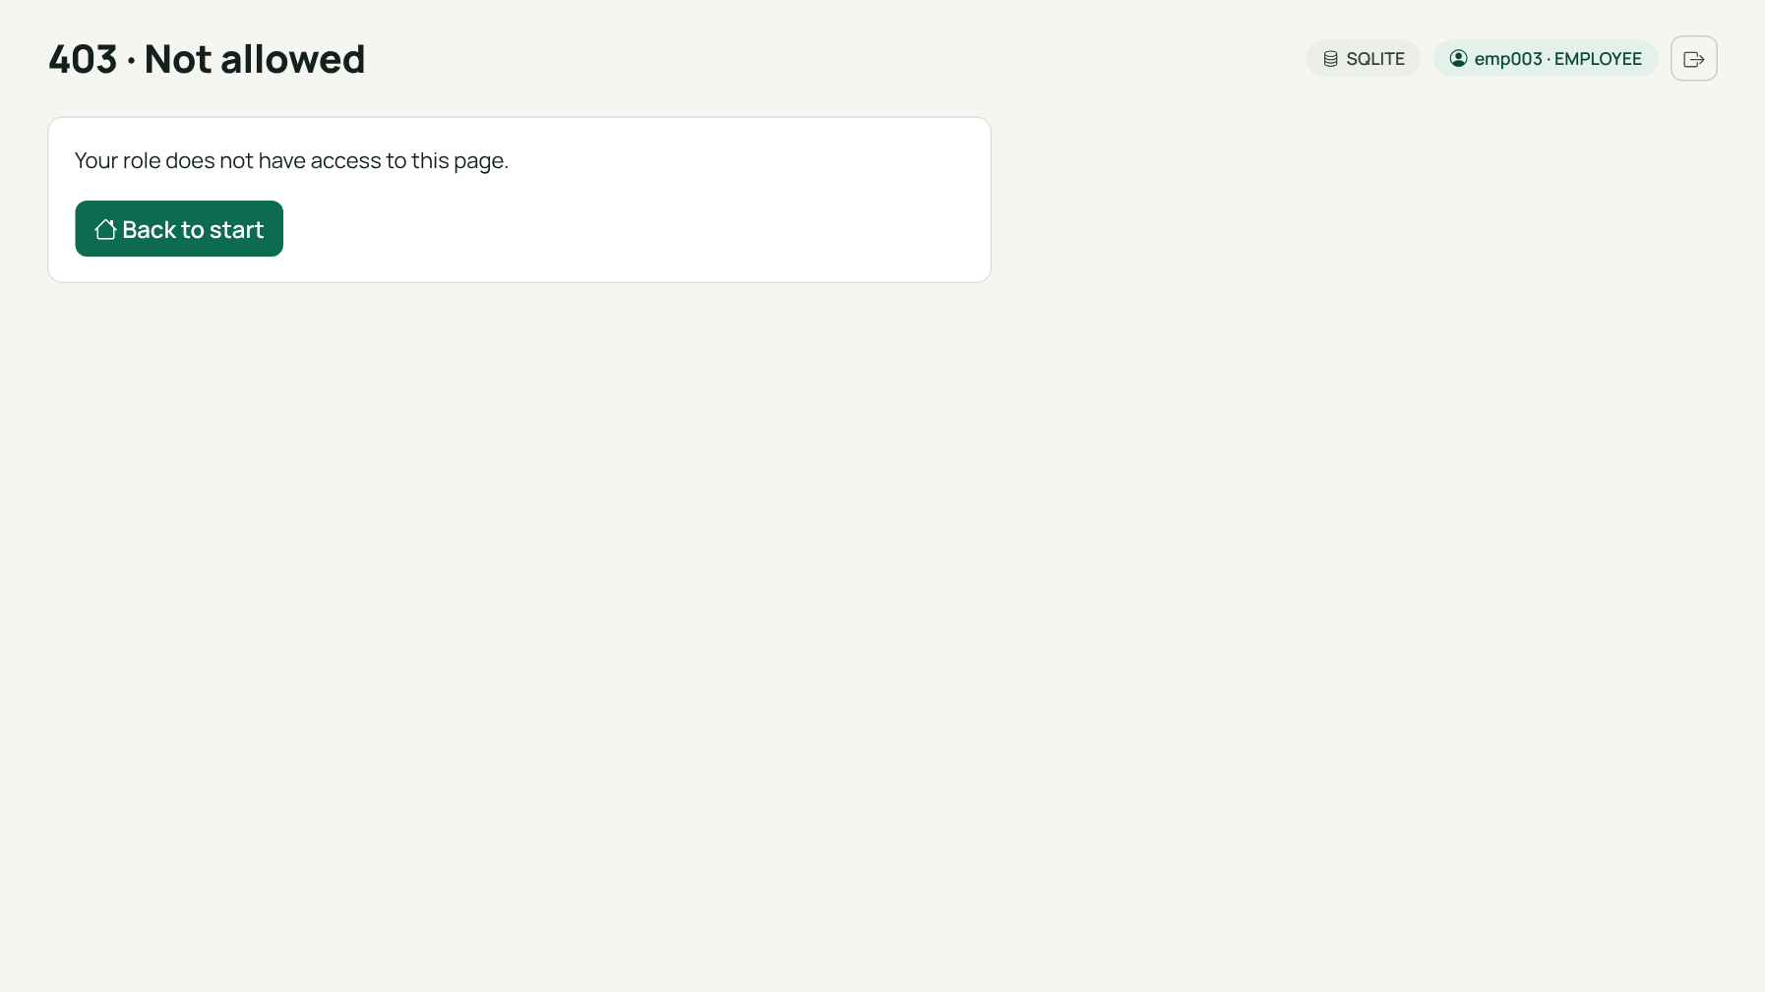
Login, Roles and Security
EMPLOYEE role: only own payslips
Same user opens the payroll register: 403
Role | Can do
ADMIN | everything + rates, users, Database Explorer
HR | manage data, run payroll, payslips, reports
EMPLOYEE | own profile, loans and payslips only
Salted PBKDF2 hashes · CSRF tokens · login throttle · own-payslip check · signed one-time password-reset links
Notes:
The application now requires a login. There are three roles. The administrator can do everything, including editing rates, managing user accounts and using the Database Explorer. HR can manage employees, salaries, attendance, loans and run payroll, but cannot open rates, users or the explorer. An employee can see only their own profile, loans and payslips: on the left is the employee view for EMP003 Pranav, and on the right is what happens when that employee tries to open the payroll register: a 403 Not allowed page. Passwords are never stored; only salted PBKDF2 hashes are. Every form carries a CSRF token, five failed logins lock a username for five minutes, the session is renewed at login, and a Forgot password link creates a signed reset link that expires after fifteen minutes and works only once. The demo has no e-mail server, so the link is shown on screen. This is a local demo: there is no HTTPS and the login throttle is in memory, so I do not claim it is ready for the internet.

Slide 10
Demonstration Flow
1
2
3
4
Sign in
Employees
Salary + attendance
Loans
admin / hr / employee
add / edit
monthly inputs
EMI, balance
5
6
7
8
Process payroll
Payslip
Bank transfers
Explorer + reports
one click
check the maths
pending > paid
triggers, audit, SQL
Reset the demo database at any time: python scripts/init_db.py
Notes:
This is the order I will follow in the live demo, and it takes about five minutes. One: sign in as the administrator and show the dashboard. Two: open the employee list and add a new employee. Three: show the salary structure and the October attendance. Four: show the loan with its repayment history. Five: process October payroll with one click. Six: open a payslip and check the arithmetic. Seven: generate bank transfers and mark them paid. Eight: open the Database Explorer to show the triggers, the audit trail and the read-only SQL console, then a report with its SQL. Every step in the deck corresponds to a real screenshot.

Slide 11

Payroll Workflow
OPEN
Enter attendance,
earnings, deductions
PROCESSED
Gross, deductions,
net + payslips written
PAID
Transfers marked
paid, history locked
Process payroll
Mark transfers paid
Inside the single transaction
Load active employees,
salary and attendance
Compute gross, LOP,
statutory deductions
Apply loan EMI and
manual deductions
Insert payroll_detail,
deductions, payslip
Update loan balance,
write repayment row
Safe: any error rolls the whole run back
Locked: a processed period cannot be processed again; triggers block edits to its rows
Skipped and reported: inactive employees, missing salary or attendance
Notes:
Payroll runs through a fixed life cycle. First the officer enters or confirms the inputs for the month: attendance, extra earnings and manual deductions. A period starts as OPEN. Pressing Process payroll calculates every active employee in one database transaction, writes the payroll detail, the itemised deduction rows, the payslip numbers and the loan repayments, and moves the period to PROCESSED. Because it is one transaction, any failure rolls everything back, and from then on database triggers refuse any change to that period's payroll rows. Then Generate bank transfers creates one pending transfer per payslip, and Mark transfers paid completes the cycle and sets the period to PAID. Once processed, the inputs for that period are locked, and a period cannot be processed twice.

Slide 12

Calculation Rules and Worked Example
Rules (illustrative, editable)
Worked example: EMP003, Oct 2026
Gross = fixed - loss of pay + extra earnings
LOP = fixed / working days x LOP days
PF = 12% of basic, basic capped at 15,000
ESI = 0.75% of gross, only if gross <= 21,000
PT = 200 if gross > 15,000
TDS = 5% of gross above 50,000
EMI = min(EMI, outstanding), ACTIVE loans
Net = gross - total deductions
Basic | 58,900.00
HRA | 23,560.00
DA | 5,890.00
Special | 11,780.00
Gross | 1,00,130.00
PF | 1,800.00
PT | 200.00
TDS | 2,506.50
Loan EMI | 5,000.00
Total deductions | 9,506.50
Net salary | 90,623.50
Notes:
These are the payroll rules, and I want to be clear that the rates are illustrative and editable in the configuration table; they are not official statutory rates. Gross is the fixed salary components minus loss of pay plus any extra earnings. Provident fund is twelve percent of basic capped at fifteen thousand. ESI is zero point seven five percent of gross, only when gross is twenty-one thousand or less. Professional tax is a flat two hundred above fifteen thousand. TDS is a simple five percent of gross above fifty thousand. Loan EMI is the smaller of the EMI and the outstanding balance. On the right is a worked example for employee EMP003 in October 2026: fixed gross is one lakh one hundred thirty rupees, PF is eighteen hundred, PT two hundred, TDS twenty-five hundred and six point five, EMI five thousand, so total deductions are nine thousand five hundred six point five and net salary is ninety thousand six hundred twenty-three point five. These numbers are also hand-checked in the unit tests.

Slide 13
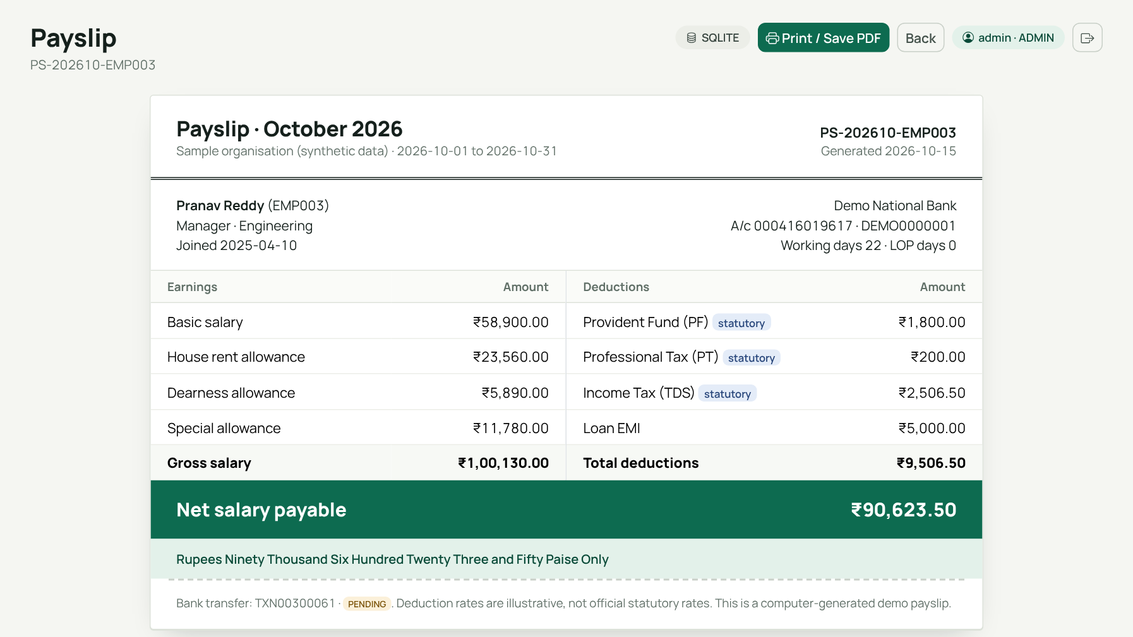
Payslip Output
Numbered: PS-202610-EMP003
Itemised: each earning and deduction line
Net payable: Rs 90,623.50
Linked: bank transfer reference TXN00300061
Printable: Print / Save PDF button
Payslip figures are read from payroll_detail and deductions; the page performs no recalculation, so a payslip cannot drift from what was paid.
Notes:
This is the payslip for EMP003 in October, generated by the application from the payroll detail row. It shows the earnings and deductions side by side, the gross, total deductions and the net salary payable, the working and loss of pay days, the bank details, and the linked bank transfer reference. The payslip number is built from the year, month and employee code. It can be printed or saved as PDF from the browser. The footer states plainly that the rates are illustrative and the data is synthetic. The figures match the worked example on the previous slide.

Slide 14
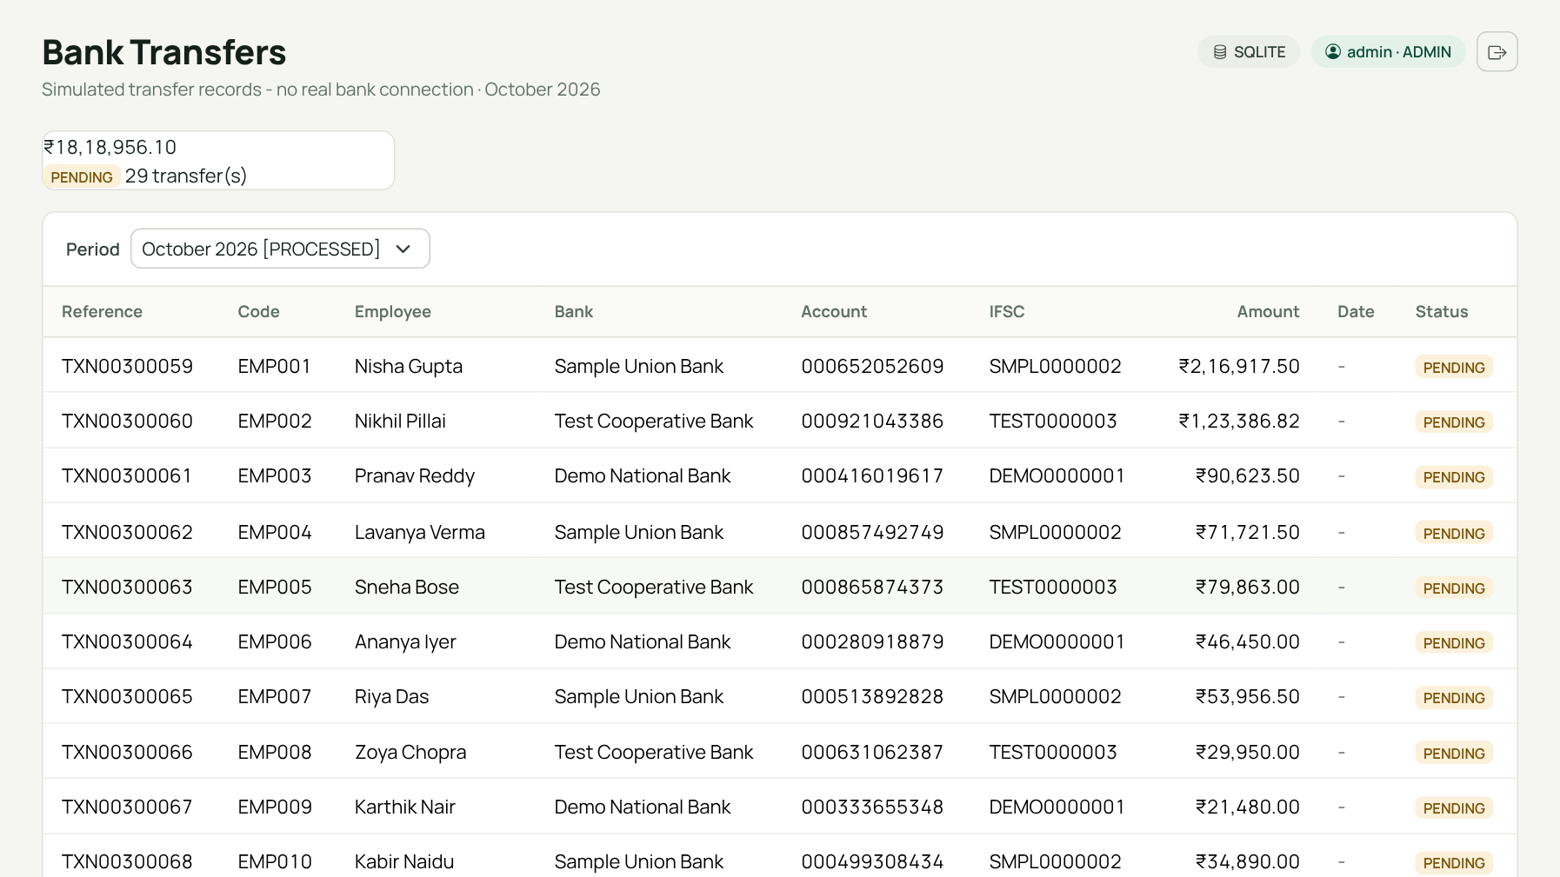
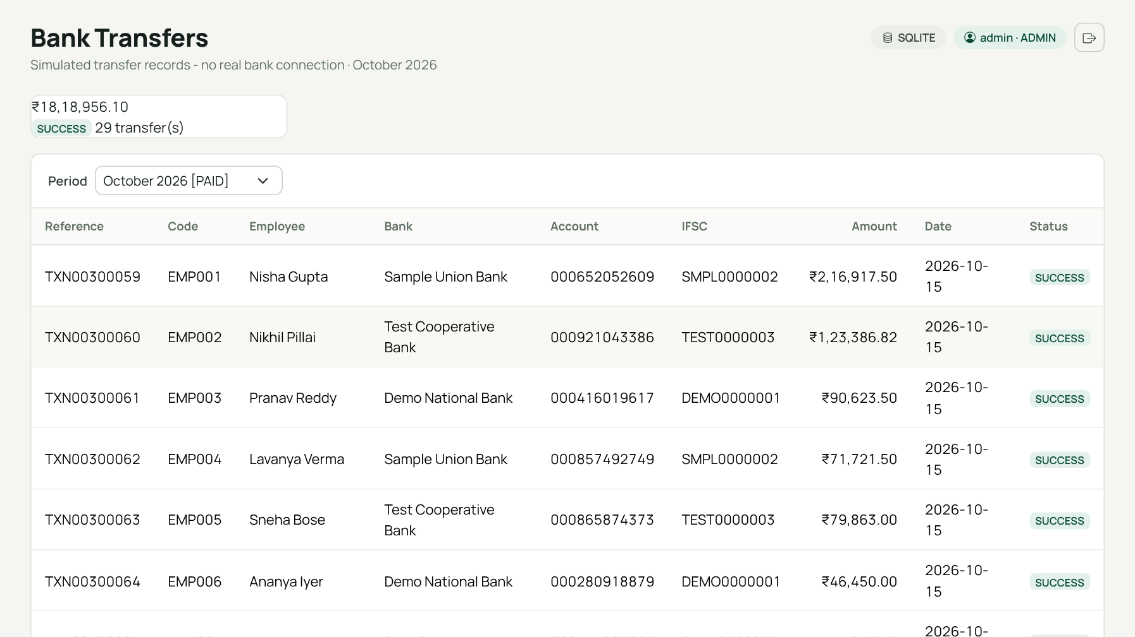
Bank Transfer Records
Before: status PENDING
After: status SUCCESS, period PAID
Simulated: records only, no real bank API, synthetic account numbers. One transfer per payslip (UNIQUE payroll_id).
Notes:
After processing, the system generates one transfer record per payslip using the employee's stored bank details, the net salary as the amount, and a reference number. On the left they are PENDING. After the officer chooses Mark transfers paid, they become SUCCESS with a date, as on the right, and the period moves to PAID. I want to be explicit that this is a simulation of the record keeping: there is no connection to any real bank and no money moves. The bank account numbers are fake.

Slide 15
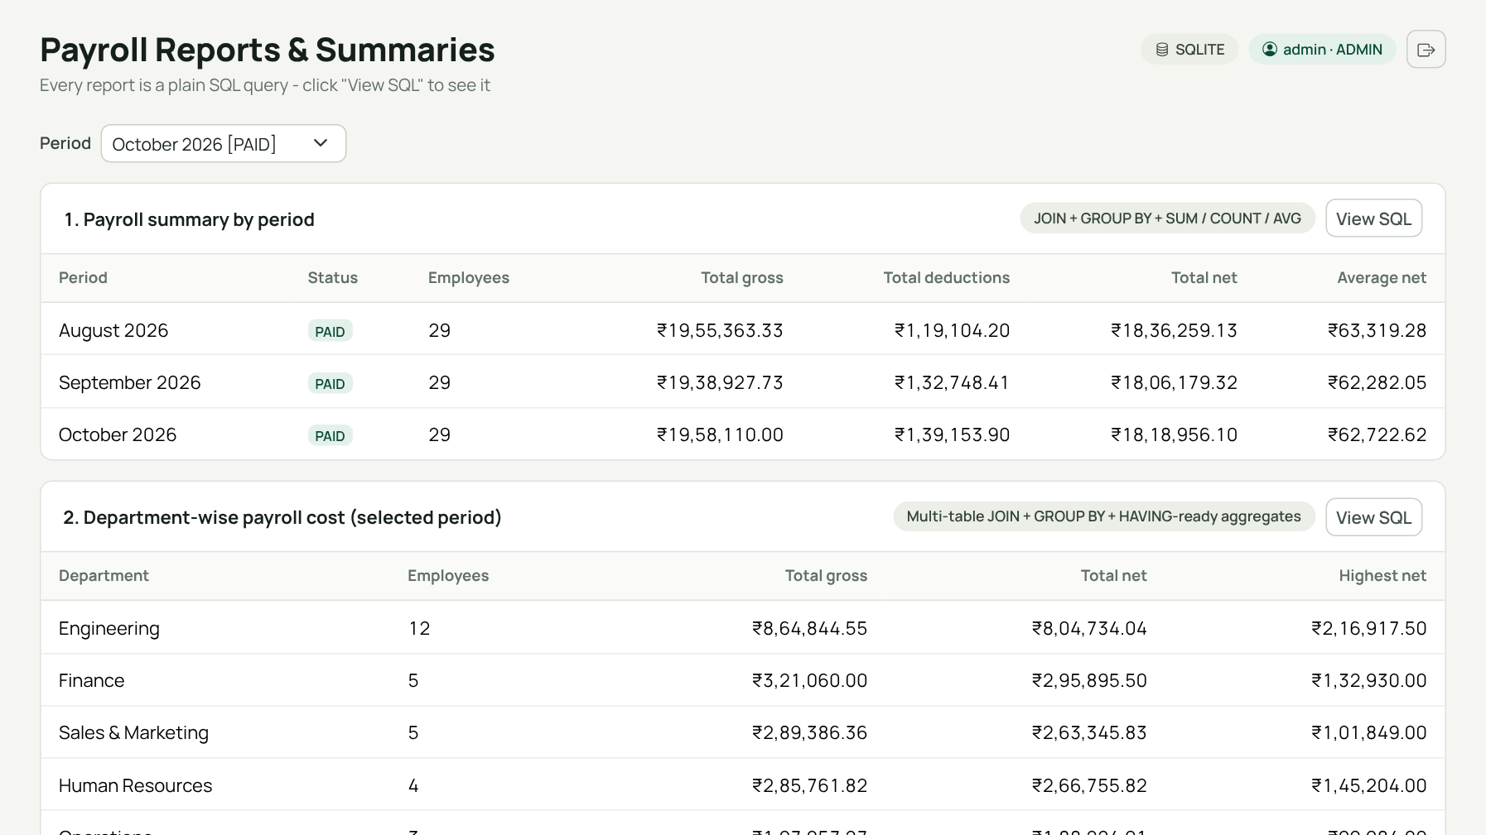
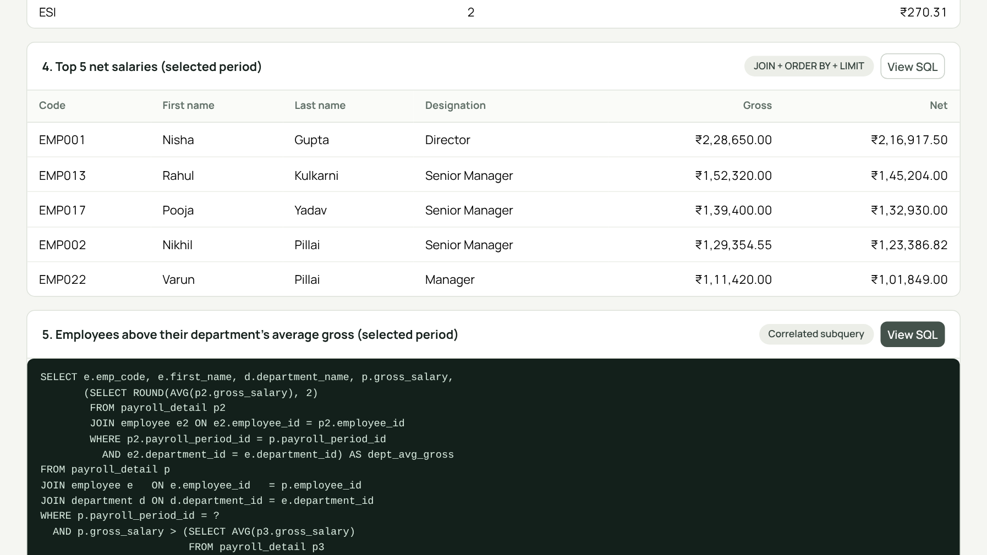
Reports
Reports page, period selector
Subquery report with its SQL shown
7 reports: period summary, department cost, statutory breakdown, top 5 net, above department average, active loans, not yet processed.
Notes:
The reports page offers seven reports, and each one has a View SQL button that shows the exact query that produced it. They are: payroll summary by period, department wise payroll cost, statutory deduction breakdown, top five net salaries, employees above their department's average gross, active loans with outstanding balance, and active employees without payroll in the selected period. The screenshot on the right shows the subquery report with its SQL expanded, which is useful in the viva because the query and result are on one screen. The payroll register can also be exported to CSV.

Slide 16
SQL Queries Behind the Results
Consistency check
NOT EXISTS
GROUP BY aggregate
SELECT payroll_id
FROM payroll_detail
WHERE ROUND(gross_salary
- total_deductions, 2)
<> net_salary;
-- expected: 0 rows
SELECT e.emp_code
FROM employee e
WHERE e.status = 'ACTIVE'
AND NOT EXISTS (
SELECT 1 FROM payroll_detail p
WHERE p.employee_id =
e.employee_id
AND p.payroll_period_id = 3);
SELECT pp.period_name,
COUNT(*) AS employees,
SUM(p.gross_salary) AS gross,
SUM(p.total_deductions) AS ded,
SUM(p.net_salary) AS net
FROM payroll_detail p
JOIN payroll_period pp
ON pp.payroll_period_id =
p.payroll_period_id
GROUP BY pp.period_name;
Also in queries.sql: INNER/LEFT JOIN, HAVING, scalar, IN, correlated and derived-table subqueries, a VIEW. All executed by the test suite.
Notes:
These are simplified excerpts from database/queries.sql, which I run in full as part of the automated tests. On the left is the cross-check I use to prove the payroll is internally consistent: for every payroll row, net must equal gross minus total deductions. The query returns zero rows when the data is correct. In the middle is NOT EXISTS, which finds active employees that have no payroll yet for a period. On the right is an aggregate with GROUP BY that totals gross, deductions and net per period. The same file also contains inner and left joins, HAVING, scalar, IN, correlated and derived-table subqueries, and a view for payslip summaries.

Slide 17
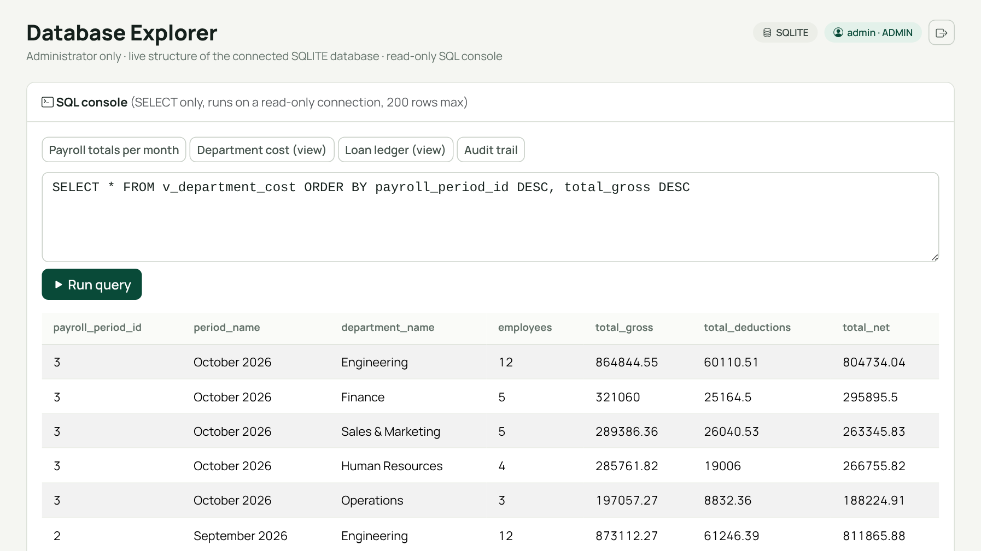
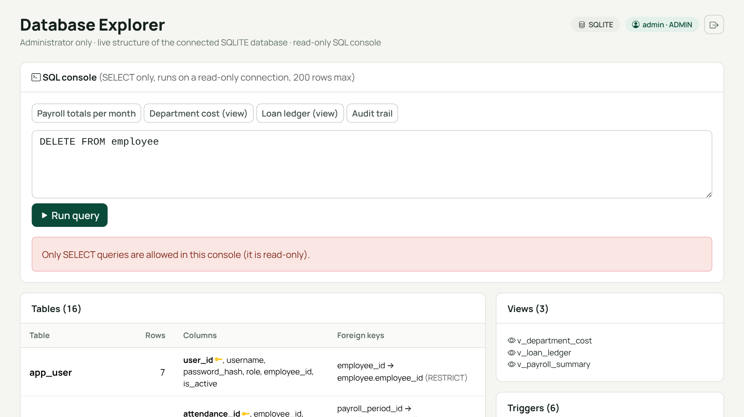
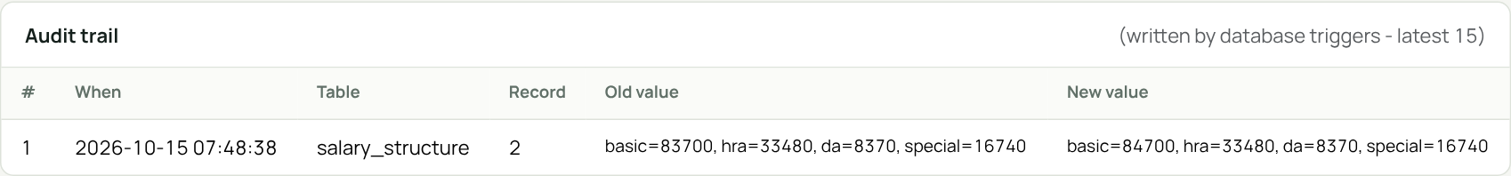
Database Explorer and Audit Trail
SELECT on a view runs
DELETE is refused (read-only)
Audit row written by a trigger after a salary edit in the web form
Notes:
The Database Explorer is an administrator-only page that reads the live structure of the connected database: tables with row counts, columns, primary keys, foreign keys with their delete rules, the three views and the six triggers. Below it is a SQL console. It accepts a single SELECT, runs it on a separate read-only connection with a five second limit and a two hundred row limit, and refuses the user table so password hashes are never shown. On the left I ran a SELECT on the department cost view. On the right I typed a DELETE and it was refused. The strip at the bottom is a real audit row: I edited a salary structure through the normal form and the database trigger recorded the old and new salary. The same page works on MySQL; I tested introspection and the console there too.

Slide 18

Payroll Results by Month
Month | Paid | Gross | Deductions | Net
August | 29 | 19,55,363 | 1,19,104 | 18,36,259
September | 29 | 19,38,928 | 1,32,748 | 18,06,179
October | 29 | 19,58,110 | 1,39,154 | 18,18,956
29 paid each month; employee 30 is inactive
Rs figures rounded to whole rupees
Synthetic demonstration data
Source: payroll_detail totals per period, read from the demo database (scripts/collect_facts.py).
Notes:
These are the real results from the three payroll months in the demo database, taken directly from the database. Each month has twenty-nine paid employees; the thirtieth employee is inactive and is skipped. Gross is about nineteen and a half lakh to nineteen point six lakh a month, total deductions rise from about 1.19 lakh in August to 1.39 lakh in October, and net salary stays around eighteen lakh. The table beside the chart gives the exact numbers. The data is synthetic, so these are demonstration results, not statistics of any real organisation.

Slide 19

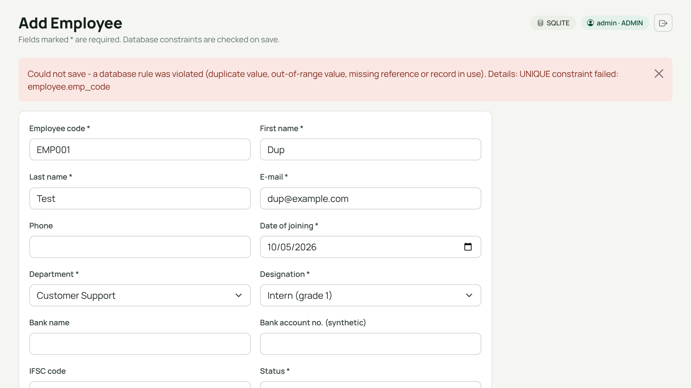
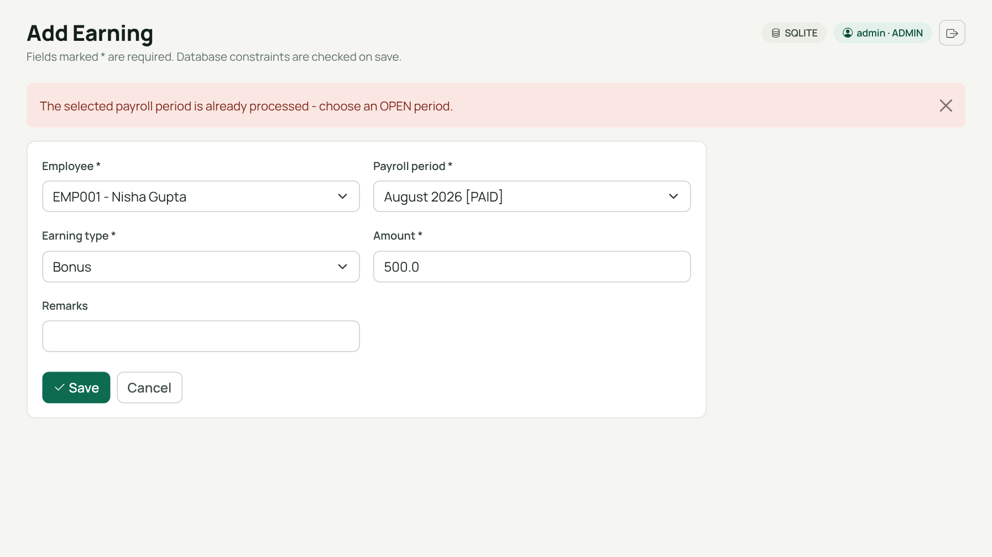
Data Integrity in Action
Duplicate employee code rejected (UNIQUE)
Edit to a paid period refused (lock)
PK, FK, UNIQUE, CHECK and ON DELETE RESTRICT/CASCADE are enforced by the database, not only by the Python code.
Notes:
Two screenshots show the database protecting the data. On the left I tried to add an employee with a code that already exists. The UNIQUE constraint rejected it and the application shows a readable message instead of a stack trace. On the right I tried to add a bonus to August 2026, which is already paid. The application refuses because processed periods are locked. Together with foreign keys, CHECK constraints and ON DELETE RESTRICT on payroll history, these rules mean a payroll record cannot be silently changed or orphaned.

Slide 20

Testing Results
74 / 74
11 / 11
SQLite tests passed
MySQL 8.0.46 tests passed
Verified
Formulas vs hand-computed values
Constraints and triggers reject bad data
Rollback and double-process guard
Roles, CSRF, own-payslip rule
Same payroll totals on SQLite and MySQL
MySQL run found and fixed a real bug
Not tested: GitHub Actions run | other MySQL versions, MariaDB | browsers other than headless Chromium | concurrent users
Notes:
All 74 automated SQLite tests pass, and a separate suite of 11 tests also passes on a real MySQL 8.0.46 server. The recorded outputs are in tests slash test_results dot txt and test_results_mysql dot txt. The SQLite suites cover calculation against hand-computed numbers, database constraints, payroll processing including rollback and double processing, the triggers and views, authentication and roles, password reset, amounts in words, the explorer, and the web layer. The MySQL suite checks that the payroll totals are identical to SQLite, that constraints and triggers work, that queries dot sql runs completely, and that the web app works and processes October. The MySQL run found one real bug: MySQL reports a violated CHECK constraint and a trigger signal as an operational error instead of an integrity error, which would have crashed pages; it is fixed. What I have not tested: the GitHub Actions workflow has not run yet, other MySQL versions or MariaDB, other browsers than headless Chromium, and many concurrent users.

Slide 21





Limitations
Demo-grade security
Simulated transfers
Illustrative rates
Roles, hashes, CSRF done; but no HTTPS, in-memory login throttle
Records only; no real bank API
Editable, not official statutory slabs
One MySQL version
Small scale
Audit lacks user name
Tested on 8.0.46 only; MariaDB and others untested
30 synthetic employees, local single server
Triggers cannot see the web user who made the change
Notes:
I want to be honest about what this project is not. Security is demo-grade: there are roles, hashed passwords and CSRF tokens, but no HTTPS, and the login throttle is in memory. The bank transfers are simulated records. The deduction rates are illustrative and editable, and are not official statutory rates, so the output must not be used for real payroll. The MySQL scripts were run and tested on one server, version 8.0.46; other versions and MariaDB are untested. The data is synthetic with about thirty employees. Finally, the audit trail records what changed but not which web user changed it, because triggers cannot see the web user.

Slide 22

Conclusion
16
12 / 12
74 + 11
6
tables, 17 foreign keys
requirements delivered
tests: SQLite + MySQL
triggers, 3 views
What was achieved
Future work
Schema enforced by constraints and triggers
Transaction-safe payroll with audit trail
Roles, payslips, transfers, reports
Official tax slabs and statutory rules
PDF / e-mail payslips, bank file export
Audit with user name; HTTPS deployment
Lesson learned: let the database enforce the rules, not only the application.
Notes:
To conclude: I took the Review 1 design and delivered a working payroll system. The database has sixteen tables with primary keys, foreign keys, unique and check constraints, plus triggers and views. The payroll engine computes gross, statutory and loan deductions and net salary for each employee in one safe transaction. Payslips, simulated bank transfers and seven reports are produced from that data, with login roles on top. 74 automated tests pass on SQLite and 11 on a real MySQL 8 server. The project taught me that the database should enforce the rules, not only the application. With more time I would replace the illustrative rates with official ones, record the acting user in the audit trail, add PDF payslips and deploy behind HTTPS.

Slide 23

Viva Readiness: Key Concepts
Normalisation
Keys
Constraints
3NF; payroll_detail is a deliberate snapshot
16 primary keys, 17 foreign keys
UNIQUE, CHECK, NOT NULL, DEFAULT
Referential actions
Transactions
Joins
RESTRICT for history, CASCADE for inputs
atomic payroll run: commit or rollback
INNER, LEFT, multi-table payslip join
Subqueries
Aggregates
Triggers, views, indexes
scalar, IN, EXISTS, correlated, derived
SUM, COUNT, AVG with GROUP BY, HAVING
6 triggers, 3 views, 8 indexes
Notes:
These are the DBMS concepts in this project that I can explain and show in the code. Normalisation: the schema is in third normal form, with payroll detail as a deliberate snapshot. Keys: every table has a primary key, and sixteen foreign keys link them. Constraints: UNIQUE on employee code and email, CHECK on amounts and status values. Referential actions: RESTRICT protects paid history, CASCADE removes employee inputs. Transactions: payroll processing is atomic with commit and rollback. Joins and subqueries are in queries.sql. Indexes speed up lookups by period and employee. Derived data: loss of pay days are computed, not stored, to avoid redundancy.

Slide 24

Viva Readiness: Likely Questions
Why store payroll_detail if it can be calculated?
A payslip must not change when salaries or rates are edited later: it is a deliberate snapshot.
Why triggers if the app already locks periods?
The database stays protected even if someone bypasses the app: paid payroll rows cannot be changed.
How do you avoid a half-finished payroll?
The whole run is one transaction; any error rolls back.
Are the rates official? Is the transfer real?
No. Rates are illustrative and editable; transfers are simulated records.
MySQL or SQLite?
Both: 74 tests on SQLite and 11 on a real MySQL 8.0.46. The app defaults to SQLite.
Notes:
Here are questions I expect, with short answers. Why is payroll detail stored if it can be calculated? Because a payslip must not change if rates or salaries are edited later, so it is a deliberate snapshot. Why RESTRICT on payroll history? So paid records cannot be deleted by accident. How do you avoid a half-finished payroll? The whole run is one transaction. Where are the deduction rates? In payroll_config, and they are illustrative. Is the bank transfer real? No, it is a simulated record. Does it use MySQL? The scripts support MySQL 8 and the app runs on SQLite by default; I tested both, SQLite with 74 tests and a real MySQL 8.0.46 server with 11. What would you add next? Official tax rules, and recording the acting user in the audit trail.

Slide 25

References
Flask documentation, Pallets Projects: flask.palletsprojects.com
SQLite documentation: sqlite.org/docs.html
MySQL 8.0 Reference Manual, Oracle: dev.mysql.com/doc
PyMySQL documentation: pymysql.readthedocs.io
Bootstrap 5 and Bootstrap Icons documentation: getbootstrap.com
Chart.js documentation: chartjs.org
R. Elmasri and S. Navathe, Fundamentals of Database Systems, Pearson
A. Silberschatz, H. Korth and S. Sudarshan, Database System Concepts, McGraw-Hill
Project 36 Review 1 presentation (problem, objectives, ER, initial schema)
Deduction rates are illustrative and not sourced from statutory documents.
Notes:
These are the references I used: the official documentation for Flask, SQLite, MySQL 8, PyMySQL, Bootstrap and Chart.js, and two standard textbooks for the database theory. The deduction rates in this project are illustrative and are not taken from any statutory document, so I have not cited any tax or provident fund rules as a source.

Slide 26

Thank You
Thank You
Questions and live demonstration
G MADHAN 25WU0102344
AI ML RHINOS
Notes:
Thank you. The source code, SQL scripts, screenshots, report and test results are in the submission folder. I am happy to demonstrate any part of the application live or to answer questions on the database design, the SQL, or the payroll calculation.

