Slide 1

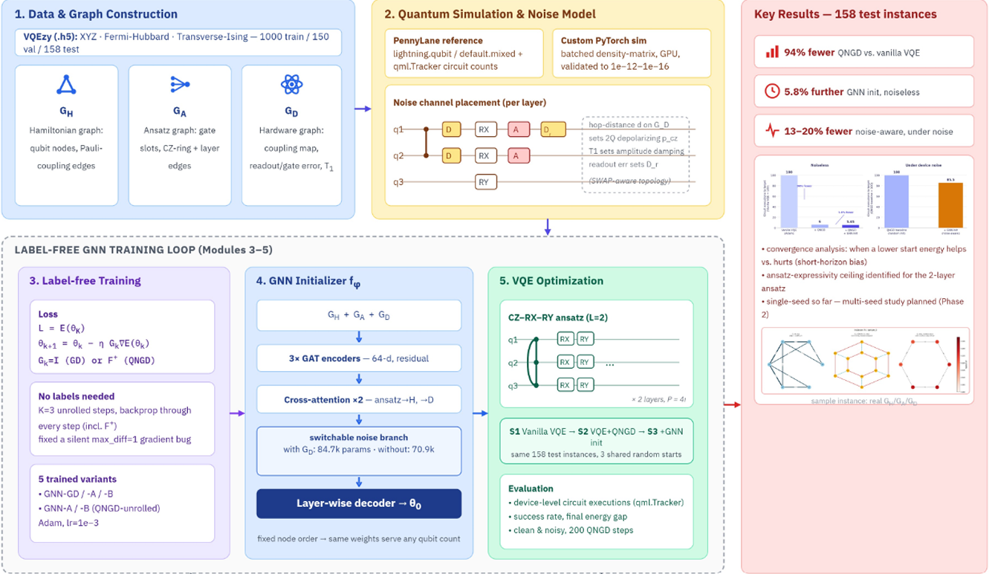
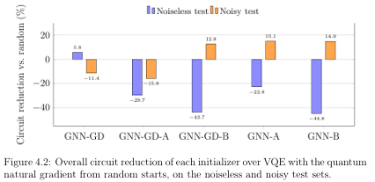
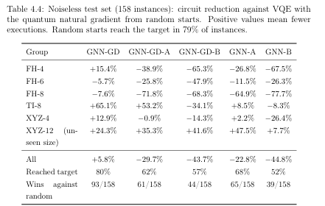
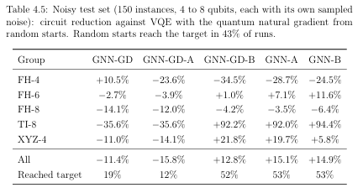
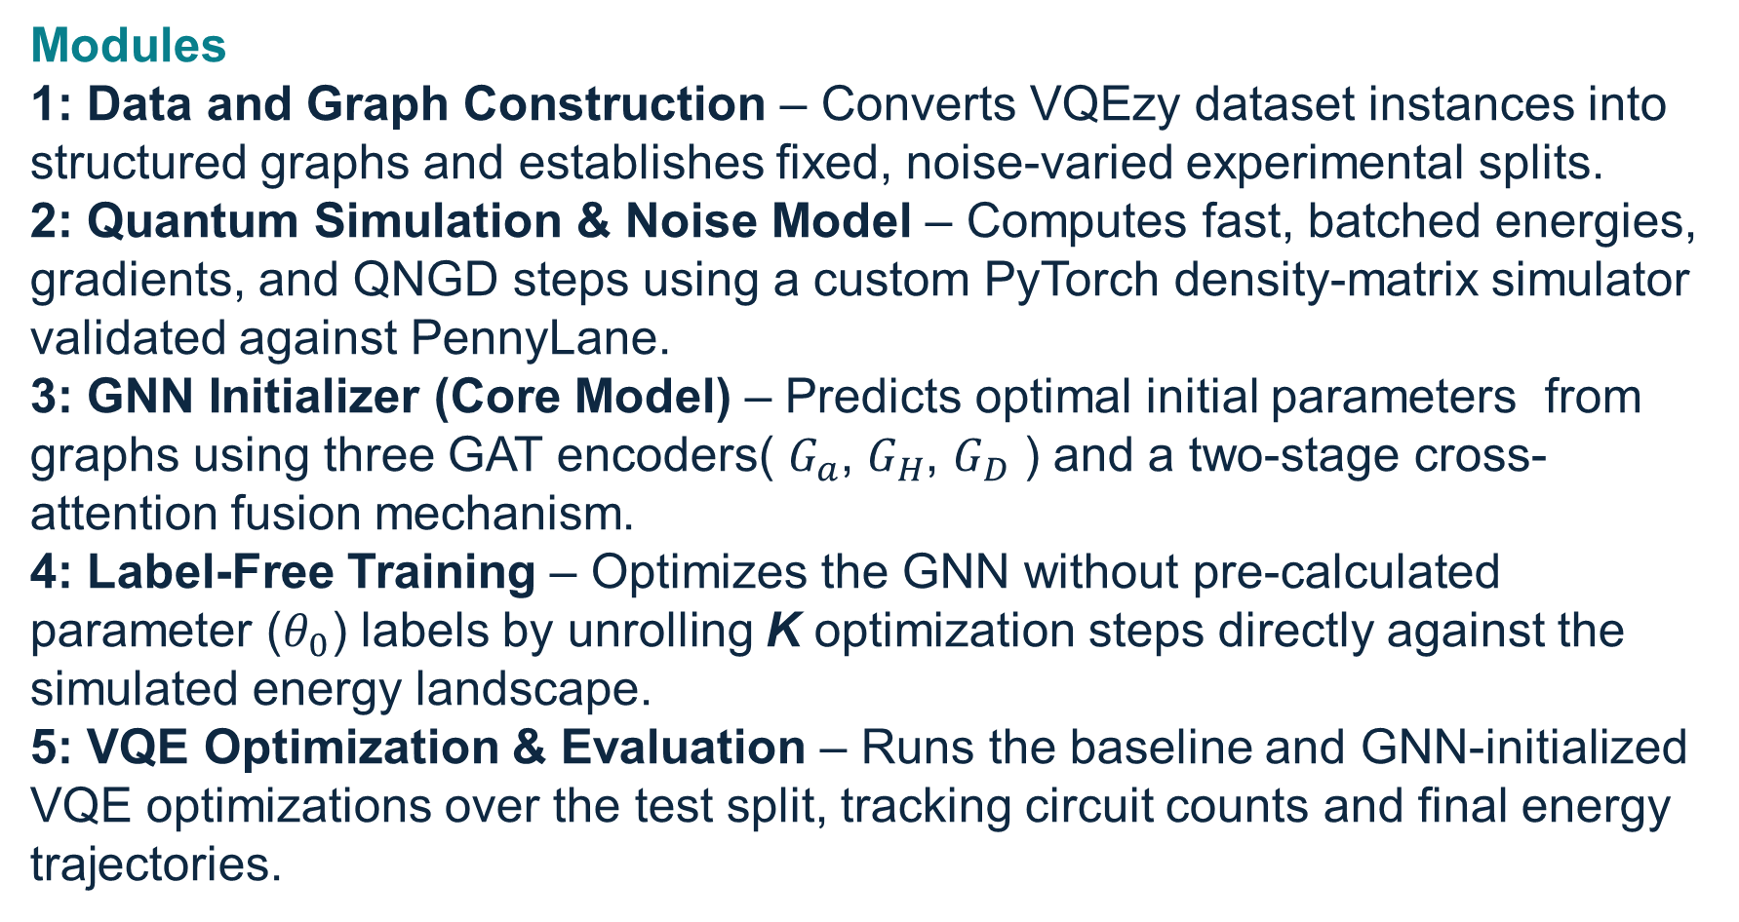
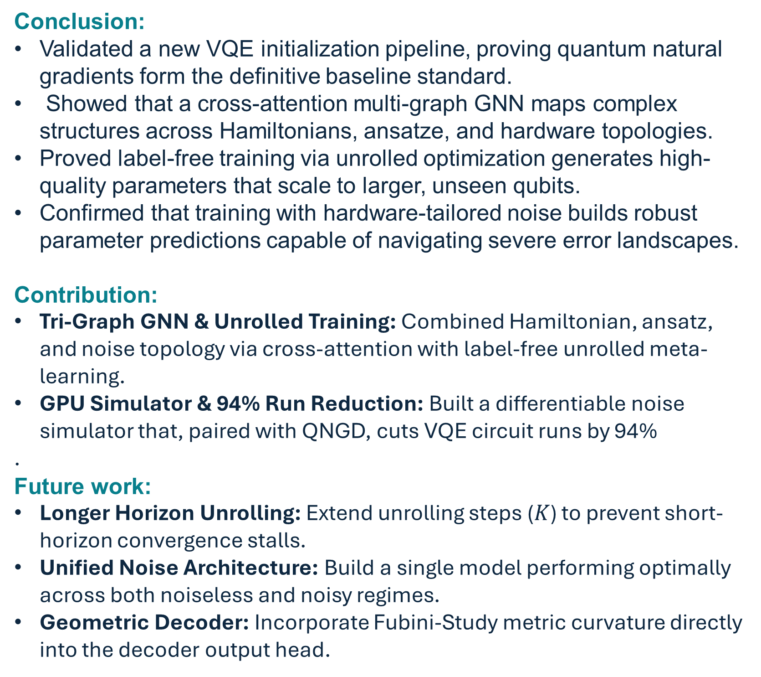
Sri Sivasubramaniya Nadar College of Engineering
Department of Computer Science and Engineering
Noise-Aware Geometry-Guided GraphNeural Initialization for Variational Quantum Eigensolvers
R.K. Barath, 3122235001029 Madhangi Karimanal, 3122235001073 Nithyasree K, 3122235001092
Guide: Dr. Sneka Nandhini, Assistant Professor, Department of Computer Science
Problem Statement & Objectives
Methodology
Results and Analysis
Problem Statement:
Noise-Aware Geometry-Guided GraphNeural Initialization for Variational Quantum Eigensolvers
Objectives
Establish the Baseline: Reproduce the VQEzy dataset procedure using VQE+QNGD from random starts with realistic hardware execution accounting.
Design the GNN Initializer: Implement a three-graph GNN that fuses Hamiltonian, ansatz, and hardware/noise graphs using cross-attention to predict initial parameters.
Implement Label-Free Training: Train the initializer without labels by unrolling the optimizer and quantifying the training objective's impact.
Evaluate Noise Awareness: Build a hardware-driven noise model to test noise-unaware and noise-aware variants in both noiseless and noisy environments.
Related work and research gap
Author & Year | Proposed Method | Finding | Limitation
Zhang et al. (2025) - Qracle | GNN-based VQE parameter initializer | Maps problem/ansatz structure to VQE initial parameters | Single graph only; ignores hardware, noise, and geometry
Cheng et al. (2025) | Clifford-circuit initialization | Classically simulable init competitive with random search | Non-learned; lacks structure from Hamiltonian/ansatz/hardware
Jiang et al., QSeer (2025 | Physics-informed GNN for QAOA | Improves plain GNN warm-starts via physics structure | QAOA-specific; no joint hardware-noise or geometry modeling
Conclusion and future work
Functional Modules and Dataset Description
Conclusion:
Validated a new VQE initialization pipeline, proving quantum natural gradients form the definitive baseline standard.
Showed that a cross-attention multi-graph GNN maps complex structures across Hamiltonians, ansatze, and hardware topologies.
Proved label-free training via unrolled optimization generates high-quality parameters that scale to larger, unseen qubits.
Confirmed that training with hardware-tailored noise builds robust parameter predictions capable of navigating severe error landscapes.
Contribution:
Tri-Graph GNN & Unrolled Training: Combined Hamiltonian, ansatz, and noise topology via cross-attention with label-free unrolled meta-learning.
GPU Simulator & 94% Run Reduction: Built a differentiable noise simulator that, paired with QNGD, cuts VQE circuit runs by 94%
.
Future work:
Longer Horizon Unrolling: Extend unrolling steps ($K$) to prevent short-horizon convergence stalls.
Unified Noise Architecture: Build a single model performing optimally across both noiseless and noisy regimes.
Geometric Decoder: Incorporate Fubini-Study metric curvature directly into the decoder output head.
Modules
1: Data and Graph Construction – Converts VQEzy dataset instances into structured graphs and establishes fixed, noise-varied experimental splits.
2: Quantum Simulation & Noise Model – Computes fast, batched energies, gradients, and QNGD steps using a custom PyTorch density-matrix simulator validated against PennyLane.
3: GNN Initializer (Core Model) – Predicts optimal initial parameters from graphs using three GAT encoders( $G_{a}$, $G_{H}$, $G_{D}$ ) and a two-stage cross-attention fusion mechanism.
4: Label-Free Training – Optimizes the GNN without pre-calculated parameter ($θ_{0}$) labels by unrolling K optimization steps directly against the simulated energy landscape.
5: VQE Optimization & Evaluation – Runs the baseline and GNN-initialized VQE optimizations over the test split, tracking circuit counts and final energy trajectories.
Research gap:
No method jointly represents Hamiltonian, ansatz and hardware/noise as separate, fused graphs
No method predicts both θ0 and a local approximation of the QNGD geometric metric
No method couples this with anadaptive, geometry-aware refinementloop to cut circuit evaluations
Dataset Description
We used the VQEzy dataset which consists of 1,308 total instances across three Hamiltonian families spanning 4 to 8 qubits, split into 1,000 train, 150 validation, and 158 test samples. A separate 12-qubit Heisenberg chain is reserved exclusively for unseen-size test evaluation.

