Slide 1

DESIGN AND OPTIMIZATION OF CMOS RING OSCILLATOR IN 5G TECHNOLOGY
21BEC1509 - B.Madhan Kumar Reddy
Guide Name - Dr. UMADEVI S
Guide’s Signature

Slide 2
Introduction
Radio frequency is used to communicate by every wireless technology, including cell phones and automated gates. As they broadcast or receive signals, several devices that share the same frequencies produce interference.
Rapid growth is being seen in the need for processors with high frequency and low power use.
In order to combat the digital noise that comes with the signal, Wi-Fi networks now employ the 5 GHz band for media streaming and transferring of music, pictures, and video.
VCO has a significant impact on the RF subsystem of the wireless communication system. The input signal is up- and down-converted using a local oscillator that is generated by a VCO.

Slide 3
The ideal characteristics for the VCO design should be low phase noise, low power consumption, and high frequency swing.
There are two distinct designs for VCOs: ring oscillator and LC oscillator. The voltage-to-current converter's voltage-to-current converter provides current to the inverter-type ring oscillator at the heart of the VCO.
Ring oscillators perform superior to relaxation oscillators in terms of efficiency. Although they may achieve a greater tuning range, relaxation oscillators are less power-efficient.
The LC oscillator takes up a lot of space on a die, has a narrow tuning range, and its performance with regard to phase noise is influenced by its quality level.
Due to their small size, digital compatibility, and ease of portability, ring oscillators are therefore preferred for use in.
As a result of the ring oscillator's low power dissipation and 5G operating frequency design, the device's performance was enhanced.
.

Slide 4
Problem Statement
The rapid advancement of 5G technology necessitates high-frequency oscillators that operate efficiently within the millimeter-wave spectrum.
Designing CMOS oscillators for 5G applications presents significant challenges, particularly:
Achieving low power consumption.
Ensuring optimal delay performance.
Maintaining high-frequency stability.
Traditional oscillator designs often face trade-offs between:
Power efficiency.
Delay optimization.
Overall system performance.
These trade-offs can hinder system performance, making it difficult to meet 5G requirements.
The project focuses on addressing these challenges by:
Designing and optimizing CMOS ring oscillator for 5G communication systems.
Reducing power consumption.
Minimizing propagation delays.
Maintaining frequency stability.
Ensuring integration capability.

Slide 5
OBJECTIVE
The objective of the project is to improve the performance and energy efficiency of a 5G communication system by implementing low-power ring oscillator delay cells.

Slide 6
Conventional CMOS oscillator
Delay cells can be used in the ring oscillator circuit in a variety of ways, in essence. Depending on the important factor they took into account when designing, several designers employed differential, source follower, and starved current delay cells.
As a result of the delay cell being utilized, the current starved ring oscillator's tuning range and power efficiency may be enhanced, leading to the widespread adoption of this design.
To achieve minimal power consumption, this sort of circuit must have the minimum supply voltage and current tail values. Furthermore, compared to other circuits, his circuit's implementation is easier.
Proposed Starved Current Ring Oscillator: A three-stage ring oscillator is initially employed to evaluate the oscillation frequency. When the ring oscillator circuit depends only on voltage supply, VDD, the output frequency becomes unstable.

Slide 7
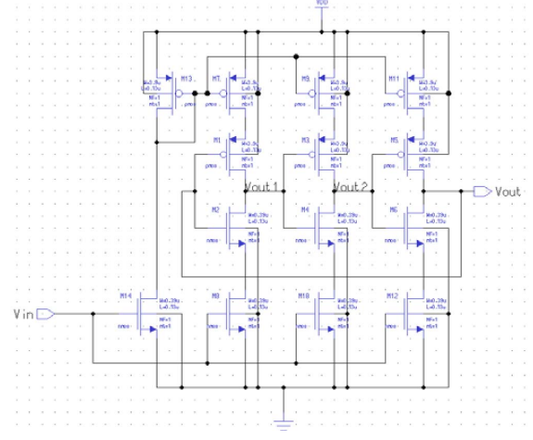
In order to solve this issue, current is now introduced to each inverter rather than VDD. In order to deliver current to each inverter instead of Vdd, each delay cell was linked to PMOS and NMOS transistors.
Due to the ring oscillator's dependence on the Vdd supply voltage, it stabilizes the output frequency as a result. For instance, the M7 and M8 transistors serve as current sources for the M1 and M2 transistors in the first stage of the inverter.
The inverter is considered to be starving for current at this moment because M7 and M8 are restricting the flow of current via M1 and M2. The input control voltages were used to set the behavior of M13 and M14 as current mirrors. Each current source stage receives the current that has been reflected.
Fig. 1: The schematic of ring oscillator with starved current circuit

Slide 8
Disadvantages
High Power Consumption
Limited applicability
Increased design effort

Slide 9
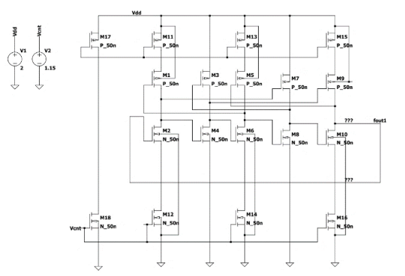
Enhanced Conventional CMOS Oscillator
The proposed architecture aims to leverage the advantages of distinct designs while mitigating their drawbacks. The design's primary goal is to create a system optimized for 5G devices, where size, frequency, and power consumption are critical factors.
The architectural schematic, shown in Figure 2, is inspired by both current-starved and negatively skewed oscillator designs.
Fig. 2: The schematic of Proposed circuit

Slide 10
Each CMOS component operates as follows: CMOS transistors M1 through M10 form the negative-skewed delay oscillators, while M11 through M16 constitute the current-limited oscillators.
CMOS transistors M17 and M18 handle biasing and control circuits. The design includes five stages of inverters, labeled M1 through M10. Current limiters M11 to M16 restrict the current in the first, third, and fifth stages, optimizing power efficiency.
VDD and VCNT serve as voltage, also functioning as the control and biasing voltages to regulate the operating voltage of the topology.

Slide 11
Advantages
High frequency performance
Low power consumption.

Slide 12
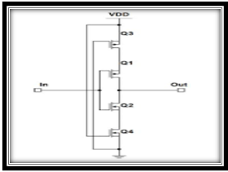
PROPOSED SAPON APPROACH
The SAPON (Stackly Arranged low Power ON transistor) technique is a novel approach to low power VLSI design that focuses on reducing power consumption in static and dynamic leakage power.
The SAPON technique is centered on the concept of controlling leakage power, which is a significant contributor to power consumption in VLSI circuits. Leakage power occurs due to the unwanted flow of current through transistors even when they are supposed to be off. To address this issue, SAPON places two leakage-control transistors outside the main logic circuit. These transistors act as resistors that increase the resistance between the supply voltage (Vdd) and ground, thereby controlling the leakage currents.

Slide 13
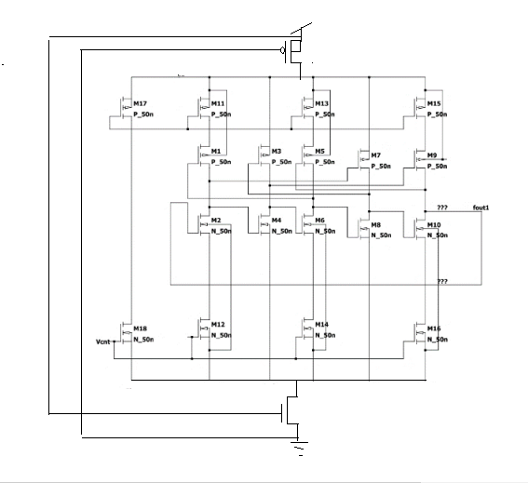
Proposed SAPON method
The proposed architecture aims to leverage the advantages of distinct designs while mitigating their drawbacks. The design's primary goal is to create a system optimized for 5G devices, where size, frequency, and power consumption are critical factors. The architectural schematic, shown in Figure 3, is inspired by both current-starved and negatively skewed oscillator designs.
Fig. 3: The schematic of Proposed circuit

Slide 14
Each CMOS component operates as follows: CMOS transistors M1 through M10 form the negative-skewed delay oscillators, while M11 through M16 constitute the current-limited oscillators.
CMOS transistors M17 and M18 handle biasing and control circuits. The design includes five stages of inverters, labeled M11 through M19. Current limiters M11 to M18 restrict the current in the first, third, and fifth stages, optimizing power efficiency.
M19 and M20 serve as current sources, also functioning as the control and biasing circuits to regulate the operating voltage of the topology.

Slide 15
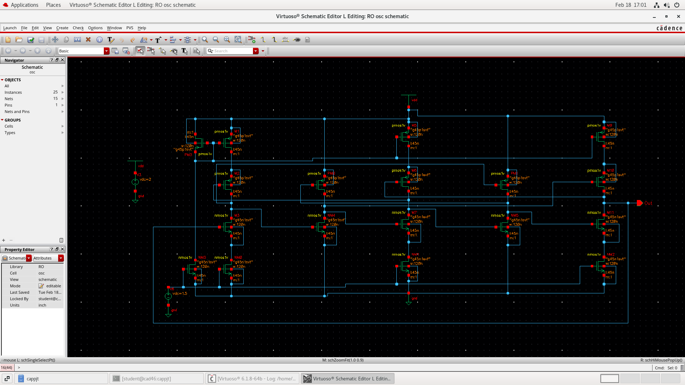
RESULTS OBTAINED
Schematic of Enhanced Ring Oscillator

Slide 16
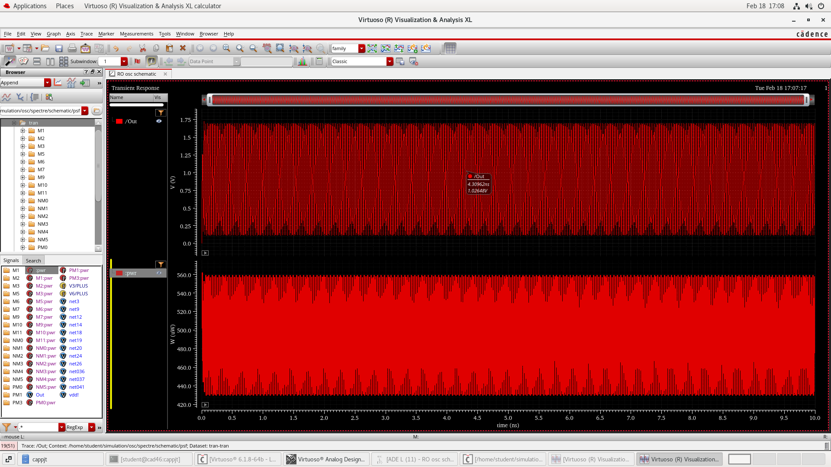
Output Waveform of Enhanced Ring Oscillator

Slide 17
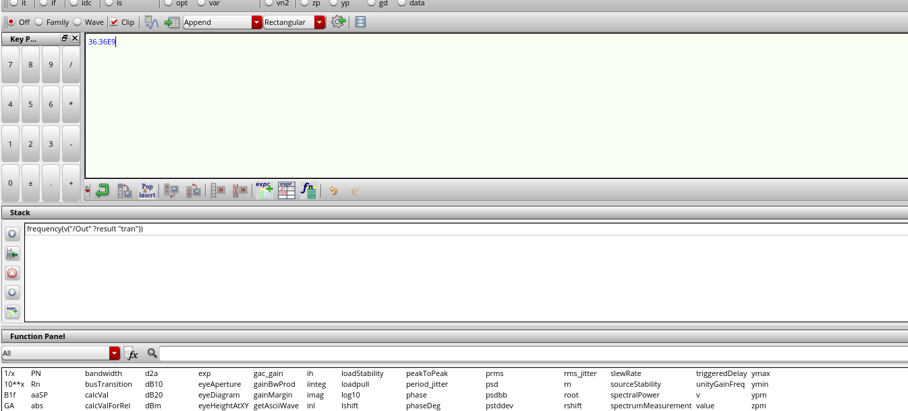
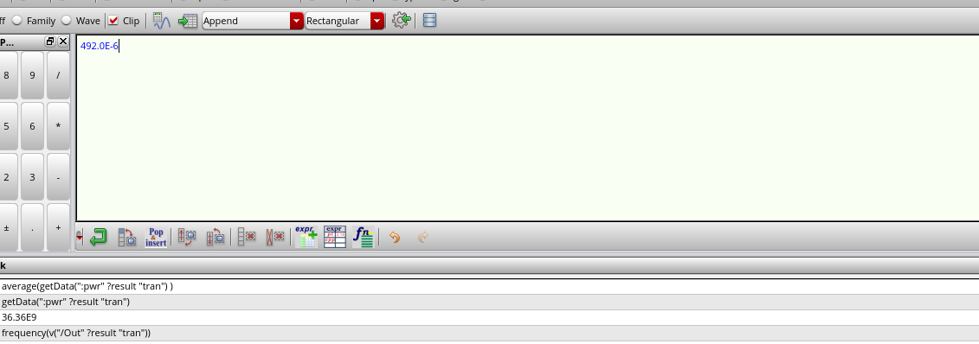
frequency
power

Slide 18
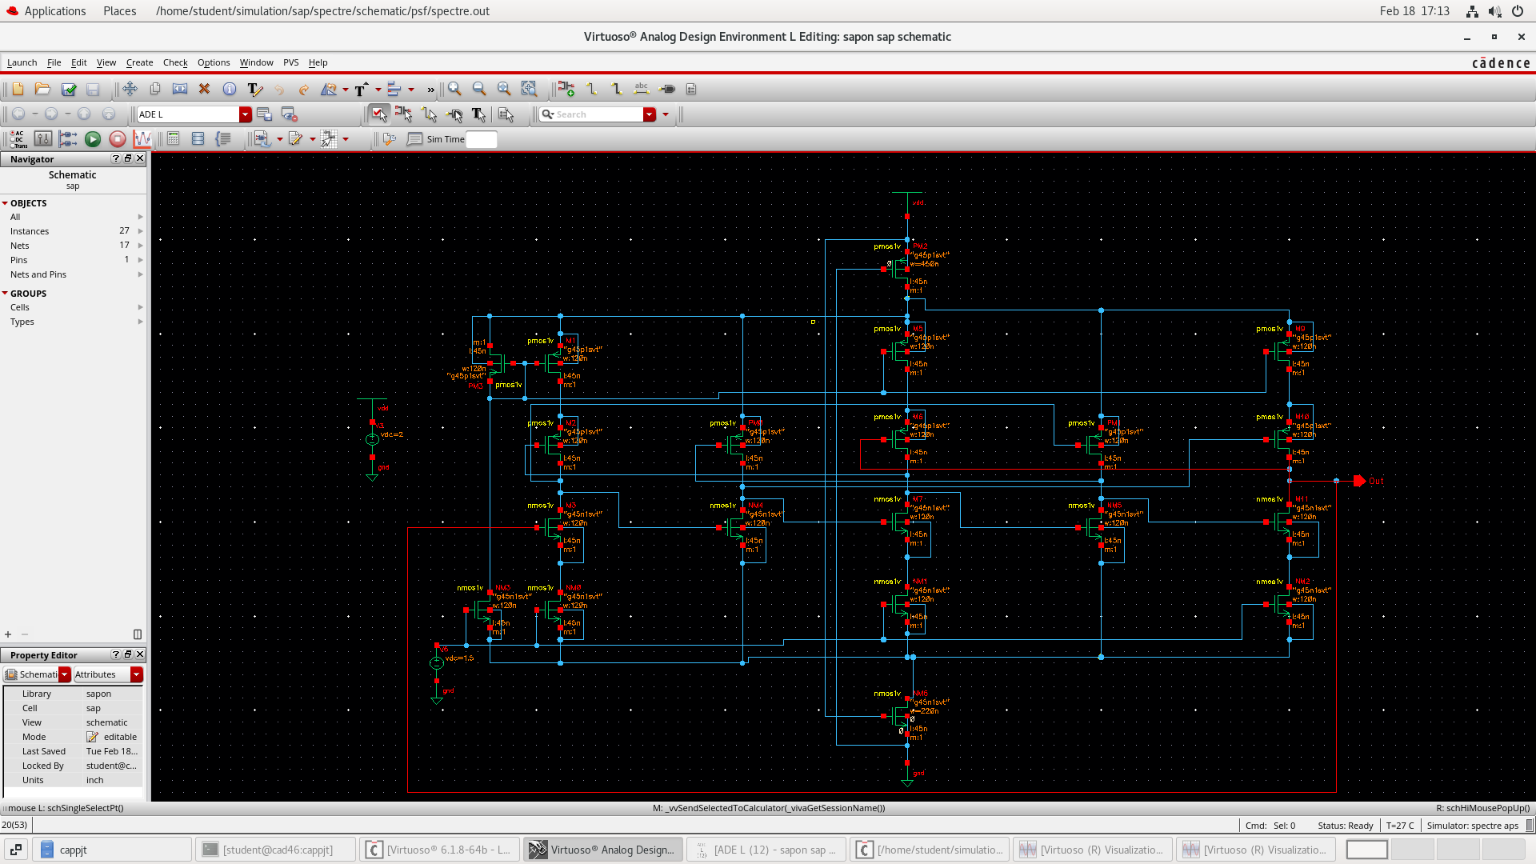
Schematic of Proposed SAPON Oscillator

Slide 19
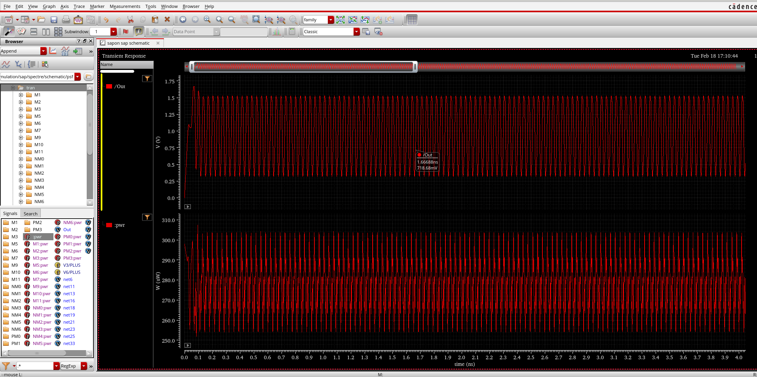
Output Waveform of Proposed SAPON Oscillator

Slide 20
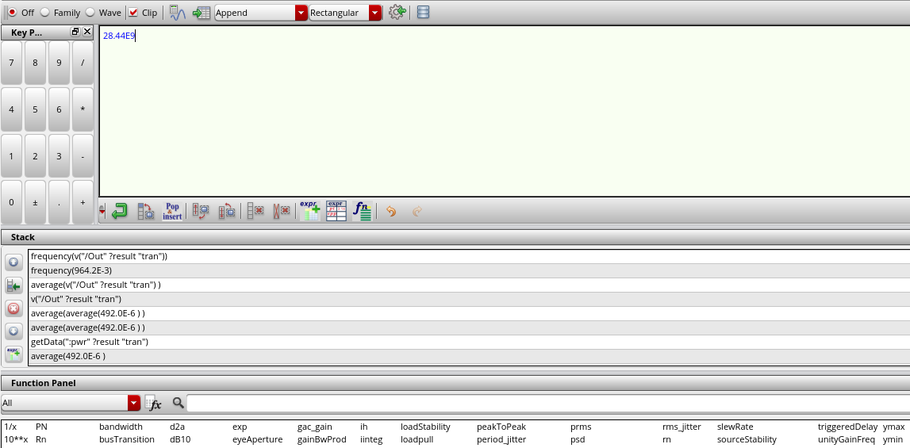
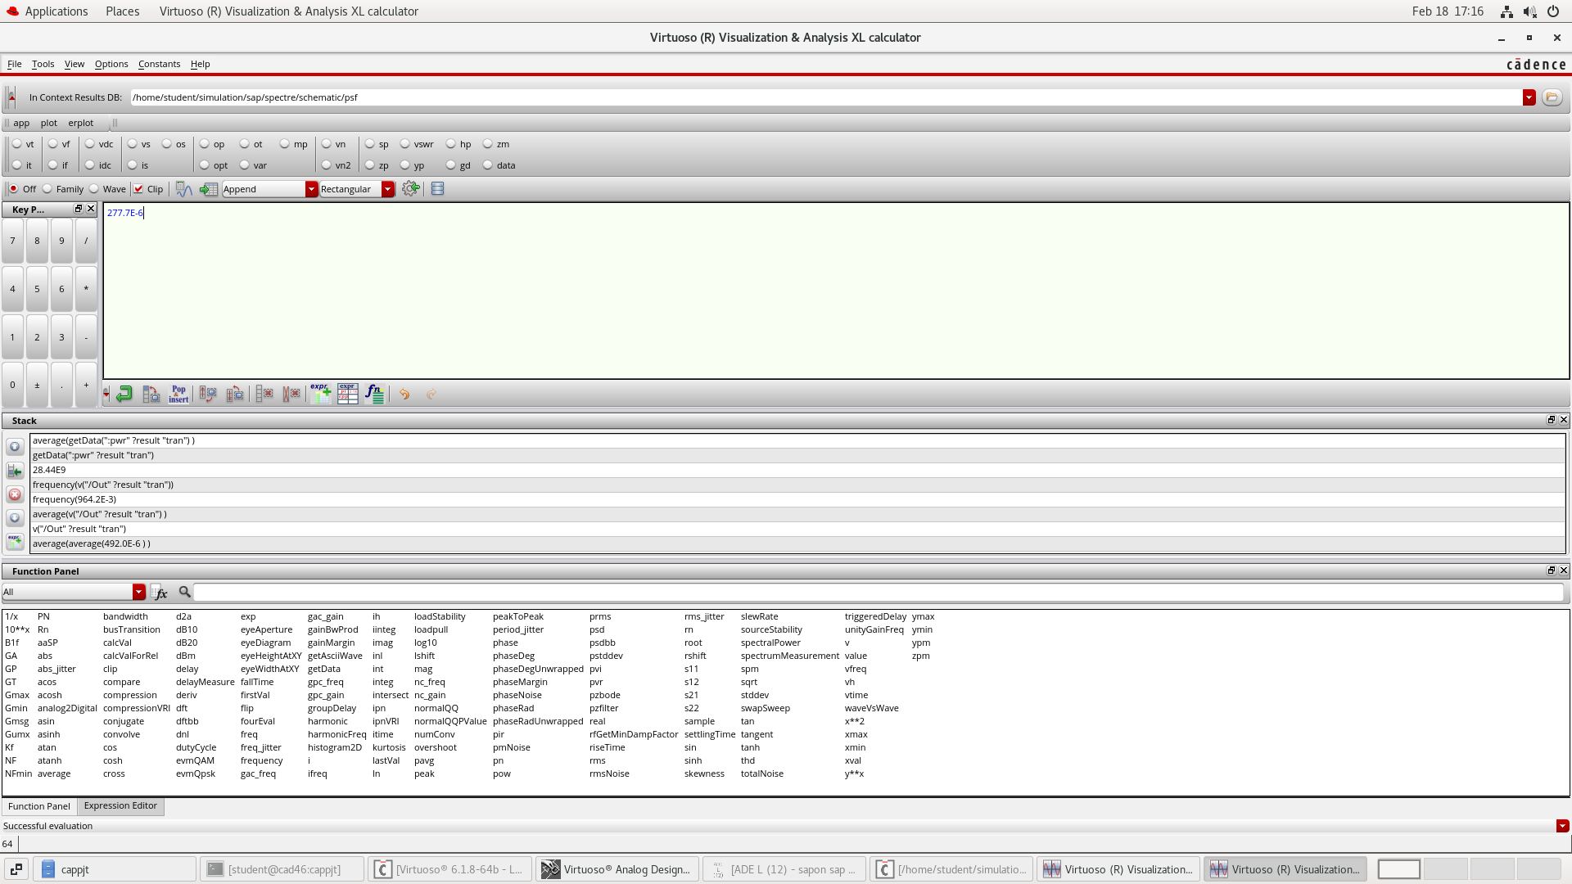
frequency
power

Slide 21
LAYOUT DESIGN OF SAPON METHOD

Slide 22
 | Mos count | Power consumption(uw) | Frequency (GHz)
Enhanced conventional | 18 | 492.0 | 36.36
SAPON | 20 | 277.7 | 28.44
MOS COUNT ,POWER CONSUMPTION AND FREQUENCY VALUES

Slide 23
Results and Interpretation
Enhanced Conventional method achieved a frequency of 36.36 GHz and consumed 492 μW of power. The SAPON included design achieved a lower power consumption of 277.77 μW while maintaining a decent frequency of 28.44 GHz. This project highlights how circuit-level modifications can achieve significant gains in energy efficiency without a substantial sacrifice in performance. A detailed comparison of waveforms and schematic behavior is also presented to validate the effectiveness of the proposed changes. The results clearly show that the SAPON-included design is more power- efficient and better suited for 5G applications.

Slide 24
Conclusion and Future Scope
Conclusion
This project explored the enhancement of CMOS ring oscillators with a focus on achieving high- speed performance and low power consumption, aligned with the needs of 5G communication systems. By evolving from a basic current-starved architecture to a negatively skewed version and finally integrating the SAPON technique, each design demonstrated specific strengths in either frequency optimization or power efficiency. The simulations validated that these architectural modifications can significantly improve oscillator performance, while the successful layout implementation in advanced CMOS technology confirmed the practical viability and scalability of the designs. Together, these results highlight the effectiveness of combining timing control and adaptive power techniques in creating efficient, next-generation analog oscillators.
Future Scope
The next phase of this work involves fabricating the proposed designs and conducting real-time testing to validate their behavior under physical conditions, including temperature, noise, and process variations. Integrating these oscillators into complex RF systems such as PLLs or frequency synthesizers can further assess their application readiness. The SAPON mechanism offers room for improvement through the addition of dynamic feedback control, allowing real- time adaptation to power demands. Additionally, future studies could incorporate AI-based tuning algorithms to enhance performance adaptability, making these designs smarter and more efficient for diverse operational environments in modern wireless technologies.

Slide 25
Tools Used
Cadence virtuoso
Technology used: 45nm

Slide 26
References
K. H. Yeo, S. H. M. Ali, P. S. Menon, and M. S. Islam, “Comparison of CMOS rectifiers for micropower energy harvesters,” 2015 IEEE Conference on Energy Conversion (CENCON), pp. 419-423, 2015.
M. Hsu and P. Chen, “5GHz Low Power CMOS LC VCO for IEEE 802.11a Application,” Proceedings of the Asia-Pacific Microwave Conference, pp. 263-266, Dec. 2010.
M. Kulkarni and K. Hosur, “Design of a Linear and Wide Range Current Starved Voltage Controlled Oscillator,” International Journal of Cybernetics and Informatics, vol. 2, no. 1, pp. 23-30, 2013.
J. H. Kim and S. Lee, “High-Performance VCO Design with Low Phase Noise,” IEEE Transactions on Circuits and Systems I: Regular Papers, vol. 67, no. 6, pp. 1850-1862, 2020.
P. Andreani and X. Wang, “Analysis and Design of CMOS Ring Oscillators for Low Power Applications,” Journal of Solid-State Circuits, vol. 48, no. 3, pp. 650-662, 2013.
A. Singh and R. Patel, “Voltage Controlled Ring Oscillators for 5G Technology,” 2016 IEEE International Symposium on Circuits and Systems (ISCAS), pp. 202-205.
M. Shankar and L. Gupta, “Design of a CMOS Current-Starved VCO for IoT Applications,” Electronics Letters, vol. 55, no. 7, pp. 401-403, 2019.
L. Tan and B. Zhao, “A Low-Power CMOS VCO for Millimeter-Wave Applications,” IEEE Microwave and Wireless Components Letters, vol. 31, no. 4, pp. 245-247, 2021.

