Slide 1
Deep Portfolio Optimization Using DSR + Sentiment-Augmented LSTM
Architecture Deep Dive
With a special focus on R's role in the pipeline
Python · R · PyTorch · reticulate

Slide 2
What Are We Building?
A casual overview — no jargon required
The big idea:
Training data 2018 – 2024
"Use deep learning to figure out how to split money across 5 big tech stocks, then let R double-check that we're not taking crazy risks."
Test period Dec 2023 – Dec 2024
• We have 5 assets: AAPL, MSFT, GOOGL, AMZN, META
• An LSTM reads 60 days of price history each week
Rebalance Every week · 10 bps cost
• It spits out 5 weights (e.g. 30% Apple, 20% Google…)
• R then checks: are those weights safe? Too concentrated?
• R runs the backtest and measures how good we'd have done
• A Streamlit dashboard shows it all live

Slide 3
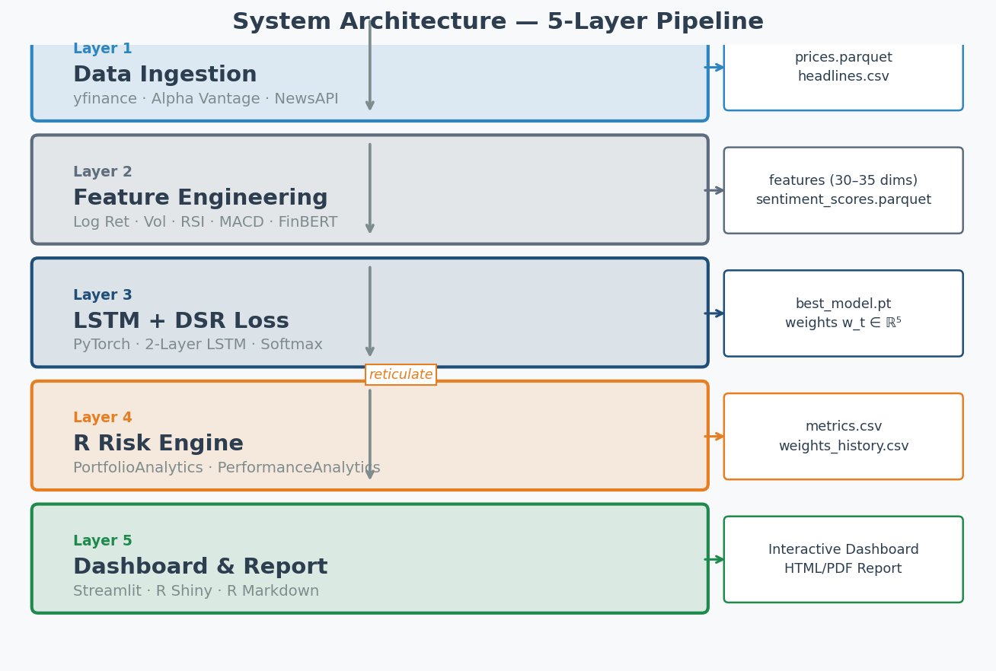
System Architecture — 5 Layers
Each layer feeds the next; Python hands off to R at Layer 4

Slide 4
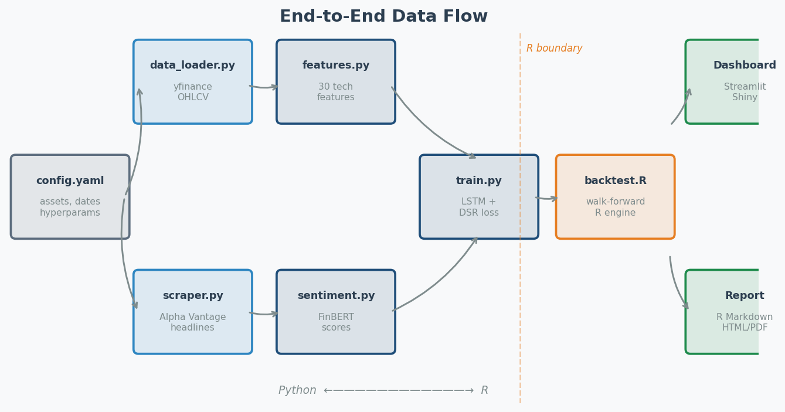
Data Flow — End to End
From raw Yahoo Finance data to an interactive dashboard

Slide 5
Layer 1 — Data Ingestion
Pulling price history and news headlines from the web
Prices (yfinance)
News Headlines (Alpha Vantage)
config.yaml
• Daily OHLCV for 5 tickers
• Historical articles per ticker
• Asset universe
• 2018-01-01 → 2024-12-31
• Free API — 25 req/day
• Date range
• Saved as prices.parquet
• Saved as headlines.csv
• Hyper-parameters
• Delta-updated for live mode
• Also yfinance recent news
• Constraint limits
Why parquet? Columnar format → 10× faster than CSV for financial time-series. Delta updates append only new rows → no re-downloading 6 years of data every refresh.

Slide 6
Layer 2 — Feature Engineering
Turning raw prices into a rich 3D tensor the LSTM can read
Feature
Formula
What it captures
Log Return
ln(P_t / P_{t-1})
Daily price momentum
Rolling Vol
20d std × √252
Annualised volatility
RSI-14
Relative Strength Index
Overbought / oversold
MACD
EMA(12) − EMA(26) signal
Trend direction
Bollinger %B
(Price − lower) / (upper−lower)
Band position
SMA Ratio
SMA(50) / SMA(200)
Golden/death cross
Sentiment *
P(pos) − P(neg) via FinBERT
News alpha signal
* Sentiment is the 7th feature — optional, enabled via config.yaml. Output tensor: (batch, 60 days, 30 or 35 features) · Z-score normalised with 252-day rolling window.

Slide 7
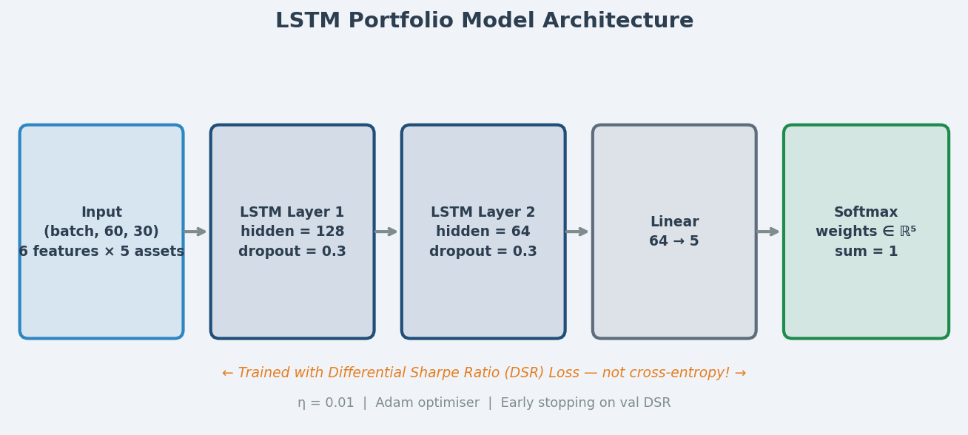
Layer 3 — LSTM + Differential Sharpe Ratio
The core ML engine — trained to maximise risk-adjusted returns directly
What makes this different from regular deep learning?
Normal neural nets minimise prediction error (MSE). This model minimises −DSR: the negative Differential Sharpe Ratio. That means it directly learns to maximise risk-adjusted profit — no intermediate step.

Slide 8
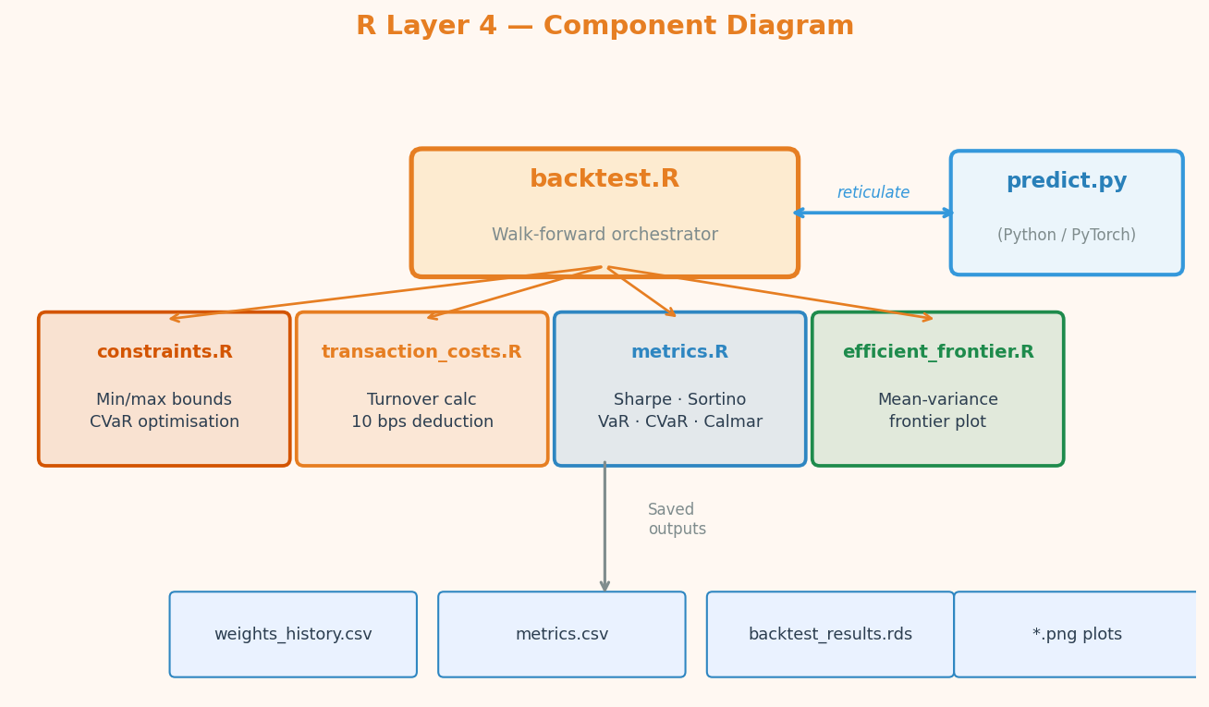
Layer 4 — R Risk Engine: Overview
R doesn't just make charts — it does the heavy quantitative lifting

Slide 9
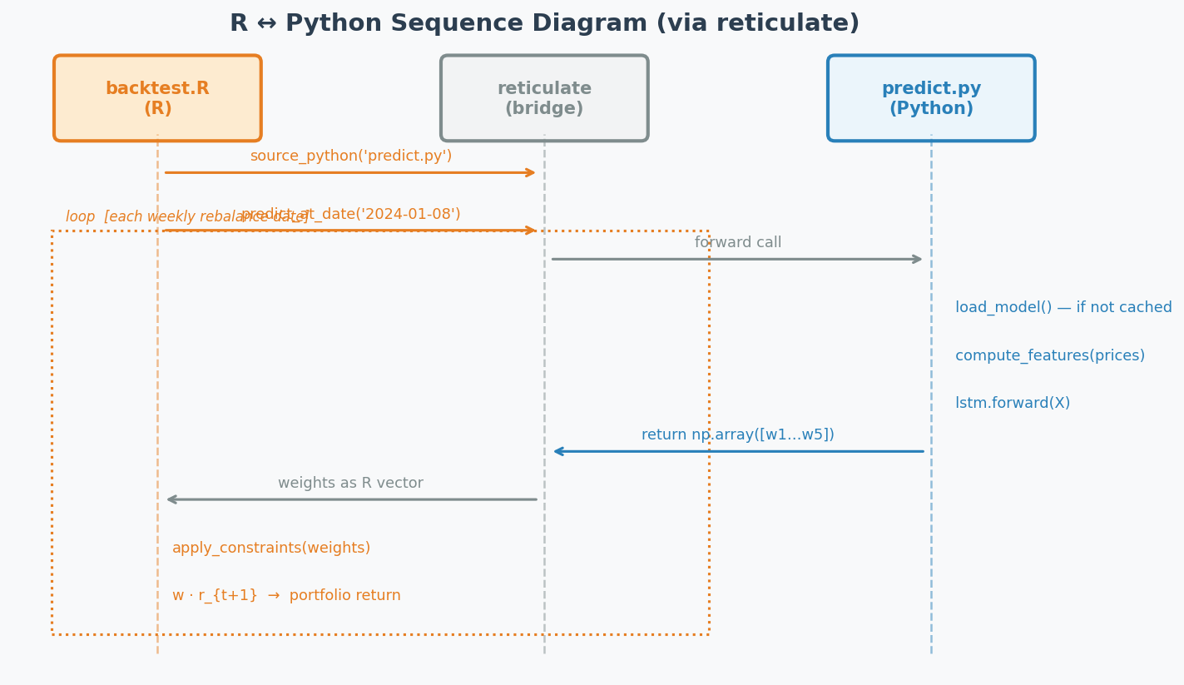
R ↔ Python Bridge: reticulate
R calls the LSTM model directly — no files exchanged, no REST API needed

Slide 10
R's Role: Walk-Forward Backtesting
backtest.R — 600 lines, the backbone of the whole experiment
Step 1 Load Data
Step 2 Get Dates
Step 3 Predict
Step 4 Constrain
Step 5 Return
Step 6 Save
→
→
→
→
→
Read prices.parquet via arrow package
Weekly rebalance dates (xts endpoints)
Call Python: predict_at_date()
Apply min/max & CVaR bounds
w_t · r_{t+1} minus 10 bps cost
weights_history.csv metrics.csv .rds
xts time series in R keeps everything perfectly date-aligned. PerformanceAnalytics::Return.portfolio() handles weight × return multiplication correctly across splits.
• ~150 rebalance points over 2023–2024 test window
• Each point: Python inference (~0.3s) + R constraint check + return calculation
• Total backtest runtime: ~2 minutes on CPU

Slide 11
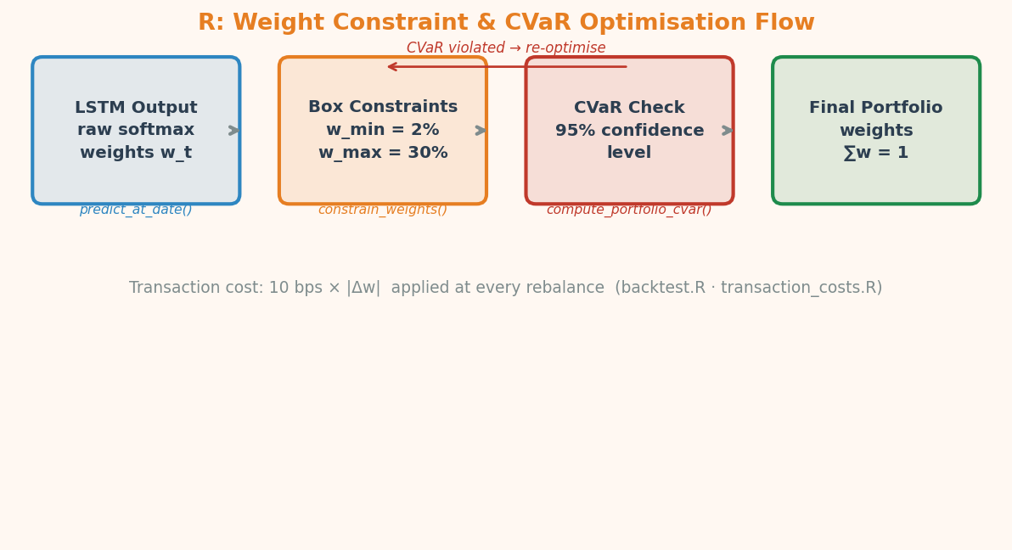
R's Role: PortfolioAnalytics & CVaR
Turning raw LSTM weights into regulated, risk-controlled positions
Why PortfolioAnalytics? It provides an ROI solver specifically designed for portfolio constraints — min/max weights, CVaR limits, long-only, sum-to-one — all in one call. scipy.optimize can do it, but PortfolioAnalytics handles the edge cases (infeasible regions, etc.) out of the box.

Slide 12
R's Role: PerformanceAnalytics
8 industry-standard risk metrics computed in <10 lines of R
Metric
R Function (PerformanceAnalytics)
Plain English
Annualised Return
Return.annualized(r, scale=252)
How much did we make?
Sharpe Ratio
SharpeRatio.annualized(r, Rf=0)
Return per unit of risk
Sortino Ratio
SortinoRatio(r)
Return per unit of downside risk
Max Drawdown
maxDrawdown(r)
Worst peak-to-trough loss
Calmar Ratio
Return / maxDrawdown(r)
Return vs max pain
VaR (95%)
VaR(r, p=0.95, method='historical')
Daily loss at 95% confidence
CVaR / ES (95%)
ES(r, p=0.95, method='historical')
Expected loss beyond VaR
Annualised Volatility
StdDev.annualized(r, scale=252)
How bumpy was the ride?

Slide 13
Layer 5 — Dashboard & Reporting
Two dashboards: R Shiny (original) + Streamlit (Python live version)
Streamlit Dashboard (Python)
R Shiny + R Markdown (original)
📊 Portfolio Overview
• Portfolio overview — equity curve
⚖️ Weight Allocation
• Weight allocation — stacked area
📈 Analytics
• Sentiment heatmap (planned)
🛡️ Risk Monitor
• Risk monitor — rolling VaR / CVaR
🔴 Live Data
• R Markdown → HTML / PDF report
📰 Sentiment
• Reads pre-computed backtest_results.rds
📡 Real-Time Signals
Both dashboards read the same pre-computed result files (CSVs + RDS). Live Streamlit tab adds real-time yfinance refresh + LSTM re-inference.

Slide 14
Why R + Python Together?
Each language does what it's genuinely best at
Task
Python
R
Winner
Deep Learning / LSTM
✅ PyTorch
❌ keras (weaker)
Python
Feature Engineering
✅ pandas, ta
⚠️ xts (workable)
Python
Portfolio Constraint Solving
⚠️ cvxpy (manual)
✅ PortfolioAnalytics
R
Risk Metrics (Sharpe/CVaR)
⚠️ manual NumPy
✅ PerformanceAnalytics
R
Time-Series Backtesting
⚠️ manual loop
✅ xts + endpoints()
R
Report Generation
⚠️ Jupyter/nbconv
✅ R Markdown
R
Interactive Dashboard
✅ Streamlit/Dash
✅ Shiny
Both
Sentiment / NLP
✅ HuggingFace
❌ limited
Python

Slide 15
Key Results — Test Period (Dec 2023 – Dec 2024)
DSR Constrained
DSR Unconstrained
Equal Weight (benchmark)
52.6% ann. return
69.1% ann. return
43.2% ann. return
Sharpe 2.51
Sharpe 3.02
Sharpe 2.13
Max DD 14.3%
Max DD 12.9%
Max DD 14.4%
DSR Constrained beats Equal Weight by +9.4 pp annualised return with a meaningfully higher Sharpe ratio and similar drawdown.
Model trained: 2018–2024 · 5 assets · 60-day lookback · LSTM (128→64) · DSR loss (η=0.01) · PortfolioAnalytics constraints
Thanks for listening — Questions?

