Slide 1





SMART/AUTOMATE IRRIGATION USING
SOIL MOISTURE AND WEATHER DATA
NAME:MADHAV M NAMBIAR
AICTE Student ID: STU684674dc3bf081749447900
AICTE Internship ID: INTERNSHIP_1748923002683e727a876ea

Slide 2

Learning Objectives
Develop an Intelligent Irrigation System
Create a system that decides sprinkler activation using environmental sensor readings.
Implement Data-Driven Predictions
Use machine learning trained on previous sensor and sprinkler records to predict
irrigation needs.
Design a User-Friendly Web App
Build a Streamlit interface that lets users adjust sensor values and view sprinkler status
easily.
Reduce Water Waste in Farming
Ensure water is supplied only when necessary, supporting sustainable agricultural practices.
GOAL
Source :
www.freepik.com/

Slide 3
Tools and Technology used
Programming & Development Environment
Python 3.12.8 for coding and data processing
Jupyter Notebook for model training and testing
VS Code for building and running the Streamlit application
Machine Learning Algorithm
Random Forest Classifier with MultiOutput handling to predict ON/OFF status for multiple sprinklers.
Libraries & Frameworks
pandas, numpy → Data cleaning and preprocessing
scikit-learn → Training, evaluation, and feature scaling
joblib → Saving and loading the trained ML model
streamlit → Creating an interactive simulation web app
Additional Components
MinMaxScaler for converting sensor readings to a 0–1 scale
Joblib .pkl file to store the trained prediction model for deployment

Slide 4
Methodology
Problem Analysis & Planning
Objective: Decide sprinkler ON/OFF using past sensor readings to create a simulated smart irrigation system.
Dataset Acquisition
Used a historical irrigation dataset with 20 environmental sensor inputs and 3 sprinkler output labels
(0 = OFF, 1 = ON).
Data Cleaning & Scaling
Removed unnecessary/index columns to keep only relevant features.
Scaled sensor values to a range of 0 to 1 using MinMaxScaler for model compatibility.
Exploratory Data Analysis (EDA)
Reviewed dataset structure using functions like .head() and .info().
Checked sensor value ranges and output balance for reliable model training.
Machine Learning Model Training
Split dataset into 80% training and 20% testing.
Used a Random Forest Classifier inside MultiOutputClassifier to predict all 3 sprinklers simultaneously.
Evaluated performance using a classification report.
Model Saving & Application Integration
Saved the trained model as Farm_Irrigation_System.pkl using joblib.
Linked the model with the Streamlit app for prediction.
Web App Creation & Local Simulation
Built a Streamlit interface with 20 sliders for sensor simulation.
Predict button displays ON/OFF sprinkler results.
Tested locally using streamlit run app.py.

Slide 5
Problem Statement:
Farmers often struggle to decide the correct time to irrigate crops, which may lead to overwatering or underwatering.
Manual monitoring of soil and environmental conditions is time-consuming and not always accurate.
Unplanned irrigation causes wastage of water and energy, reducing agricultural efficiency.
There is a lack of a simple decision-support system that can analyze environmental data and recommend sprinkler activation automatically.
Traditional irrigation systems are not data-driven and cannot adapt to changing weather or soil conditions.
Human dependency in irrigation management increases labor costs and the risk of delayed watering, which may harm crops.

Slide 6
Solution:
Smart Irrigation Framework
Implement a system using 20 environmental sensors and 3 automated sprinklers to support intelligent irrigation decisions.
Machine Learning–Based Prediction
Train a model on historical sensor and sprinkler data to determine which sprinklers should be ON or OFF under different
conditions.
Simulation through a Streamlit Web App
Provide a user-friendly interface with sliders to mimic sensor readings, allowing users to see sprinkler status predictions instantly.
Water Optimization and Automation
Ensure water is supplied only when required, minimizing water wastage and manual effort in crop irrigation.
GITHUB LINK:
https://github.com/Madhav-M-Nambiar/Smart-Irrigation

Slide 7
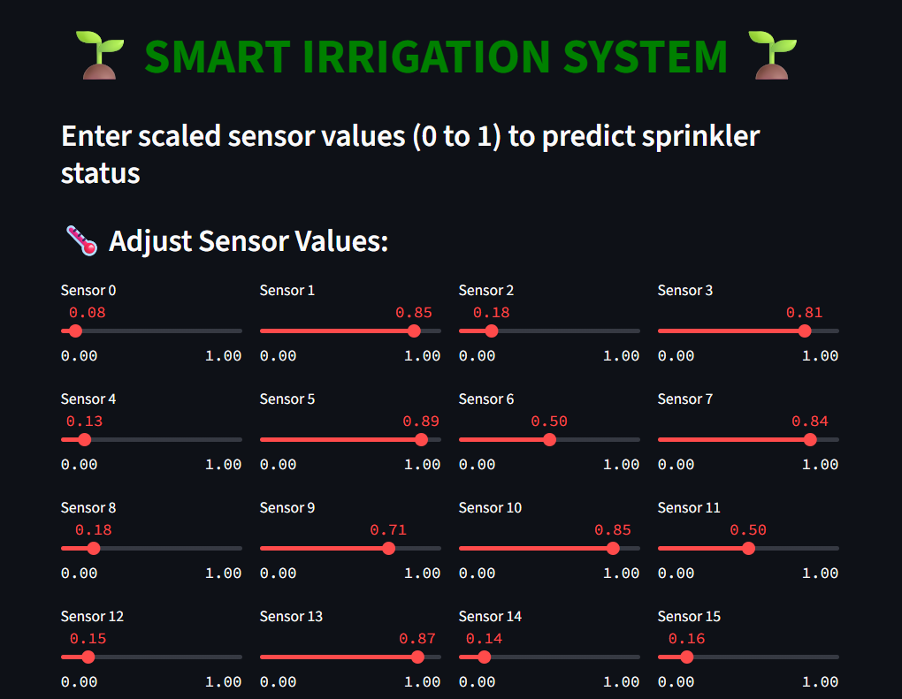
Screenshot of Output:
Interactive Streamlit Interface for Smart Irrigation System – Simulating 20 Environmental Sensor Inputs

Slide 8
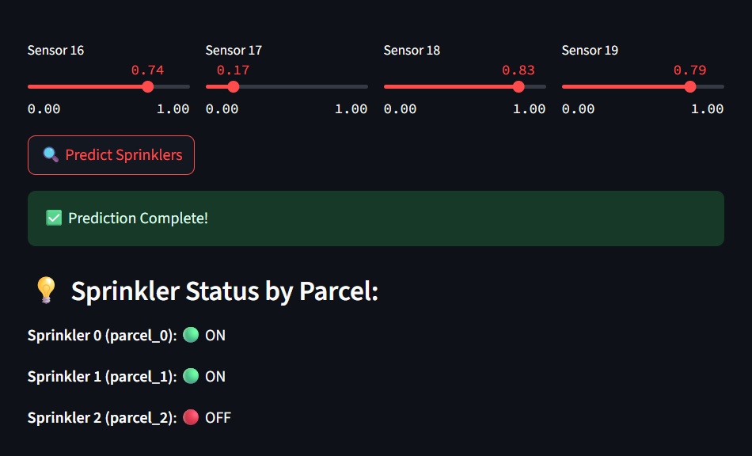
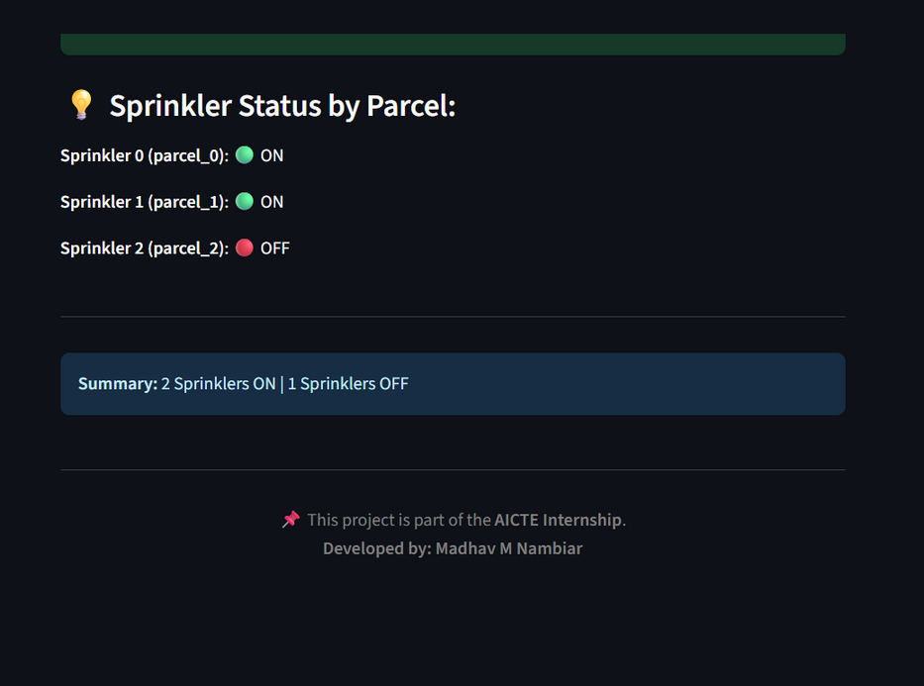
Screenshot of Output:

Slide 9
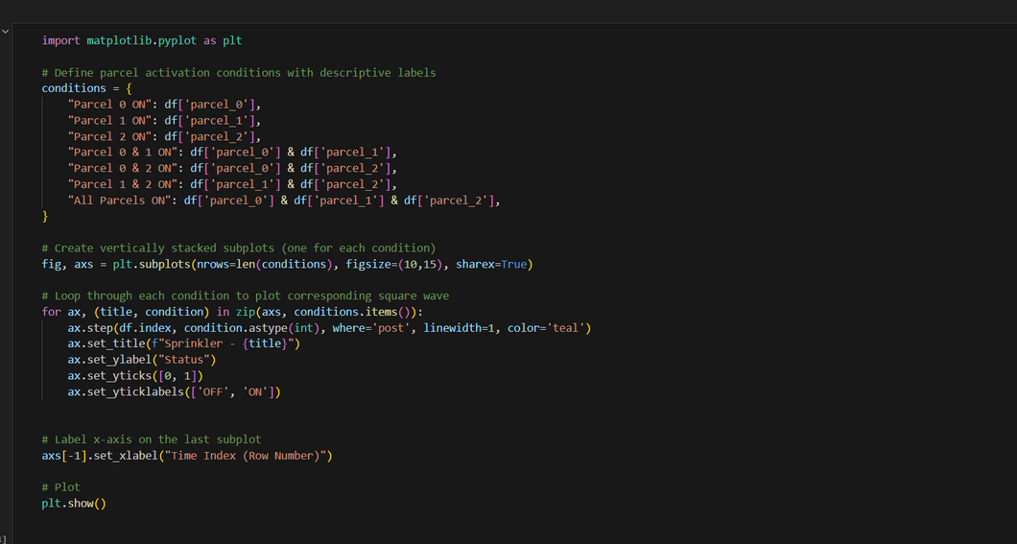
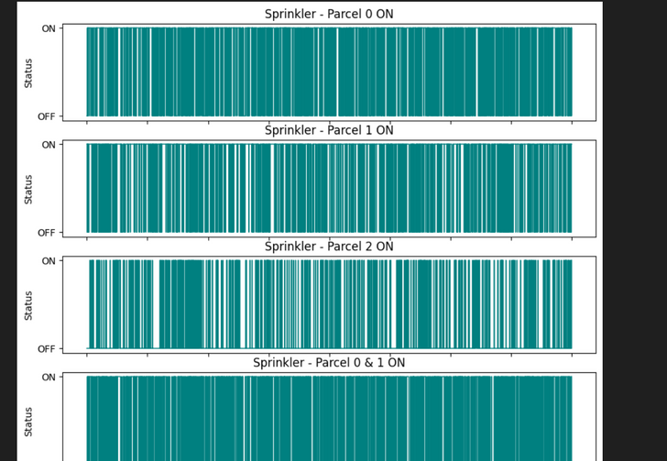
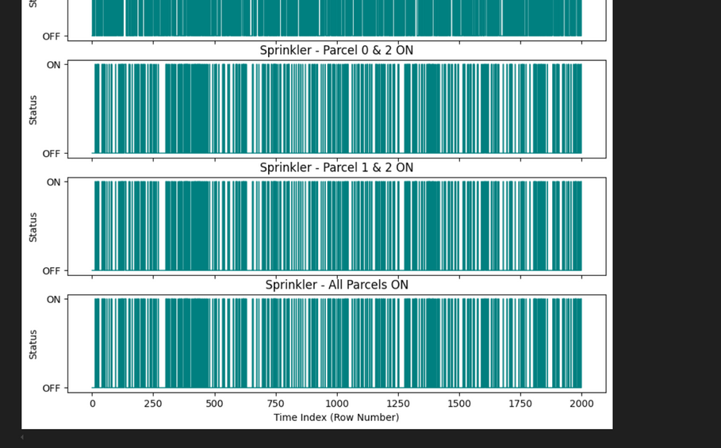
Screenshot of Output:
Sprinkler Activation Patterns for Different Parcel Combinations

Slide 10
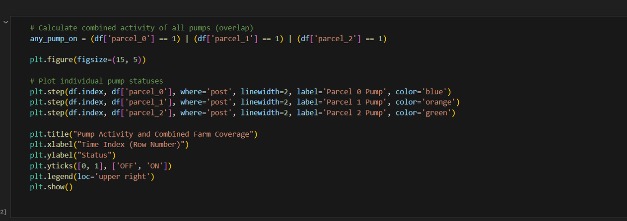
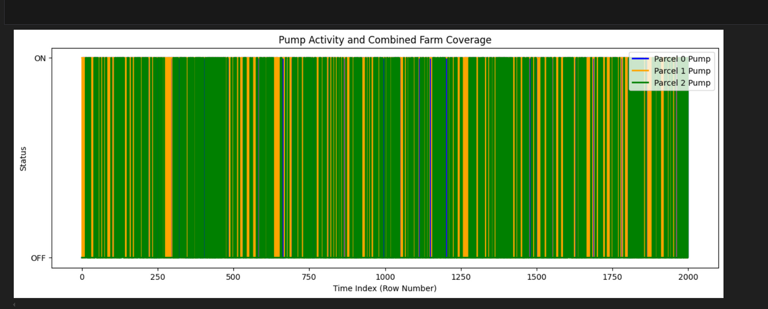
Screenshot of Output:
Visualization of Individual Pump Status and Overall Farm Irrigation Coverage

Slide 11
Conclusion:
Project Summary
A historical irrigation dataset with 20 sensors and 3 sprinkler outputs was used for model training.
Data preprocessing involved dropping unnecessary/index columns and scaling sensor readings to 0–1.
A MultiOutput Random Forest Classifier was developed to predict sprinkler ON/OFF status.
A Streamlit-based simulation app was created to simulate sensor values and display sprinkler predictions interactively.
Future Scope
Fertilizer & Nutrient Integration
Extend the system to automatically mix and deliver fertilizers along with water based on crop requirements.
Cloud-Based Data Storage & Analytics
Store sensor readings and irrigation history in the cloud for long-term analysis and performance optimization.

