Slide 1
ECE 465
Digital Systems Design
Fall 2024
Boolean Minimization Using Quine McCluskey
Sai Madhav Badri
662377681

Slide 2
Motivation
Boolean minimization is crucial for optimizing digital logic circuits, leading to more efficient designs in terms of cost, power, and speed.
This project combines theoretical methods with practical Python implementation of Boolean Minimization using Quine McCluskey and petrick’s method.

Slide 3
Problem Statement
Simplifying complex Boolean functions manually or using K-Maps is impractical for more than 4-6 variables.
Traditional methods struggle with large-scale problems or multi-output systems.
Efficient algorithms like Quine-McCluskey, enhanced by Row and Column Dominance, are required for reliable minimization.
Automating this process using python has more efficiency and provides accurate solutions.

Slide 4
Techniques
1. Quine-McCluskey Algorithm: This is a method for minimizing Boolean expressions by systematically combining binary terms that differ by one bit, replacing the differing bit with a -. The process continues until no further combinations are possible, yielding the minimal prime implicants of the function.
2. Row and Column Dominance: Row dominance removes redundant rows in the prime implicant chart when one row covers all the columns of another. Column dominance eliminates unnecessary columns when one column is fully covered by another’s rows.
3. Petrick’s Method: Petrick’s method finds all possible combinations of prime implicants that cover uncovered minterms by converting the chart into a logical expression. It simplifies the expression and selects the combination with the fewest terms to minimize the Boolean function.

Slide 5
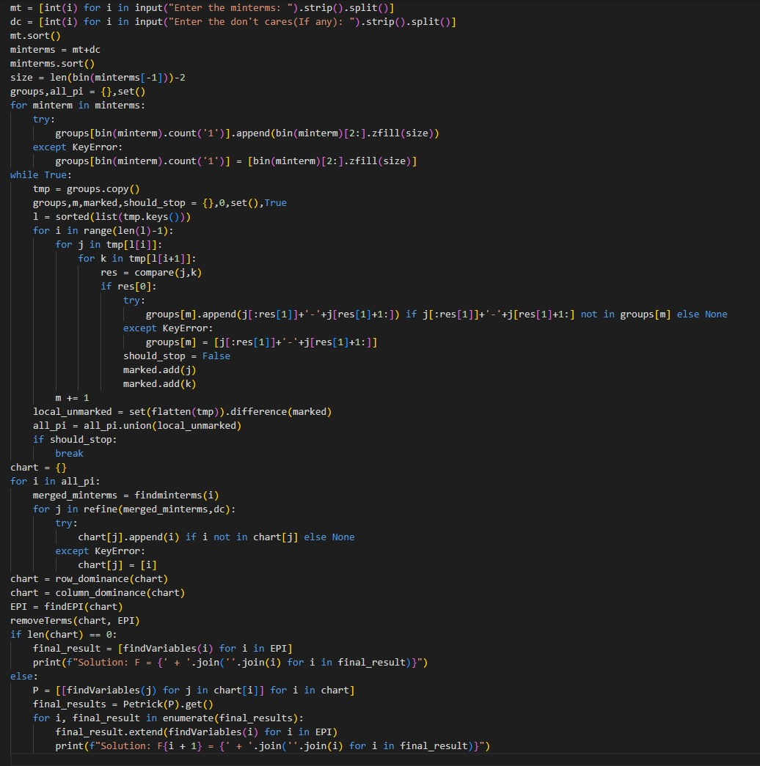
Case-1

Slide 6
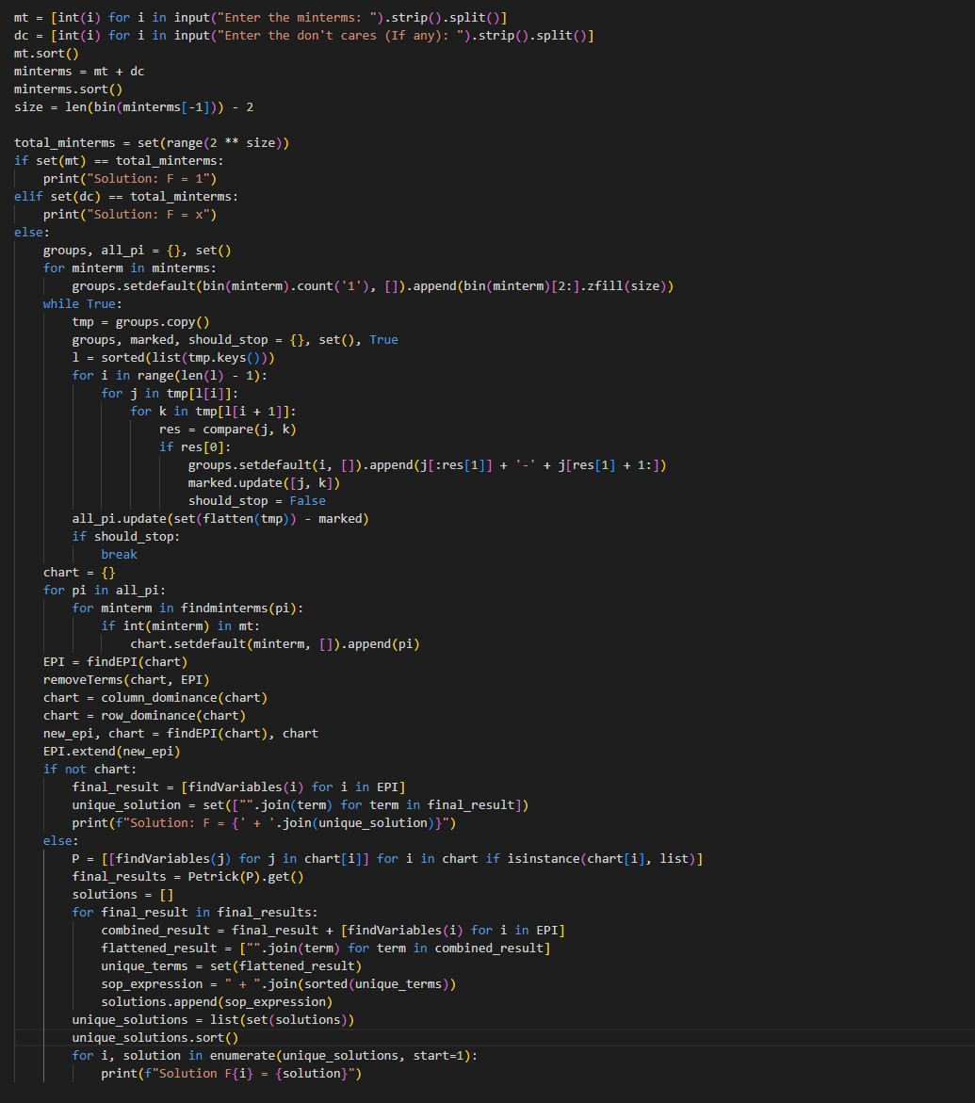
Case-2

Slide 7
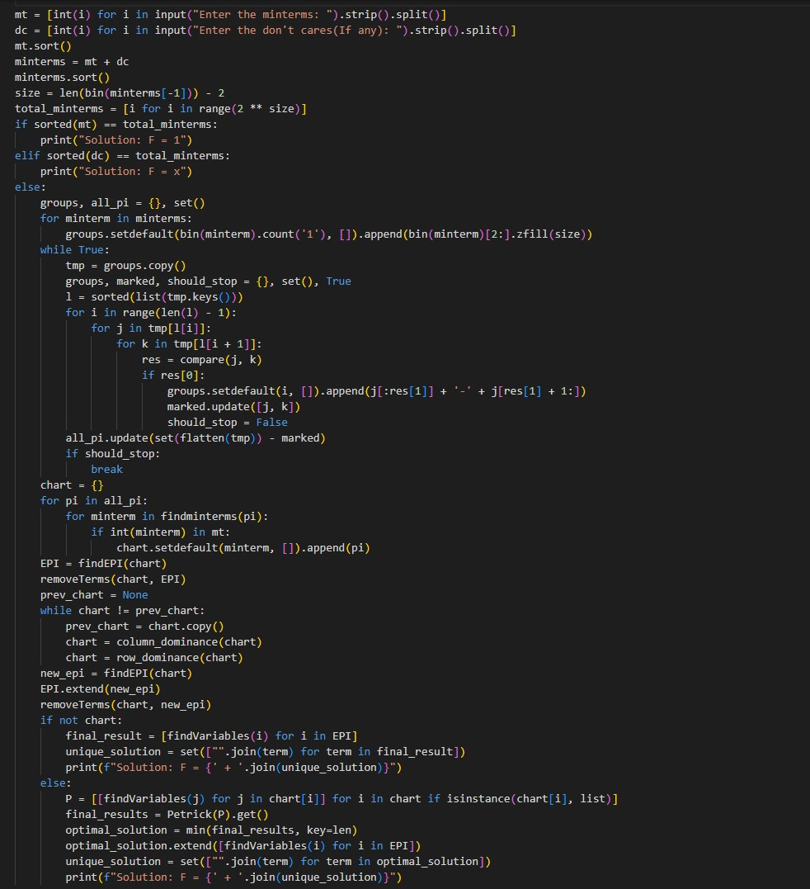
Case-3

Slide 8
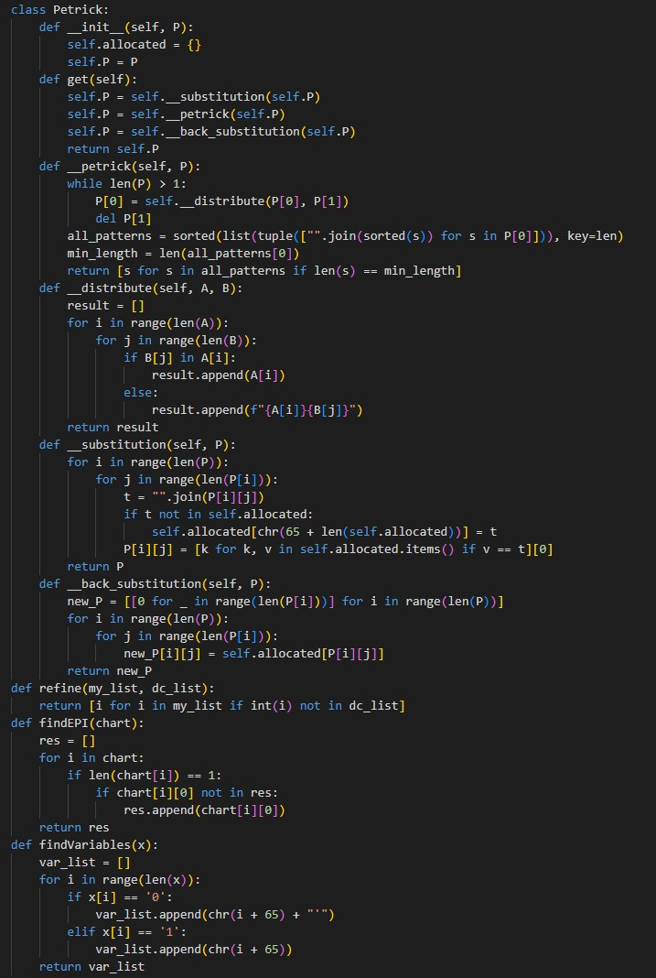
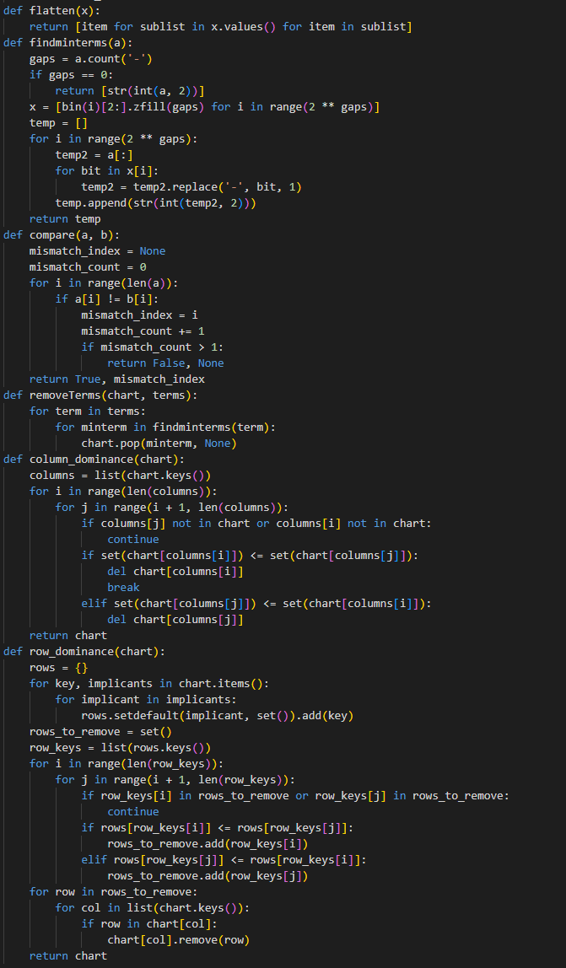
Petrick Function

Slide 9
Results
MINTERMS | DON'T CARE TERMS | CASE-1 | CASE-2 | CASE-3 | 32x8
0 2 4 6 8 10 12 14 | 1 3 5 7 9 | Solution: F = D' | Solution: F = D' | Solution: F = D' | y = D'
0 5 8 12 15 | 1 2 9 10 11 | Solution F = B'C' + A'C'D + AC'D' + ACD | Solution: F = ACD + AC'D' + B'C' + A'C'D | Solution: F = A'C'D + AC'D' + ACD + B'D' | y = B'C' + AC'D' + A'C'D + ACD
0 1 2 5 6 7 8 9 10 14 |  | A'BD + B'C' + CD' | Solution: F1 = B'C' + CD' + A'BD | Solution: F = A'BD + B'C' + CD' | y = B'C' + CD' + A'BD
0 7 15 21 27 30 31 | 6 11 19 24 | Solution: F1 = A'B'CD + BDE + ABCD + A'B'C'D'E' + AB'CD'E Solution: F2 = A'CDE + BDE + ABCD + A'B'C'D'E' + AB'CD'E Solution: F3 = A'CDE + AC'DE + ABCD + A'B'C'D'E' + AB'CD'E Solution: F4 = A'CDE + BDE + ABCD + A'B'C'D'E' + AB'CD'E | Solution: F1 = A'B'C'D'E' + A'CDE + BDE + AB'CD'E + ABCD | Solution: F = ABCD + A'B'C'D'E' + AB'CD'E + BDE + A'CDE | y = BDE + A'CDE + ABCD + A'B'C'D'E' + AB'CD'E
1 7 19 21 23 25 26 29 31 | 3 4 5 13 14 | Solution: F = A'B'E + ABD'E + ACE + B'DE + ABC'DE' | Solution: F = ABD'E + B'DE + A'B'E + ACE + ABC'DE' | Solution: F = A'B'E + B'DE + ACE + ABD'E + ABC'DE' | y = ACE + A'B'E + B'DE + ABD'E + ABC'DE'
0 8 13 23 26 33 39 40 44 55 56 58 | 3 4 15 16 18 27 31 35 48 52 60 63 | Solution: F1 = AC'DEF + A'B'D'E'F' + BCD'EF' + BDEF + A'B'CDF + AB'C'D'F + ACE'F' Solution: F2 = AB'C'EF + A'B'D'E'F' + BCD'EF' + BDEF + A'B'CDF + AB'C'D'F + ACE'F' | Solution F1 = A'B'CDF + A'B'D'E'F' + AB'C'D'F + AC'DEF + ACE'F' + BCD'EF' + BDEF | Solution: F = AB'C'D'F + ACE'F' + AC'DEF + BDEF + A'B'CDF + A'B'D'E'F' + BCD'EF' | y = BDEF + ACE'F' + A'B'D'E'F' + BCD'EF' + AC'DEF + A'B'CDF + AB'C'D'F
0 1 5 38 39 59 63 | 18 19 20 21 22 23 24 | Solution: F1 = A'B'C'E'F + AB'C'DE + A'B'C'D'E' + ABCEF Solution: F2 = A'C'DE'F + AB'C'DE + A'B'C'D'E' + ABCEF | Solution F = A'B'C'D'E' + A'C'DE'F + AB'C'DE + ABCEF | Solution: F = A'B'C'E'F + A'B'C'D'E' + ABCEF + AB'C'DE | y = A'B'C'D'E' + A'B'C'E'F + AB'C'DE + ABCEF
19 24 35 38 43 48 49 50 53 55 57 61 | 0 2 5 7 29 32 52 63 | Solution: F = A'BC'D'EF + AB'C'DEF' + ABDF + ABC'D'F' + AB'D'EF + ABE'F + A'BCD'E'F' | Solution: F = A'BCD'E'F' + AB'D'EF + ABDF + A'BC'D'EF + ABC'D'F' + ABE'F + AB'C'DEF' | Solution: F = ABE'F + ABDF + AB'D'EF + ABC'D'F' + A'BCD'E'F' + A'BC'D'EF + AB'C'DEF' | y = ABE'F + ABDF + AB'D'EF + ABC'D'F' + A'BC'D'EF + A'BCD'E'F' + AB'C'DEF'
19 24 35 38 43 48 49 50 53 55 57 61 |  | Solution: F = ABE'F + ABC'D'F' + A'BCD'E'F' + ABC'DF + AB'D'EF + A'BC'D'EF + AB'C'DEF' | Solution: F = A'BCD'E'F' + AB'C'DEF' + ABC'D'F' + ABC'DF + ABE'F + A'BC'D'EF + AB'D'EF | Solution: F = ABE'F + AB'D'EF + A'BCD'E'F' + ABC'DF + ABC'D'F' + A'BC'D'EF + AB'C'DEF' | y = ABE'F + AB'D'EF + ABC'D'F' + ABC'DF + A'BC'D'EF + A'BCD'E'F' + AB'C'DEF'
0 1 2 3 4 5 6 7 8 9 10 50 51 52 53 54 55 56 57 58 59 60 |  | Solution: F1 = ABD'E + ABCE'F' + A'B'D'E' + ABC'D + ABCD' + A'B'D'F' + A'B'C' Solution: F2 = ABD'E + ABDE'F' + A'B'D'E' + ABC'D + ABCD' + A'B'D'F' + A'B'C' Solution: F3 = ABC'E + ABCE'F' + A'B'D'E' + ABC'D + ABCD' + A'B'D'F' + A'B'C' Solution: F4 = ABC'E + ABDE'F' + A'B'D'E' + ABC'D + ABCD' + A'B'D'F' + A'B'C' | Solution F1 = A'B'C' + A'B'D'E' + A'B'D'F' + ABC'D + ABCD' + ABD'E + ABDE'F' | Solution: F = ABC'E + A'B'D'F' + ABC'D + A'B'D'E' + ABCD' + ABDE'F' + A'B'C' | y = A'B'C' + A'B'D'E' + A'B'D'F' + ABC'E + ABC'D + ABCD' + ABDE'F'
0 1 2 3 4 5 6 7 8 9 10 50 51 52 53 54 55 56 57 58 59 60 | 25 26 27 28 29 30 31 32 33 34 35 | Solution: F1 = AC'D'E + A'CD'E'F + ABCD' + A'B'D'F' + ABCE'F' + ABC'D + A'B'C' Solution: F2 = AC'D'E + A'CD'E'F + ABCD' + A'B'D'F' + ABCE'F' + ABC'D + A'B'C' Solution: F3 = AC'D'E + A'CD'E'F + ABCD' + A'B'D'F' + ABDE'F' + ABC'D + A'B'C' Solution: F4 = AC'D'E + A'CD'E'F + ABCD' + A'B'D'F' + BCDE'F' + ABC'D + A'B'C' Solution: F5 = AC'D'E + A'B'D'E' + ABCD' + ABCE'F' + A'CD'EF' + ABC'D + A'B'C' Solution: F6 = AC'D'E + A'B'D'E' + ABCD' + A'B'D'F' + ABCE'F' + ABC'D + A'B'C' Solution: F7 = AC'D'E + A'B'D'E' + ABCD' + ABCE'F' + A'CD'EF' + ABC'D + A'B'C' Solution: F8 = AC'D'E + A'B'D'E' + ABCD' + A'B'D'F' + ABCE'F' + ABC'D + A'B'C' 68 | Solution F1 = A'B'C' + A'B'D'E' + A'B'D'F' + ABC'E + ABC'D + ABCD' + ABDE'F' | Solution: F = A'B'C' + A'B'D'E' + A'B'D'F' + ABC'E + ABC'D + ABCD' + ABDE'F' | y = A'B'C' + A'B'D'E' + A'B'D'F' + ABC'E + ABC'D + ABCD' + ABDE'F'
0 1 2 8 11 15 17 19 22 25 27 30 41 43 46 49 59 60 61 62 |  | Solution: F1 = A'C'D'E'F + CD'EF + A'B'C'D'F' + ABCDE' + A'BDEF' + A'B'D'E'F' + A'BD'F + A'B'CEF + ACDEF' + AB'CD'F + BC'D'E'F Solution: F2 = A'B'C'D'E' + CD'EF + A'B'C'D'F' + ABCDE' + A'BDEF' + A'B'D'E'F' + A'BD'F + A'B'CEF + ACDEF' + AB'CD'F + BC'D'E'F | Solution: F = CD'EF + A'B'D'E'F' + A'B'CEF + ABCDE' + A'BDEF' + A'BD'F + A'B'C'D'F' + BC'D'E'F + ACDEF' + AB'CD'F + A'B'C'D'E' | Solution: F = CD'EF + A'B'D'E'F' + A'B'CEF + ABCDE' + A'BDEF' + A'BD'F + A'B'C'D'F' + BC'D'E'F + ACDEF' + AB'CD'F + A'B'C'D'E' | y = CD'EF + A'BD'F + A'B'C'D'E' + A'B'C'D'F' + A'B'D'E'F' + A'B'CEF + BC'D'E'F + A'BDEF' + AB'CD'F + ACDEF' + ABCDE'
9 12 18 24 27 31 34 40 42 45 50 58 61 | 2 6 13 15 21 53 55 | Solution: F1 = ACDE'F + A'BCEF + A'B'CDE' + A'BCD'E'F' + A'B'CE'F + C'D'EF' + AB'CD'F' + AD'EF' | Solution F1 = A'B'CDE' + A'B'CE'F + A'BCD'E'F' + A'BCEF + AB'CD'F' + ACDE'F + AD'EF' + C'D'EF' | Solution: F = C'D'EF' + ACDE'F + A'BCD'E'F' + AB'CD'F' + A'B'CDE' + A'B'CE'F + A'BCEF + AD'EF' | y = AD'EF' + C'D'EF' + A'BCEF + AB'CD'F' + ACDE'F + A'B'CE'F + A'B'CDE' + A'BCD'E'F'
21 27 35 36 37 40 42 44 46 47 48 50 53 56 59 62 63 | 0 3 4 6 14 15 | Solution: F1 = ABD'E'F' + AB'C'DE' + ABC'D'F' + AB'CF' + BCD'EF + ACDE + B'C'D'EF + BC'DE'F Solution: F2 = ACD'E'F' + AB'C'DE' + ABC'D'F' + AB'CF' + BCD'EF + ACDE + B'C'D'EF + BC'DE'F | Solution F1 = AB'C'DE' + AB'CF' + ABC'D'F' + ABD'E'F' + ACDE + B'C'D'EF + BC'DE'F + BCD'EF | Solution: F = ABD'E'F' + ACDE + B'C'D'EF + ABC'D'F' + AB'CF' + BCD'EF + BC'DE'F + AB'C'DE' | y = AB'CF' + ACDE + BC'DE'F + BCD'EF + AB'C'DE' + ACD'E'F' + ABC'D'F' + B'C'D'EF
3 4 11 17 18 19 20 21 29 35 36 37 41 42 43 44 45 51 52 56 57 61 63 | 0 1 6 7 13 14 23 25 27 39 53 54 62 | Solution: F1 = C'DE'F' + A'BE'F + ABCDF + ACE'F + A'D'EF + AB'DE' + ABCD'E' + C'D'EF + A'BC'D'E + AB'CD'E Solution: F2 = C'DE'F' + A'BE'F + ABCDF + A'D'EF + AB'CD'F + AB'DE' + ABCD'E' + C'D'EF + A'BC'D'E + AB'CD'E Solution: F3 = C'DE'F' + A'BE'F + ABCDF + ACE'F + B'D'EF + AB'DE' + ABCD'E' + C'D'EF + A'BC'D'E + AB'CD'E Solution: F4 = C'DE'F' + A'BE'F + ABCDF + B'D'EF + AB'CD'F + AB'DE' + ABCD'E' + C'D'EF + A'BC'D'E + AB'CD'E Solution: F5 = C'DE'F' + A'BE'F + ABCDF + ACE'F + A'D'EF + AB'DE' + ABCD'E' + C'D'EF + A'BC'D'E + AB'CD'E Solution: F6 = C'DE'F' + A'BE'F + ABCDF + ACE'F + B'D'EF + AB'DE' + ABCD'E' + C'D'EF + A'BC'D'E + AB'CD'E Solution: F7 = C'DE'F' + A'BE'F + ACE'F + ABCDE + A'D'EF + AB'DE' + ABCD'E' + C'D'EF + A'BC'D'E + AB'CD'E Solution: F8 = C'DE'F' + A'BE'F + ACE'F + ABCDE + B'D'EF + AB'DE' + ABCD'E' + C'D'EF + A'BC'D'E + AB'CD'E | Solution F1 = A'BC'D'E + A'BE'F + AB'CD'E + AB'DE' + ABCD'E' + ABCDF + ACE'F + B'D'EF + C'D'EF + C'DE'F' | Solution: F = C'D'EF + C'DE'F' + B'D'EF + ACE'F + A'BE'F + AB'DE' + ABCD'E' + ABCDF + A'BC'D'E + AB'CD'E | y = C'D'EF + C'DE'F' + B'D'EF + ACE'F + A'BE'F + AB'DE' + ABCD'E' + ABCDF + A'BC'D'E + AB'CD'E
0 1 2 3 4 5 6 7 8 9 10 11 12 13 14 15 16 17 18 19 20 21 22 23 24 25 26 27 28 29 30 31 32 33 34 35 36 37 38 39 40 41 42 43 44 45 46 47 48 49 50 51 52 53 54 55 56 57 58 59 60 61 62 63 |  | Solution: F = 1 | Solution: F = 1 | Solution: F = 1 | y = 1
 | 0 1 2 3 4 5 6 7 8 9 10 11 12 13 14 15 16 17 18 19 20 21 22 23 24 25 26 27 28 29 30 31 32 33 34 35 36 37 38 39 40 41 42 43 44 45 46 47 48 49 50 51 52 53 54 55 56 57 58 59 60 61 62 63 | Solution: F = x | Solution: F = x | Solution: F = x | y = 0y = 1
0 1 2 3 4 5 6 7 8 9 10 16 18 19 27 31 35 41 47 49 50 57 58 62 63 | 13 14 15 22 23 24 25 37 38 39 52 53 54 56 | Solution: F1 = CDEF + A'BEF + A'B'D'F' + A'C'D'F' + ABC'E'F + ABEF' + CD'E'F + A'B'C' + B'C'EF Solution: F2 = CDEF + A'BEF + A'B'D'F' + A'C'D'F' + ABD'E'F + ABEF' + CD'E'F + A'B'C' + B'C'EF Solution: F3 = CDEF + A'BEF + A'B'D'F' + A'C'D'F' + ABC'E'F + ABEF' + CD'E'F + A'B'C' + B'C'EF Solution: F4 = CDEF + A'BEF + A'B'D'F' + A'C'D'F' + ABD'E'F + ABEF' + CD'E'F + A'B'C' + B'C'EF | Solution F1 = A'B'C' + A'B'D'F' + A'BEF + A'C'D'F' + ABC'E'F + ABEF' + B'C'EF + CD'E'F + CDEF | Solution: F = A'BEF + CD'E'F + ABEF' + A'B'D'F' + B'C'EF + A'B'C' + A'C'D'F' + CDEF + ABC'E'F | y = A'B'C' + A'B'D'F' + A'C'D'F' + B'C'EF + CD'E'F + CDEF + A'BEF + ABEF' + ABD'E'F
3 4 11 23 26 31 35 38 44 54 57 58 59 60 | 13 14 28 41 63 | Solution: F1 = ABCD'F + B'C'D'EF + BCD'EF' + AC'DEF' + ACDE'F' + A'BDEF + A'B'D'EF + A'B'C'DE'F' | Solution F1 = A'B'C'DE'F' + A'B'D'EF + A'BDEF + ABCD'F + AC'DEF' + ACDE'F' + B'C'D'EF + BCD'EF' | Solution: F = AC'DEF' + ACDE'F' + BCD'EF' + ABCD'F + A'BDEF + B'C'D'EF + A'B'D'EF + A'B'C'DE'F' | y = A'B'D'EF + B'C'D'EF + A'BDEF + BCD'EF' + AC'DEF' + ACDE'F' + ABCD'F + A'B'C'DE'F'

Slide 10
Conclusion
The implementation of Boolean minimization using the Quine-McCluskey algorithm and associated techniques like Row and Column Dominance and Petrick’s Method has demonstrated its effectiveness in optimizing digital circuits. By automating the process with Python, the project provides an efficient, scalable solution for handling complex multi-variable and multi-output systems. This work bridges the gap between theoretical methodologies and practical applications, ensuring cost-effective, power-efficient, and high-speed designs. Future work can extend these techniques to support dynamic or real-time logic simplifications in evolving digital systems.

Slide 11
References
http://www.32x8.com/index.html
https://github.com/int-main/Quine-McCluskey
https://atozmath.com/
https://www.researchgate.net/publication/220176082_Quine-McCluskey_method_for_many-valued_logical_functions

