Slide 1
Title
7-Segment Display Controller
Using Lookup Table Logic

Slide 2
Objective
• Design a 7-segment display controller using Verilog HDL
• Convert 4-bit binary input into 7-segment output
• Simulate using Icarus Verilog and GTKWave

Slide 3
Tools Used
• Visual Studio Code
• Icarus Verilog
• GTKWave

Slide 4
Introduction
A 7-segment display is an electronic display device used to display decimal numbers.
The project converts binary inputs into segment control outputs.

Slide 5
Working Principle
• Input: 4-bit binary number
• Case statement acts as lookup table
• Output controls segments a–g
• Correct digit appears on display

Slide 6
Truth Table
0 → 1111110
1 → 0110000
2 → 1101101
3 → 1111001
4 → 0110011
5 → 1011011
6 → 1011111
7 → 1110000
8 → 1111111
9 → 1111011

Slide 7
Verilog Design
The design module uses a case statement to map binary inputs to 7-segment patterns.

Slide 8
Testbench
The testbench automatically changes input values from 0 to 9 every 10 time units.

Slide 9
Simulation
Simulation is performed using Icarus Verilog.
Waveforms are viewed using GTKWave.

Slide 10
Applications
• Digital clocks
• Calculators
• Elevators
• Scoreboards
• Microwave displays

Slide 11
Advantages
• Simple design
• Easy debugging
• Fast implementation
• No complex Boolean equations

Slide 12
Conclusion
The 7-segment display controller was successfully designed and simulated using Verilog HDL.

Slide 13
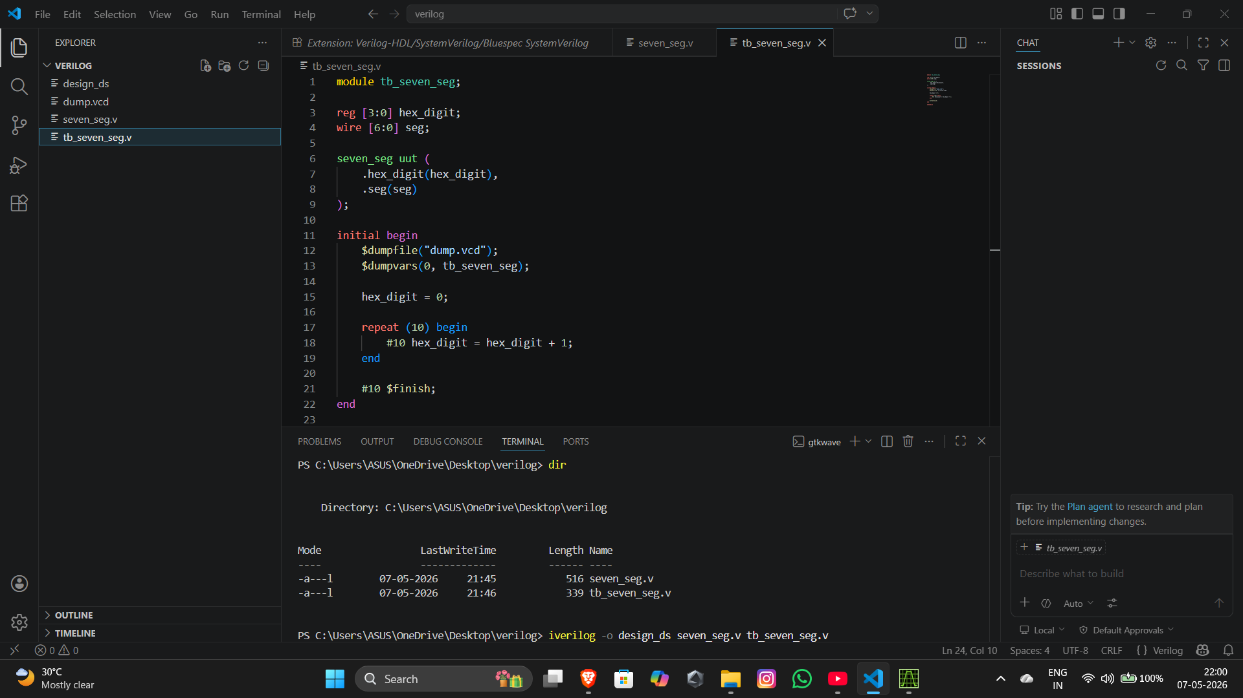

Slide 14


Slide 15
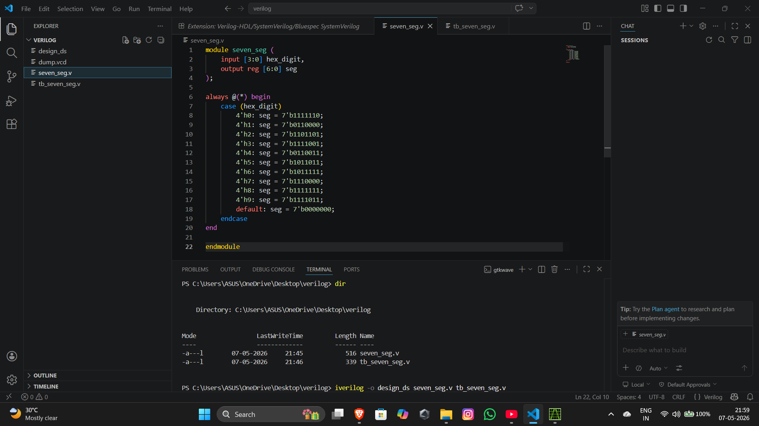

Slide 16
