Slide 1
DATA MINING | SEMESTER III
CREDIT CARD
TRANSACTION
ANOMALY DETECTION
Unsupervised learning approaches for identifying and ranking unusual financial transactions
Priti Prakash Mohanta | 2025MSBDA015
Madhav Kumar | 2025MSBDA011
M.Sc. Computer Science (Big Data Analytics) • Semester III
Submitted to: Dr. Subodh Kumar
Department of Data Science and Analytics, Central University of Rajasthan

Slide 2
01 | OVERVIEW
Project at a Glance
TRANSACTIONS
FRAUD CASES (0.1727%)
DETECTION METHODS
FRAUDS IN TEST SET
284,807
492
4
25
Objectives
Core principle
Quantify class imbalance and explore transaction patterns
Train and compare Isolation Forest, LOF, PCA reconstruction and Robust Z-score
Produce continuous anomaly scores and ranked suspicious-transaction lists
Evaluate with Precision, Recall, F1, Average Precision, PR curves and Precision@K
Investigate flagged records; fraud labels used only after scoring
An anomaly score is a prioritisation signal for human investigators, not an automatic fraud verdict.
CREDIT CARD TRANSACTION ANOMALY DETECTION • DATA MINING
02 / 25

Slide 3
02 | DATA UNDERSTANDING
Dataset Profile
ROWS
COLUMNS
FRAUD
MISSING VALUES
284,807
31
492
0
Feature group | Columns | Description
Time | Time | Seconds elapsed since the first transaction (about 2 days)
Amount | Amount | Transaction amount, range 0 to 25,691
Anonymised | V1 - V28 | PCA-transformed variables, no direct business meaning
Label | Class | 1 = fraud, 0 = normal (evaluation only)
Source: Kaggle / ULB (mlg-ulb/creditcardfraud). Findings describe statistical deviation, not specific customer behaviour.
CREDIT CARD TRANSACTION ANOMALY DETECTION • DATA MINING
03 / 25

Slide 4
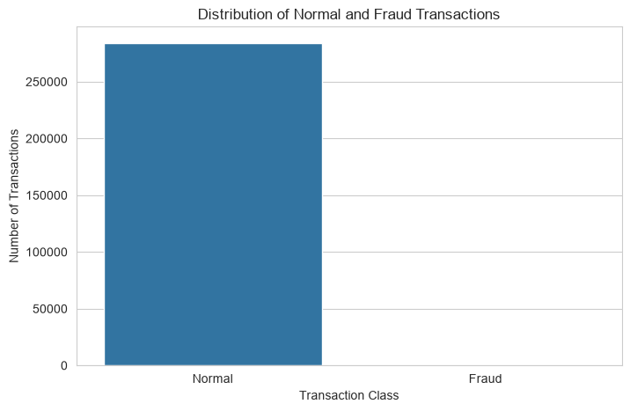
02 | DATA UNDERSTANDING
The Central Challenge: Extreme Class Imbalance
NORMAL | 99.8273%
FRAUD | 0.1727%
284,315
492
Predicting every transaction as normal gives about 99.83% accuracy yet finds zero fraud
Accuracy is therefore not used as the main metric
Precision, Recall, F1, Average Precision and Precision@K are used instead
Random-ranking AP baseline equals the fraud rate
Imbalance drives every design choice: stratified split, ranking metrics, alert-budget evaluation.
CREDIT CARD TRANSACTION ANOMALY DETECTION • DATA MINING
04 / 25

Slide 5
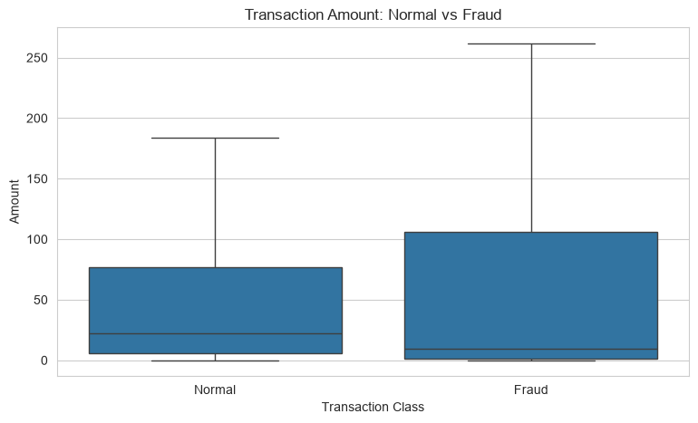
02 | DATA UNDERSTANDING
Transaction Amounts: Normal vs Fraud
Class | Mean | Median | Max
Normal | 88.29 | 22.00 | 25,691.16
Fraud | 122.21 | 9.25 | 2,125.87
Fraud median (9.25) is lower than normal median (22.00)
Fraud is not simply large-value activity
Amount alone is not a reliable fraud rule
Insight: extreme-amount transactions are unusual but often legitimate, which affects later detector rankings.
CREDIT CARD TRANSACTION ANOMALY DETECTION • DATA MINING
05 / 25

Slide 6
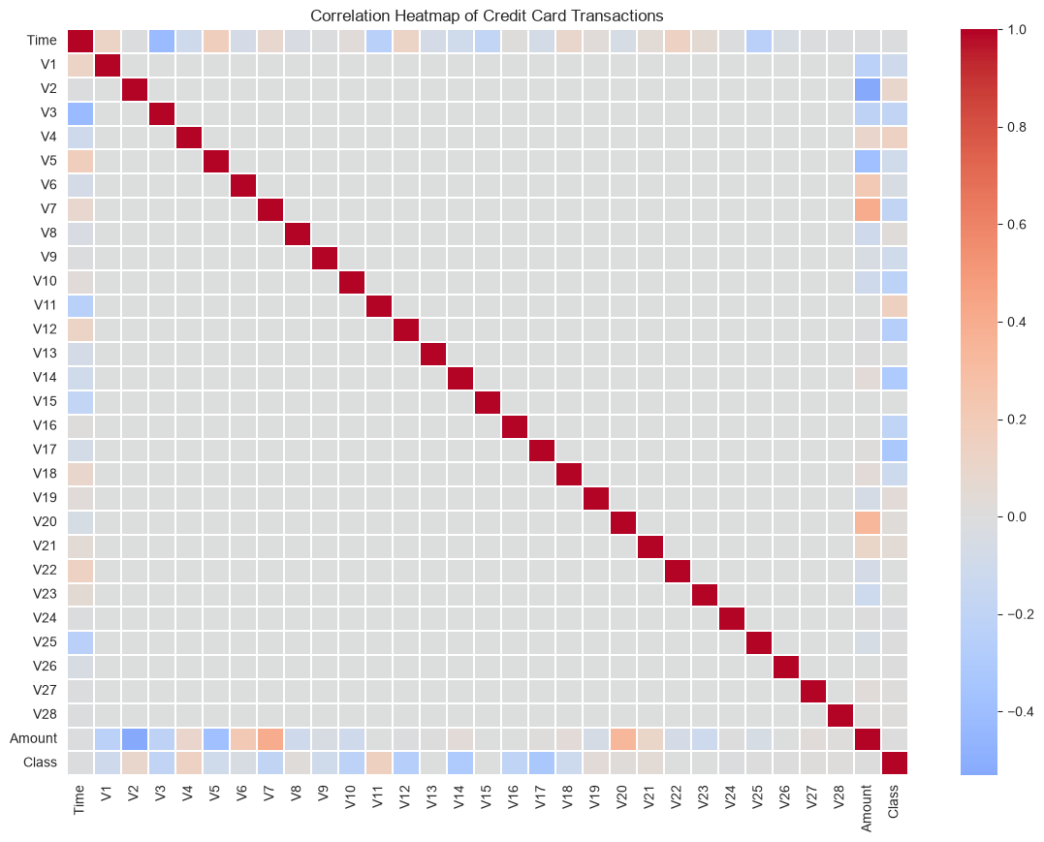
02 | DATA UNDERSTANDING
Data Quality and Correlation
MISSING VALUES
0
DUPLICATE ROWS (0.38%)
1,081
AMOUNT SKEW AFTER LOG1P
16.98 → 0.16
Duplicates were counted and retained: repeated small amounts can be legitimate.
V1-V28 are largely uncorrelated PCA components; Amount and Time show the visible structure.
CREDIT CARD TRANSACTION ANOMALY DETECTION • DATA MINING
06 / 25

Slide 7
03 | METHODOLOGY
End-to-End Methodology
01
02
03
04
Load + EDA
Log-transform Amount
Stratified sample + split
Scale features
05
06
07
08
Fit detectors
Score + rank
Evaluate (PR, AP, Top-K)
Investigate flagged
The same train/test split feeds all four detectors. Labels are excluded from inputs and used only for evaluation.
CREDIT CARD TRANSACTION ANOMALY DETECTION • DATA MINING
07 / 25

Slide 8
03 | METHODOLOGY
Preprocessing and Leakage-Safe Design
df["Amount_log"] = np.log1p(df["Amount"])
X = df.drop(columns=["Class","Amount"])
X["Amount"] = df["Amount_log"]
y = df["Class"]
X_sample = X.sample(n=50000, random_state=42)
X_train, X_test, y_train, y_test = train_test_split(
X_sample, y_sample, test_size=0.30,
random_state=42, stratify=y_sample)
scaler = StandardScaler()
X_train_scaled = scaler.fit_transform(X_train)
X_test_scaled = scaler.transform(X_test)
Set | Rows | Frauds
Sample | 50,000 | 83
Train | 35,000 | 58
Test | 15,000 | 25
Class never enters fit() or scoring
Scaler fitted on training data only
Zero train/test index overlap (checked)
Stratified split keeps the rare fraud class in both sets; test metrics rest on only 25 frauds.
CREDIT CARD TRANSACTION ANOMALY DETECTION • DATA MINING
08 / 25

Slide 9
04 | DETECTION METHODS
Four Complementary Detectors
Isolation Forest
Local Outlier Factor
PCA Reconstruction
Robust Z-score
ISOLATION-BASED
DENSITY-BASED
RECONSTRUCTION-BASED
STATISTICAL
Anomalies need fewer random splits to isolate.
200 trees, contamination 0.01
Compares local density with neighbours.
k = 20, novelty mode
10 components keep 42.18% variance. Large error = unusual.
Median and MAD deviations; mean of the 5 largest feature scores.
Four definitions of "unusual" means their rankings can legitimately disagree.
CREDIT CARD TRANSACTION ANOMALY DETECTION • DATA MINING
09 / 25

Slide 10
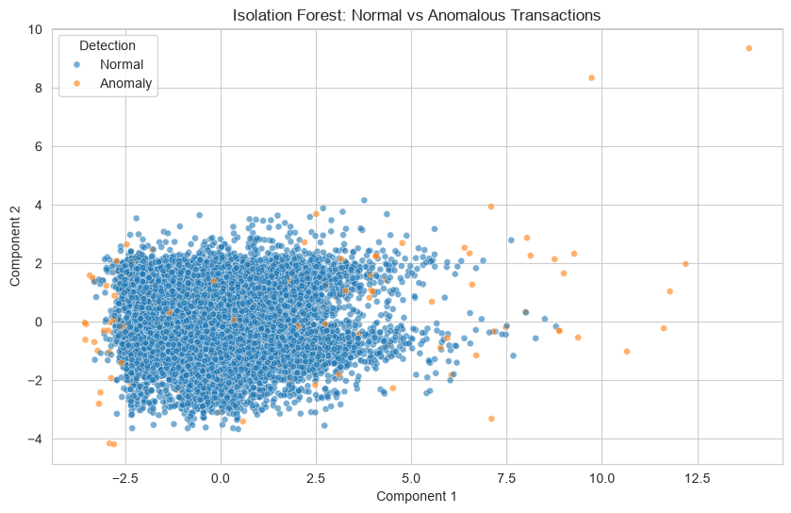
04 | DETECTION METHODS
Method 1: Isolation Forest
HOW IT WORKS
Randomly partitions the feature space; unusual observations are isolated in fewer splits.
SETTINGS
n_estimators = 200 | contamination = 0.01 | random_state = 42
isolation_forest.fit(X_train_scaled)
if_scores = -isolation_forest.score_samples(X_test_scaled)
if_flags = (isolation_forest.predict(X_test_scaled)==-1)
PRECISION
RECALL
F1
AVG PREC.
147 flagged: 13 fraud, 134 false alarms
0.0884
0.52
0.1512
0.1782
CREDIT CARD TRANSACTION ANOMALY DETECTION • DATA MINING
10 / 25

Slide 11
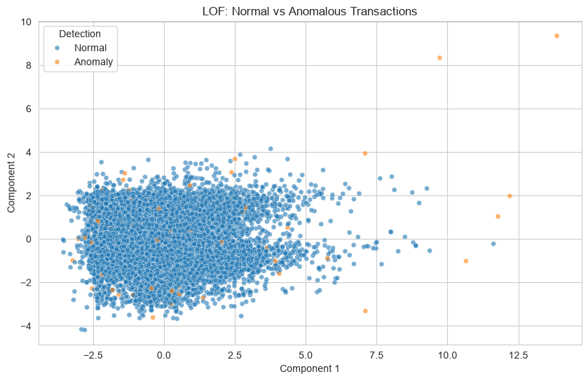
04 | DETECTION METHODS
Method 2: Local Outlier Factor
HOW IT WORKS
Compares each point's local density with its neighbours; sparse regions may be anomalies.
SETTINGS
n_neighbors = 20 | contamination = 0.01 | novelty = True
lof.fit(X_train_scaled)
lof_scores = -lof.score_samples(X_test_scaled)
lof_flags = (lof.predict(X_test_scaled) == -1)
PRECISION
RECALL
F1
AVG PREC.
155 flagged: 3 fraud, 152 false alarms
0.0194
0.12
0.0333
0.0083
CREDIT CARD TRANSACTION ANOMALY DETECTION • DATA MINING
11 / 25

Slide 12
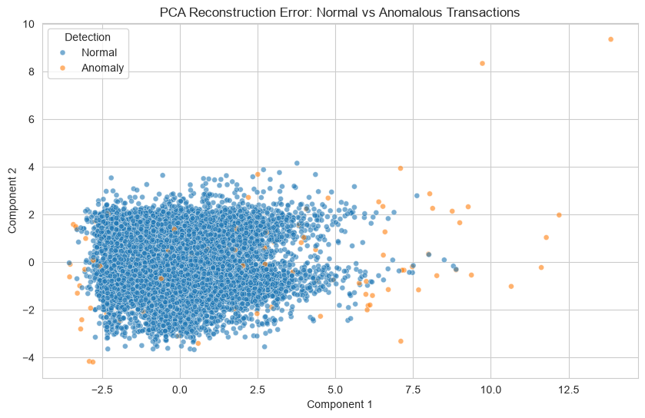
04 | DETECTION METHODS
Method 3: PCA Reconstruction Error
HOW IT WORKS
Compresses the features and reconstructs test records; large error means a poor fit to learned components.
SETTINGS
n_components = 10 | variance kept = 42.18% | threshold = 99th pct
pca.fit(X_train_scaled)
X_rec = pca.inverse_transform(pca.transform(X_test_scaled))
pca_scores = np.mean((X_test_scaled - X_rec) ** 2, axis=1)
PRECISION
RECALL
F1
AVG PREC.
133 flagged: 16 fraud, 117 false alarms
0.1203
0.64
0.2025
0.1700
CREDIT CARD TRANSACTION ANOMALY DETECTION • DATA MINING
12 / 25

Slide 13

04 | DETECTION METHODS
Method 4: Robust Z-score
HOW IT WORKS
Median and MAD deviations per feature; the mean of the 5 largest forms the score.
SETTINGS
zr = |x - median| / (1.4826 x MAD) | threshold = 99th pct (12.15)
robust_z = (X_test_scaled - median).abs() / (1.4826*mad)
robust_scores = robust_z.apply(lambda r: r.nlargest(5).mean(), axis=1)
PRECISION
RECALL
F1
AVG PREC.
141 flagged: 8 fraud, 133 false alarms
0.0567
0.32
0.0964
0.0520
CREDIT CARD TRANSACTION ANOMALY DETECTION • DATA MINING
13 / 25

Slide 14
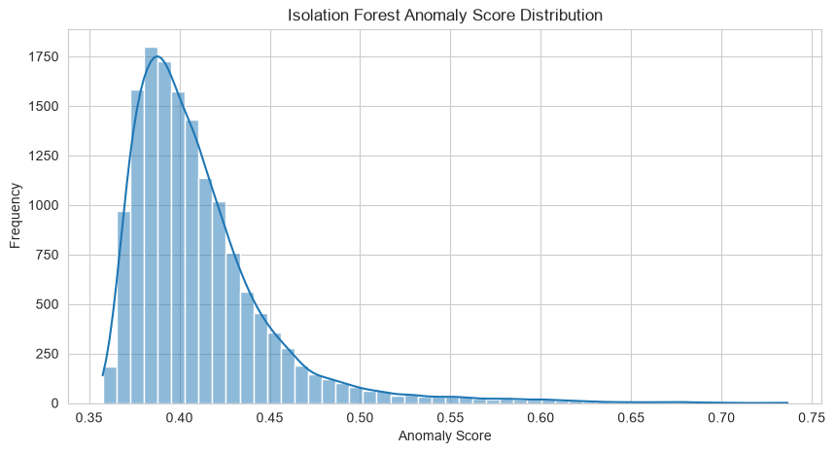
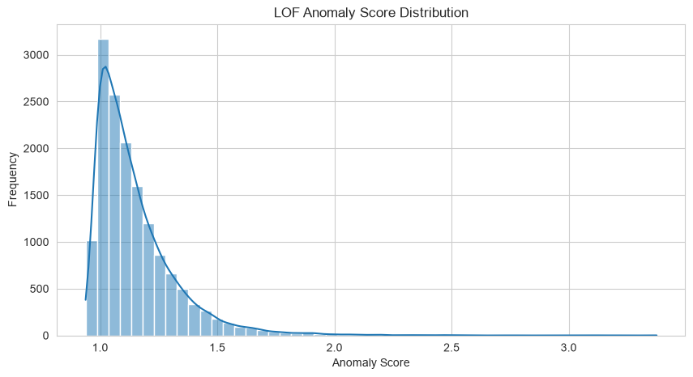
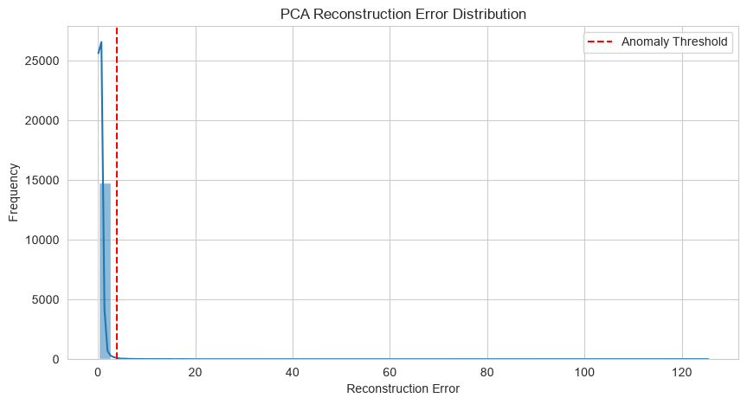
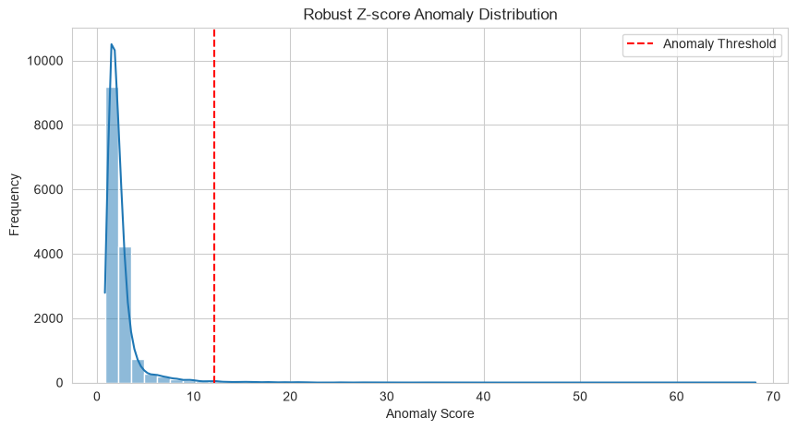
05 | RESULTS
Anomaly Score Distributions
All four score distributions are heavily right-skewed: a small tail of extreme transactions drives the rankings.
CREDIT CARD TRANSACTION ANOMALY DETECTION • DATA MINING
14 / 25

Slide 15
05 | RESULTS
Model Comparison (Test Set, 25 Frauds)
Method | Precision | Recall | F1-score | Avg Precision
Isolation Forest | 0.0884 | 0.5200 | 0.1512 | 0.1782
PCA Reconstruction | 0.1203 | 0.6400 | 0.2025 | 0.1700
Robust Z-score | 0.0567 | 0.3200 | 0.0964 | 0.0520
LOF | 0.0194 | 0.1200 | 0.0333 | 0.0083
Random baseline | 0.0017 | - | - | 0.0017
Best AP: Isolation Forest (0.1782) | Best Recall and F1: PCA (0.64 / 0.2025) | gap between them is within sampling noise.
CREDIT CARD TRANSACTION ANOMALY DETECTION • DATA MINING
15 / 25

Slide 16
05 | RESULTS
Ranking Quality vs Detection at the 1% Threshold
Isolation Forest and PCA clearly separate from Robust Z-score and LOF.
CREDIT CARD TRANSACTION ANOMALY DETECTION • DATA MINING
16 / 25

Slide 17
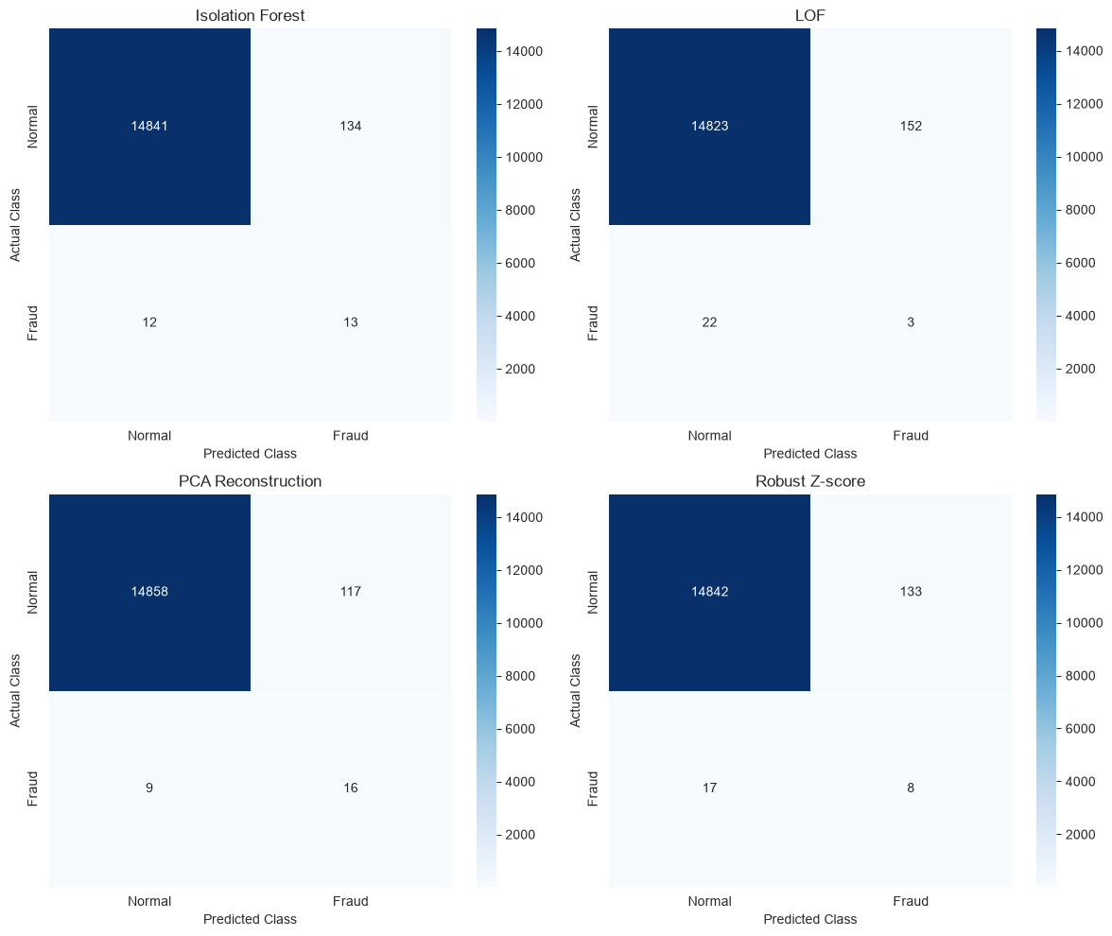
05 | RESULTS
Fraud Found vs False Alarms
ISOLATION FOREST
13 TP | 134 FP
PCA RECONSTRUCTION
16 TP | 117 FP
ROBUST Z-SCORE
8 TP | 133 FP
LOF
3 TP | 152 FP
Even the best detectors raise many false alarms: expected under severe imbalance.
CREDIT CARD TRANSACTION ANOMALY DETECTION • DATA MINING
17 / 25

Slide 18
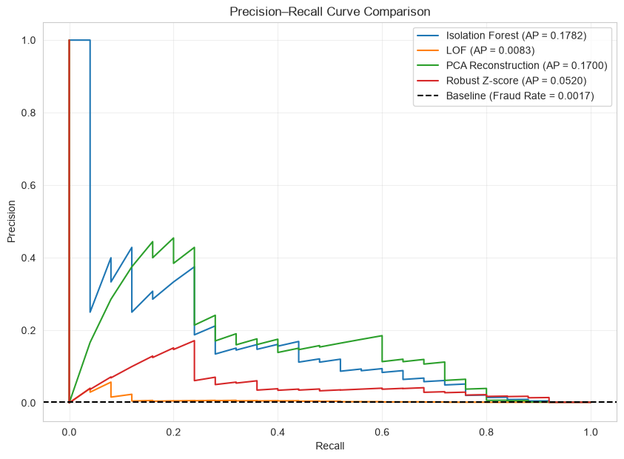
05 | RESULTS
Precision-Recall Curves
The dashed line is the random baseline (fraud rate 0.0017)
IF and PCA curves sit far above the baseline at low recall
LOF stays close to the baseline across the range
Curves start high but fall quickly: precision costs recall
CREDIT CARD TRANSACTION ANOMALY DETECTION • DATA MINING
18 / 25

Slide 19
05 | RESULTS
Alert Budget: Precision@K and Recall@K
Reviewing the top 200 of 15,000 finds 16 (IF) or 18 (PCA) of the 25 frauds; the top 500 finds 19 each.
CREDIT CARD TRANSACTION ANOMALY DETECTION • DATA MINING
19 / 25

Slide 20
06 | INTERPRETATION
Ranked Anomalous Transactions (Isolation Forest)
Rank | Amount | Anomaly score | Actual class
1 | 364.19 | 0.7365 | Fraud
2 | 1,235.79 | 0.7326 | Normal
3 | 1.00 | 0.6952 | Normal
4 | 1.18 | 0.6942 | Normal
5 | 97.00 | 0.6894 | Fraud
6 | 660.38 | 0.6882 | Normal
7 | 1.00 | 0.6800 | Fraud
8 | 1.00 | 0.6790 | Normal
9 | 1,210.00 | 0.6782 | Normal
10 | 152.00 | 0.6779 | Normal
FRAUDS IN TOP 10
3 of 10
FRAUDS IN TOP 20
6 of 20
FRAUDS IN TOP 100 (88 FALSE ALARMS)
12 of 100
Frauds appear at tiny amounts (1.00) as well as at larger ones; ranked lists are exported as CSV for each method.
CREDIT CARD TRANSACTION ANOMALY DETECTION • DATA MINING
20 / 25

Slide 21
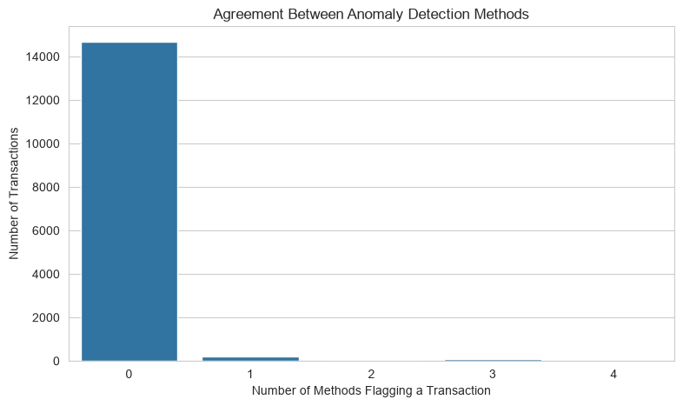
06 | INTERPRETATION
Agreement Between Detectors
FLAGGED BY ALL FOUR
REAL FRAUDS AMONG THEM
18
0
Full agreement picked extreme-value, mostly high-amount legitimate transactions
Statistical unusualness is not the same as fraud
Next step: a rank-average ensemble score instead of a flag count
Consensus of four detectors did not identify fraud: agreement supports prioritisation, not proof.
CREDIT CARD TRANSACTION ANOMALY DETECTION • DATA MINING
21 / 25

Slide 22
06 | INTERPRETATION
What Makes Flagged Records Unusual?
Top-100 IF records deviate most on V20, V2, V28, V1 and V7
Features are anonymised: this is mathematical deviation, not a business cause
12 of the top 100 were real fraud, 88 were unusual but normal
CREDIT CARD TRANSACTION ANOMALY DETECTION • DATA MINING
22 / 25

Slide 23
07 | DISCUSSION
Key Insights
PRECISION LIFT OVER RANDOM FOR IF AND PCA FLAGS
ISOLATION FOREST AP VS THE 0.0017 BASELINE
≈53x - 72x
≈107x
FRAUDS CAUGHT IN THE TOP 200 (IF, PCA)
LOF AP OVER BASELINE: NEAR-RANDOM RANKING
64% - 72%
≈5x
Unsupervised ranking is useful for prioritising manual review
Precision stays below about 15%, so automatic blocking is not justified
LOF likely struggles because density contrast fades in about 30 dimensions (hypothesis)
Choice of detector matters: IF and PCA worked, LOF did not.
CREDIT CARD TRANSACTION ANOMALY DETECTION • DATA MINING
23 / 25

Slide 24
07 | DISCUSSION
Limitations and Future Work
Limitations
Future work
50,000-record sample; only 25 test frauds
Executed feature matrix has 31 columns: log-Amount appears twice and Time is included
1,081 duplicates retained
Thresholds learned from all training records
Anonymised features limit interpretation
Re-run on cleaned 29-feature matrix and full dataset
Rank-average ensemble and bootstrap confidence intervals
Add One-Class SVM and an autoencoder
Chronological split and deduplication sensitivity check
Tune LOF neighbours
CREDIT CARD TRANSACTION ANOMALY DETECTION • DATA MINING
24 / 25

Slide 25
08 | CONCLUSION
Conclusion and Thank You
Built a leakage-safe pipeline: labels used only for evaluation
Compared four unsupervised detectors on 15,000 held-out transactions
Isolation Forest (AP 0.178) and PCA reconstruction (AP 0.170) performed best; LOF was near-random
Detectors surface unusual, not necessarily fraudulent, transactions
Best use: a ranked shortlist for human investigators
Thank You | Questions?
Priti Prakash Mohanta (2025MSBDA015) • Madhav Kumar (2025MSBDA011)
Submitted to Dr. Subodh Kumar • Dept. of Data Science and Analytics, CURAJ
CREDIT CARD TRANSACTION ANOMALY DETECTION • DATA MINING
25 / 25

