Slide 1
DBMS
J-COMPONENT REVIEW 2

Slide 2
Weather Valley
By
Dilshath (16BCE0669)
Madhav Bahl (16BEC0080)

Slide 3
ABSTRACT
Weather forecasting is the prediction of what the atmosphere will be like in a particular place by using technology and scientific knowledge to make weather observations. In other words, it's a way of predicting things like cloud cover, rain, snow, wind speed and temperature before they happen. The main ways the weather can be forecast include looking at current weather conditions, tracking the motion of air and clouds in the sky, finding previous weather patterns that resemble current ones, examining changes in air pressure and running computer models. In this project, we are going to make a database which predicts the weather of different places. In other words, this is a website for weather station. This contains a big data about weekly weather conditions of all the places in India. Through this website the user will be able to check the current weather conditions in his locality. And each of the big data will get refreshed on Sunday morning each week. Thus the main purpose of this project is to develop a platform to store weather date, compare the weather between two different places and in case of calamities, tell the user the safest place near him. Hence we are trying to make a website which will be very useful for the mankind.

Slide 4
Problems Solved
Weather Details
Gives the details and weekly and current weather forecast of any area you want to search
Natural Calamities
Gives the details, forecast and tells the safest place near you in times of natural calamities

Slide 5
MAIN FEATURES OF MONGODB
✓
Easy Queries using Node.JS
✓
Indexing and Replication
✓
Server-side java-script execution

Slide 6
QUERIES
MongoDB supports field, range queries, regular expression searches.
Queries can return specific fields of documents and also include user defined JavaScript functions.
Queries can also be configured to return a random sample of results of a given size.

Slide 7
INDEXING AND REPLICATION
Fields can be indexed with primary and secondary indices.
MongoDB provides high availability with repilca sets. A replica set consists of two or more copies of the data. Each replica set member may act in the role of primary or secondary replica at any time.

Slide 8
SERVER-SIDE JAVASCRIPT EXECUTON
Java script can be used in queries, aggregation functions and sent directly to the database to be executed

Slide 9
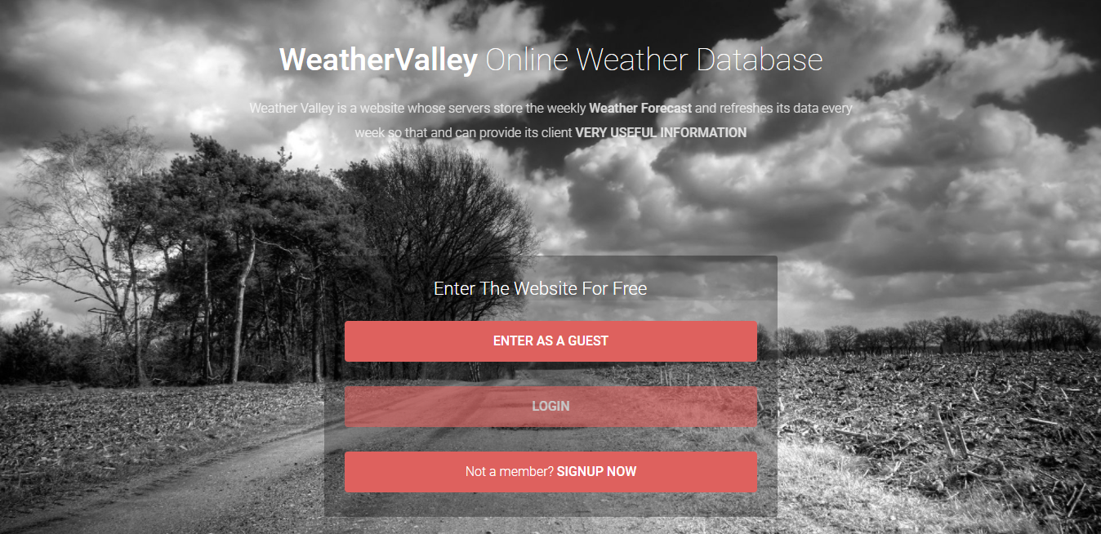
Some screenshots of work done till now

Slide 10
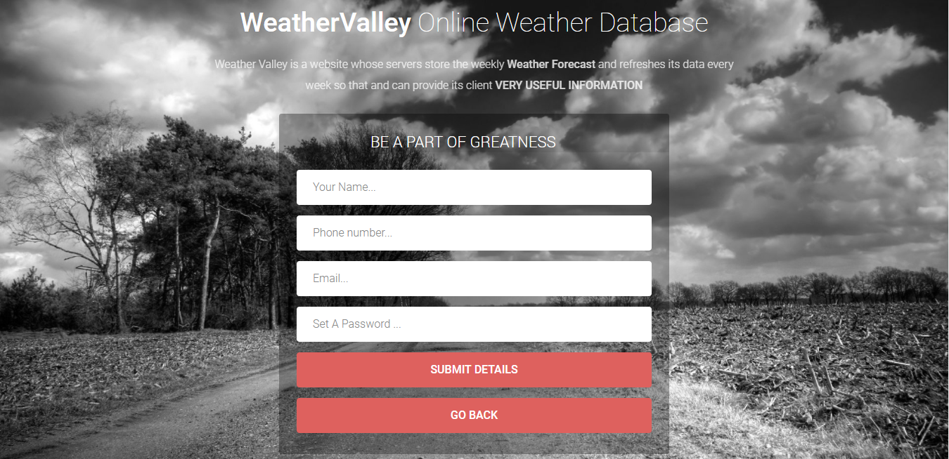
Some screenshots of work done till now

Slide 11
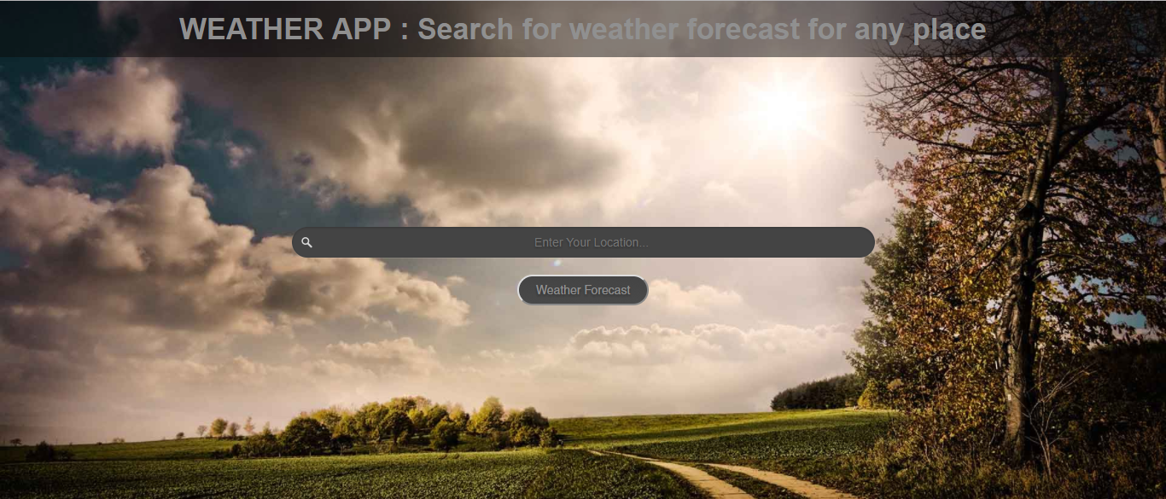
Some screenshots of work done till now

Slide 12

Some screenshots of work done till now

Slide 13
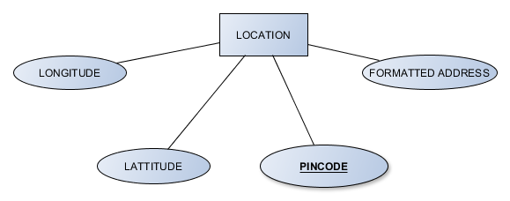
Construction

Slide 14
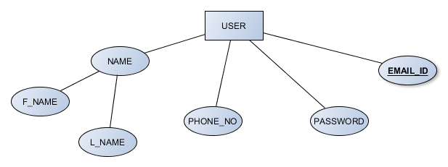
Construction

Slide 15
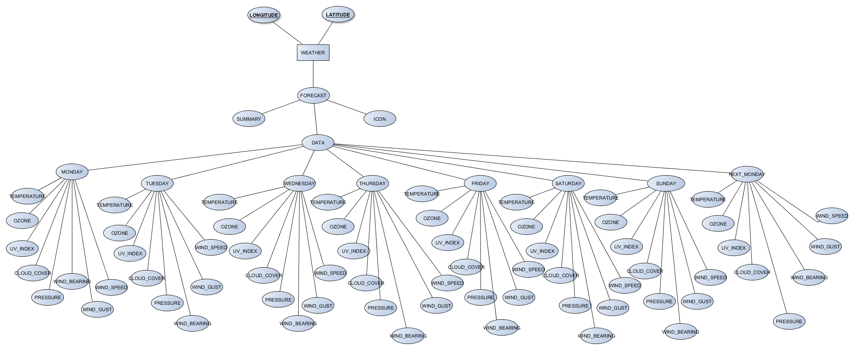
Construction

Slide 16
Prototype
Demo

