Slide 1
Introduction to GraphQL
Find the slides at - madhavbahl.tech/graphql-starter/slides.pptx

Slide 2
Topics
Let’s take some REST!
Let’s create a mini-LinkedIn model?
But wait, we shouldn’t always REST!
Well then, what’s the solution?
Let’s take a look at our Graphical tool (ah, that’s GraphiQL)
Let’s create our own server first
It’s time to write some queries
getting that was cool, but what about POSTing or PATCHing that?
Let’s write some mutations
But wait, we can’t ship GraphiQL to users, can we?
Can I try hitting a GQL query with Postman?
What’s the solution though?

Slide 3
Starting the Mini-LinkedIn project
$ npm init –y
$ npm install express express-graphql graphql axios json-server
$ npm install -–save-dev nodemon

Slide 4
Let’s take some REST first!
GET /abc
POST /abc
GET /abc/:id
PATCH /abc/:id
DELETE /abc/:id
Fetches all the records
Creates a new record
Fetch a specific record by ID
Update a specific record with ID
Delete a specific record with ID

Slide 5
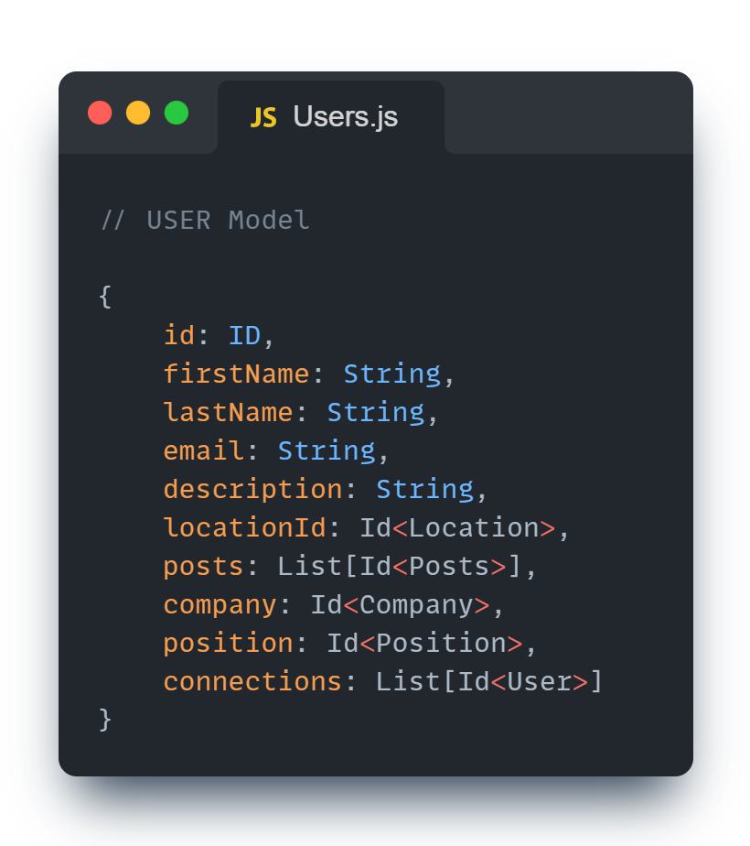
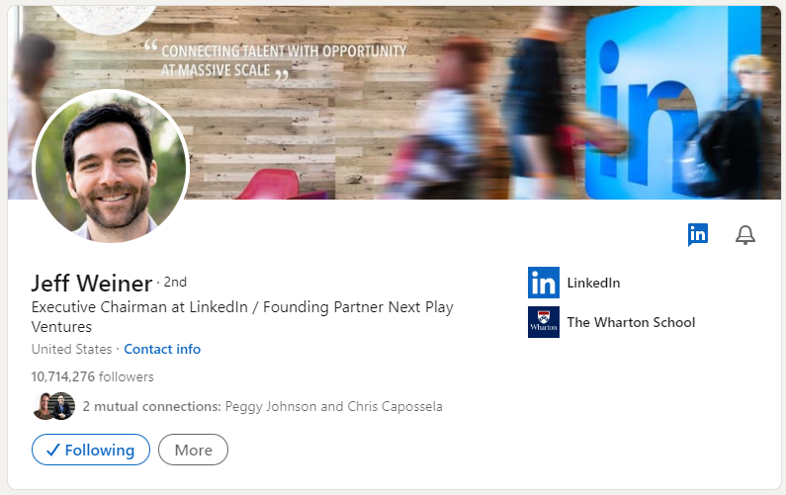
Let’s try to design our own Mini-LinkedIn models

Slide 6
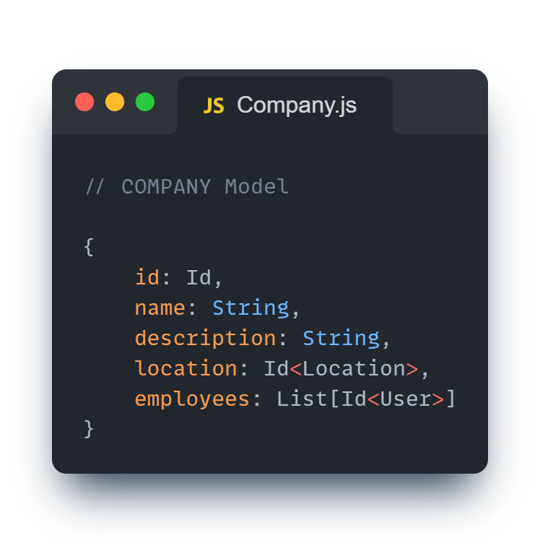
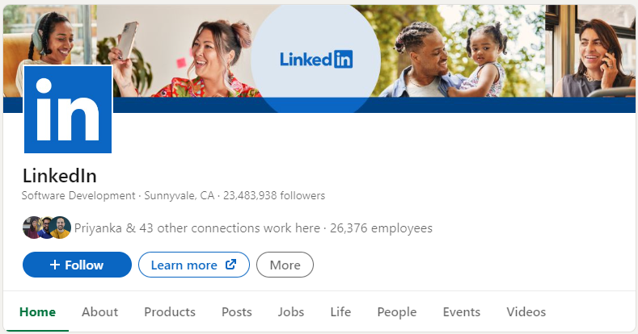
Let’s try to design our own Mini-LinkedIn models

Slide 7
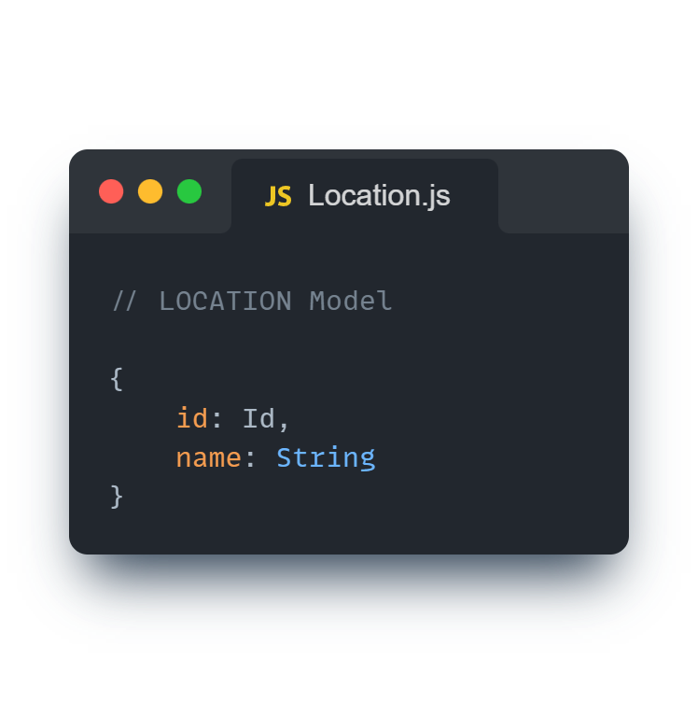
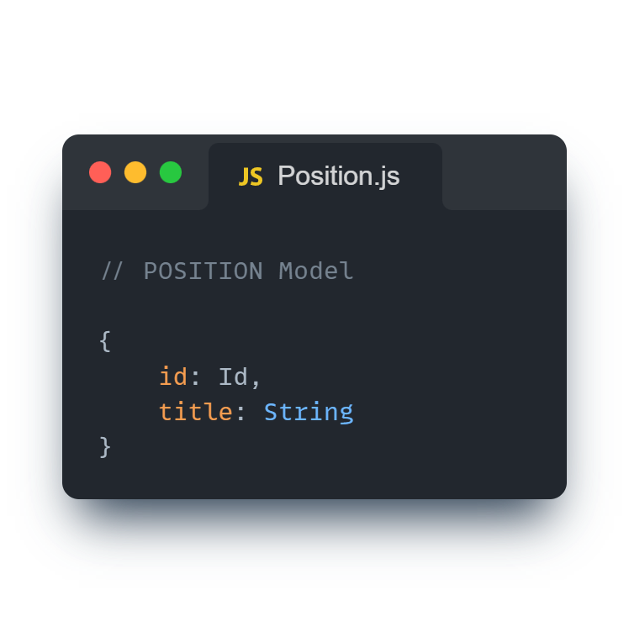
Let’s try to design our own Mini-LinkedIn models

Slide 8
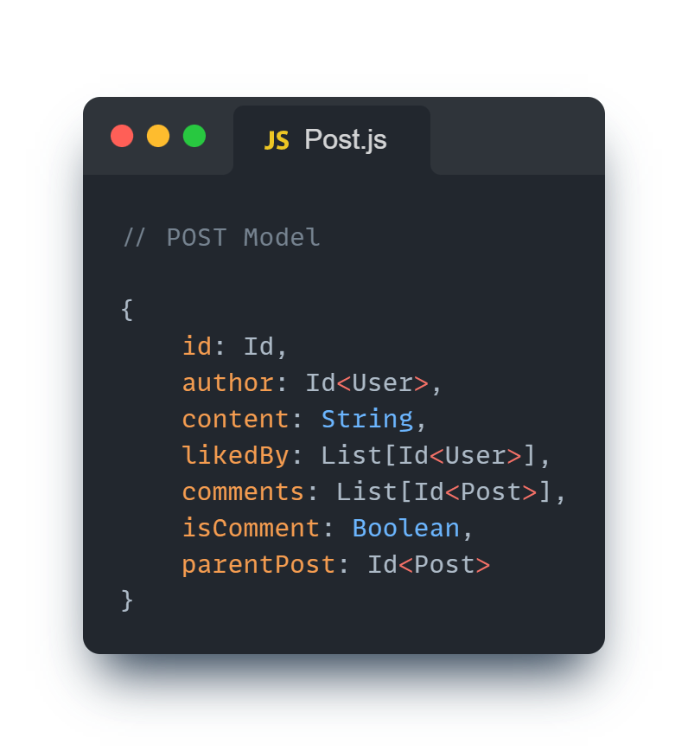
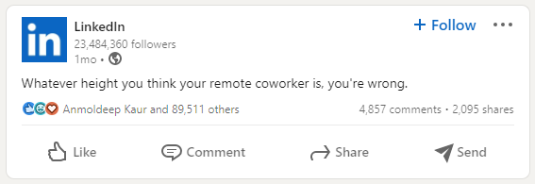
Let’s try to design our own Mini-LinkedIn models

Slide 9
REST is cool, but what if…
You have to find all users at a specific location? GET /locations/1/users
You have to find where all your connections work? GET /users/4102/connections/companies/
Or, maybe you just need the fName, lName and description of a user (to show on top of a comment)? GET /users/4102 -> You end up with so much data that you don’t want
Or, what if you need to get everyone working at the location where user `4201` is working? GET /users/4201 -> Take the location ID GET /locations/20/users -> Find all users from that place

Slide 10
RESTing too much might lead to…
1. Under-Fetching: If you need more data than what the single endpoint supports, you'll have to call multiple APIs
2. Over-Fetching: If you need less data than what the endpoint is giving, you're just wasting your users data pack

Slide 11
GraphQL to the rescue
Developed by Facebook (Meta) in 2012 (and publicly released in 2015), GraphQL is an open source data query and manipulation language for APIs.
In layman terms, it’s a server which sits on top of your server and allows you to do whatever you want with the data you want to fetch or modify
When I say “do whatever you want” – I mean, you’re no longer limited to those REST URLs to do your job, whole data models are in your hands, need something, fetch only that thing, don’t need something, delete only that thing, want to change something, edit it.

Slide 12
GraphQL to the rescue
Developed by Facebook (Meta) in 2012 (and publicly released in 2015), GraphQL is an open source data query and manipulation language for APIs.
In layman terms, it’s a server which sits on top of your server and allows you to do whatever you want with the data you want to fetch or modify
When I say “do whatever you want” – I mean, you’re no longer limited to those REST URLs to do your job, whole data models are in your hands, need something, fetch only that thing, don’t need something, delete only that thing, want to change something, edit it.

Slide 13
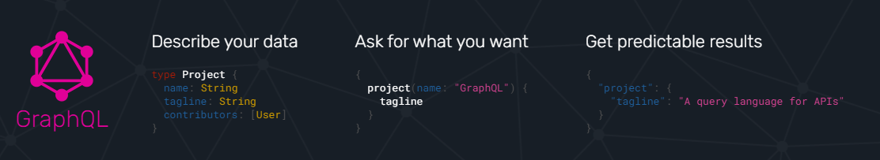
Or, as they say…
Describe your data
Ask for what you want
Get predictable results

Slide 14
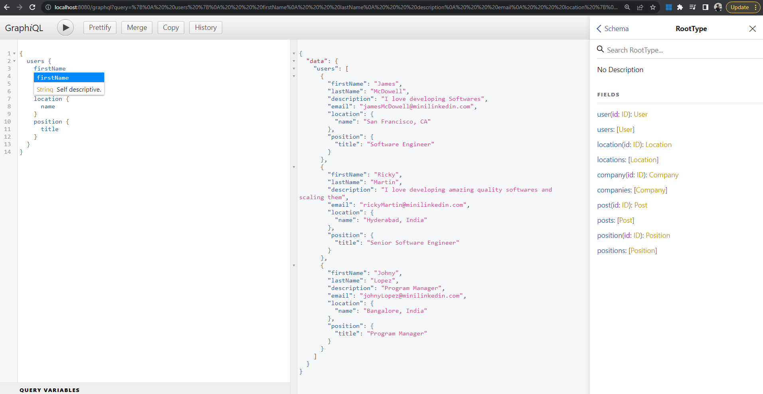
Let’s take a look at a Graphical interface
Oof! No, it’s not Graphical, it’s GraphiQL

Slide 15
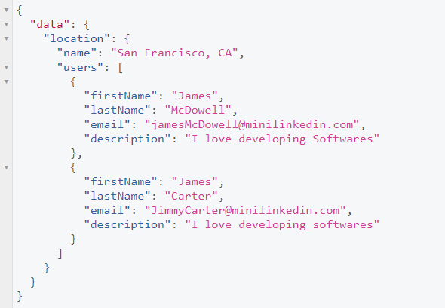
GraphQL to the rescue
You have to find all users at a specific location? GET /locations/1/users
query {
location (id: "1") {
nam
users {
firstName
lastName
email
description
}
}
}

Slide 16
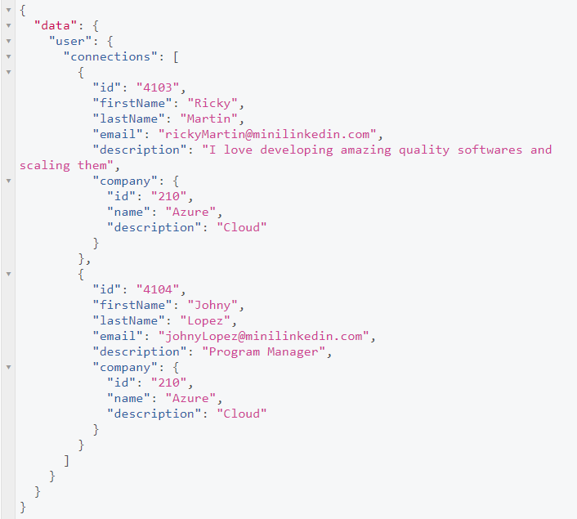
GraphQL to the rescue
You have to find where all your connections work? GET /users/4102/connections/companies/
query {
user (id: "4102") {
connections {
id
firstName
lastName
email
description
company {
id
name
description
}
}
}
}

Slide 17
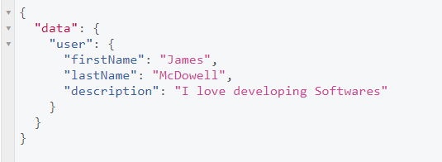
GraphQL to the rescue
Or, maybe you just need the fName, lName and description of a user (to show on top of a comment)? GET /users/4102 -> You end up with so much data that you don’t want
query {
user (id: "4102") {
firstName
lastName
description
}
}

Slide 18
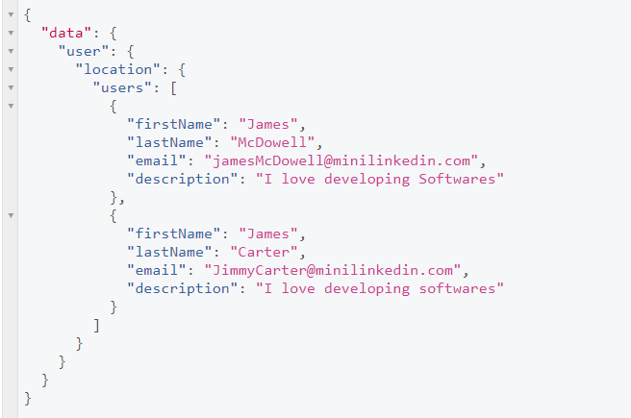
GraphQL to the rescue
Or, what if you need to get everyone working at the location where user `4201` is working? GET /users/4201 -> Take the location ID GET /locations/20/users -> Find all users from that place
query {
user (id: "4102") {
location {
users {
firstName
lastName
email
description
}
}
}
}

Slide 19
But, GraphQL isn’t always what you need to use!
A GraphQL server must be carefully defined, sometimes it’s easier to define specific endpoints for specific needs.
GraphQL client can (at times) make tasks more complex. Using GraphQL for simple apps is not recommended.
Read more here: https://blog.logrocket.com/graphql-vs-rest-api-why-you-shouldnt-use-graphql

Slide 20
Let’s create our own GraphQL server
That being said,

Slide 21
Let’s write some queries
Hands-on

Slide 22
GETing that was cool, but what about chaging it?
Hands-on

Slide 23
GETing that was cool, but what about chaging it?
Hands-on

Slide 24
But, we can’t ship GraphiQL!
GraphQL clients

Slide 25
But, we can’t ship GraphiQL!
GraphQL clients

Slide 26
Hitting GQL queries with Postman?
Hands-on

Slide 27
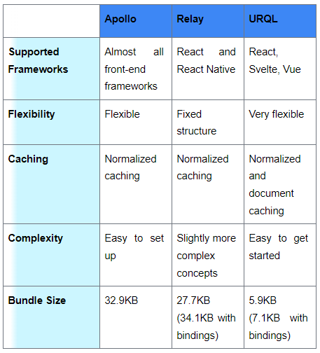
A good blog on Apollo vs Relay
https://hasura.io/blog/exploring-graphql-clients-apollo-client-vs-relay-vs-urql/

Slide 28
Thank you
Do you want a separate session on GraphQL clients?

