Slide 1
Multimodal Emotion Detection from Face Images
Efforts by:
Madhav Sharma
Under Guidance of: Dr. S Nagaraju

Slide 2
Introduction to Image Data and CNN
In ANN image learning is very difficult and it yields very low accuracy
Two main issues persist with the ANN:
The location of feature matters
The ANN will take lot of resources
The CNN tries to identify featured by convolution and pooling and frpom those features it can identify the image
The strategy of CNN was hence used here
The images had lot of noise hence beyond some point the accuracy was not boosted above 79%
The model detects 5 emotions with 90% accuracy

Slide 3
Data Preprocessing
We have one directory which contains testing, training, and validation datasets the data is first stored in an image array, then converted into the same size of 64*64 due to hardware constraints, now what we have done is normalized the array to lie between [0,1] to do this we know that maximum pixel value will be 255.0 and minimum will be 0.0 hence we have directly divided by 255.0 Now final dataset is available for train test and val testing • 80-20 ratio was maintained for training and testing: and then 50-50 between training and validation, • The main purpose of testing is to test if the model is not overfit or underfit while the purpose of validation is to solely prevent overfitting the model

Slide 4
Model Architecture
Initialize the CNN: The Sequential model is initialized. The Sequential model allows you to build a neural network layer by layer.
Convolutional Layers: Three convolutional layers are added to the model. The first layer (Conv2D) has 32 filters of size 3x3, uses ReLU activation, and takes input images of size 64x64 pixels. A max-pooling layer (MaxPooling2D) with a 2x2 pool size follows each convolutional layer. The second convolutional layer has 64 filters, and the third has 128 filters, both using ReLU activation.
Dropout Layer: Dropout rate of 0.2 was maintained
Flatten Layer: The Flatten layer is used to flatten the 3D output to a 1D vector, preparing the data for the fully connected layers.
Fully Connected Layers: One fully connected layer is added with 256 units and ReLU activation. The output layer has 7 units, corresponding to the 7 classes in your classification task. It uses the softmax activation function, which is suitable for multiclass classification.

Slide 5
Measuring Loss
Accuracy: Accuracy measures the overall correctness of a model's predictions. It's the ratio of correctly predicted instances to the total instances in the dataset. Formula: (True Positives + True Negatives) / (True Positives + True Negatives + False Positives + False Negatives) Accuracy is a good metric when the classes are balanced, meaning there are roughly equal numbers of positive and negative instances. However, it may not be informative when dealing with imbalanced datasets.
Precision: Precision quantifies the accuracy of positive class predictions. It measures the ratio of true positive predictions to all positive predictions (both true positives and false positives). Formula: True Positives / (True Positives + False Positives) High precision is important when false positives are costly or when you want to minimize the chances of incorrectly classifying a negative instance as positive.
Recall (Sensitivity or True Positive Rate): Recall assesses the model's ability to identify all positive instances correctly. It measures the ratio of true positive predictions to all actual positive instances (both true positives and false negatives). Formula: True Positives / (True Positives + False Negatives) High recall is crucial when missing positive instances (false negatives) is costly or when you want to ensure that positive instances are not overlooked.
F1 Score: The F1 score is the harmonic mean of precision and recall. It provides a balanced measure that considers both false positives and false negatives. Formula: 2 * (Precision * Recall) / (Precision + Recall) The F1 score is a good choice when you want to strike a balance between precision and recall. It's especially useful in situations where class imbalance exists.

Slide 6
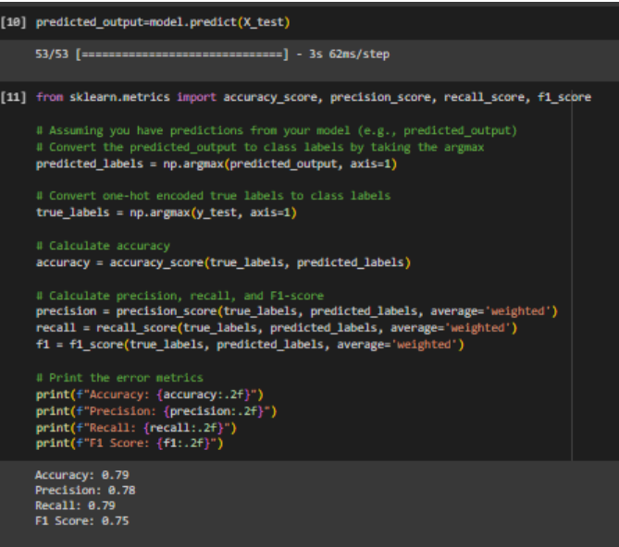
Snippet

Slide 7
Confusion Matrix
True Positives (TP): Instances that were correctly predicted as positive by the model. These are the actual positive cases that the model identified correctly.
True Negatives (TN): Instances that were correctly predicted as negative by the model. These are the actual negative cases that the model identified correctly.
False Positives (FP): Instances that were incorrectly predicted as positive by the model when they were actually negative. These are also known as Type I errors.
False Negatives (FN): Instances that were incorrectly predicted as negative by the model when they were actually positive. These are also known as Type II errors

Slide 8
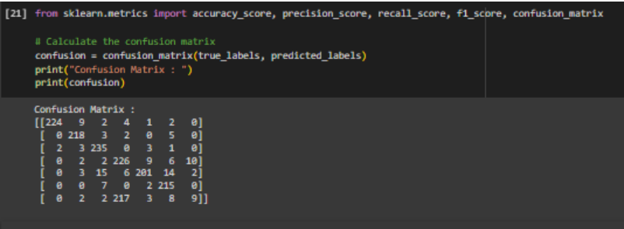
Snippet

Slide 9
Changing Hyperparameters
Increasing dropout rate: Beyond 0.3 accuracy decreased
Activation Function: ReLU gave best results
Adding GAN and quarter circle rotation: Decreased accuracy but maked model robust
Adding transforms: Worsens the performance ( made anger distorted and eyes all black for LEE)
Initialization : Done internally by HE Initialization
Optimization Function: Adam> Vannila > RMSProp

Slide 10
Conclusion
The model performed good when we had to identify only 5 emotions
The main problem faced by model will be that the face will be of same person
The model gave best accuracy with Adam
The number of epochs couldn't be done above 10 due to hardware issues but sweet point was reached
The model was negligibly overfit

