Slide 1
Speed Prediction Using Various RNN Models
Efforts by: Madhav Sharma
Under the Guidance of : Dr. S Nagaraju

Slide 2
Introduction to Time Series Dataset
The time series is time-dependent series or sequences of data-point values
They follow some kind of ‘pattern’ and have certain cyclic nature
Two goals of Time series Analysis-
Identify and model the structure of the time series
Forecast future values in time series

Slide 3
Terminology in Time Series
Trend refers to the long-term movement of a time series, it can increase or decreasing over period
Seasonality refers to the fixed and punctual fluctuations of time series values over time
A cyclic component refers to periodic fluctuations not due to time but some external factor
Random component refers to unexpected movement of the series values, the noise is one subcategory of this part, know that we will make models on this component only to understand underlying trends and patterns

Slide 4
Terminology in Time Series (Continued)
The time period after which cycle repeats itself is known as ‘sequence or cycle’
The data must be sorted in ascending order of timestamp
The data then must be plotted to show the trend

Slide 5
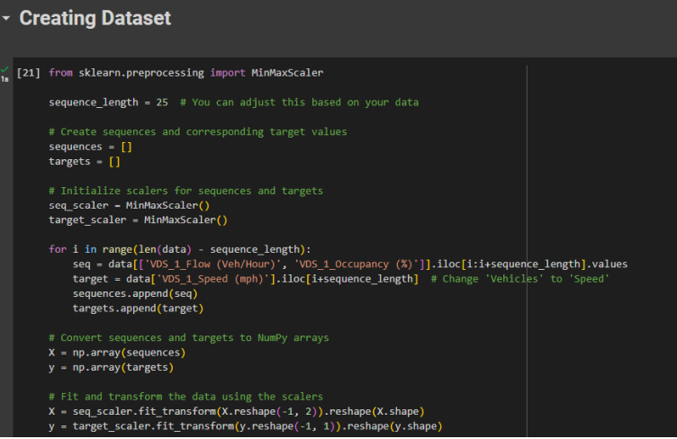
Data Preprocessing Snnipet

Slide 6
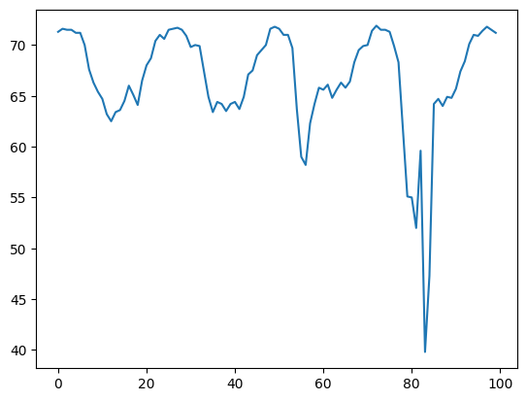
Plotting graph

Slide 7
Model Architecture for RNN
_________________________________________________________________
Layer (type) Output Shape Param #
=================================================================
simple_rnn_2 (SimpleRNN) (None, 25, 256) 66304
simple_rnn_3 (SimpleRNN) (None, 25, 128) 49280
flatten_2 (Flatten) (None, 3200) 0
dense_6 (Dense) (None, 64) 204864
dense_7 (Dense) (None, 32) 2080
dense_8 (Dense) (None, 1) 33
=================================================================
Total params: 322,561
Trainable params: 322,561
Non-trainable params: 0
_________________________________________________________________

Slide 8
Model Architecture for LSTM
_________________________________________________________________
Layer (type) Output Shape Param #
=================================================================
lstm (LSTM) (None, 25, 256) 265216
lstm_1 (LSTM) (None, 25, 128) 197120
flatten_3 (Flatten) (None, 3200) 0
dense_9 (Dense) (None, 64) 204864
dense_10 (Dense) (None, 32) 2080
dense_11 (Dense) (None, 1) 33
=================================================================
Total params: 669,313
Trainable params: 669,313
Non-trainable params: 0
_________________________________________________________________

Slide 9
Model Architecture for GRU
_________________________________________________________________
Layer (type) Output Shape Param #
=================================================================
gru (GRU) (None, 25, 256) 199680
gru_1 (GRU) (None, 25, 128) 148224
flatten (Flatten) (None, 3200) 0
dense (Dense) (None, 64) 204864
dense_1 (Dense) (None, 32) 2080
dense_2 (Dense) (None, 1) 33
=================================================================
Total params: 554,881
Trainable params: 554,881
Non-trainable params: 0
_________________________________________________________________

Slide 10
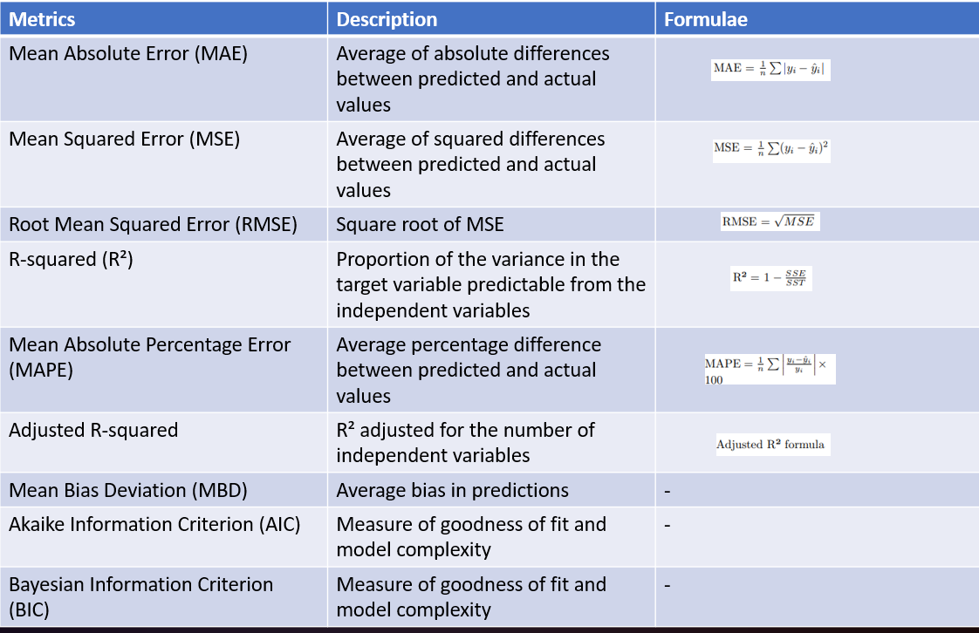
Model Evaluation Metrics

Slide 11
Changing Hyperparameters in RNN
Hyperparameter | Metrics
Number of Epochs=10 Number of Epochs=100 | 70%(R) 80%(R)
Number of Layers=1 Number of Layers=2 Number of Layers=3 | 60% 65% 79%
Activation Function= relu Activation Function= sigmoid Activation Function= tanh | - 80% -
Regularization=True Regularization=False | 70% 80%
Algorithm=Adam Algorithm=RMSProp Algorithm= Vannila Momentom | 80% - 80%

Slide 12
Conclusion
RNN and GRU gave good accuracy while LSTm gave satisfying accuracy
The model is robust due to L2 Regularization
Model was measured on R^2 score only for different hyperparameters
The model can detect 5 to 7 days and 15 days also
Model gives good accuracy but sometimes does underestimation of speed

