Slide 1
Design And Implementation Of Real-Time Autonomous Vehicle Using IoT BASED Image Processing

Slide 2
Abstract
Detects and classifies vehicles and obstacles.
Python program executes CNN algorithm for object identification on RPi.
Motor speed controlled based on object detection.
Voice commands to reduce the risk of accidents.
Ultrasonic and proximity sensors provide real-time feedback.

Slide 3
Literature Survey

Slide 4
Proposed Methodology
Uses real time image processing using IoT based systems
Uses CNN for image recognition aided by sensors
Has voice identification which prevents the accidents
Paper proposes LiDAR methodology for future works which makes system more robust to weather conditions
Motor controls which reduce speed based on obstracle

Slide 5
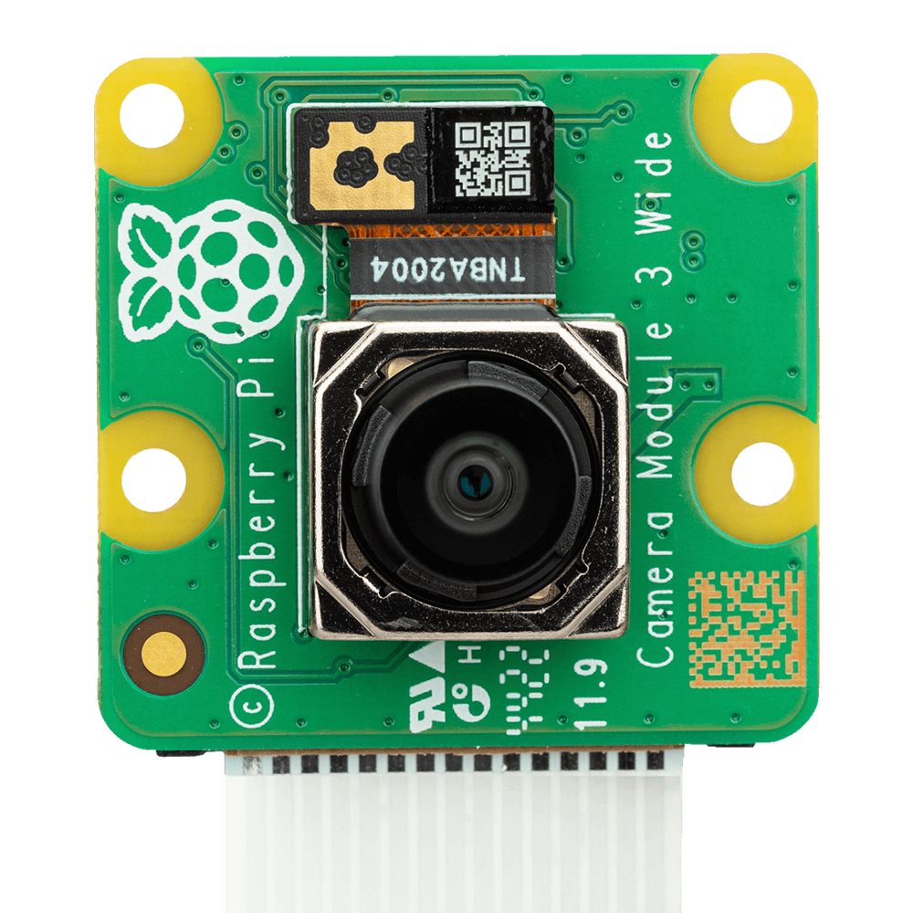
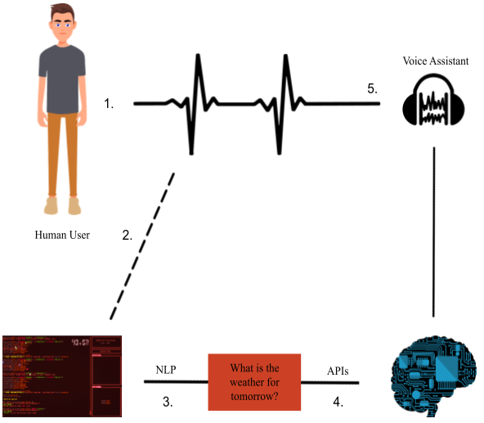
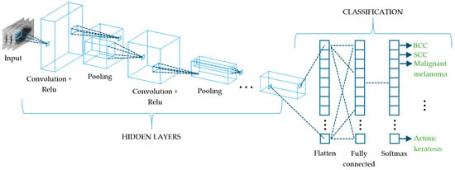
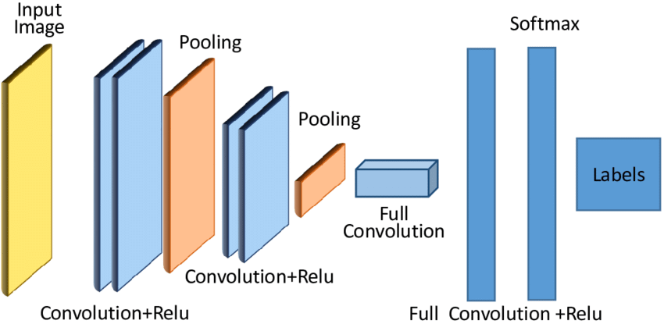
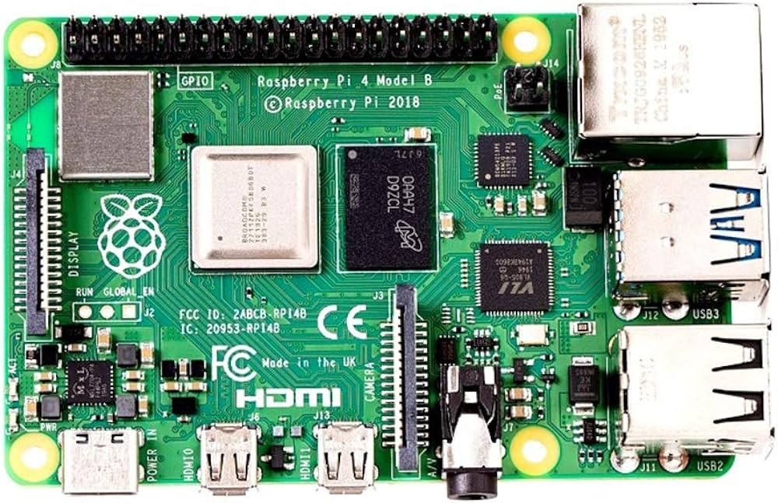
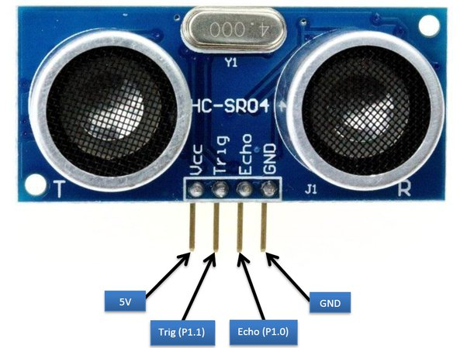

Components

Slide 6
Sensor Readings and Motor Response
Reading | Ultrasonic Distance (cm) | Proximity Sensor (Boolean) | Camera Detection | Speed Reduction (%)
1 | 50 | 1 | Car, Truck | 10
2 | 30 | 0 | Bicycle | 20
3 | 40 | 1 | Pedestrian | 15
4 | 60 | 1 | None | 0
5 | 35 | 0 | Car | 10
6 | 25 | 1 | Truck | 20
7 | 45 | 1 | None | 00
8 | 55 | 0 | Bicycle | 15
9 | 20 | 1 | Pedestrian | 25
10 | 50 | 1 | Car | 10

Slide 7
Architecture

Slide 8
Implementation

Slide 9
Conclusion

